Slide 1
Micro Plate Rounds
Session 9
Wound Cultures

Slide 2
GI pathogens wrap-up
Case
A 93 year old woman with HTN, Afib, and recent hospitalization for GI bleed presented with three days of RLQ abdominal pain, constipation and bilateral leg swelling admitted for right sided heart failure. On the third day of hospitalization, she was febrile to 100.8F with leukocytosis to 11K. Blood cultures were obtained​:
BCx:
An oxidase test performed on the organism was negative

Slide 3
Gram Stain:
Gram negative coccobacillus
Bipolar staining (ends stain more prominently than middle)
BAP:
Slow growth
Small, gray-white, opaque colonies

Slide 4
MacConkey:
Non lactose fermenter
Urease test on urea slant:
Change from phenol red – orange to magenta pink

Slide 5
Poll #1
The urease test, discussed in a previous micro plate rounds session, can be used to differentiate which of the following organisms:
A. E. coli and Klebsiella pneumoniae
B. Klebsiella oxytoca and Klebsiella pneumoniae
C. Pseudomonas aeruginosa and Salmonella typhi

Slide 6
Poll #1
The urease test, discussed in a previous micro plate rounds session, can be used to differentiate which of the following organisms:
A. E. coli and Klebsiella pneumoniae
B. Klebsiella oxytoca and Klebsiella pneumoniae
C. Pseudomonas aeruginosa and Shigella
Indole test:
K. oxytoca: indole (-)
K. pneumoniae: indole (+)
Oxidase test:
P. aeruginosa: oxidase (+), (also motile)
Shigella: oxidase (-), (also non-motile)

Slide 7
Urease Test (from session 7)
Used to determine ability of organism to hydrolyze urea, through the production of urease
Hydrolysis of urea produces ammonia + CO₂
Ammonia alkalinizes medium → pH shift is detected by color change from phenol red – orange to magenta pink
Organisms can be negative, rapidly positive, or weakly positive (may take several days) for urease
Urease (+) | Urease (-)
Klebsiella (weak) Proteus Helicobacter pylori Yersinia | E. coli Shigella Salmonella

Slide 8
Poll #2
This non-lactose fermenter, oxidase (-), urease (+), bipolar staining gram negative coccobacillus is most likely:
Shigella
Salmonella typhi
Yersinia enterocolitia
Campylobacter jejuni
Vibrio
urease (+)

Slide 9
Poll #2
This non-lactose fermenter, oxidase (-), urease (+), bipolar staining gram negative coccobacillus is most likely:
Shigella
Salmonella typhi
Yersinia enterocolitica
Campylobacter jejuni
Vibrio
urease (+)

Slide 10
Poll #2
This non-lactose fermenter, oxidase (-), urease (+), bipolar staining gram negative coccobacillus is most likely:
Shigella
Salmonella typhi
Yersinia enterocolitia
Campylobacter jejuni
Vibrio
Urease (-)
Urease (-)
Gull-wing shape on gram stain
oxidase (+), comma shaped
urease (+)

Slide 11
Yersinia enterocolitia
Microbiological characteristics:
Grows slowly on regular culture media. Specialized CIN agar (cefsulodin-irgasan-novobiocin) can assist in growth/isolation
”Bulls eye” appearance due to red centers and transplant borders (from mannitol fermentation)
Bipolar gram staining
Lactose non fermenter
Oxidase (-)
Urease (+)
Motility depends on temperature
Motile at 22 - 25ºC; non-motile at 37ºC
In contrast, Y. pestis is non-motile at all temperatures
Notes:
Yersinia grows well at lower temperature
Y. pestis is the only species of Yersinia which is non motile at room tmperature

Slide 12
Poll #3
To which food exposure is Yersinia enterocolitia most closely linked?
Pigs/pork
Poultry
Eggs

Slide 13
Poll #3
To which food exposure is Yersinia enterocolitia most closely linked?
Pigs/pork
Poultry
Eggs

Slide 14
Yersinia enterocolitia
Linked to chitterlings (chitins) because Y. enterocolitia is present in pig intestines
Other sources: unpasteurized milk, contaminated water, banked blood (grows at 4ºC)
Localization of pain to RLQ may be diagnostic clue
Associations:
Erythema nodosum (2 – 14 days after abd pain)
Reactive arthritis (7 – 14 days after abd pain)
20% of patients may present with pharyngitis
Treatment (if required)
TMP-SMX, 3rd generation cephalosporins, fluoroquinolones, tetracyclines
Resistant to 1st generation cephalosporins, penicillins
Abx has no effect on post infectious sequalae

Slide 15
Gram Negative Bacilli
Gram Negative Bacilli
*also oxidase (-)
*sometimes NLF
lactose fermenters
non lactose fermenters
fast
slow
oxidase (+)
oxidase (-)
Klebsiella: mucoid (2/2 capsule), urease +
pneumoniae indole -
oxytoca indole +
Citrobacter
Pseudomonas
Shigella: non motile, no H₂S production
Serratia
Campylobacter:
seagull winged shaped microaerophilic, 37 – 42ºC
Salmonella: motile, H₂S production (generally)
E. coli
Indole +
Urease -
Vibrio
Proteus: swarming, urease +
mirabilis, penneri: indole +
vulgaris: indole -
Aeromonas
Enterobacter
Burkholderia
Yersinia enterocolitia:
bipolar staining, urease (+)

Slide 16
Wound and Non-Sterile Cultures

Slide 17
Specimen Collection
Actual tissue, aspirates, fluids are specimens of choice, rather than swabs to optimize clinically relevant results
Limitations of swabs:
Pick up extraneous microbes (greater risk of contamination)
Hold extremely small volumes of specimen (0.05 mL) which may lead to insufficient quantity especially when other cultures (fungal or mycobacteria) are requested
The specimen of choice is a biopsied sample of the advancing margin of the lesion
Pus alone or a cursory surface swab is inadequate and may not represent the disease process
IDSA ASM Lab Utilization Guide 2018

Slide 18
Specimen Collection
(for wound cultures in Epic)
For anaerobes,
Collection of suitable sites in Eswab media are appropriate (this is the only anaerobic device accepted here, but may vary across institutions)
Only sources that could harbor anaerobic environments such as deep sites or tissues, not superficial samples should be sent for anaerobic cultures
Notes:
Anaerobic transport media/vial is also acceptable

Slide 19
Specimen Collection
(for wound cultures in Epic)
Swabs, when submitted, must be received in suitable transport medium (ESwabs). Dry swabs are not acceptable.
ESwabs incorporate Liquid Amies medium which maintains viability of organisms
Transport directly to lab within 2 hours of collection to maintain optimum viability (or if delayed, refrigeration is preferred over room temperature)

Slide 20
Specimen Collection
Specify body site and type of wound (e.g. “wound” versus “human bite wound, thumb”)
Labeling is crucial, it affects:
Specimen Processing:
The organisms reported and the organisms considered normal flora
Interpretation: many body sites have normal, commensal microbiota that can easily contaminate inappropriately collected specimen and complicate interpretation
Distinguishing pathogen versus colonization depends on clinical presentation, host factors, and site involved

Slide 21
Specimen Processing
Intake/Gram stains
Culture Media
Evaluation of growth
Gram stains are made on all specimens. Examine for # of PMNs, squamous epithelial cells, relative quantity of each organism
Aerobic specimens inoculated onto BAP, CAP, MAC & CNA
Anaerobic specimens inoculated onto above and CMC, CDC-ANA, BBE, KVLB
Samples are incubated at 37ºC and includes CO₂ for fastidious organisms. Examined for growth daily (anaerobes examined at 48 hrs)
When there is growth on a plate or in the broth, definitive identification only performed on potential pathogens from appropriately collected specimens
Wound cultures are held for 4 days and tissue/fluid cultures are held for 7 days
Notes:
CMC – cooked meat medium, nonselective broth medium
CDC-ANA anaerobe blood agar, nonselective, for primary isolation
BBE- Bacteroides bile esculin agar, selective and differential for recovery of Bacteriodes
KVLB- Kanamycin-vancomycin-laked blood agar, selective

Slide 22
Which factors determine how extensively a sample is worked up for identification and susceptibility testing?
Site: sterile vs. non-sterile, expected normal flora (if any) for the region
Sample quality: superficial vs. deep (especially for skin samples)
Number of pathogens: >3 pathogens with no predominant organism suggests colonization, contamination, or delayed transport and are not worked up routinely
Amount of growth: Very few colonies of certain organisms suggest it is unlikely the causative agent and more likely a contaminant or colonizer.
Notes:
Knowing the site is very important- if the environment is supposed to be sterile, anything that grows should be worked up. If non-sterile environment such as skin, if the sample is superficial it could be colonized with environmental bacteria.

Slide 23
Case
55 yo F with CKD and longstanding DM II with neuropathy presenting with erythema and pain of RLE . She recently vacationed in the Dominican Republic and swam in a local body of water. She reports no noted bites.
She is febrile to Tmax 101.3, and hypotensive requiring vasopressors. Her RLE notable for erythema and swelling from ankle to knee with few flaccid bullae and two shallow, superficial ulcers that have overlying yellow discharge. CT RLE shows edema and stranding of subcutaneous soft tissues but no focal drainable collection.
The primary team performs superficial swabs (Eswabs) of her ulcers

Slide 24
Case
*More specificity on site of skin swab would be helpful; normal flora may differ depending on site
*Send anaerobic cultures only for sources that could harbor anaerobic environments such as deep sites or tissues, not superficial samples
The primary team is concerned the GPC in pairs, chains, clusters are S. aureus. You receive a request to ask the Micro Lab to identify the normal flora. ​
A. Send a request to the Micro Lab because the GPC in pairs, chains, and clusters could be S. aureus. ​
B. Do not ask the lab to work everything up. If the GPC in pairs, chains, and clusters were S. aureus, it would have been definitively identified​
C. The GPC in pairs, chains, and cluster may be S. aureus, but no further identification was performed because it was no predominant

Slide 25
Case
*More specificity on site of skin swab would be helpful; normal flora may differ depending on site
*Send anaerobic cultures only for sources that could harbor anaerobic environments such as deep sites or tissues, not superficial samples
The primary team is concerned the GPC in pairs, chains, clusters are S. aureus. You receive a request to ask the Micro Lab to identify the normal flora. ​
A. Send a request to the Micro Lab because the GPC in pairs, chains, and clusters could be S. aureus. ​
B. Do not ask the lab to work everything up. If the GPC in pairs, chains, and clusters were S. aureus, it would have been definitively identified​
C. The GPC in pairs, chains, and cluster may be S. aureus, but no further identification was performed because it was no predominant

Slide 26
Specimen Reporting
Definitive identification and AST are performed on:
Any quantity of S. aureus
Any quantity of P. aeruginosa
Potential pathogens with unpredictable antimicrobial susceptibility patterns
All organisms isolated from normally sterile tissues

Slide 27
Case
Although the wound cultures were unremarkable, both sets of the patient's blood cultures are positive by instrument. Gram negative bacilli are seen on gram stain.

Slide 28
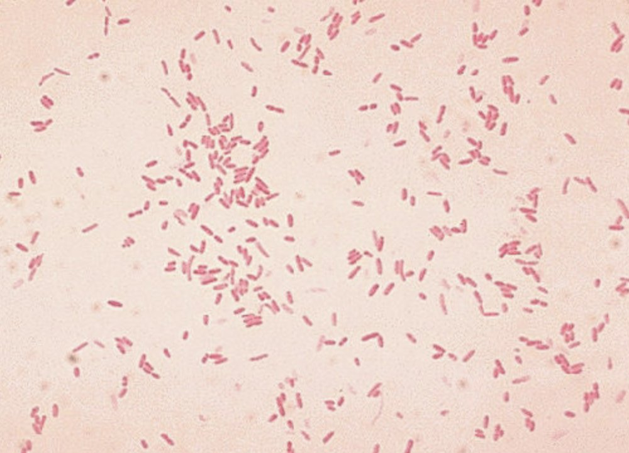
Case
BAP:
Beta hemolytic
Smooth, translucent
Wet appearing
Spreading (sometimes)
MAC:
Lactose fermenter
Gram stain:
Straight
Short, plump with rounded ends

Slide 29
Poll #5
The most likely organism is
A. Pseudomonas aeruginosa
B. Aeromonas hydrophilia
C. Vibrio parahaemolyticus
D. Erysipelothrix rhusiopathiae
Additional biochemical characteristics
Oxidase positive
Indole positive
Urease negative

Slide 30
Poll #5
The most likely organism is
A. Pseudomonas aeruginosa
B. Aeromonas hydrophilia
C. Vibrio parahaemolyticus
D. Erysipelothrix rhusiopathiae
Additional biochemical characteristics
Oxidase positive
Indole positive
Urease negative

Slide 31
Aeromonas hydrophilia
Found in fresh water, brackish water, and marine environments, polluted water
Manifestations: diarrheal illness (most common), bacteremia, deep seated, wound infections (cellulitis, traumatic wound infections, myonecrosis, necrotizing soft tissue infection)
20 – 30% of patients with Aeromonas related NSSTI report no history of preceding trauma or water exposure
Patients who develop NSSTI from Aeromonas spp often have gastrointestinal colonization with this organism (potential mechanism - seeding into soft tissues and muscles)

Slide 32
Poll #6
The plastic surgery team calls you for antimicrobial prophylaxis recommendations in a patient receiving leech therapy for a skin flap placed after surgical resection of malignancy. The preferred antimicrobial agent is:
A. Ciprofloxacin
B. Amoxicillin
C. Azithromycin
D. Cephalexin

Slide 33
Poll #6
The plastic surgery team calls you for antimicrobial prophylaxis recommendations in a patient receiving leech therapy for a skin flap placed after surgical resection of malignancy. The preferred antimicrobial agent is:
A. Ciprofloxacin
B. Amoxicillin
C. Azithromycin
D. Cephalexin

Slide 34
Aeromonas hydrophilia
Aeromonas is a normal component of leech gut flora
Up to 20% of leech therapy courses are complicated by gram negative infections, particularly Aeromonas species
Uniformly resistant to ampicillin, first generation cephalosporins
Major resistance mechanism is inducible chromosomal beta-lactamase: ESBL, AmpC, and metallo-b-lactamase against carbapenems
Preferred prophylaxis: fluoroquinolones, TMP-SMX, 3rd generation cephalosporins

Slide 35
Poll #4
Curved or comma shaped (typically)
Halophilic and grows optimally at 30 – 35ºC, therefore found in warm water estuaries/brackish water
Seafood associated gastroenteritis in the US (raw oysters), NSSTI with hemorrhagic bullae + necrosis
The most likely organism is
A. Pseudomonas aeruginosa
B. Aeromonas hydrophilia
C. Vibrio parahaemolyticus
D. Erysipelothrix rhusiopathiae

Slide 36
Poll #4
Grows on thiosulfate citrate bile-salts sucrose (TCBS)
Salt encourages growth and bile/high pH suppresses growth of other organisms
Differential based on sucrose (sucrose fermentation = yellow)
Kanagawa phenomenon: clinical isolates, compared to environmental strains are nearly always beta hemolytic on high salt blood agar, due to presence of thermostable direct hemolysin (TDH)
The most likely organism is
A. Pseudomonas aeruginosa
B. Aeromonas hydrophilia
C. Vibrio parahaemolyticus
D. Erysipelothrix rhusiopathiae
Notes:
thermostable direct hemolysin (TDH)

Slide 37
Poll #4
Gram positive rod
Produces H₂S
Exposure to infected animals particularly fish or swine -> fishermen, butchers, farmers, veterinarians, undercooked pork/seafood
Manifestations: localized cutaneous lesion, generalized cutaneous form, septicemic form associated with infective endocarditis
Intrinsically resistant to vancomycin
The most likely organism is
A. Pseudomonas aeruginosa
B. Aeromonas hydrophilia
C. Vibrio parahaemolyticus
D. Erysipelothrix rhusiopathiae
*can stain unevenly appearing as gram (-) rods

Slide 38
Take Home Points
Yersinia is bipolar staining. Y. enterocolitia motility is temperature dependent, unlike that of Y. pestis which is non-motile.
Tissue, aspirates, fluids are preferred over swabs.
Appropriate, specific specimen labeling influences specimen processing and clinical interpretation
Send anaerobic cultures only for sources that could harbor anaerobic environments
Aeromonas hydrophilia and Vibrio spp are important causes of water-associated necrotizing soft tissue infections

Slide 39
Gram Negative Bacilli
Gram Negative Bacilli
*also oxidase (-)
*sometimes NLF
lactose fermenters
non lactose fermenters
fast
slow
oxidase (+)
oxidase (-)
Klebsiella: mucoid (2/2 capsule), urease +
pneumoniae indole -
oxytoca indole +
Citrobacter
Pseudomonas
Shigella: non motile, no H₂S production
Serratia
Campylobacter:
seagull winged shaped microaerophilic, 37 – 42ºC
Salmonella: motile, H₂S production (generally)
E. coli
Indole +
Urease -
Vibrio: curved, comma shaped, halophilic
Proteus: swarming, urease +
mirabilis, penneri: indole +
vulgaris: indole -
Enterobacter
Aeromonas
Yersinia enterocolitia:
bipolar staining, urease (+)
Burkholderia: pseudomallei, capecia

