Slide 1
Micro Plate Rounds
Session 8
GI pathogens

Slide 2
BioFire FilmArray GI panel (NAAT)
Tests for 22 pathogens from stool specimens
Stool is collected in container then transferred into orange top container with Cary Blair medium
Medium prevents replication and maintains organism viability
Biofire GI panel is not validated on other transport media (e.g. rectal swabs, endoscopy aspirates, vomitus)

Slide 3
BioFire GI panel performance
Sensitivity and specificity varies depending on organism
100% for 12/22 targets, ≥94.5% for 7 additional targets, prevalence too low for 3 other targets
Specificity: ≥97.1% for all panel targets
Reflex culture is performed only on Campylobacter, Salmonella, Shigella, Vibrio, Yersinia, E. coli O157
Facilitates outbreak investigations
Susceptibilities are performed on Salmonella and Shigella
Buss et al, 2015
Notes:
At our institution, reflex culture is performed only on:

Slide 4
BioFire GI panel: key points and limitations
Detection of organisms does not imply organisms are infectious or cause of clinical symptoms
There is potential cross-reactivity with other organisms (e.g. ETEC with Hafnia alvei and certain strains of Citrobacter)
Certain species are not detected on this panel
Rare strains of pathogenic organisms may not carry the genetic determinants detected by the panel
Notes:
O157 - Reported only if STEC is detected to aid in identification of O157 serotype

Slide 5
BioFire GI panel: key points and limitations
Campylobacter:
Detects only C. jejuni, C. coli, C. upsaliensis – the most common species associated with human disease
Positive test does not differentiate among these species
Salmonella:
Cross-reactivity may occur with certain E. coli strains (variants of the cryptic ETT2-type III secretion system)
Yersinia:
Detects Yersinia enterocolitia
Potential cross-reactivity with Y. kristensenii and Y. fredriksenii when present in high levels
Notes:
Examples of these limitations:

Slide 6
BioFire GI panel: key points and limitations
Vibrio:
Detects only V. parahaemolyticus, V. vulnificus, V. cholerae
False positives:
Cary Blair media sporadically contaminated with low levels of Vibrio nucleic acid
Presence of Vibrio species in water where seaweed/algae is harvested to make agar
Vibrio cholerae is not reported unless it is detected in stool culture (Vibrio cholerae infection is exceedingly rare in US; in 2014, only 7 cases)

Slide 7
Poll #1
A primary team calls you about a patient who was admitted for multiple episodes of diarrhea. The patient’s infectious GI panel result was:
The team inquires if this means the patient’s diarrhea is caused both by EAEC and STEC. The best response is:
A. The test is incorrect and the patient should be retested
B. The patient’s diarrhea may be due to both EAEC and STEC
C. The patient’s diarrhea may be due to one diarrheagenic E. coli strain that has both EAEC and STEC targets on the test panel
D. B or C are both possible

Slide 8
Poll #1
A primary team calls you about a patient who was admitted for multiple episodes of diarrhea. The patient’s infectious GI panel result was:
The team inquires if this means the patient’s diarrhea is caused both by EAEC and STEC. The best response is:
A. The test is incorrect and the patient should be retested
B. The patient’s diarrhea may be due to both EAEC and STEC
C. The patient’s diarrhea may be due to one diarrheagenic E. coli strain that has both EAEC and STEC targets on the test panel
D. B or C are both possible

Slide 9
BioFire GI panel: key points and limitations
E. coli
If multiple diarrheagenic E. coli/Shigella are detected on GI panel, it may be due to a single strain containing the genetic determinants of multiple pathotypes (horizontal transfer of genes). For instance,
2011 E. coli O104:H4 outbreak strain had determinants of both STEC and EAEC
STEC and Shigella/EIEC:
Shiga toxin is found in Shigella dysenteriae
Shigella dysenteriae infection can cause positive results for both STEC and Shigella/EIEC
EPEC: eae gene is target on GI panel
Some STEC strains have eae gene
When STEC detected, EPEC will be reported as N/A
Biofire cannot distinguish between STEC containing eae and co-infection with EPEC and STEC
Notes:
Panel has multiple assays to detect genetic determinants associated with E. coli diarrheagenic pathotypes

Slide 10
Poll #2
A primary team calls you about a patient with Crohn’s disease who is admitted for multiple episodes of bloody diarrhea with mucus. They inquire if the patient’s diarrhea could still be from E. coli O157 since it was reported as “Not Applicable” on the GI panel
The best response is:
It is reported as “Not applicable” because STEC was not detected
B. It is reported as “Not applicable” because the Biofire GI panel is not validated to test for E. coli O157

Slide 11
Poll #2
A primary team calls you about a patient with Crohn’s disease who is admitted for multiple episodes of bloody diarrhea with mucus. They inquire if the patient’s diarrhea could still be from E. coli O157 since it was reported as “Not Applicable” on the GI panel
The best response is:
It is reported as “Not applicable” because STEC was not detected
B. It is reported as “Not applicable” because the Biofire GI panel is not validated to test for E. coli O157

Slide 12
BioFire GI panel: key points and limitations
E. Coli O157
Subset of STEC contains O157 antigen (and flagellar H7 antigen)
Reported only if STEC is detected
Pathogenicity of E. coli O157 of non-STEC strains is undefined
Notes:
O157 - Reported only if STEC is detected to aid in identification of O157 serotype

Slide 13
BioFire GI panel: key points and limitations
C. difficile
GI Panel detects toxin A and B genes
Detection of toxin A/B does not necessarily indicate C. difficile colitis
All different C. difficile testing options cannot differentiate asymptomatic colonization and infection
BioFire Panel does not take into account consistency of tested stool
Currently, result is hidden because our lab uses a multi-step algorithm

Slide 14
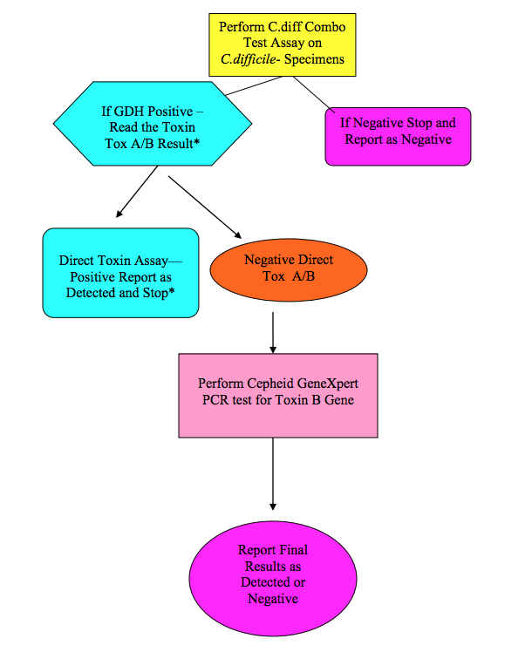
C. difficile
Testing Algorithm
(at Montefiore)
*Highly mucoid specimens are tested directly by PCR (will not suspend in buffers for GDH and Toxin B assay)

Slide 15
C. difficile Testing Algorithm
Glutamate dehydrogenase assays (GDH)
Screening test for presence of C. difficile
Detects GDH enzyme produced by both toxigenic and non-toxigenic strains of C. difficile
Sensitive but poor specificity
Toxin detection (EIA or chromatographic methods)
Toxin testing alone may miss clinically significant disease (sensitivity of 70-85%)
Assays detecting both toxin A or B improves sensitivity (some strains produce only Toxin B and not Toxin A)

Slide 16
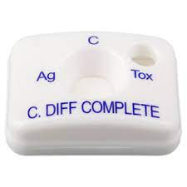
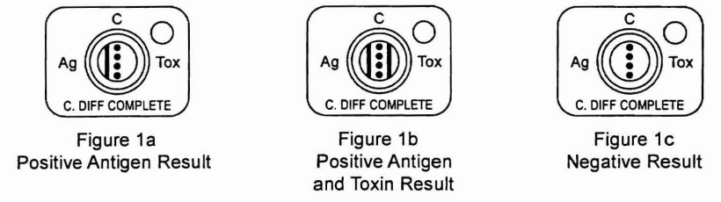
C. difficile Quik Check Complete
Simultaneous detection of GDH antigens and toxins A/B
Notes:
Ag- GDH
Toxin-

Slide 17

C. difficile Testing Algorithm
Nucleic Acid Amplification Tests (Cepheid Xpert C. difficile assay)
Detects presence of C. difficile bacteria capable of producing toxin, not the toxin itself
Stand-alone NAAT may lead to misdiagnosis and overtreatment for CDI:
Lacks clinical specificity
Hospitalized patients often have multiple reasons for diarrhea
Most NAAT (+), toxin (-) patients recover spontaneously without treatment, generally do not have CDI as cause of symptoms, and have similar duration of symptoms to CDI negative patients
In our lab, NAAT used to arbitrate discrepant GDH and EIA toxin results
Studies on asymptomatic NAAT screening suggest it can decrease in hospital, horizontal transmission by facilitating early implementation of infection control and prevention practices
Fang, Polage, and Wilcox, 2017

Slide 18
C. difficile Testing Key Points
CDI is a clinical diagnosis. All of the testing options cannot differentiate between colonization and infection.
Improve lab test relevance by testing the appropriate population:
Unexplained, new onset ≥ 3 unformed stools stools in 24 hours
Not on laxatives in last 48 hrs
Submit stool in empty container to assess consistency. Reject specimens that do not take the shape of the container (ileus is the rare exception)
Each test (GDH, toxin, NAAT) has limitations; IDSA-SHEA recommends a multistep testing algorithm

Slide 19
Gram Negative Bacilli
Gram Negative Bacilli
*also oxidase (-)
*sometimes NLF
lactose fermenters
non lactose fermenters
fast
slow
oxidase (+)
oxidase (-)
Klebsiella: mucoid (2/2 capsule), urease +
pneumoniae indole -
oxytoca indole +
Citrobacter
Pseudomonas
Shigella
Serratia
Campylobacter
Salmonella
Vibrio
Proteus: swarming, urease +
mirabilis, penneri: indole +
vulgaris: indole -
E. coli
Indole +
Urease -
Aeromonas
Burkholderia
Yersinia
Enterobacter
Stenotrophomonas
Acinetobacter

Slide 20
Hektoen Enteric Agar (HEA)
Selective and differential media that cultivates gram (-) enteric organisms
Selective due to bile salts:
Inhibits gram + organisms
Slows growth of normal intestinal microbiota (except for Salmonella and Shigella)
Differential due to lactose, sucrose, ferric salts
Lactose fermentation
H₂S production

Slide 21
Poll #3
A 18 year old presents to the ED with abdominal discomfort and dysentery. She recently returned from India. The following non – lactose fermenting organism was recovered from the stool. Growth on Hektoen Enteric agar is shown below. The organism is most likely
A. Shigella
B. Salmonella
C. E. coli 0157:H7
D. Vibrio cholerae

Slide 22
Poll #3
A 18 year old presents to the ED with abdominal discomfort and dysentery. She recently returned from India. The following non – lactose fermenting organism was recovered from the stool. Growth on Hektoen Enteric agar is shown below. The organism is most likely
A. Shigella
B. Salmonella
C. E. coli 0157:H7
D. Vibrio cholerae

Slide 23
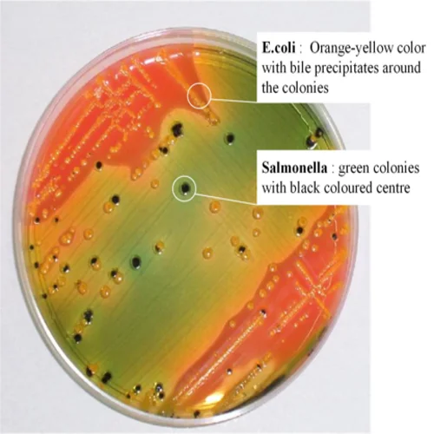
Hektoen Enteric Agar (HEA)
Lactose fermentation
E. coli: ferments lactose forming appear as bright orange – salmon pink colonies
Salmonella and Shigella: lactose non fermenters, appear as green– blue colonies

Slide 24
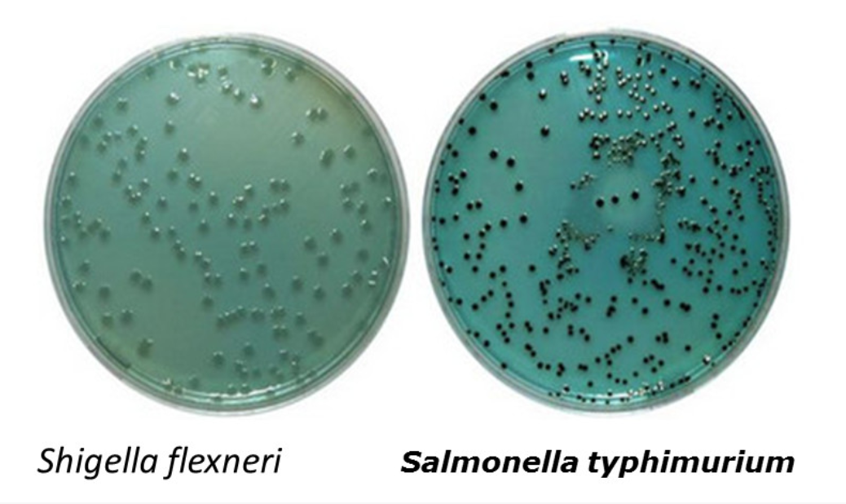
Hektoen Enteric Agar (HEA)
H₂S production
Salmonella produces H₂S which reacts with iron forming colonies with black centers (FeS)
*there are exceptions
Shigella: does not produce H₂S so colonies remain green-blue
Notes:
FeS: iron sulfide

Slide 25
Appearance on HEA
Organism | Appearance
E. coli | Large, yellow to salmon color; some strains inhibited
Enterobacter/Klebsiella | Large, yellow to salmon color
Proteus | Variable, blue-green to blue or salmon, most strains with black center or completely black
Salmonella | Blue-green to blue; most strains with black center or completely black
Shigella | Green and moist, raised
Pseudomonas | Irregular, green to brown
Gram-positive bacteria | No growth to slight growth

Slide 26
Case
11 year old girl who traveled to Bangladesh 4 – 6 weeks ago presenting for 6 days of fever (Tmax 102.9), emesis, and non-bloody diarrhea.
BCx:
The GI pathogen panel is positive and reflexes to a stool culture

Slide 27
Case
BAP:
Large, gray-white smooth colonies (usually)
Colonies may also appear rough
MacConkey:
Pale – colorless
Non lactose fermenter
HE agar:
Green to blue-green colonies

Slide 28
Poll #4
The organism is a non lactose fermenter with green-blue colonies without black centers on HE agar. It is inoculated into Motility Indole Orthinine Medium. There is growth extending from the line of inoculation indicating motility.
What is the most likely organism?
A. Shigella
B. Salmonella typhi
C. Yersinia enterocolitia
D. E. coli
E. Unsure, could be A or B
non motility
(+)
motility
Motility Indole Orthinine (MIO) Medium
Notes:
Motile organism will grow extending from the line of inoculation. Nonmotile organisms grow only along the line of inoculation.

Slide 29
Poll #4
The organism is a non lactose fermenter with green-blue colonies without black centers on HE agar. It is inoculated into Motility Indole Orthinine Medium. There is growth extending from the line of inoculation indicating motility.
What is the most likely organism?
A. Shigella
B. Salmonella typhi
C. Yersinia enterocolitia
D. E. coli
E. Unsure, could be A or B
(+)
motility
Motility Indole Orthinine (MIO) Medium
Notes:
Motile organism will grow extending from the line of inoculation. Nonmotile organisms grow only along the line of inoculation.

Slide 30
Salmonella vs. Shigella
H₂S production:
Shigella does not produce H₂S
Although most Salmonella species are H₂S producers,
Salmonella typhi is a weak – trace H₂S producer (thus black colonies may not appear on HE agar).
Salmonella paratyphi A rarely produces H₂S
Motility:
Salmonella: motile
Shigella: non - motile
Salmonella typhi

Slide 31
Salmonella
Can be classified by:
Species: Salmonella enterica (type species, further into subspecies e.g. S. enterica subsp. enterica), Salmonella bongori
Serotype based on antigenic determinants (O, K, H)
If identified based on O antigen: designated into serogroups A, B, C1, C2, D, and E
Salmonella typhi: serogroup D, Vi positive
Clinical patterns: typhoidal, non-typhoidal
Manifestations: enteric fever, gastroenteritis, bacteremia and other extra-intestinal complications, chronic carrier state
CDC, 2019

Slide 32
Salmonella
Susceptibility testing
Routine AST not required for non-typhoidal Salmonella isolated from stool
Stool: Ampicillin, fluoroquinolone, TMP-SMX
Extra-intestinal: Ampicillin, fluoroquinolone, TMP-SMX, 3rd generation cephalosporin
Only Salmonella enterica sero typhi has an established azithromycin breakpoint

Slide 33
Salmonella
Resistance: mainly due to antibiotic use in animal feed
Worldwide, high rates of resistance to TMP-SMX, fluoroquinolones, ampicillin
Most strains remain susceptible to ceftriaxone
CDC, 2019

Slide 34
Shigella
4 serogroups can be differentiated via slide agglutiniation antisera test (A: S. dysenteriae, B: S. flexneri, C: S. boydii, D: S. sonnei)
Microbiological characteristics:
Non-motile
Flattened colonies, non lactose fermenter
HE agar: clear with green appearance
Humans only host and reservoir. Spread through fecal-oral, contaminated water/food, sexual transmission
Low inoculum required to cause disease (as low as 10 organisms)
Complications: bacteremia, HUS (most commonly S. dysenteriae; unlike that for EHEC, abx treatment does not increase rates of HUS), neurological symptoms, leukomoid reaction
Notes:
Hemolytic-uremic syndrome is a complication that may occur with shiga-toxin producing Shigella (the most commonly associated is S. dysenteriae).

Slide 35
Shigella
Susceptibilities:
AST performed on Shigella isolated from all sources
Rising resistance rates is a concern, especially reduced susceptibilities of ciprofloxacin and azithromycin in HIV-infected individuals or MSM
Azithromycin:
No standardized CLSI breakpoint
Can be requested, but cut-offs are based on epidemiological values
CDC, 2019
Notes:
Fluoroquinolone resistance is 20 – 30% in Asia - Africa
TMP-SMX 65 – 85% resistance in Asia – Africa

Slide 36
Case
58 year old woman presented for progressive quadriparesis over the past 2 days. Symptoms began in lower extremities, progressed to upper extremities. Two weeks ago she had a diarrheal illness that lasted 3 days associated with bloody stools after eating undercooked chicken.
Her infectious GI panel was positive and a reflex stool culture was performed.

Slide 37
Poll #5
What is the most likely gram stain appearance of her organism that grew in her stool culture?
A. Comma shaped
B. Lancet shaped
C. Big, boxy
D. Safety pin appearance
E. Seagull-shaped/gull wing

Slide 38
Poll #5
What is the most likely gram stain appearance of her organism that grew in her stool culture?
A. Comma shaped
B. Lancet shaped
C. Big, boxy
D. Safety pin appearance
E. Seagull-shaped/gull wing

Slide 39
Campylobacter jejuni
Microbiological characteristics:
Small, curved gram negative rods (S or C shaped, or gull wing shaped)
Growth supported by selective Campy CVA agar
Plates are incubated at 42ºC and microaerophilic conditions
Oxidase (+)
Food associations: Raw – undercooked poultry, raw milk/cheese, contaminated water/produce, cat/dog feces
Notes:
Grows grow at 37-42C, but plates are usually incubated at 42 for best growth and because it inhibits less thermotolerant gut flora

Slide 40
Campylobacter jejuni
Non GI associations:
Guillian-Barre syndrome: cross-reactivity between organism and neural ganglioside epitomes.
Seen in 1 – 2/10,000 cases of Campylobacteriosis
Of those with GBS, 20 – 40% will have a history of C. jejuni infection.
Reactive arthritis: 2.6% of cases, occurs 1 – 2 weeks after infection

Slide 41
Poll #6
Campylobacter jejuni is intrinsically resistant to which class of antibiotics?
Cephalosporins
Macrolides
Fluoroquinolones

Slide 42
Poll #6
Campylobacter jejuni is intrinsically resistant to which class of antibiotics?
Cephalosporins
Macrolides
Fluoroquinolones
Treatment:
Macrolides (resistance approaches 1.7%)
Fluoroquinolones (resistance rates of 20 – 27% in the US)
Intrinsically resistant to cephalosporins

Slide 43
Gram Negative Bacilli
Gram Negative Bacilli
*also oxidase (-)
*sometimes NLF
lactose fermenters
non lactose fermenters
fast
slow
oxidase (+)
oxidase (-)
Klebsiella: mucoid (2/2 capsule), urease +
pneumoniae indole -
oxytoca indole +
Citrobacter
Pseudomonas
Shigella: non motile, no H₂S production
Serratia
Campylobacter:
seagull winged shaped microaerophilic, 37 – 42ºC
Salmonella: motile, H2S production (generally)
E. coli
Indole +
Urease -
Vibrio
Proteus: swarming, urease +
mirabilis, penneri: indole +
vulgaris: indole -
Aeromonas
Enterobacter
Burkholderia
Yersinia enterocolitia

