Slide 1
Microbiology Plate Rounds
Session 7
Agenda
Urine Cultures
Gram Negative Organisms

Slide 2
Poll #1
  A clean-catch urine culture demonstrates 10,000-50,000 CFU/mL E. coli, 10,000-50,000 CFU/mL P. mirabilis, <10,000 CFU/mL Enterococcus. How will the culture results be reported?
  A. 10,000 – 50,000 E. coli; 10,000 – 50,000 P. mirabilis
  B. 10,000 – 50,000 E. coli; 10,000 – 50,000 P. mirabilis; < 10,000 E. faecalis
  C. 10,000 – 50,000 E. coli; 10,000 – 50,000 P. mirabilis; <10,000 Enterococcus species
  D. 3 or more organisms presenting without predominating organism. Probable contamination/colonization, please resubmit

Slide 3
Poll #1
  A clean-catch urine culture demonstrates 10,000-50,000 CFU/mL E. coli, 10,000-50,000 CFU/mL P. mirabilis, <10,000 CFU/mL Enterococcus. How will the culture results be reported?
  A. 10,000 – 50,000 E. coli; 10,000 – 50,000 P. mirabilis
  B. 10,000 – 50,000 E. coli; 10,000 – 50,000 P. mirabilis; <10,000 Enterococcus
  C. 10,000 – 50,000 E. coli; 10,000 – 50,000 P. mirabilis; <10,000 Enterococcus
  D. 3 or more organisms presenting without predominating organism. Probable contamination/colonization, please resubmit

Slide 4
Urine Cultures
Appropriate ordering, specimen collection and correct labeling is crucial
Interpret urine culture in context with urinalysis and clinical presentation to determine clinical significance
How the Micro Lab works up an urine specimen depends on:
  1. Urine source (clean catch vs. aseptic acquisition)
    Clean catch, voided
    Indwelling catheters (chronically colonized with bacteria and yeast)
      Strongly discouraged, but if required specimen can be taken from sampling port from newly inserted device
    Straight catheter, nephrostomy, cystoscopy, suprapubic aspirate
  2. The uropathogen identified
  3. Quantitation of uropathogen
  4. Number of different bacterial species present (presence of background flora vs. predominant organism)

Slide 5
Urine Cultures Internal Work Up Scheme
B. ≥ 3 uropathogens reported as contaminant unless > 1 predominant organism of ≥ 10⁵ CFU
A. Specimen type matters
C. Uropathogens from specimens collected “sterile manner” are worked up at lower colony counts than clean catch or indwelling cath
Notes:
Seen here is the table used by the Micro Lab to work up urine cultures that reflects those four points from the last side
Notice the following:
1. Specimen type is one factor that determines the extent to which urine cultures are worked up (clean catch, indwelling catheter, sterilely obtained specimens. Uropathogens from specimens collected “sterile manner” are worked up at lower colony counts than clean catch or indwelling cath
2. Number of different bacterial species present, if there is a predominating organism, and the quantitation of the uropathogen
3. The uropathogen identified

Slide 6
Urine Cultures
Other key points:
  Foley catheter tips will be rejected (no clinical value)
  Do not collect urine from Foley bag (stagnant urine)
  Do not collect 24 hr urine for urine culture

Slide 7
Urine Cultures
IDSA Guide to Utilization of Microbiology Laboratory
Notes:
Other pertinent pathogens for urine testing:
MTB recovery best accomplished with first void morning specimens of > 20 mL
Adenovirus in urine is detected by NAAT
Polyoma BK virus nephropathy best diagnosed by quantitative NAAT (blood better than urine)

Slide 8
Urinary Microbiota
Normal Urogenital Flora
  Viridans group streptococci, Neisseria spp., diphtheroids, Lactobacillus spp., anaerobes
  Report as ”normal skin flora” unless present in amounts >10-fold more than other microbiota
Normal Skin Flora
  Diphtheroids, Staphylococcus spp.
  Report as “normal skin flora” unless present in amounts >10-fold more than other microbiota.
Notes:
In contrast to the potential uropathogens listed in the previous table, listed here are organisms that are considered to be part of the normal urinary microbiota or normal skin microbiota.

Slide 9
Urine Cultures: lab processing
Urine should not sit at room temp for > 30 mins. If not cultured in 30 mins, refrigerate or place into preservative…
Boric acid preservative stabilizes urine for ~48 hours but specimen should be processed as soon as possible
Urine specimen collected in specimen cup
Provider transfers urine from cup to preservative containing tubes (gray top)
Kiestra InoqulA plates urine specimen on:
BAP – used for colony counts
MacConkey (gram negative selective)
CNA (gram positive selective)
Notes:
Use of refrigeration immediately after collection may decrease the proliferation of small numbers of contaminating organisms
Processed by Kiestra InoqulA which delivers 10 uL of urine to each culture plate or biplate section (1 cfu = 100 cfus/mL)

Slide 10
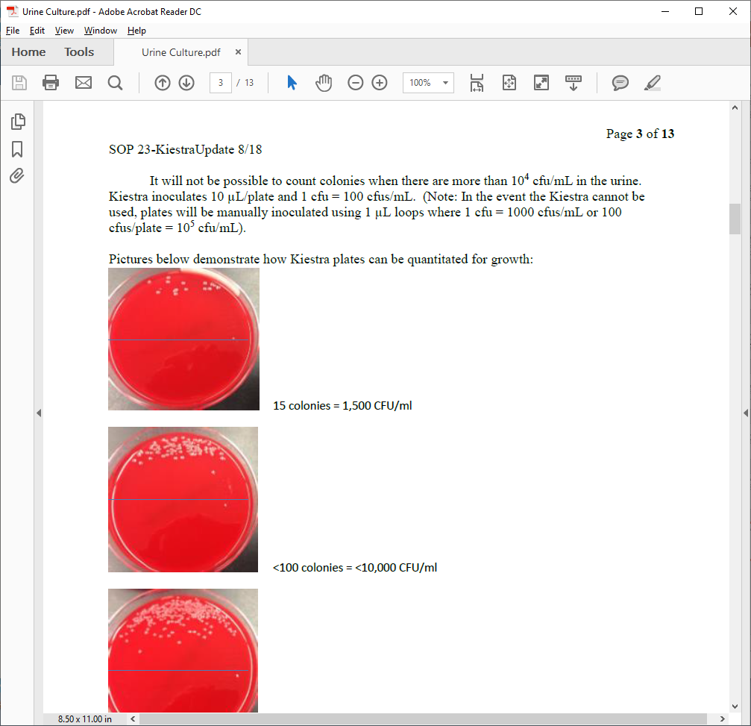
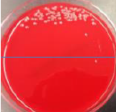
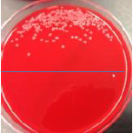
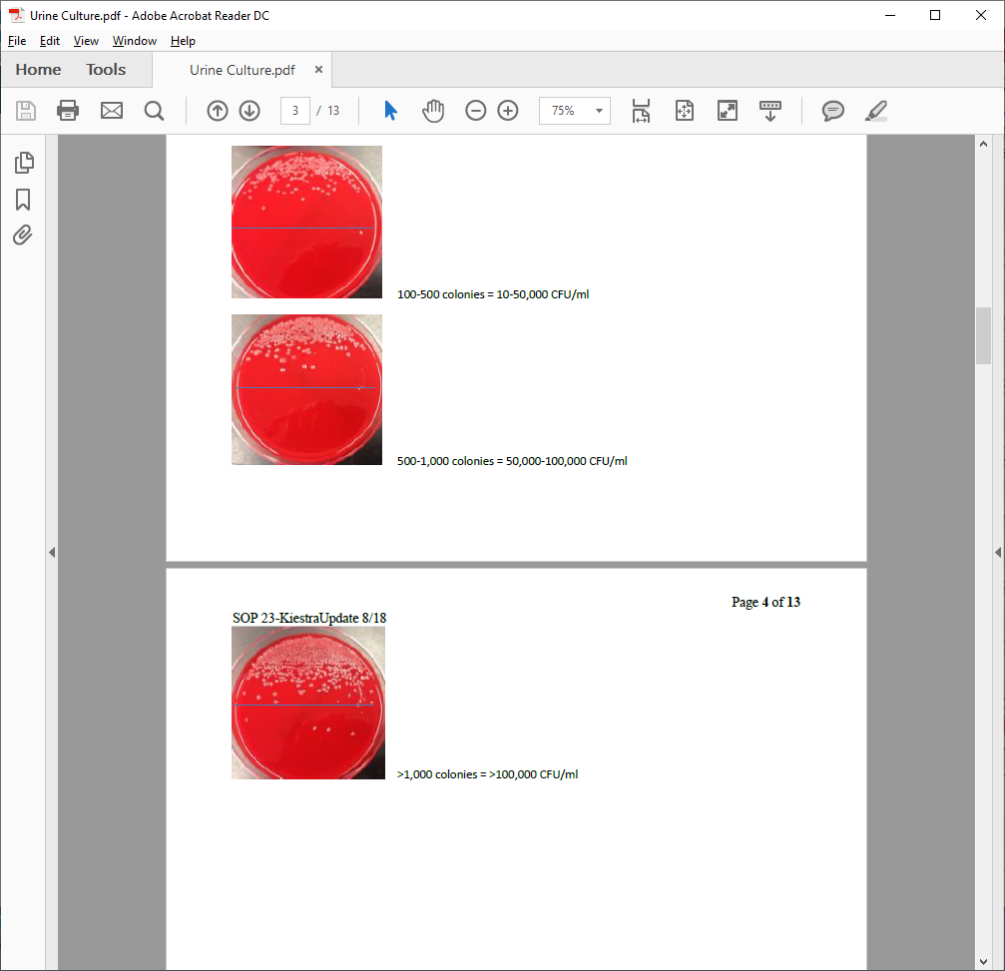
Urine Cultures: CFU, colony count
Kiestra InoqulA delivers 10 uL of urine to each culture plate or biplate section
1 cfu = 100 cfus/mL such that…
15 colonies = 1,500 CFU/mL
< 100 colonies =
<10,000 CFU/mL
100 – 500 colonies = 10 – 50,000 CFU/mL
500 – 1,000 colonies =
50,000 – 100,000 CFU/mL
> 1,000 colonies =
> 100,000 CFU/mL
Notes:
Processed by Kiestra InoqulA which delivers 10 uL of urine to each culture plate or biplate section (1 cfu = 100 cfus/mL)
Pictures below demonstrate how Kiestra plates can be quantitated for growth

Slide 11
Urine Cultures Internal Work Up Scheme
Poll #2. A urine culture is reported as mixed bacterial species. This means…
A. There is normal skin flora growing with no predominant species
B. There is normal urogenital flora growing with no predominant species
C. There is one predominant organism but fewer than <10⁴ CFU/mL
D. The Microbiology lab is working on identifying all the organisms growing in culture
Notes:
*Change answer

Slide 12
Urine Cultures Internal Work Up Scheme
Poll #2. A urine culture is reported as mixed bacterial species. This means…
A. There is normal skin flora growing with no predominant species
B. There is normal urogenital flora growing with no predominant species
C. There is one predominant organism but fewer than <10⁴ CFU/mL
D. The Microbiology lab is working on identifying all the organisms growing in culture
Notes:
*Change answer

Slide 13
Urine Cultures Internal Work Up Scheme
Poll #2. A urine culture is reported as mixed bacterial species. This means…
A. There is normal skin flora growing with no predominant species
B. There is normal urogenital flora growing with no predominant species
C. There is one predominant organism but fewer than <10⁴ CFU/mL
D. The Microbiology lab is working on identifying all the organisms growing in culture
e.g. diphtheroids, staphylococcus (unless present in amounts >10-fold more than other microbiota)
Notes:
*Change answer

Slide 14
Urine Culture Internal Work Up
  Enterococcus
Poll #3. A 26 year old, 32 week pregnant woman is admitted for early pre-term labor. The primary team inquires when susceptibilities of the below Enterococcus isolate in urine will return. The best response is
Wait 24 – 48 hrs
The Micro Lab will not routinely perform a species level ID or susceptibility test for 10,000 – 50,000 CFU/mL Enterococcus in urine culture

Slide 15
Urine Culture Internal Work Up
  Enterococcus
  No identification and susceptibilities performed if < 100,000 CFU/mL
    Can be added-on upon request if needed
  If > 100,000 CFU/mL Enterococcus AND in pure culture, will be identified with susceptibilities

Slide 16
Case
Poll #4. The ED calls you because they are following up on a urine culture from a patient they discharged. The patient is a 85 year old man with dementia and history of prostate cancer who came in for altered mental status.
The gram stain of his urine culture shows gram positive cocci in clusters. The ED would like to know if the patient should be called to return because they had once patient that grew S. aureus in urine culture who was later found to have S. aureus bacteremia.
Gram positive cocci
Grouped, clusters
α hemolytic
Gray, pinpoint colonies
Convex colonies (not well seen here)
No growth on MacConkey
Catalase (-)

Slide 17
Case
  Poll #4. The organism growing in the 85 year old patient’s urine culture was…
  A. Aerococcus urinae
  B. Staphylococcus saprophyticus
  C. Corynebacterium urealyticum
  D. Streptococcus agalactiae

Slide 18
Case
  Poll #4. The organism growing in the 85 year old patient’s urine culture was…
  A. Aerococcus urinae
  B. Staphylococcus saprophyticus
  C. Corynebacterium urealyticum
  D. Streptococcus agalactiae

Slide 19
Case
  Poll #4. The organism growing in the 85 year old patient’s urine culture was…
  A. Aerococcus urinae
  B. Staphylococcus saprophyticus
  C. Corynebacterium urealyticum
  D. Streptococcus agalactiae
GPC in clusters (or pairs, short chains)
γ-hemolytic, coagulase (-)
Colonies: large, opaque, usually white but may be yellow – orange, convex
Typically implicated in UTIs for young females
Virulence: utilizes urease to produce ammonia, has cell wall adhesions that help organism anchor to urogenital cells
Only ID performed per internal work scheme. Usually methicillin susceptible (also TMP-SMX, nitrofurantoin)
Notes:
Second most common cause of UTIs in young women, after E. coli
High survivability of S. saprophyticus inside urinary tract due to adhesions within cell wall that help organism anchor to urogenital cells and colonize the uroepitheliium
Possess the enzyme urease that leads to alkalization of the urine and may result in the formation of kidney/bladder stones

Slide 20
Case
  Poll #4. The organism growing in the 85 year old patient’s urine culture was…
  A. Aerococcus urinae
  B. Staphylococcus saphroyticus
  C. Corynebacterium urealyticum
  D. Streptococcus agalactiae
Gram (+), coryneform
Urease (+), catalase (+)
Colonies: pinpoint, whitish, opaque, smooth, convex, γ-hemolytic
RF: elderly pts with prolonged hospitalizations, prolonged use of catheter, ICT, prior urological abnormalities or manipulation
A/w alkaline encrusted cystitis, encrusted pyelitis
Hydrolyzes urea -> alkalinizes urine
-> stone formation/encrustation
Tx: vancomycin; highly resistant to β-lactams
Notes:
When organism adheres to the urinary tract, it grows under the stimulation of the urea present in the urine. Hydroloysis of urea leads to hyperammonia and alkinazination of urine resulting in crystal formation (stones/encrustatoin)
UTI, alkaline encrusted cysitis, encrusted pyelitis

Slide 21
Aerococcus urinae
Rare (likely underreported) and increasingly recognized as an uropathogen (several case reports describing A. urinae endocarditis)
RF: elderly (M > F), chronic indwelling catheters, prostate disease
Can be easily mistaken for viridans Strep or Enterococcus
Micro Characteristics
  Gram positive in clusters of pairs or tetrads
  Catalase (-)
  Colonies: small, convex, shiny, α hemolytic
Tx: b-lactams, vancomycin. Variable resistance to TMP-SMX, fluoroquinolones

Slide 22
Case
62 year old woman with hx of CVA s/p trach/PEG, hx of sepsis 2/2 ESBL Klebsiella UTI 2 months ago, hx CRE E. coli pneumonia 1 month ago.
Admitted for septic shock, found to have R hydronephrosis due to obstructing R calculus.
BCx: aerobic bottle (+) by instrument
UCx:
Gram stain: gram negative bacilli
Culture is plated on BAP, MacConkey and CNA plates
Growth on BAP
gram stain
Growth on MacConkey

Slide 23
Case
  Poll #5. Based on the MacConkey plate, the organism is a
  A. Lactose fermenter
  B. Lactose non fermenter
MacConkey:
Mucoid
Not pink
Green pigment

Slide 24
Case
  Poll #5. Based on the MacConkey plate, the organism is a
  A. Lactose fermenter
  B. Lactose non fermenter
LF
Produce acidic environment
Colonies are pink
NLF
Normal – colorless on MAC

Slide 25
Case
  Poll #6. What is the most likely organism?
  1. Klebsiella pneumoniae
  2. Pseudomonas aeruginosa
  3. Acinetobacter
  4. Proteus mirabilis
BAP:
  Mucoid, spreading colonies
  Metallic sheen
MacConkey:
  Mucoid
  Not pink – red
  Green pigment
gram stain: gram (-) rods

Slide 26
Case
  Poll #6. What is the most likely organism?
  1. Klebsiella pneumoniae
  2. Pseudomonas aeruginosa
  3. Acinetobacter
  4. Proteus mirabilis
From Micro Sessiosn #5 & #6 Kirby Bauer
(Disk diffusion testing)
Notes:
Kirby Bauer disk diffusion and broth microdilution are two reference methods for aerobic bacteria (other methods are approved but not considered reference standards)

Slide 27
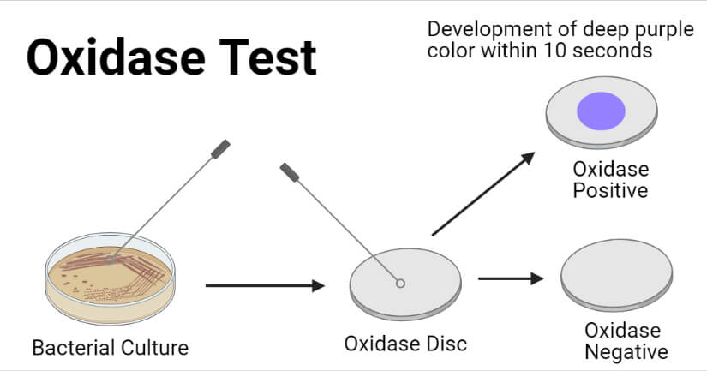
Pseudomonas aeruginosa
Latin: copper, rust, green color
Simple nutritional requirements: can withstand high temps (42ºC), [high salt]
Colonies
  Grape-like or masa for tortilla odor
  Variety of pigments (blue, green, fluorescent, red-brown, brown-black)
  Large spreading colonies with metallic sheen or mucoid
  Swarming, motile
Biochemical:
  Lactose: non – fermenter (not pink– red on MacConkey)
  Oxidase: positive (has cytochrome system)
Virulence factors: many, for instance
  cell surface polysaccharides (lipopolysaccharide and exopolysaccharide) are produced by mucoid strains and form biofilm matrixes
Notes:
Cytochrome system is found in Pseudomonas, Aeromonas, Campylobacter, Pasteurella, Vibrio, Neissieria but not any of the Enterobacteriacae

Slide 28
Gram Negative Bacilli
Gram Negative Bacilli
Can be further differentiated by H2S production & motility (more on this next plate rounds)
*also oxidase (-)
lactose fermenters
non lactose fermenters
fast
slow
oxidase (+)
oxidase (-)
Klebsiella
Citrobacter
Pseudomonas
Shigella
E. coli
Serratia
Campylobacter
Salmonella
Enterobacter
Vibrio
Proteus
Aeromonas
Yersinia
Burkholderia
Stenotrophomonas
Acinetobacter
Notes:
Cytochrome system is found in Pseudomonas, Aeromonas, Campylobacter, Pasteurella, Vibrio, Neissieria but not any of the Enterobacteriacae

Slide 29
Case
A 83 year old woman with DM from a nursing facility presents for dysuria associated with subjective fevers.. Urine culture was sent
Growth on MacConkey shows pink, mucoid colonies
Oxidase test is negative
MacConkey: Pink, mucoid colonies
gram stain: stout, gram (-) rods
BAP:
Gamma hemolytic
Large, slimy, mucoid colonies

Slide 30
Case
  Poll #7. This oxidase negative, mucoid organism with pink colonies on MacConkey is most likely…
  A. Klebsiella pneumoniae
  B. E. coli
  C. Proteus spp
  D. Not sure, could be Klebsiella pneumoniae or E. coli

Slide 31
Case
Proteus
Lactose non fermenter
Oxidase negative
Highly motile
  Extends in concentric waves over the surface of the agar as it grows (swarming)
  Poll #7. This oxidase negative, mucoid organism with pink colonies on MacConkey is most likely…
  A. Klebsiella pneumoniae
  B. E. coli
  C. Proteus spp
  D. Not sure, could be Klebsiella pneumoniae or E. coli
No
Notes:
Swarming appearance because growth takes place in a discontinuous manner which each period of outward growth followed by a stationary period

Slide 32
Case
  Poll #8. Which test can help distinguish Klebsiella pneumoniae and E. coli?
  Evaluate for lactose fermentation
  Oxidase test
  Indole test
  None of the above

Slide 33
Case
  Poll #8. Which test can help distinguish Klebsiella pneumoniae and E. coli?
  Evaluate for lactose fermentation
  Oxidase test
  Indole test
  None of the above
No, both are lactose fermenters
No, both are oxidase negative

Slide 34
Indole Test
Demonstrates ability of organism to decompose the amino acid tryptophan to indole
There are several ways to perform this test, two are:
  Using Kovac’s reagent solution
    If indole is present, when combined with Kovac’s reagent solution, solution turns from yellow to cherry red (“cherry red ring”)
    Byproduct is not water soluble (forms an oily layer at top of the broth)

Slide 35
Indole Test
There are several ways to perform this test, two are:
  Using Kovac’s reagent solution
  Spot indole test
    Indole combines with filter paper matrix with 1% p-dimethylaminocinnamaldehyde reagent to produce a green– blue compound
    Positive: green-blue color
    Negative: colorless - pink color

Slide 36
Indole Test
Indole (+) | Indole (-)
E. coli Klebsiella oxytoca, variicola All other Proteus species Citrobacter koseri | Klebsiella pneumoniae Proteus mirabilis, penneri Citrobacter freundii
*table includes only limited examples of indole positive or indole negative organisms

Slide 37
Urease Test
Used to determine ability of organism to hydrolyze urea, through the production of urease
Hydrolysis of urea produces ammonia + CO₂
Ammonia alkalinizes medium → pH shift is detected by color change from phenol red – orange to magenta pink
Organisms can be negative, rapidly positive, or weakly positive (may take several days) for urease
Urease (+) | Urease (-)
Klebsiella (weak) Proteus Helicobacter pylori Yersinia | E. Coli Shigella Salmonella

Slide 38
Case
  Poll #9. MALDI-ToF identifies the organism as Klebsiella pneumoniae. What is one ”test” that can help differentiate between hypervirulent Klebsiella and classical Klebsiella?
  Indole test
  Motility test
  H₂S test
  String test

Slide 39
Case
  Poll #9. MALDI-ToF identifies the organism as Klebsiella pneumoniae. What is one ”test” that can help differentiate hypervirulent and classical Klebsiella?
  Indole test
  Motility test
  H₂S test
  String test
String Test
Hypermucoviscosity seen with formation of viscous strings > 5 mm in length when loop used to stretch colony on agar plate
Note: this phenotype is not optimally specific or sensitive for hvKp strains (some cKp have this phenotype, some hvKp do not)

Slide 40
Klebsiella pneumoniae
Classical (cKp) | Hypervirulent (hvKp)
More common in health care setting Older, often immunocompromised patients Usually single site of infection Liver abscess occurs in presence of biliary disease | More common in community acquired Healthy individuals of any age (often East Asian, Pacific Islander, Hispanic) More likely to possess hypermucoviscuous phenotype (+ string test) than non invasive strains Propensity for multiple sites of infection and/or development of subsequent metastatic spread (endophthalmitis, meningitis, brain abscess, necrotizing SSTI, splenic abscess, brain abscess) Liver abscess usually occurs in absence of biliary disease (hallmark clinical syndrome)
*Note: these are general features, there are exceptions

Slide 41
Gram Negative Bacilli
Gram Negative Bacilli
Can be further differentiated by H2S production & motility (more on this next plate rounds)
*also oxidase (-)
*sometimes NLF
lactose fermenters
non lactose fermenters
fast
slow
oxidase (+)
oxidase (-)
Klebsiella: mucoid (2/2 capsule), urease +
pneumoniae indole -
oxytoca indole +
Citrobacter
Pseudomonas
Shigella
Serratia
Campylobacter
Salmonella
Vibrio
Proteus: swarming, urease +
mirabilis, penneri: indole +
vulgaris: indole -
E. coli
Indole +
Urease -
Aeromonas
Burkholderia
Yersinia
Enterobacter
Stenotrophomonas
Acinetobacter

