Slide 1
Microbiology Plate Rounds
Session 6

Slide 2
Gram Positive Bacilli
Bacilli
Large
Small or coccobacillary
Coryneform
Branching, filamentous
Bacillus big, boxy, may have spores, catalase (+)
Clostridium big, boxy, may have spores, catalase (-)
Listeria short rods, may appear coccobacillary catalase (+)
Rhodococcus
beaded to solidly
staining coccobacilli
Erysipelothrix
slender or coccoid
rods OR
thin, filamentous
catalase (-)
Cutibacterium acnes catalase (+)
catalase (-) Corynebacterium
Streptomyces
Gordonia
Tuskamurella
Beaded
Nocardia
Actinomyces

Slide 3
Case
53 yo woman w/ hx of OHT (5/2021, CMV D-/R+, Toxo D-/R-) presenting for abnormal CXR performed after routine endomyocardial biopsy
afebrile, SpO2 100% RA
coarse breath sounds at R upper lung field
WBC 3.8
CT chest: Confluent 2.5 cm RUL opacities
BAL is performed

Slide 4
Case
BAL AFB culture: (unable to submit, overgrown with contaminants)
BAL bacterial culture: pending
BAL fungal culture: pending

Slide 5
Case
Gram Stain
Beaded, thin gram positive rods
Filamentous, typically right angle branching

Slide 6
Case
Colonies on agar
Growth in aerobic conditions
Chalky, matte, velvety, powderly, irregular, wrinkled (heaped colonies
Yellow pigmented (but different species have various pigments)
Smell: moldy basement
Notes:
Selective media may be necessary to enhance recovery of Nocardia species and minimize the growth of contaminating organisms, such as BCYE (Buffered Charcoal Yeast agar)

Slide 7
gram stain
Poll #1
What is the most likely organism?
A. Bacillus cereus
B. Rhodococcus
C. Cutibacterium acnes (formerly Propionibacterium)
D. Nocardia
E. Mycobacteria
Colony morphology

Slide 8
gram stain
Poll #1
What is the most likely organism?
A. Bacillus cereus
B. Rhodococcus
C. Cutibacterium acnes (formerly Propionibacterium)
D. Nocardia
E. Mycobacteria
Colony morphology

Slide 9
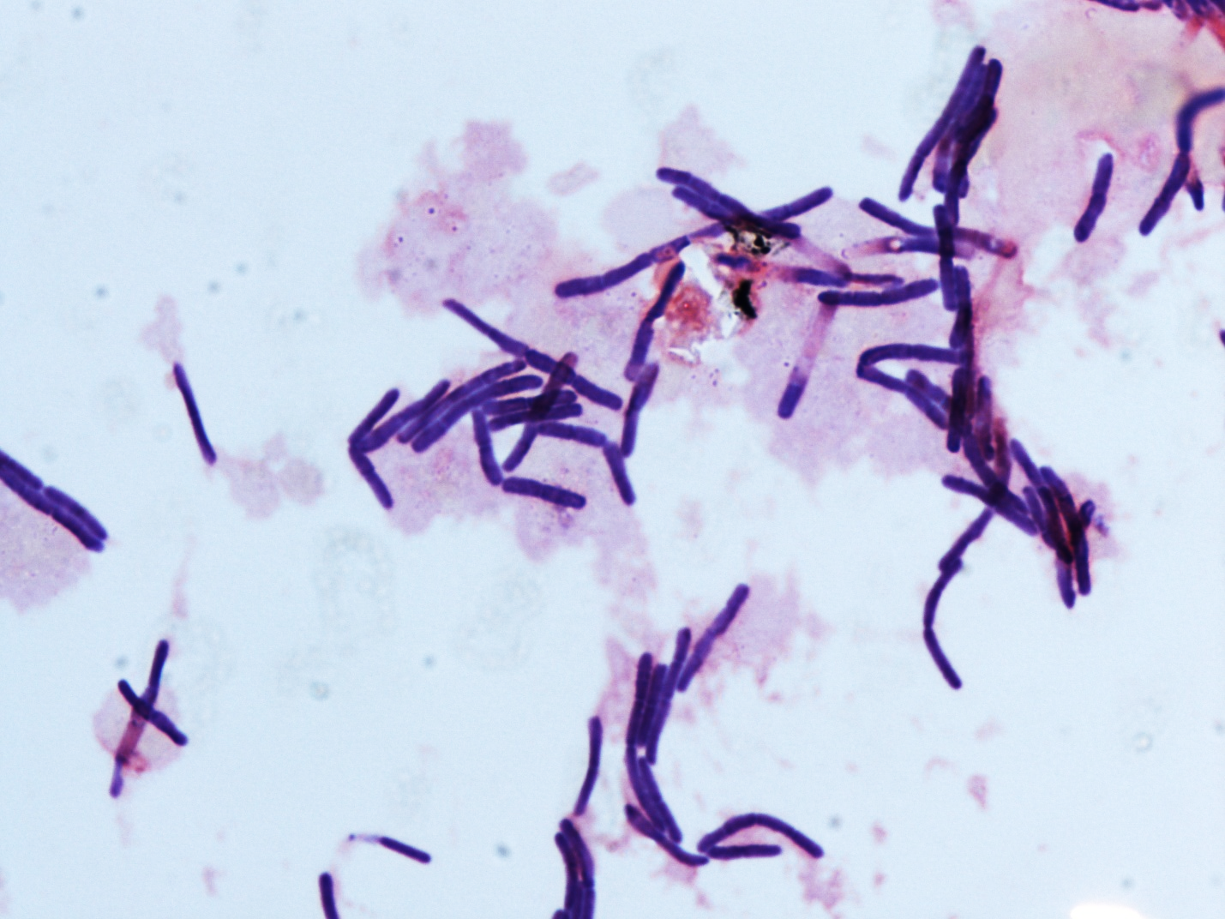
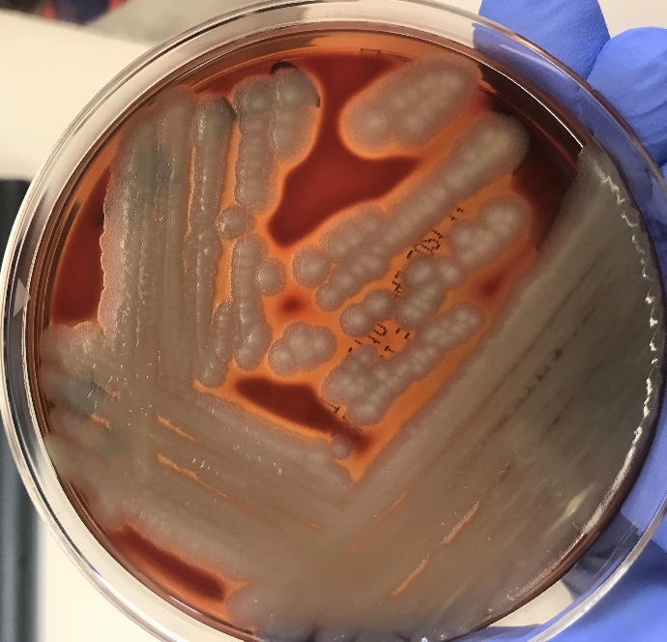
Poll #1
What is the most likely organism?
A. Bacillus cereus
B. Rhodococcus
C. Cutibacterium acnes (formerly Propionibacterium)
D. Nocardia
E. Mycobacteria
large boxy rods
beta hemolytic, large matte, opaque, whitish – cream colonies
*differentiate from B. anthracis with: hemolysis, motility
Many syndromes including bacteremia (RF: HSCT, CVC, IVDU)

Slide 10
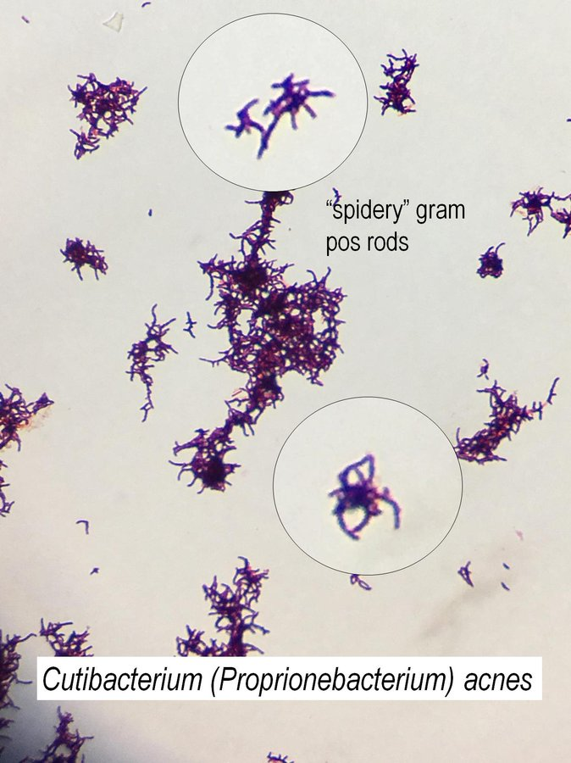
Poll #1
What is the most likely organism?
A. Bacillus cereus
B. Rhodococcus
C. Cutibacterium acnes (formerly Propionibacterium)
D. Nocardia
E. Mycobacteria
gram positive, pleomorphic, branched, unbranched, coccoid, bifid, can appear singly, pairs, chains or clumps
Causes: acne, prosthetic joint (shoulder) or bone infections, CSF infections

Slide 11
Poll #2
If you suspect Nocardiosis but are worried the culture will be overgrown with contaminants, use of which agar might you request?
A. BCYE agar
B. Mueller Hinton agar
C. MacConkey agar

Slide 12
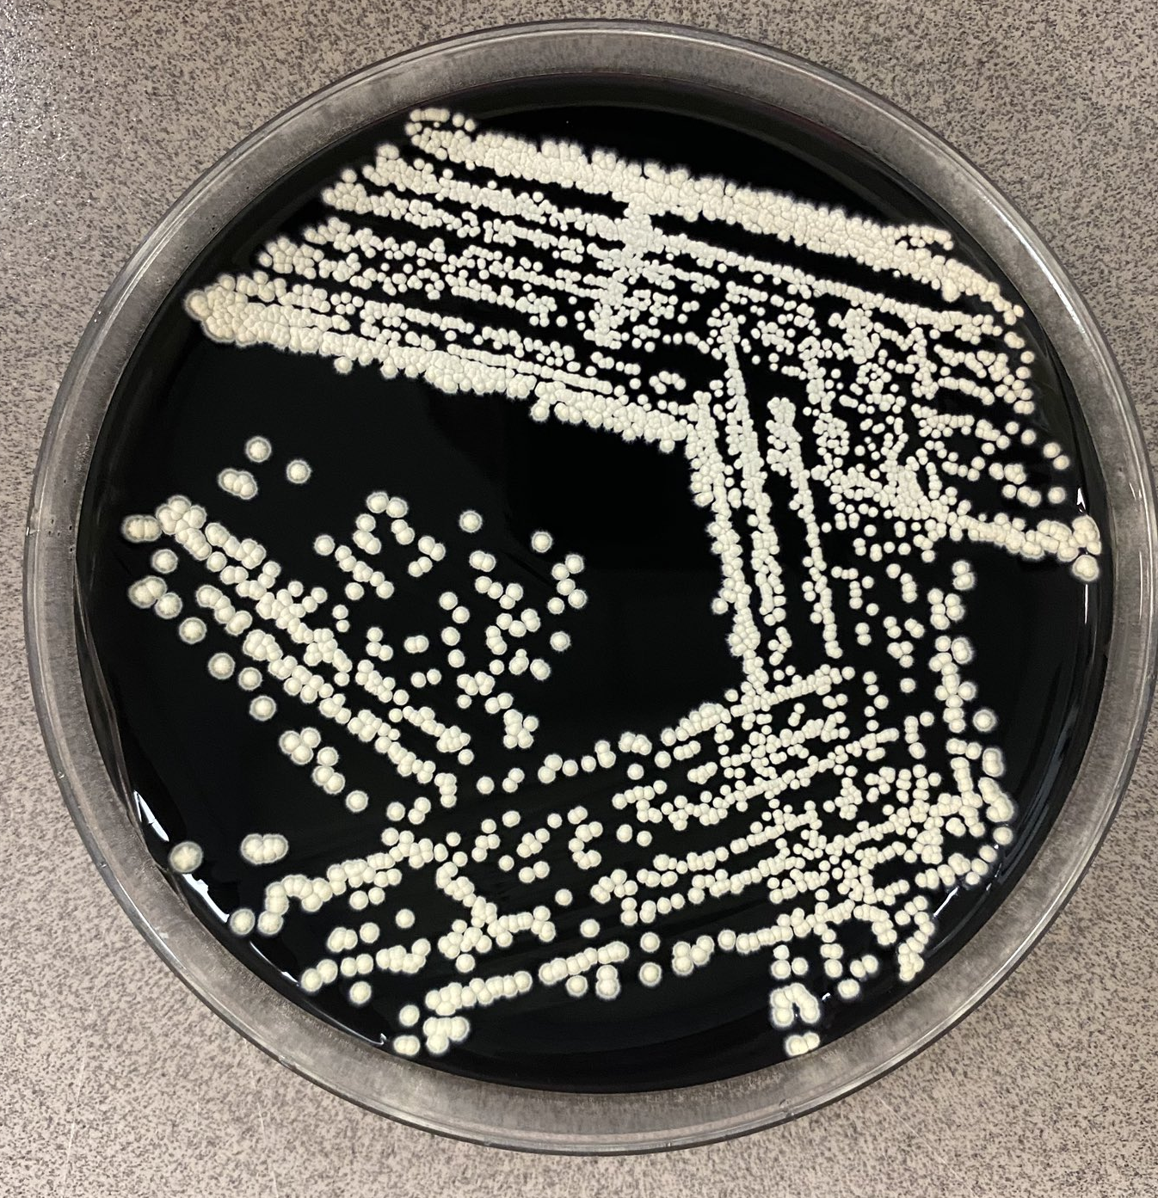
Poll #2
If you suspect Nocardiosis but are worried the culture will be overgrown with contaminants, use of which agar might you request?
A. BCYE agar
B. Mueller Hinton agar
C. MacConkey agar
Enriched medium (e.g. L-cysteine and iron salts)
Required for Legionella growth
Can assist in recovery of Nocardia

Slide 13
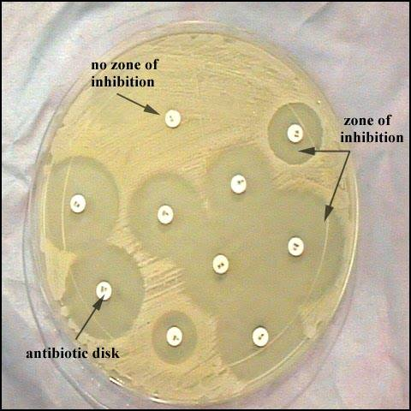
Poll #2
If you suspect Nocardiosis but are worried the culture will be overgrown with contaminants, use of which agar might you request?
A. BCYE agar
B. Mueller Hinton agar
C. MacConkey agar
Used to perform disk diffusion testing (Kirby Bauer)
Can be supplemented to support growth of fastidious organisms

Slide 14
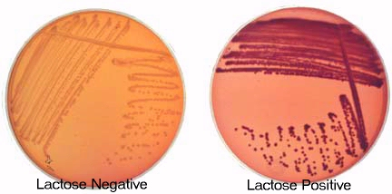
Poll #2
If you suspect Nocardiosis but are worried the culture will be overgrown with contaminants, use of which agar might you request?
A. BCYE agar
B. Mueller Hinton agar
C. MacConkey agar
Selective and differential agar
Differentiates enteric gram negatives (ability to ferment lactose)
*Not all gram (-)s grow on MacConkey agar

Slide 15
Actinomycetes (order; not to be confused with Actinomyces, a genus)
Gram positive
Generally with filamentous, branching rod structures (branching networks resemble and may be confused as fungi)
Some clinically important Actinomycetes are…
Aerobic Actinomycetes | Anaerobic Actinomycetes
Nocardia Gordonia Tsukamurella Streptomyces Rhodococcus | Actinomyces Rothia

Slide 16
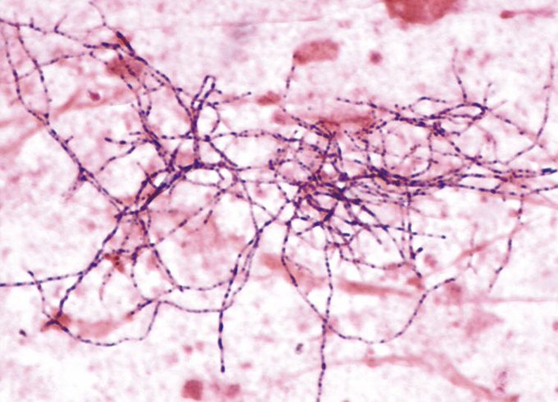
Nocardia
Environmental: Present in the soil, water and acquired by inhalation or direct inoculation
RF: ICT, EtOH, DM, structural lung disease
Presentations: pulmonary with dissemination (CNS, cutaneous)
Susceptibilities depend on species (e.g. N. asteroides, N. abscessus, N. farcinica…)
Microbiological characteristics:
Strict aerobe
Catalase (+)
Gram stain:
Beaded
Long, thin, wavy, thread-like/thin branching (right angle), thin filaments
Filaments may fragment may produce bacillary or coccoid forms
Usually gram positive, but can appear gram variable or negative (if suboptimal growth conditions)

Slide 17
Nocardia
Environmental: Present in the soil, water and acquired by inhalation or direct inoculation
RF: ICT, EtOH, DM, structural lung disease
Presentations: pulmonary with dissemination (CNS, cutaneous)
Susceptibilities depend on species (e.g. N. asteroides, N. abscessus, N. farcinica…)
Microbiological characteristics:
Culture
May be isolated on routine bacteria, fungal, and mycobacteria media
48 hrs - 14 days for growth to occur
*may be isolated in fungal cultures due to slow growth
Abundant aerial growth
Chalky-white or cotton ball appearance

Slide 18
Nocardia
Susceptibilities
Antimicrobial susceptibility profile is highly variable among Nocardia species (and varies between studies and countries)
Of 2,091 Nocardia isolates at Mayo Clinic reference lab from 2011 – 2017,
> 90% Nocardia species susceptible to TMP-SMX, linezolid, amikacin
Susceptibility to imipenem, ceftriaxone, amoxicillin-clavulanic acid, ciprofloxacin, tetracyclines varies among species
Hamdi et al 2020

Slide 19
Poll #3
If you suspect nocardiosis, which stain can assist your diagnosis?
A. Acid fast stain
B. Modified acid fast stain

Slide 20
Poll #3
If you suspect nocardiosis, which stain may best assist your diagnosis?
A. Acid fast stain
B. Modified acid fast stain

Slide 21
Acid Fast Staining
Kinyoun method (does not use heat) or Ziehl Nelson method (uses heat)
Modified acid-fast: decolorizes weak acid (1% sulfuric acid) instead of more active acid-alcohol – e.g. Nocardia will resist decolorization with 1% but not 3% HCL acid
Actinomycetes (order; not to be confused with Actinomyces, a genus)
Anaerobic: will not stain weakly acid fast
Some (not all) aerobic may stain weakly acid fast due to presence of mycolic acids
Partially acid-fast: Nocardia, Rhodococcus, Gordonia
Not acid-fast: Streptomyces
**Some Nocardia spp stain acid-fast but not all

Slide 22
Case
69 M with RUL SCC (s/p chemo/XRT, immunotherapy) complicated by RT pneumonitis presenting for fevers, cough, dyspnea, found to have RUL cavitary pneumonia
CT chest: cavity at site of previously demonstrated lung mass with new air-fluid level
Tmax 102.7
WBC 9.9
RCx:

Slide 23
Case
Immunocompromised host
Cavitary PNA
Culture:
Facultative anaerobe
Small, irregular, smooth-slightly granular
Gram stain:
Thin filamentous, beaded, short branching
May form networks

Slide 24
Poll #4
Modified acid-fast stain is negative. What is the most likely organism?
A. Rhodococcus equi
B. Rothia mucilaginosa
C. Actinomyces israelli
D. Nocardia spp
E. Mycobacteria

Slide 25
Poll #4
Modified acid-fast stain is negative. What is the most likely organism?
A. Rhodococcus equi
B. Rothia mucilaginosa
C. Actinomyces israelli
D. Nocardia spp
E. Mycobacteria

Slide 26
Actinomyces
Environmental: normal flora of oral, GI, respiratory, pelvic-genital tracts
RF: recent dental procedures, periodontal disease, poor dentition, aspiration (thoracic), IUD (pelvic), chronic lung disease
Presentations: oro-cervicofacial (lumpy jaw) > thoracic & abdominal
Ignores tissue planes, forms sinuses, fistulas
Microbiological characteristics:
Anaerobic (facultative)
Catalase (-)
NOT weakly acid fast
Produces sulfur granules on histopathology: conglomeration of bacteria that look like sulfur
Gram stain:
Gram positive rods
Beaded (beaded morphology more common on histopathology)
Filamentous, branching (network or short, often with diphteroid forms)
Culture:
Slow growth

Slide 27
Actinomyces
Susceptibilities
Uniformly susceptible to beta-lactams
Species identification crucial if beta-lactam allergic
Linezolid and doxycycline (usually) retains activity
Variable resistance to clindamycin, fluoroquinolones (differs across studies)
High rates of resistance to metronidazole
Steininger et al 2016

Slide 28
Case
33 year old HIV + male (CD4 20) presents for 1 month of fevers, dyspnea, and dry cough
Tmax 38.5ºC, RR 30
CD4 count: 20
A respiratory gram stain and culture were obtained

Slide 29
Poll #5
Gram stain:
Gram positive
Pleomorphic, coccobacillus
What is the most likely organism?
A. Rhodococcus equi
B. Rothia mucilaginosa
C. Actinomyces
D. Nocardia
E. Mycobacteria
Culture:
Irregularly round, smooth, semi-transplant
Mucoid
Salmon - pink color

Slide 30
Poll #5
What is the most likely organism?
A. Rhodococcus equi
B. Rothia mucilaginosa
C. Actinomyces
D. Nocardia
E. Mycobacteria

Slide 31
Poll #5
What is the most likely organism?
A. Rhodococcus equi
B. Rothia mucilaginosa
C. Actinomyces israelli
D. Nocardia
E. Mycobacteria
Gram positive
Coccobacillus, cocci can occur in clusters or tetrads
Colonies: mucoid-sticky, transparent to white, and nonhemolytic and often adhere to the agar
Normal inhabitant of mouth and upper respiratory tract
RF: ICT, neutropenia, malignancy, indwelling vascular foreign body

Slide 32
Poll #6
Rhodococcus is an aerobic Actinomycetes similar to Nocardia. A modified acid-fast stain is performed. Might Rhodococcus stain weakly acid fast?
A. Yes
B. No

Slide 33
Poll #6
Rhodococcus is an aerobic Actinomycetes similar to Nocardia. A modified acid-fast stain is performed. Might Rhodococcus stain weakly acid fast?
A. Yes
B. No

Slide 34
Poll #7
What exposure is linked to Rhodococcus equi infections?
A. Freshwater exposure
B. Pigeons
C. Farm animals (e.g. horses & cattle)
D. Vaping

Slide 35
Poll #7
What exposure is linked to Rhodococcus equi infections?
A. Freshwater exposure
B. Pigeons
C. Farm animals (e.g. horses & cattle)
D. Vaping

Slide 36
Indolent PNA (80%) with nodules/thick walled cavities possible, cutaneous, CNS
RF: HIV CD4 < 100, SOT, farm, soil, manure or horse exposure (reported in 30 – 50% of cases)
Rhodococcus
Microbiological characteristics:
Gram stain: short, gram positive rod (coccobacillus)
Beaded – solid staining
Coccoid – bacillary (depending on stage of growth)
Pus, tissue: most coccoid form
Blood, BAL, sputum: usually rod form
Colonies: Salmon – pink colonies
May stain weakly acid fast (Nocardia also weakly acid fast but with beaded, filamentous branching)

Slide 37
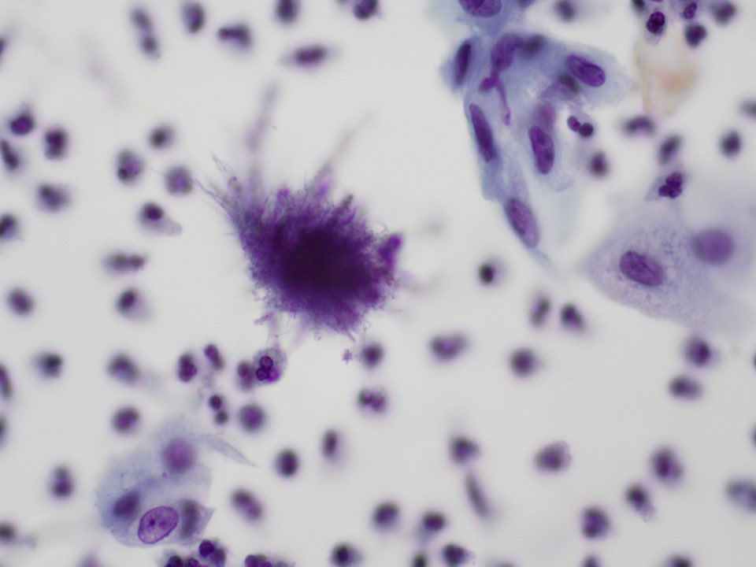
Take Home Points
A 25 year old woman with an IUD in place undergoes a routine cervical pap smear. She is asymptomatic (e.g. no symptoms of PID). Results are shown below.
Poll #8: What is the most likely organism?
A. Rhodococcus equi
B. Rothia mucilaginosa
C. Actinomyces
D. Nocardia
Poll #9: Does the IUD need to be removed?
A. Yes
B. No
Pap smear with clusters of filamentous bacteria
(cotton ball)

Slide 38
Take Home Points
A 25 year old woman with an IUD in place undergoes a routine cervical pap smear. She is asymptomatic (e.g. no symptoms of PID). Results are shown below.
Poll #8: What is the most likely organism?
A. Rhodococcus equi
B. Rothia mucilaginosa
C. Actinomyces
D. Nocardia
Poll #9: Does the IUD need to be removed?
A. Yes
B. No
Seen in up to 25% of pts with IUD
In asymptomatic pts, identification of actinomyces by Pap smear cytology is not diagnostic or predictive of any disease (normal inhabitant of female genital tract)
Pap smear with clusters of filamentous bacteria
(cotton ball)

Slide 39
Take Home Points
 | Nocardia | Actinomyces
Habitat | Environmental (inhalation) | Commensal of oral, GI, pelvic tracts
Aerobic/anaerobic?
Catalase (+/-) | (+) | (-)
Gram stain | Gram positive rods Filamentous Beaded, thread-like, thin branching | Gram positive rods Filamentous Network or shorter branching
Other characteristics | Aerial hyphae on culture | Sulfur granules on histopathology
Weakly acid fast?
Poll #10
Poll #11
Poll #12
Poll #13

