Slide 1
Microbiology Plate Rounds
Session 5

Slide 2
Poll Test Run
Text HELENTSAI677 to 22333 to join Polls

Slide 3
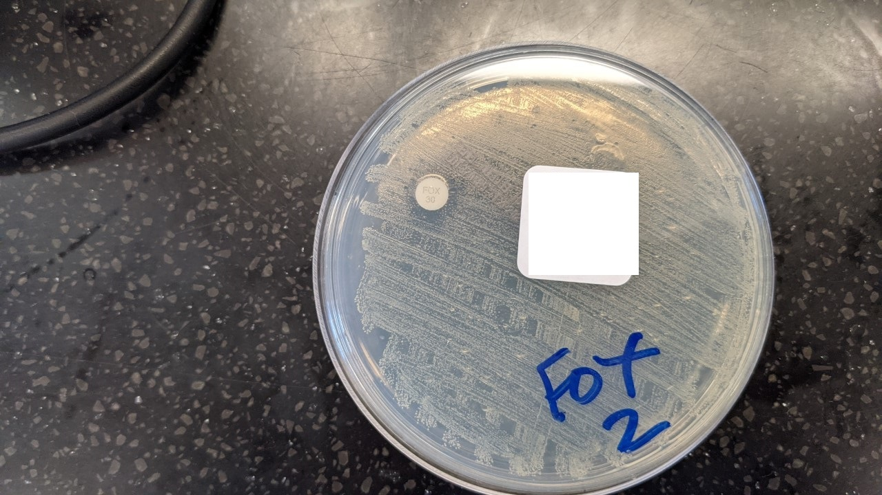
Poll Test Run
MALDI-ToF identifies S. aureus in a positive blood culture. To distinguish if the isolate is MSSA versus MRSA, the microbiology lab performs disk diffusion testing with which antibiotic?
a. Vancomycin
b. Cefoxitin
c. Oxacillin
d. Methicillin
Impregnated disc with…

Slide 4
Poll Test Run
MALDI-ToF identifies S. aureus in a positive blood culture. To distinguish if the isolate is MSSA versus MRSA, the microbiology lab performs disk diffusion testing with which antibiotic?
a. Vancomycin
b. Cefoxitin
c. Oxacillin
d. Methicillin
Impregnated disc with…

Slide 5
Agenda: susceptibility testing (bacteria)
Disk diffusion testing (Kirby Bauer)
Broth Microdilution
*Agar microdilution to be discussed with anaerobes
Automated susceptibility testing
Manual gradient diffusion method (Etest)
ESBL/AmpC resistance
Beta-lactamase testing

Slide 6
Poll #1
Which is the standard agar used to perform disk diffusion testing (for non-fastidious organisms)?
  a. Blood agar
  b. CNA (Columbia – Naladixic Acid) agar
  c. Mueller-Hinton agar
  d. MacConkey agar

Slide 7
Poll #1
Which is the standard agar used to perform disk diffusion testing (for non-fastidious organisms)?
  a. Blood agar
  b. CNA (Columbia – Naladixic Acid) agar
  c. Mueller-Hinton agar
  d. MacConkey agar

Slide 8
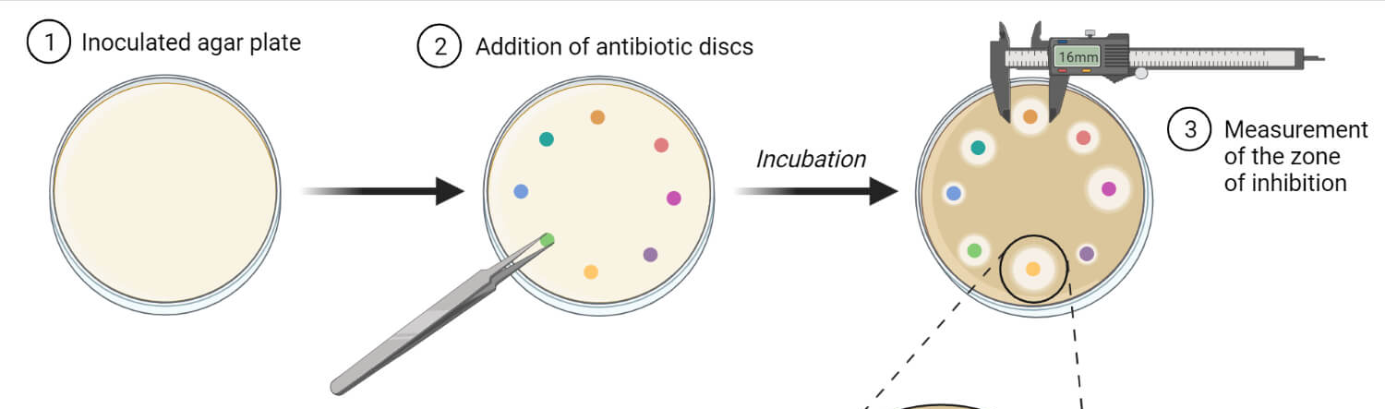
Disk Diffusion Testing (Kirby Bauer)
Performed on Mueller Hinton Agar (MHA)
Kirby Bauer disk diffusion and broth microdilution are two reference methods for aerobic bacteria (other methods are approved but not considered reference standards)

Slide 9
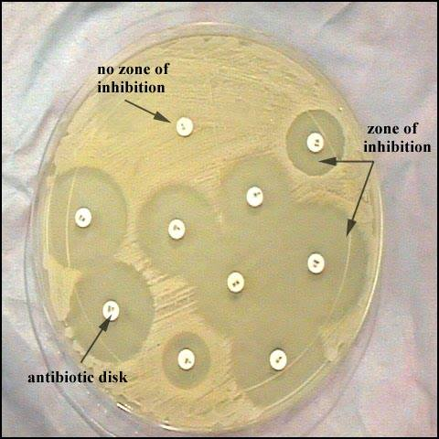
Disk Diffusion Testing (Kirby Bauer)
Procedure:
  Standard organism inoculum onto plate (0.5 McFarland standard from direct colony suspension)
  Commercially available 6 mm filter paper disks impregnated with antimicrobial agents are applied to the surface of the agar plate
  Incubate x 18-24 hrs
  Measure zone of inhibition
  Interpret zone of inhibition as S/R/I using CLSI, FDA, EUCAST guidelines

Slide 10
Disk Diffusion Testing (Kirby Bauer)
For fastidious organisms (Haemophilius spp, N. meningitidis, S. pneumoniae) supplemental media used
Standardization is crucial: agar, colony inoculation, disks
  Colonies must be from fresh culture (< 24 hrs) – ie. cannot add on antibiotic testing to 3 day old isolate
Does NOT provide quantitative data (reported as susceptible, intermediate, resistant compared to established guidelines)
Advantages: Simple to perform, reproducible, inexpensive

Slide 11
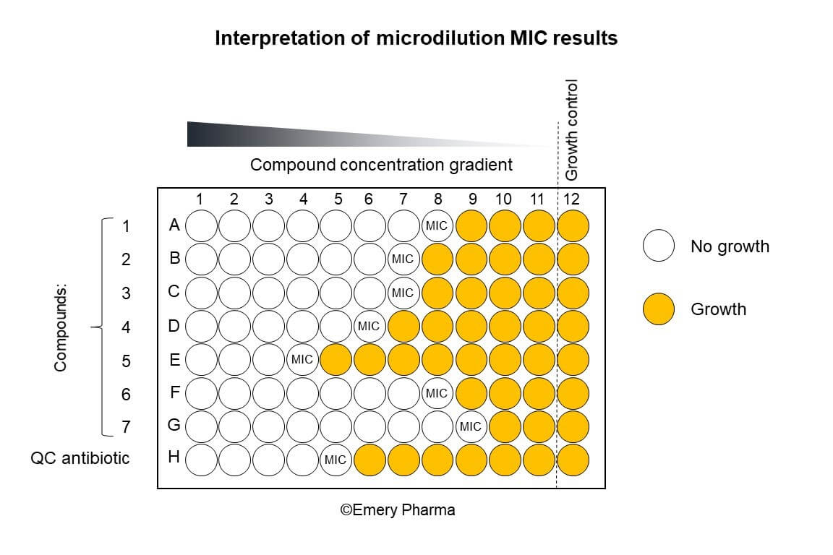
Minimum Inhibitory Concentration
Definition: lowest concentration of an antimicrobial agent that inhibits the growth of bacteria
Compare to established concentration breakpoints for a given organism, antibiotic, and site of infection to define susceptible or resistant
The standard MIC reporting error is plus or minus one doubling dilution.
Refer to CLSI guidelines for most up to date recommendations

Slide 12
Broth Microdilution
Gold standard
How it works:
  Antimicrobials are prepared in two-fold dilutions in a 96 well plate
  Value reported/read is MIC
Cons:
  Requires a large volume of reagants
  Tedious dilution steps
  Chances for cross-contamination or bacterial incompatibility of growth
  Requires maintenance of optimum testing parameters (ie. temp, length of incubation)

Slide 13
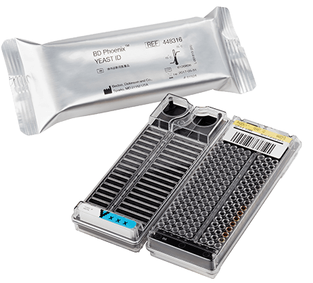
Automated Susceptibility Testing
Replicate manual methods
May or may not contain two-fold dilutions of antimicrobials
Instruments: Vitek2, BD Phoenix, MicroScan
How it works:
  1. Introduction of bacterial suspension into pre-formulated panels of antibiotics
  2. Panels are incubated
  3. Inhibition of bacterial growth by antibiotic measured by turbidity or fluorescence
  4. Reports susceptibility based on MIC

Slide 14
Automated Susceptibility Testing
Advantages:
  Rapid turn around time
  Highly reproducible
  Ability to retain and analyze a large amount of susceptibility data
Disadvantages:
  High cost
  Cannot test all encountered pathogens
  Does not reflect recent updates in breakpoints or contain new drugs (until company updates panels or system)
  Problems with unusual resistance phenotypes

Slide 15
Manual gradient diffusion method (Etest)
Hybrid between disk diffusion and broth microdilution
How it works:
  Lawn of isolate on MHA agar
  Plastic strips (sprayed with an antimicrobial gradient) placed on agar
  Drugs diffuse through agar
  MIC is the value where ellipse intersects the strip
  MIC compared to established CLSI MIC breakpoints to determine S/I/R
*

Slide 16
Manual gradient diffusion method (Etest)
  Advantages:
    Simple and easy to perform
    Can be used for anaerobes
  Disadvantages:
    More expensive
    Potential reader variability
    MIC intersection affected by colony density, inoculation technique, requires stability of antibiotic gradient

Slide 17
Poll #2
  Which of the following methods report susceptibilities based on minimum inhibitory concentrations?
  a. Disk diffusion testing
  b. Manual broth microdilution
  c. Etest
  d. A and C
  e. B and C

Slide 18
Poll #2
  Which of the following methods report susceptibilities based on minimum inhibitory concentrations?
  a. Disk diffusion testing
  b. Manual broth microdilution
  c. Etest
  d. A and C
  e. B and C
Reports S/R/I based on zone of inhibition
Reports MIC (labor intensive), automated susceptibility testing also report MICs
Reports MICs

Slide 19
Poll #3
A blood culture growing E. coli has the following susceptibility pattern. What is the most likely mechanism of resistance?
  AmpC beta lactamase
  b. Alteration in PBP2a encoded by mecA gene
  c. Extended spectrum beta lactamase
E. coli
Pip-tazo: resistant
Cefoxitin: susceptible
Ceftriaxone: resistant
Cefepime: resistant
Meropenem: susceptible
Notes:
Inhibitors - clavulanate, sulbactam, tazobactam and avibactam, relebactam, vaborbactam
Newer inhibitors – avibactam, relebactam, vaborbactam efficiently inhibit class C enzymes but not ESBLs

Slide 20
Poll #3
A blood culture growing E. coli has the following susceptibility pattern. What is the most likely mechanism of resistance?
  AmpC beta lactamase
  b. Alteration in PBP2a encoded by mecA gene
  c. Extended spectrum beta lactamase
E. coli
Pip-tazo: resistant
Cefoxitin: susceptible
Ceftriaxone: resistant
Cefepime: resistant
Meropenem: susceptible

Slide 21
 | AmpC | ESBL
Inhibited by clavulanate | No | Yes
Hydrolyzes 1st, 2nd, 3rd cephalosporins | Yes (R) | Yes (R)
Cephamycins (cefoxitin) | Yes (R) | No (S)
Cefepime | No (S) | Yes (R)
Mechanism | AmpC gene may become de-repressed upon exposure to beta-lactam antimicrobials resulting in resistance to 3rd generation cephalosporins and pip-tazo SPICE/SPACE organisms | Acquired via mobile genetic elements

Slide 22
Poll #4
The patient is started on cefoxitin by the primary team . Do you recommend…
Continue cefoxitin
b. Change to meropenem
E. coli
Pip-tazo: resistant
Cefoxitin: susceptible
Ceftriaxone: resistant
Cefepime: resistant
Meropenem: susceptible

Slide 23
 | AmpC | ESBL
Inhibited by clavulanate | Yes | No
Hydrolyzes 1st, 2nd, 3rd cephalosporins | Yes (R) | Yes (R)
Cephamycins (ie. cefoxitin) | Yes (R) | No (S)
Cefepime | No (S) | Yes (R)
*
Cephamycins can demonstrate
in-vitro activity against ESBL
Enterobacteriaceae isolates
This distinguishes ESBL resistance from AmpC resistance
Clinical data for use of cephamycins for ESBL infections is scarce

Slide 24
Case
67 yo man with pre-DM transferred from OSH for R knee pain, erythema and swelling and neck pain
MRI c-spine: C5-C6 discitis/OM with pre-vertebral soft tissue enhancement and thickening consistent with phlegmon
R knee arthrocentesis
  38,750 WBC (72% PMNs)
  Synovial culture (at OSH)

Slide 25
Poll #5
The primary team wants to know the susceptibilities for H. influenzae. What would you ask the outside lab about this isolate?
  a. Was the isolate penicillin susceptible?
  b. What was the isolate’s MIC to ceftriaxone?
  c. Was the isolate tested for beta lactamase production?
  d. Was it non-typable or typable H. influenzae?

Slide 26
Poll #5
The primary team wants to know the susceptibilities for H. influenzae. What would you ask the outside lab about this isolate?
  a. Was the isolate penicillin susceptible?
  b. What was the isolate’s MIC to ceftriaxone?
  c. Was the isolate tested for beta lactamase production?
  d. Was it non-typable or typable H. influenzae?

Slide 27
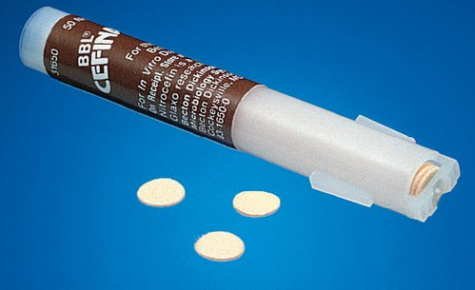
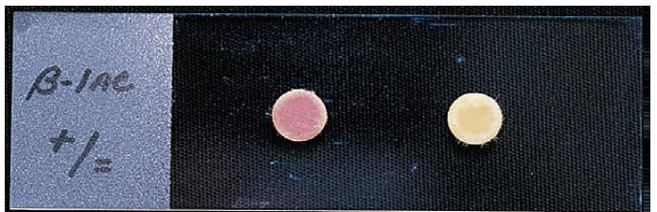
β-lactamase testing
Cefinase disc: impregnated with chromogenic cephalosporin (nitrocefin)
Smear colonies onto cefinase disc
Yellow → red color change if β-lactam ring is hydrolyzed by a β-lactamase (*color change does not usually develop over the entire disc)
Clinical significance for H. influenzae
  (+) beta lactamase
  R: ampicillin
S: cephalosporins
  (-) beta lactamase imply but do not
  guarantee ampicillin susceptibility
Presence of β-lactamase
No β-lactamase

Slide 28
Poll #6
Beta-lactamase testing is not reliable for which of the following organisms below?
a. H. influenzae
b. Fusobacterium necrophorum
c. Neisseria gonorrheae
d. Enterobacterales

Slide 29
Poll #6
Beta-lactamase testing is not reliable for which of the following organisms below?
a. H. influenzae
b. Fusobacterium necrophorum
c. Neisseria gonorrheae
d. Enterobacterales

Slide 30
Poll #6
Beta-lactamase testing is not reliable for which of the following organisms below?
a. H. influenzae
b. Fusobacterium necrophorum
c. Neisseria gonorrheae
d. Enterobacterales
Pleomorphic, long gram negative, bacilli
Filamentous – rod like forms with round or tapered ends
Associated with Lemierre’s syndrome

Slide 31
β-lactamase testing
Test is efficacious for predicting β-lactamase only for the following organisms:
  Neisseria gonorrhoeae
  H. influenzae (parainfluenzae)
  M. catarrhalis (and Eikenella)
  Staphylococci spp
  Enterococci spp
  Certain anaerobic bacteria
β-lactamase test not accurate for Enterobacterales
Interpretation of β-lactamase for anaerobic bacteria:
  (+)
    Probable identification is Bacteroides species
    Probably resistant to cephalosporins including cefotaxime and rarely cefoxitin
  (-): beware isolates may be resistant to βlactams by other mechanisms

Slide 32
Take Home Points
Kirby-Bauer (disk diffusion), broth microdilution, automated susceptibility testing, and Etests are phenotypic methods for antimicrobial susceptibility testing
  Broth microdilution, automated testing, and Etests report MIC
  Disk diffusion tests report zone of inhibition
Beta-lactamase testing performed on organisms including H. influenzae and certain anaerobes to detect presence/absence of beta lactamase

