Slide 1
Micro Plate Rounds
Session 4

Slide 2
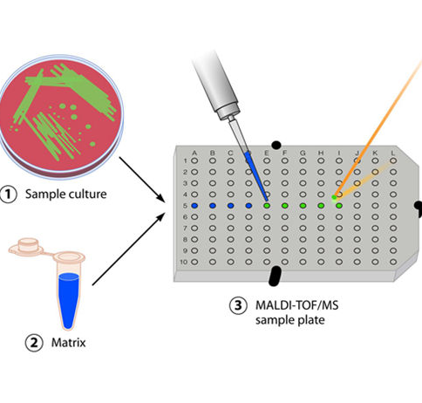
MALDI-ToF Mass Spectrometry
(Matrix-Assisted Laser Desorption/Ionization Time of Flight)
Only a single colony required for identification
Identification based on protein content (typically ribosomal proteins)
Second most accurate identification method after sequencing
  *Pearl: For blood cultures, performed directly from (+) blood culture sample

Slide 3
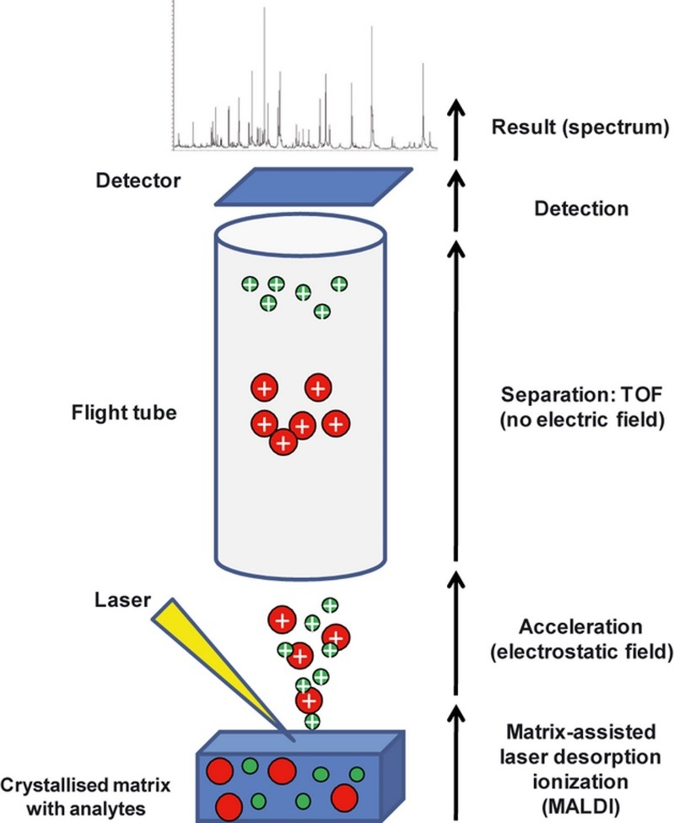
MALDI-ToF Mass Spectrometry
(Matrix-Assisted Laser Desorption/Ionization Time of Flight)
1. Colony added to target plate and covered with matrix
2. Colony/matrix shot with a laser which ionizes proteins
3. Ionized proteins travel through a vacuum and hit a detector at a rate proportional to their mass/charge ratio
4. This creates a spectrum (or fingerprint) which is compared to a database to determine an identification

Slide 4
Case
35 year old man presenting for R toe swelling, drainage with small area of fluctuance with associated with cellulitis
TMP-SMX allergy (anaphylaxis)
Vancomycin allergy (anaphylaxis)
Wound culture: MRSA
The primary team inquires if clindamycin is appropriate. What test could the Microbiology lab perform that may be of value?
a. MALDI-ToF mass spectrometry
b. E-test
c. D-test
d. Coagulase test
e. CAMP test

Slide 5
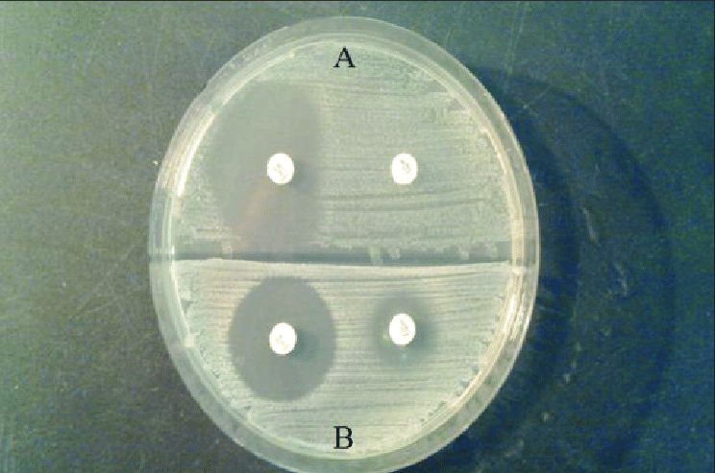
D-test
Documented clinical failures of clindamycin for MRSA isolates that were clindamycin sensitive but erythromycin resistant
Assesses for inducible clindamycin resistance
For S. aureus that test erythromycin R and clindamycin S or I → d-test required before reporting clindamycin susceptibilities by:
  Disk diffusion or
  Automated broth microdilution (Phoenix) with combined erythromycin + clindamycin well
Agar plate inoculated with Staphylococcus isolate
Erythromycin disk (15 ug) placed in close proximity of clindamycin disk (2 ug)
  *Pearl: d-test also performed for PCN allergic pregnant woman w/ (+) GBS screen if erythromycin R and clindamycin S or I

Slide 6
D-test (disk diffusion method shown here)
[A]: Positive D-test
  D-shaped flattening of zone of inhibition around clindamycin disk proximal to erythromycin disk.
  Indicates erythromycin HAS induced clindamycin resistance
  Inducible clindamycin-resistant isolates reported as clindamycin resistant
[B]: Negative D-test
  Completely round zone of inhibition around clindamycin disk
  Erythromycin has NOT induced clindamycin resistance

Slide 7
D-test
Erm gene encodes Macrolide-Lincosamide-Streptogramin B (MLSB) resistance ➝ resistance to erythromycin, clindamycin, streptogramin B
Mechanism can be:
  Constitutive
  Inducible
    Erythromycin is effective inducer of MLSB resistance
    Isolates with inducible resistance are resistant to erythromycin but appear susceptible to clindamycin in routine in-vitro testing

Slide 8
Case
28 yo M w/ IVDU (heroin, cocaine) presenting for subjective fevers and cough x 2 weeks
TTE with 2.4 cm mobile tricuspid vegetation
Blood cultures x 2 sets drawn

Slide 9
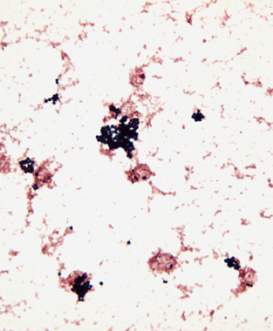
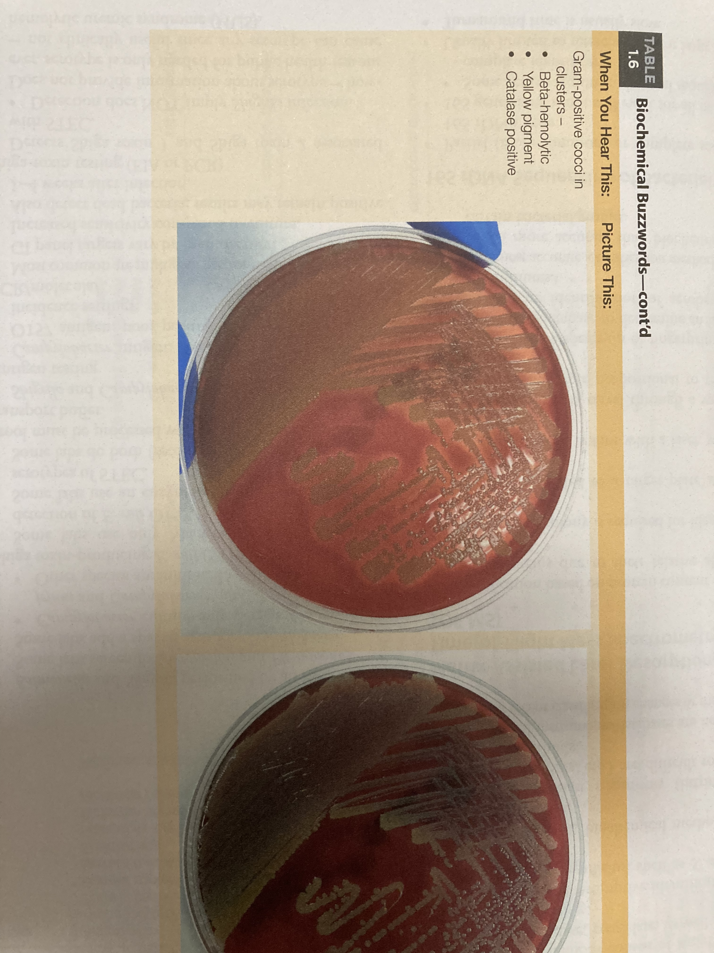
Identify the organism:
a. Streptococcus agalactiae
b. Staphylococcus aureus
c. Streptococcus viridans
d. Enterococcus faecalis
e. Bacillus cereus

Slide 10
Identify the organism:
a. Streptococcus agalactiae
b. Staphylococcus aureus
c. Streptococcus viridans
d. Enterococcus faecalis
e. Bacillus cereus
    GPC clusters
    Catalase (+)
    Coagulase (+)
    Beta hemolytic
    Yellow colonies

Slide 11
MSSA vs MRSA
What laboratory methods can be used to determine MSSA versus MRSA? (Yes/No for each)
1. Broth dilution testing?

Slide 12
MSSA vs MRSA
What laboratory methods can be used to determine MSSA versus MRSA? (Yes/No for each)
1. Broth dilution testing? Yes
  2. Methicillin disk diffusion testing?

Slide 13
MSSA vs MRSA
What laboratory methods can be used to determine MSSA versus MRSA? (Yes/No for each)
1. Broth dilution testing? Yes
  2. Methicillin disk diffusion testing? No, methicillin no longer commercially available

Slide 14
MSSA vs MRSA
What laboratory methods can be used to determine MSSA versus MRSA? (Yes/No for each)
1. Broth dilution testing? Yes
  2. Methicillin disk diffusion testing? No, methicillin no longer commercially available
  3. Oxacillin disk diffusion testing?

Slide 15
MSSA vs MRSA
What laboratory methods can be used to determine MSSA versus MRSA? (Yes/No for each)
1. Broth dilution testing: Yes
  2. Methicillin disk diffusion testing: No, methicillin no longer commercially available
  3. Oxacillin disk diffusion testing: Not reliable for S. aureus and S. lugdunensis. For detection of mec-A mediated resistance, can use oxacillin broth microdilution or agar dilution (but NOT disk)

Slide 16
MSSA vs MRSA
What laboratory methods can be used to determine MSSA versus MRSA? (Yes/No for each)
1. Broth dilution testing? Yes
  2. Methicillin disk diffusion testing? No, methicillin no longer commercially available
  3. Oxacillin disk diffusion testing? Not reliable for S. aureus and S. lugdunensis. For detection of mec-A mediated resistance, can use oxacillin broth microdilution or agar dilution (NOT disk)
  4. Cefoxitin disk diffusion testing?

Slide 17
MSSA vs MRSA
What laboratory methods can be used to determine MSSA versus MRSA? (Yes/No for each)
1. Broth dilution testing? Yes
  2. Methicillin disk diffusion testing? No, methicillin no longer commercially available
  3. Oxacillin disk diffusion testing? Not reliable for S. aureus and S. lugdunensis. For detection of mec-A mediated resistance, can use oxacillin broth microdilution or agar dilution (NOT disk)
  4. Cefoxitin disk diffusion testing? Yes, better inducer of mecA gene than oxacillin, more reproducible and accurate results than oxacillin

Slide 18
MSSA vs MRSA
What laboratory methods can be used to determine MSSA versus MRSA? (Yes/No for each)
1. Broth dilution testing? Yes
  2. Methicillin disk diffusion testing? No, methicillin no longer commercially available
  3. Oxacillin disk diffusion testing? Not reliable for S. aureus and S. lugdunensis. For detection of mec-A mediated resistance, can use oxacillin broth microdilution or agar dilution (NOT disk)
  4. Cefoxitin disk diffusion testing? Yes, better inducer of mecA gene than oxacillin, more reproducible and accurate results than oxacillin testing
  5. PCR?

Slide 19
MSSA vs MRSA
What laboratory methods can be used to determine MSSA versus MRSA? (Yes/No for each)
1. Broth dilution testing? Yes
  2. Methicillin disk diffusion testing? No, methicillin no longer commercially available
  3. Oxacillin disk diffusion testing? Not reliable for S. aureus and S. lugdunensis. For detection of mec-A mediated resistance, can use oxacillin broth microdilution or agar dilution (NOT disk)
  4. Cefoxitin disk diffusion testing? Yes, better inducer of mecA gene than oxacillin, more reproducible and accurate results than oxacillin testing
  5. PCR? Yes, PCR detects of mecA but does not detect novel resistance such as mecC or borderline resistant oxacillin resistance

Slide 20
MSSA vs MRSA
What laboratory methods can be used to determine MSSA versus MRSA? (Yes/No for each)
1. Broth dilution testing? Yes
  2. Methicillin disk diffusion testing? No, methicillin no longer commercially available
  3. Oxacillin disk diffusion testing? Not reliable for S. aureus and S. lugdunensis. For detection of mec-A mediated resistance, can use oxacillin broth microdilution or agar dilution (NOT disk)
  4. Cefoxitin disk diffusion testing? Yes, better inducer of mecA gene than oxacillin, more reproducible and accurate results than oxacillin testing
  5. PCR? Yes, PCR detection of mecA but does not detect novel resistance such as mecC or borderline resistant oxacillin resistance
  6. D-test?

Slide 21
MSSA vs MRSA
What laboratory methods can be used to determine MSSA versus MRSA? (Yes/No for each)
1. Broth dilution testing? Yes
  2. Methicillin disk diffusion testing? No, methicillin no longer commercially available
  3. Oxacillin disk diffusion testing? Yes, potentially, but CLSI recommends use of different antibiotic
  4. Cefoxitin disk diffusion testing? Yes, better inducer of mecA gene than oxacillin, more reproducible and accurate results than oxacillin testing
  5. PCR? Yes, PCR detection of mecA but does not detect novel resistance such as mecC or borderline resistant oxacillin resistance
  6. D-test? No, detects inducible clindamycin resistance

Slide 22
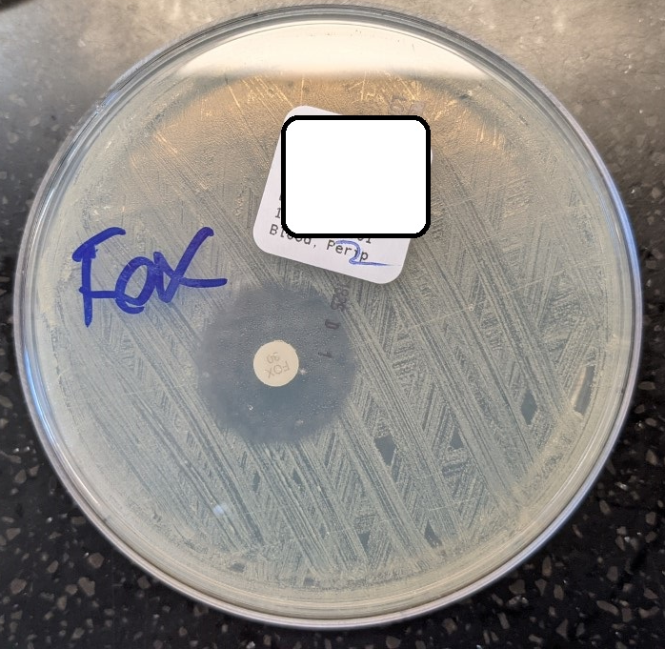
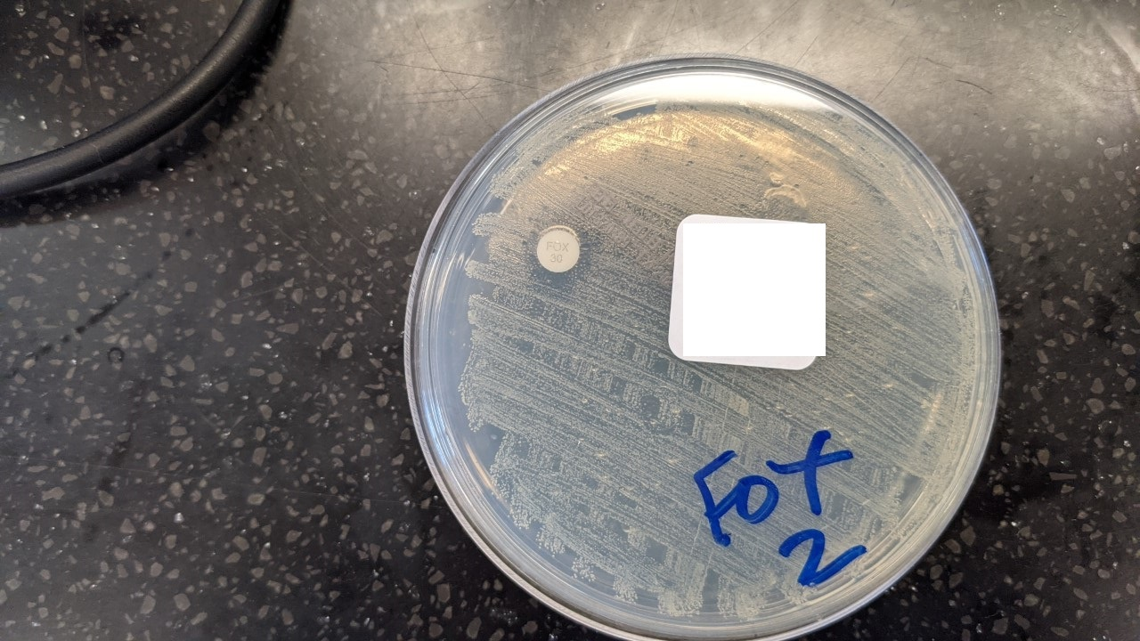
Cefoxitin disk diffusion (for mecA mediated resistance)
Assess for growth within zone of inhibition (against light)
Any discernable growth within zone of inhibition is indicative of resistance
MSSA
MRSA

Slide 23
PCR (detects mecA gene)
Work Flow in Micro Lab
Blood culture flags positive
↓
Gram stain GPC in clusters
↓
MALDI identifies S. aureus
↓
Cepheid MRSA assay/Cepheid Xpert from bottle to distinguish MRSA vs. MSSA
  *Pearl: only performed for first (+) Bcx, not performed on subsequent (+) S. aureus Bcx at our institution

Slide 24
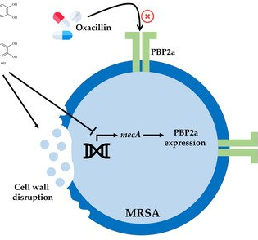
mecA gene
MRSA resistance to oxacillin/methicillin occurs due to mecA gene
  Encodes penicillin binding protein PBP2a which has low affinity for β-lactams ➝ resistance
Mechanism of oxacillin resistance other than mecA are rare
Heteroresistance: All cells in a culture may carry the genetic information (mecA) for resistance, but only a small number may express the resistance in vitro -> CLSI has recommendations about incubating isolates being tested against oxacillin

Slide 25
mecC gene
Reported in 2011 in S. aureus isolates obtained from Europe (cattle, humans)
Low homology (70% nucleotide identity) of mecC to mecA causes diagnostic challenges
mecC positive isolates detected as MRSA:
  Cefoxitin disk diffusion: 100% (superior marker for mecC harboring MRSA)
  Oxacillin broth microdilution: 61.3%

Slide 26
Case
42 yo M here for septic shock and high volume output from enterocutaneous fistula
Crohn’s colitis s/p subtotal colectomy with J pouch
C. difficile infection in 2014
Hx of SOB (2013) c/b enterocutaneous fistula
Klebsiella pneumoniae
Catalase (-)
gram stain performed
BCx inoculated onto agar

Slide 27
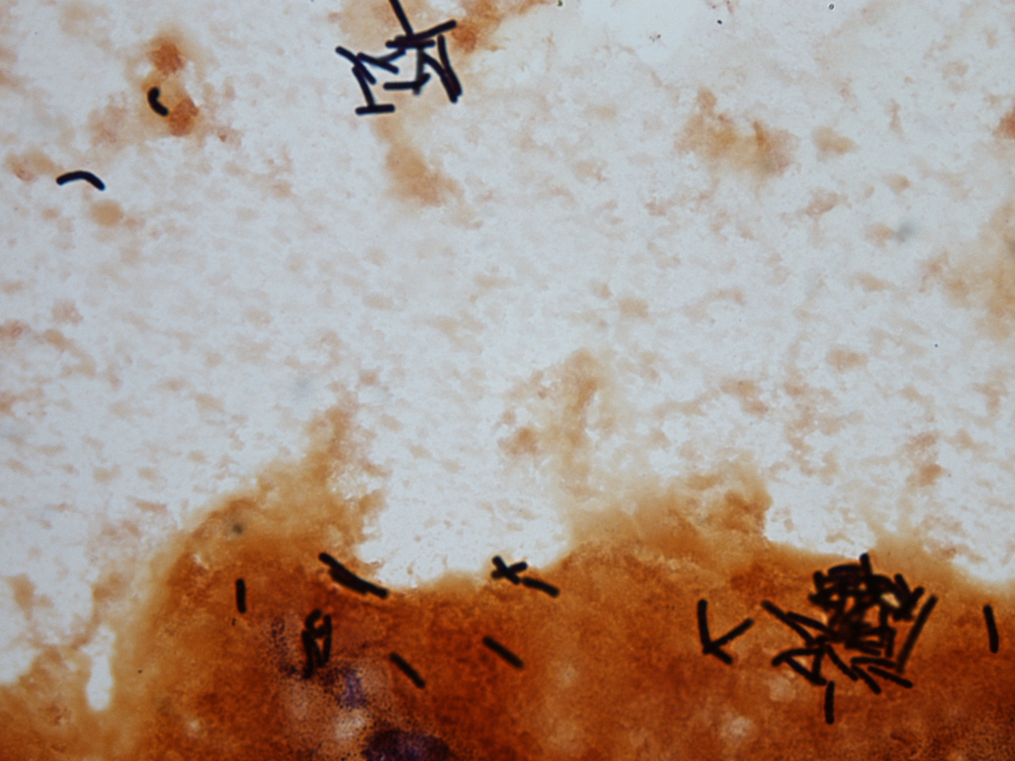
Describe gram stain
Gram positive or negative
Shape
(ie. boxy, coryneform, plump,
club shaped, curved, beaded,
branching)

Slide 28
Describe gram stain
Gram positive
Boxy with rounded ends

Slide 29
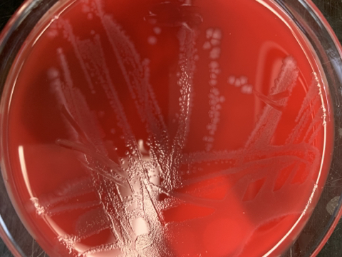
Describe growth on anaerobic agar

Slide 30
Circular colonies
Slightly embossed
White or gray
No hemolysis
Notes:
Colonies are 2-5 mm, circular, occasionally rhizoid, flat or low convex, opaque, grayish or whitish, and have a matt to glossy surface.
Nonhemolytic.
Fluorescence pale green
Odor horse stable

Slide 31
What is the organism?
a. Bacteroides fragilis
b. Actinomyces spp
c. Clostridioides difficile (formerly Clostridium difficile)
d. Cutibacterium (Proprionebacterium) acnes

Slide 32
What is the organism?
a. Bacteroides fragilis
b. Actinomyces spp
c. Clostridioides difficile (formerly Clostridium difficile)
d. Cutibacterium (Proprionebacterium) acnes

Slide 33
What is the organism?
a. Bacteroides fragilis
b. Actinomyces spp
c. Clostridioides difficile (formerly Clostridium difficile)
d. Cutibacterium (Proprionebacterium) acnes
gram negative
pleomorphic bacilli, rods or coccobacillus forms
catalase (+)

Slide 34
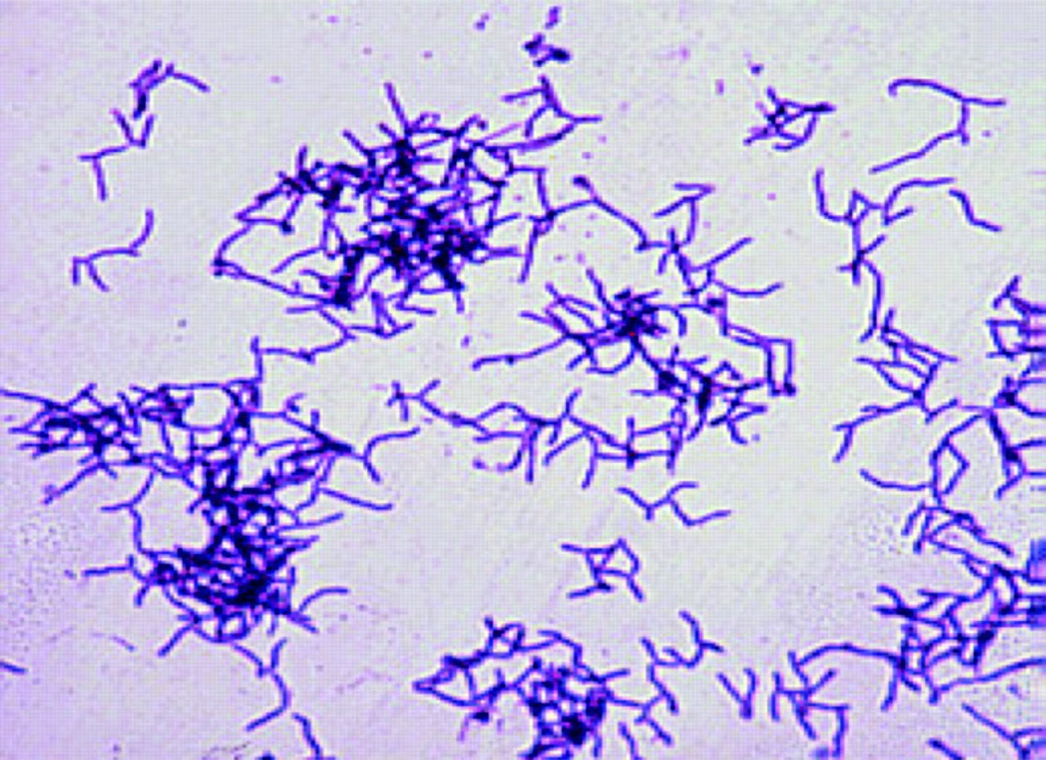
What is the organism?
a. Bacteroides fragilis
b. Actinomyces spp
c. Clostridioides difficile (formerly Clostridium difficile)
d. Cutibacterium (Proprionebacterium) acnes
filamentous gram positive rod, catalase (-)

Slide 35
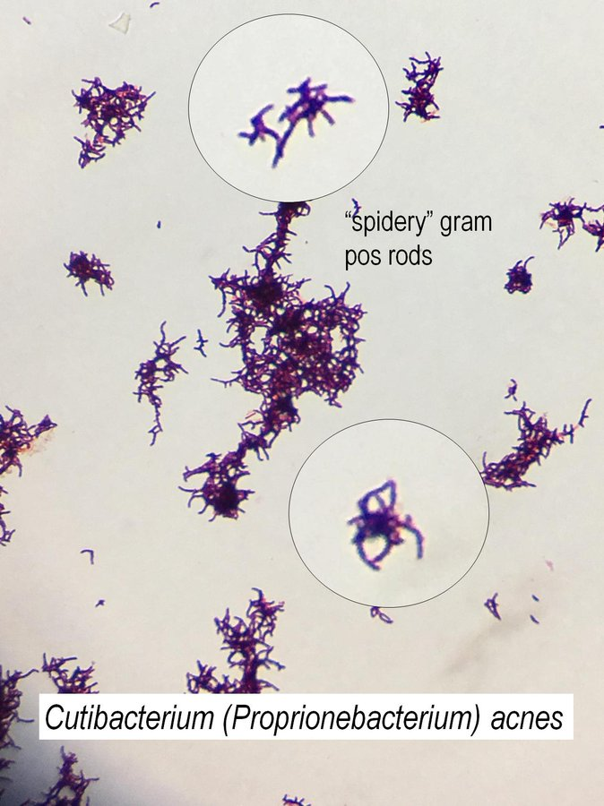
What is the organism?
a. Bacteroides fragilis
b. Actinomyces spp
c. Clostridioides difficile (formerly Clostridium difficile)
d. Cutibacterium (Proprionebacterium) acnes
gram positive
pleomorphic, branched, unbranched, coccoid, bifid, can appear singly, pairs, chains or clumps
catalase (+)

Slide 36
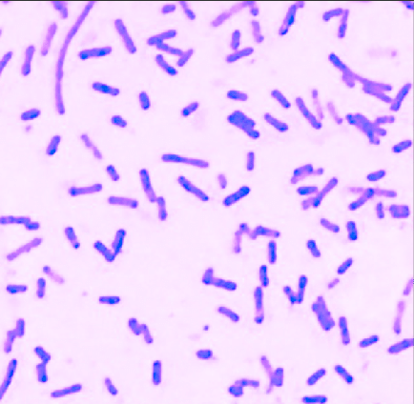
Clostridioides difficile (formerly Clostridium difficile)
Box car shaped with rounded ends, big gram positive bacilli/rods, catalase (-)
“Horse stable” smell
May have subterminal spores visible as oval, intracellular clear swellings
Ultraviolet irradiation shows yellow-green fluorescence of C. difficile in agar medium (not used routinely in lab)

Slide 37
Clostridioides difficile (formerly Clostridium difficile)
NAP1 (North American Pulsed Field type I): hypervirulent strain due to greater production of toxins A and B and other virulence factors. Fluoroquinolone use strongly correlated with NAP1 strain
Extracolonic C. difficile infection extremely rare. C. difficile bacteremia - 137 cases reported in the literature
  C. difficile bacteremia not systemically associated with documented diarrhea
  50% monobacteremia, 50% C. difficile + another pathogen
  Tx: metronidazole or vancomycin
Dofair et al 2017

Slide 38
Case
38 yo M w/ ITP (s/p splenectomy) here for CVA and thrombectomy evaluation
BCx: 2 sets on day 5
(+) by instrument
Thought to be a contaminant based on organism
BCx: 5/8 subsequent bottles grew this same organism (day 6 – 13)
Organism grew on blood agar, but not on MacConkey agar
Catalase (+)

Slide 39
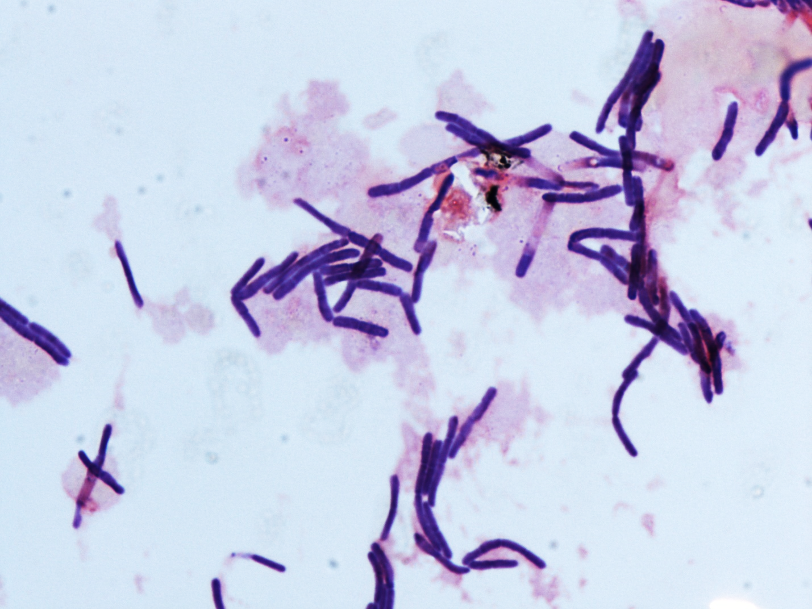
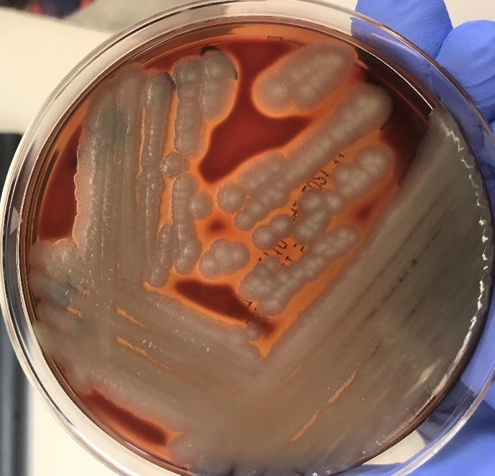
Describe gram stain
Describe colony growth on agar

Slide 40
Gram positive, boxy rods
Tend to occur in chains (bamboo appearance)
Beta hemolytic
Large, matte, opaque, whitish - cream

Slide 41
Gram positive, boxy rods
Tend to occur in chains (bamboo appearance)
Beta hemolytic
Large, matte, opaque, whitish - cream

Slide 42
Case
Catalase (+)
Gram positive, boxy rods
Colonies: beta hemolytic, large matte, opaque, whitish - cream
What is the organism originally thought to be a contaminant?
a. Listeria monocytogenes
b. Bacillus cereus
c. Rhodococcus equi
d. Staphylococccus aureus

Slide 43
Case
What is the organism originally thought to be a contaminant?
a. Listeria monocytogenes
b. Bacillus cereus
c. Rhodococcus equi
d. Staphylococccus aureus

Slide 44
Case
What is the organism originally thought to be a contaminant?
a. Listeria monocytogenes
b. Bacillus cereus
c. Rhodococcus equi
d. Staphylococccus aureus
Short, gram positive rods, can be coccobacillary
Filaments may occur
Catalase (+)

Slide 45
Case
What is the organism originally thought to be a contaminant?
a. Listeria monocytogenes
b. Bacillus cereus
c. Rhodococcus equi
d. Staphylococccus aureus
Gram positive, beaded to coccobacilli
Usually affects pts w/ impaired cellular immunity (chemo, HIV, SOT)
80% pneumonia (usually cavitary)

Slide 46
Case
What is the organism originally thought to be a contaminant?
a. Listeria monocytogenes
b. Bacillus cereus
c. Rhodococcus equi
d. Staphylococccus aureus
Not a contaminant
GPC clusters, beta hemolytic, yellow colonies
Notes:
agar.3). The isolate was inoculated onto motility media with an indicator and, after incubation, was observed to be motile (Figure 4). Final identification to the species level was done by MALDI-TOF.

Slide 47
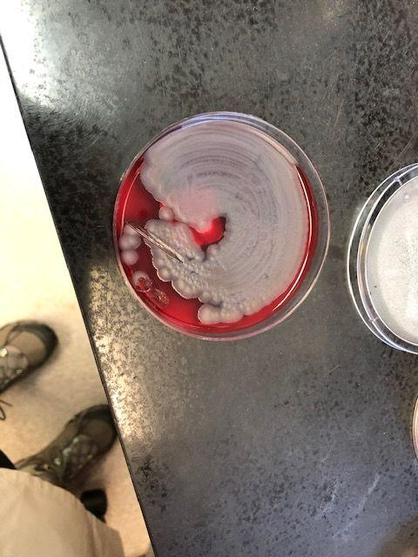
Bacillus cereus
Spore forming gram positive bacilli
Catalase (+)
Ubiquitous in soil, plants, foods
Accounts for 0.1 – 0.9% of all blood cultures submitted of which 5 – 10% of isolates represent clinically significant disease
Usually associated with CVC, IVDU, immunocompromised patients
Foodborne illness, bacteremia, endocarditis, endophthalmitis, pneumonia, meningitis, OM

Slide 48
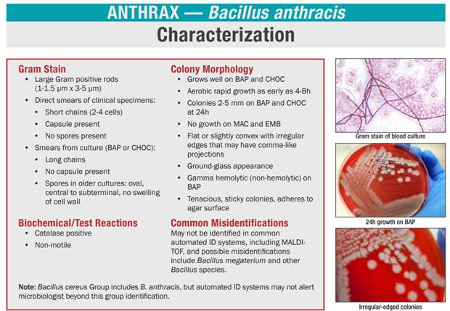
B. cereus vs B. anthracis
Notify lab for additional precautions
Potential bioterrorism agent

Slide 49
B. cereus vs B. anthracis
Notify lab for additional precautions
Potential bioterrorism agent
The lab should be notified about what other organism we’ve discussed in a prior session?

Slide 50
B. cereus vs B. anthracis
Notify lab for additional precautions
Potential bioterrorism agent
The lab should be notified about what other organism we’ve discussed in a prior session?
B. pseudomallei (potential bioterrorism agent)
Burkholderia capecia selective agar used to rule in/out B. pseudomallei

Slide 51
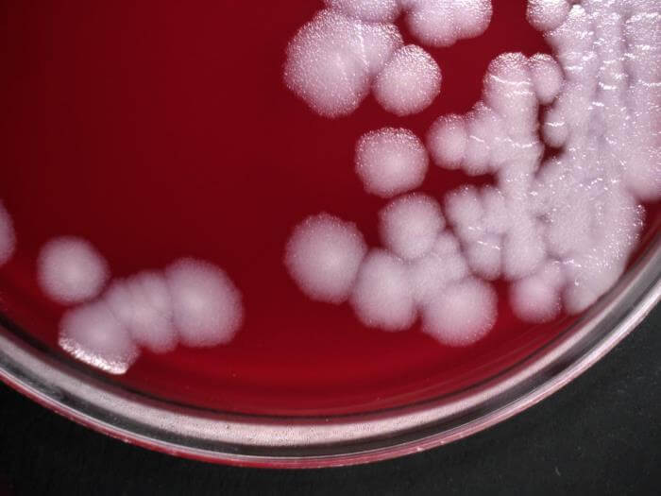
B. cereus vs B. anthracis
Hemolysis
B. cereus beta hemolytic
B. anthracis usually non-hemolytic after 24 h incubation
2. Motility test Inoculate motility medium by stabbing down the center with loopful of culture
B. cereus
B. anthracis

Slide 52
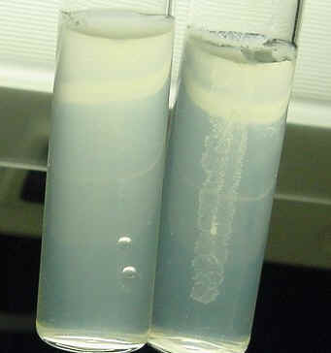
B. cereus vs B. anthracis
Hemolysis
B. cereus beta hemolytic
B. anthracis usually non-hemolytic after 24 h incubation
2. Motility test Inoculate motility medium by stabbing down the center with loopful of culture
B. cereus is motile → diffuse growth into medium away from stab
B. anthracis is non motile
→ growth in and only around stab

Slide 53
Gram Positive Bacilli
Bacilli
Large
Small or coccobacillary
Coryneform
Beaded
Branching, filamentous
Bacillus big, boxy, may have spores, catalase (+)
Clostridium big, boxy, may have spores, catalase (-)
Listeria short rods, may appear coccobacillary catalase (+)
Rhodococcus
beaded to solidly
staining coccobacilli
Erysipelothrix
slender or coccoid
rods OR
thin, filamentous
catalase (-)
Cutibacterium acnes catalase (+)
Corynebacterium catalase (-)
more to come…
more to come…
Notes:
beaded to solidly staining coccobacilli.

Slide 54
Take Home Points
MALDI-ToF mass spectrometry uses laser ionization and time of flight to identify microorganism by generating characteristic mass spectral fingerprints that can be compared to a library of mass spectra
D-test used assess for inducible resistance to clindamycin for S. aureus
To distinguish MSSA vs MRSA, use broth dilution, cefoxitin disk diffusion, or PCR methods
  MecA gene encodes PBP2 which confers β-lactam resistance to S. aureus
  PCR (Cepheid MRSA assay/Cepheid Xpert) can distinguish MRSA vs MSSA via detection of mecA gene only
  Clostridioides difficile and Bacillus spp are large, boxy gram positive, spore forming rods
  Distinguish B. cereus and B. anthracis using hemolysis and motility testing

