Slide 1
Micro Plate Rounds
Session 3

Slide 2
Agenda
Respiratory cultures/specialized media wrap – up
Biochemical tests
α and γ hemolytic gram (+) organisms
Blood cultures & blood cultures processing
Notes:
CF

Slide 3
Gram (-)s that do not grow on MacConkey agar…
MacConkey optimal for recovery of Enterobacterales
Not all gram negatives grow on MacConkey (fastidious, specific nutritional requirements)
Examples?

Slide 4
Gram (-)s that do not grow on MacConkey agar…
MacConkey optimal for recovery of Enterobacterales
Not all gram negatives grow on MacConkey (fastidious, specific nutritional requirements)
Examples…
Legionella spp
Chryseobacterium spp
Bordetella pertussis
Brucella spp
Pastuerella spp
HACEK organisms
Francisella tularensis
Campylobacter spp
Helicobacter pylori
Actinobacillus spp
Mycoplasma spp
Ureaplasma spp

Slide 5
Case
18 yo male w/ cystic fibrosis transferred from OSH for acute hypoxic respiratory failure
RCx:
4+ WBC, 3+ gram negative bacilli
Pseudomonas and normal flora
Febrile despite Cefepime for Pseudomonas coverage
What specialized testing could you request?

Slide 6
Burkholderia cepacia
GNB, oxidase (+)
Often grow slowly and poorly on conventional media
Can be overgrown by faster growing mucoid bacteria ubiquitous in the respiratory tract of CF pts
Burkholderia cepacia selective agar assists in isolation of B. cepacia
Notes:
B. cepacia is a slow grower and usually outgrown by the faster growing Escherichia coli , Staphylococcus aureus , and Pseudomonas aeruginosa
On BCSA medium Burkholderia cepacia colonies typically appear translucent and rough as greenishbrown with a yellowish halo or white with a yellowish-pink halo (phenol red color indicator).

Slide 7
Burkholderia cepacia
Burkholderia cepacia selective agar
Bile salts, crystal violet → inhibits gram (+)
Polymyxin B, gentamicin, ticarcillin → inhibit gram (-) of normal flora
Burkholderia cepacia appears
Translucent, rough
Greenish-brown w/ yellow halo OR white with yellowish-pink halo (phenol red color indicator)
B. pseudomallei and B. mallei also grow on this media. Agar used as part of rule in algorithm for B. pseudomallei
Notes:
On BCSA medium Burkholderia cepacia colonies typically appear translucent and rough as greenishbrown with a yellowish halo or white with a yellowish-pink halo (phenol red color indicator).

Slide 8
Biochemical Tests
*S. lugdunensis
tube: coagulase (-)
rapid slide agglutination: falsely (+) coagulase
* some strains produce bound coagulase (clumping factor) resulting in false (+) on slide coagulase test
Catalase | (-) Streptococcus (+) Staphylococcus
CAMP | (+) S. agalactiae (-) non S. agalactiae beta hemolytic Strep
Coagulase | (+) S. aureus (-) S. epidermidis, S. lugdunensis
Oxidase | (+) Pseudomonas, Burkholderia (-) Proteus, Shigella, Salmonella, Stenotrophomonas, Acinetobacter
Optochin
Bile solubility
6.5% NaCl
PYR
Indole

Slide 9
Gram Positives
Cocci
α hemolysis
β hemolysis
γ hemolysis
catalase (-)
catalase (+)
Group A, B, C, F, G Strep
S. aureus
CAMP (-)
CAMP (+)
Group A, C, F, G Strep
Group B Strep

Slide 10
Case
55 yo M from community presenting with 3 days of productive cough, shortness of breath and fevers​
​
T101, 93% on 2 L NC​
WBC 12.3​
​
RCx: ​
​

Slide 11
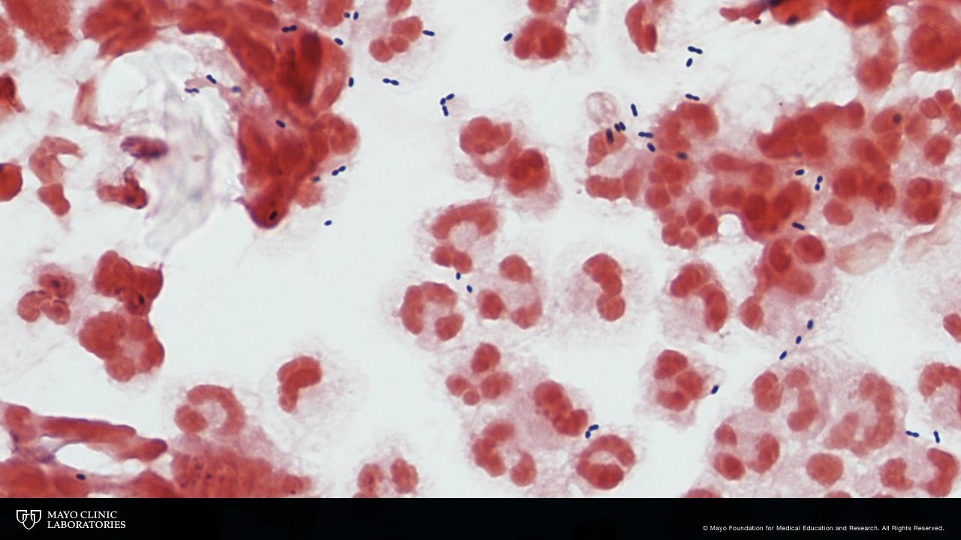
Case
Describe gram stain
Gram (+) or (-)
Shape
Additional characteristics?

Slide 12
Case
Gram positive cocci, pairs
Lancet shaped
Surrounding halo (represents capsule)

Slide 13
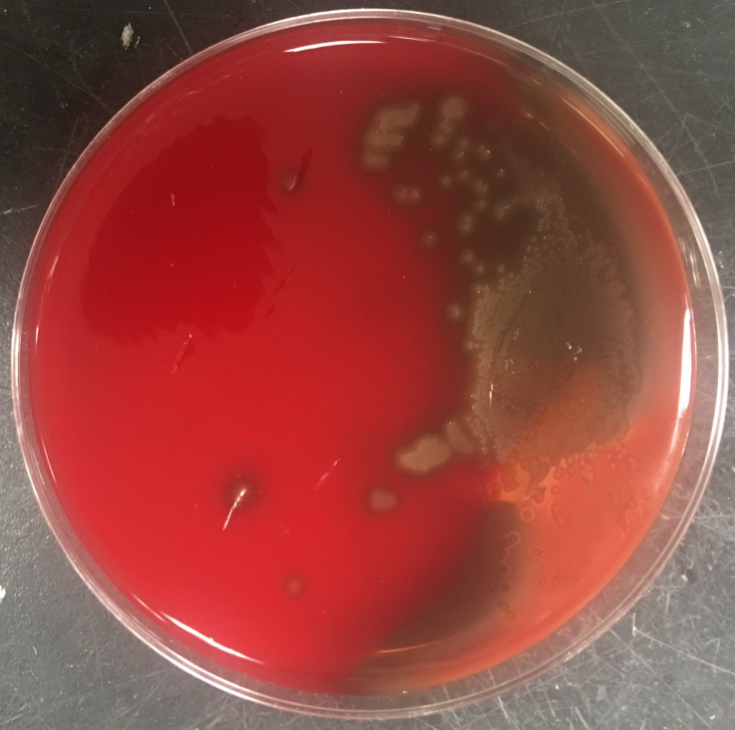
Case
Gram stain: Gram positive cocci, pair lancet shaped, surrounding halo
Describe growth on agar
Colony color
Hemolysis

Slide 14
Case
Gram stain: Gram positive diplococci, lancet shaped, surrounding halo
Grey colonies, α hemolysis
Organism?
What additional tests (biochemical or non biochemical) would be helpful?
Hint: Choose from the following biochemical tests
optochin, bile solubility, 6.5% NaCl, PYR, indole

Slide 15
Case
Gram positive diplococci, lancet shaped, surrounding halo
Grey colonies, alpha hemolysis
Organism? Streptococcus pneumoniae
Typical colony appearance: central indent from autolysis or mucoid appearing
What additional tests would be helpful?
Optochin
Bile solubility
Streptococcus pneumoniae urinary antigen

Slide 16
Optochin Test
Allows for presumptive identification of α-hemolytic S. pneumoniae from α-hemolytic S. viridans
Optochin (ethylhydrocupreine hydrochloride) impregnated disc on lawn of organism
Zone of ≥ 14 mm is considered susceptible
S. mitis
no zone of inhibition resistant to optochin
S. pneumoniae
zone ≥ 14 mm
susceptible to optochin

Slide 17
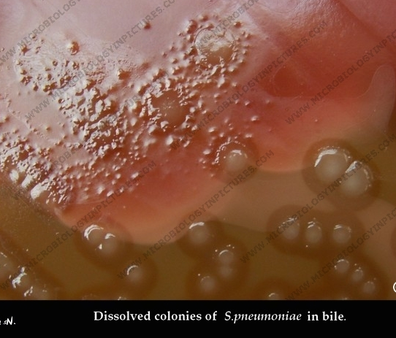
Bile Solubility
Optochin susceptibility is presumptive only
Some pneumococcal strains are optochin-resistant ∴ bile solubility testing
Bile (or solution of bile salt) rapidly lyses pneumococcal colonies
S. pneumoniae has presence of intracellular autolytic enzyme, amidase
S. mitis
Bile insoluble
No change in turbidity in bile salt solution
S. pneumoniae
Bile soluble
All turbidity in bile salt solution has cleared indicating cell lysis
Notes:
Optochin susceptibility is a presumptive test only. It is recommended that further biochemical tests be performed for complete identification.
A presumptive identification for S. pneumoniae can be made if the alpha-hemolytic colony produces a zone of inhibition of 14mm or greater around the disk. Organisms producing smaller zone sizes should be tested for bile solubility

Slide 18
S. pneumoniae antigen
FDA approved on urine and CSF specimens only
Detects C-polysaccharide of S. pneumoniae cell wall (present in all serotypes)
Improved detection is correlated with urine concentration
Notes:
Pneumococcal UAT detects S. pneumoniae C-polysacharide (a cell wall component) which is present in all serotypes
Use of the UAT improves diagnostic yield (i.e. increased the number of persons diagnosed with pneumococcal pneumonia) by 23-39%.3,4

Slide 19
S. pneumoniae urinary antigen
Gold standard: S pneumoniae culture
Sensitivity: 74% (Boulware et al 2007, Sinclair et al 2013)
False negatives: low level of urinary antigen
Specificity: 94% (Boulware et al 2007, Sinclair et al 2013)
S. pneumoniae vaccine (48 hrs, do not perform urine testing within 5 days of receiving vaccination)
C-polysaccharide also found in S. mitis and S. oralis
Persistence: months after pneumococcal disease (Andreo et al 2009)
35% pts positive 2 mos
17% pts positive 4 mos
6% pts positive 6 mos later
3 cases detected for > 1 year

Slide 20
Gram Positives
Cocci
α hemolysis
β hemolysis
γ hemolysis
Optochin sensitive
Bile soluble
Optochin resistant
Bile insoluble
catalase (-)
catalase (+)
Group A, B, C, F, G Strep
S. aureus
S. pneumoniae
S. viridans
CAMP (-)
CAMP (+)
Group A, C, F, G Strep
Group B Strep

Slide 21
Case
5 week old male born at 40 GW via normal delivery presented with decreased PO intake, fever, irritability x 1 day
Mother GBS pregnancy screening negative and had fever x 1 after giving birth
98.7ºF, BP 89/60, HR 163
WBC 16.1
CRP 6 mg/dL
CXR negative
13:18
Order placed for blood cx
13:45
Given antibiotics
Day 1
14:45
12:53
Pt presents to the ED
ED:
Should we still get BCx?
How many sets?
Timing of sets?

Slide 22
Blood cultures
What is the most important variable in recovering organism?
Volume of blood obtained for each blood culture
Number of individual sets sent
Ensuring adequate time between sets
Incubation time
Timing prior to antibiotic administration

Slide 23
Blood cultures: volume
Volume of blood obtained for each blood culture is the single most important variable in recovering microorganisms in patients with bloodstream infections (IDSA, 2018)
Bouza et al 2007
Even for automated continuous monitoring blood culture systems,
the higher volume obtained, the larger the # of BSI detected
yield of detection increased by 3.5% each mL of blood cultured

Slide 24
Blood cultures: volume
Volume of blood obtained for each blood culture is the single most important variable in recovering microorganisms in patients with bloodstream infections (IDSA, 2008)
Adults:
20 - 30 mL per culture (~10 cc each bottle)
2 – 3 sets used per septic episode (40 – 60 mL of blood total)
Pediatrics:
Volume of blood to collect based on weight of patient
Aerobic bottle (unless anaerobic infection suspected)

Slide 25
Blood cultures: sets & timing
Sensitivity of single BCx set is limited since bacteria/fungi may not be constantly present in bloodstream
Cumulative yield of pathogens from
1 BCx sets: 73.1%
2 BCx sets: 89.7%
3 BCx sets: 98.3%

Slide 26
Blood cultures: timing of sets
Timing of BCx dictated by clinical acuity
Time interval between collecting 2 blood culture samples is not considered a critical factor (diagnostic yield stays the same)
BCx at spaced intervals (1 – 2 hrs apart) recommended in those with suspected infective endocarditis or other endovascular infections

Slide 27
Blood cultures: incubation time
Current recommended, standard incubation period for routine BCx performed by continuous monitoring blood systems is 5 days
3 days may be adequate to recover > 97% of micro-organisms including HACEK (Bourbeau et al 2005)
Notable exceptions: P. acnes, Mycobacteria, dimorphic fungi
Notes:
97.4% of clinically significant isolates recovered within the first 3 days of incubation and 93.8% within 2 days of incubation

Slide 28
Blood cultures: abx administration
Rand et al, 2019
Retrospective; adult pts with BCx obtained in ED (n= 25,686. 6731 septic)
Rate of positive BCx reduced by >50% in septic (and non septic pts) by 2nd hour of IV abx treatment
Ongoing positivity: not explained by antibiotic resistant organisms
24.3%
22.6%
< 10%

Slide 29
Case
13:18
Order placed for blood cx
14:45
Blood cultures obtained
What identification system do we use in the lab?
12:53
Pt presents to the ED
13:45
Given antibiotics
17:45
BCx received in lab
Day 1

Slide 30
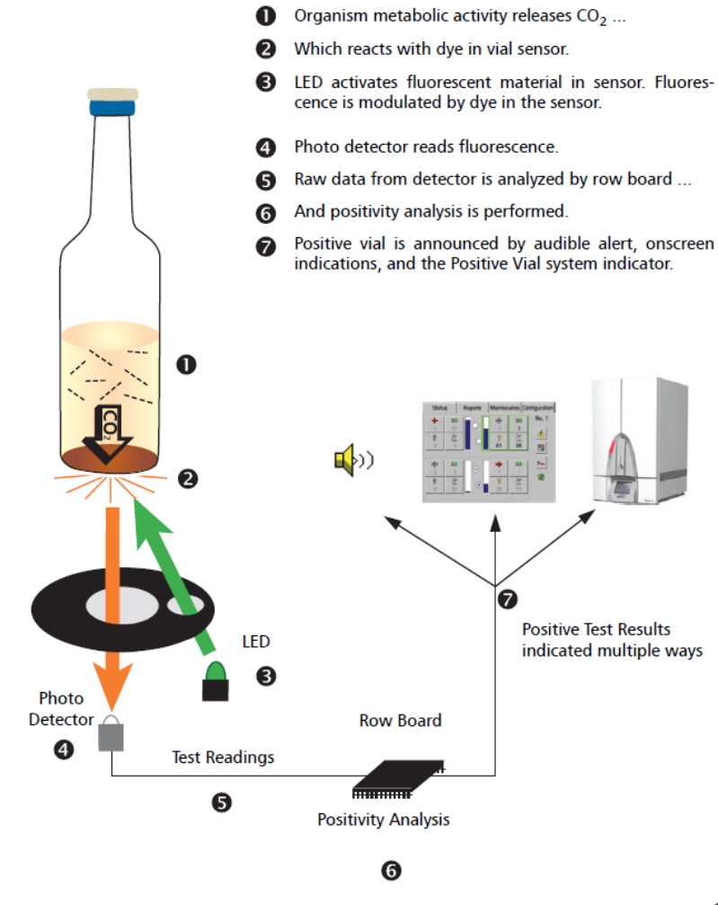
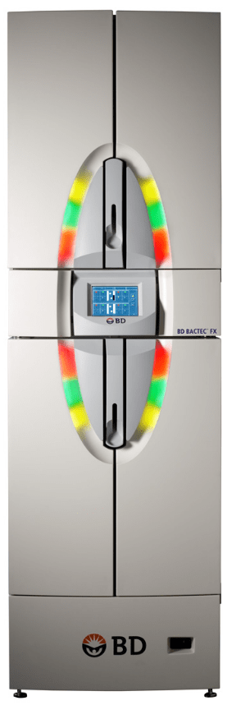
BACTEC
When organisms present, metabolize nutrients in culture media
Releases CO₂ into medium
Dye in sensor (which modulates fluorescence) at bottom of BCx reacts with CO₂
Photo detector measures level of fluorescence (corresponds to amount of CO₂ released by organisms)
False (+)s: high WBC

Slide 31
Case
13:18
Order placed for blood cx
14:45
blood cultures obtained
8 AM
BCx flags positive
Day 1
Day 2
gram stain performed
followed by media inoculation
12:53
Pt presents to the ED
13:45
Given antibiotics
17:45
BCx received in lab

Slide 32
Case
5 week old male presenting for neonatal sepsis
Describe gram stain
Gram (+) or (-)
Shape

Slide 33
Case
5 week old male presenting for neonatal sepsis
Describe gram stain
Gram (+) or (-)
Shape
Gram positive cocci in chains

Slide 34
Case
5 week old male presenting for neonatal sepsis
Gram positive cocci in chains
Describe colonies (color, hemolysis) on BAP

Slide 35
Case
(5 week old male presenting for neonatal sepsis)
Gram positive cocci in chains
Small white colonies, γ hemolytic
What additional biochemical tests would be helpful?
Catalase (-)
Hint: choose from the following biochemical tests
Optochin, bile solubility, 6.5% NaCl, PYR, indole

Slide 36
Case
5 week old male presenting for neonatal sepsis
Gram positive cocci in chains
Small white colonies
γ hemolytic
Catalase (-)
What additional biochemical tests would be helpful?
PYR
6.5% NaCl

Slide 37
PYR test
Detects ability of organism to produce L-pyrrolidonyl arylamidase enzyme​
Substrate PYR is hydrolyzed by L-pyrrolidonyl arylamidase enzyme
➝ bright pink, cherry red color​
Performed either via broth assay or rapid paper disk method​
PYR test (+) ​
Group A beta hemolytic Streptococci​
Enterococci​
PYR test (-)​
Other beta hemolytic Strep (non Group A)​
Group D streptococci (not enterococci) such as S. gallolyticus​
*Other PYR (+): E. coli; S. lugdunensis, haemolyticus, intermedius​

Slide 38
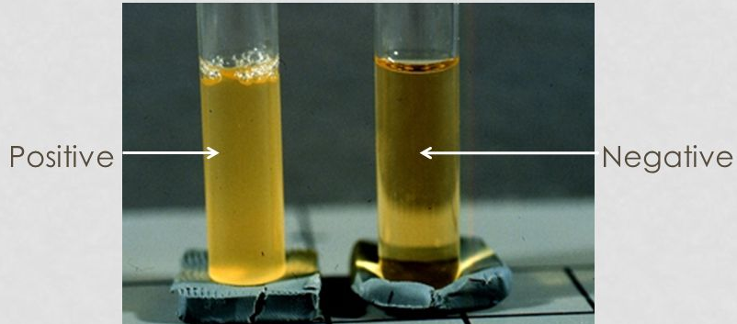
6.5% NaCl Test
A high salt concentration inhibits a range of bacteria but allows salt-tolerant organisms to grow​
​
Positive (salt tolerant)​
Enterococcus spp​
Aerococcus​​
​
​
Negative
Non enterococci​
Group D Streptococci (S. gallolyticus, lactis)​

Slide 39
Case
5 week old male presenting for neonatal sepsis
Gram positive cocci in chains
Small white colonies
γ hemolytic
6.5% NaCl (-)
PYR (-)
MALDI-TOF (next session) identified as…
PYR (-)
6.5% NaCl (-)

Slide 40
Case
5 week old male presenting for neonatal sepsis
Gram positive cocci in chains
Small white colonies
γ hemolytic
6.5% NaCl (-)
PYR (-)
MALDI-TOF identified as
PYR (-)
6.5% NaCl (-)

Slide 41
Gram Positives
Cocci
α hemolysis
β hemolysis
γ hemolysis
Optochin sensitive
Bile soluble
Optochin resistant
Bile insoluble
PYR (+)
Growth in 6.5% NaCl
PYR (-)
NO growth in 6.5% NaCl
catalase (-)
catalase (+)
Group A, B, C, F, G Strep
S. aureus
E. faecalis
E. faecium
S. pneumoniae
S. viridans
Non enterococcal Group D
S. gallolyticus
CAMP (-)
CAMP (+)
Group A, C, F, G Strep
Group B Strep
PYR (+)
PYR (-)
Group A Strep
Group C, F, G
Some Enterococcal spp are β – hemolytic
Anginosus Group Strep: α and/or β hemolytic

Slide 42
Take Home Points
BYCE agar is required for Legionella growth. Burkholderia capecia agar can assist in B. capecia recovery​
S. pneumoniae is alpha hemolytic, optochin sensitive, bile soluble​
PYR test identifies GAS and Enterococcus spp​
6.5% NaCl salt tolerance tests identifies Enterococcus spp (salt tolerant)​
Volume of blood obtained for each blood culture is the single most important variable in recovering microorganisms in patients with BSIs​
BACTEC system uses CO₂ detection to identify positive blood cultures

