Slide 1
Micro Plate Rounds
Session 2

Slide 2
Agenda
1. Throat cultures & pharyngitis
2. Respiratory specimens processing
3. Specialized media

Slide 3
Case
20 year old man with history of recurrent strep pharyngitis presents for sore throat for 1 day. He reports no cough or fevers.
Physical exam: tonsillar exudates, no anterior cervical lymphadenopathy
What diagnostic tests do you send?

Slide 4
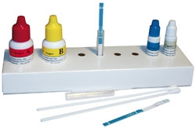
Rapid antigen detection test
Readily available, helps provide treatment at point of care
Detects Lancefield group A carbohydrate (GAS-specific cell wall antigen)
Enzyme lateral flow immunoassay
Optical immunoassay
Utility
Specificity: 95% compared to throat cultures
Sensitivity: 65% - 90% (higher for optical immunoassay)

Slide 5
Case
20 year old man with history of recurrent strep pharyngitis presents for sore throat for 1 day. He reports no cough or fevers.
Physical exam: tonsillar exudates, no anterior cervical lymphadenopathy
What diagnostic tests do you send?
Rapid antigen detection test (RADT): negative
Any further diagnostic testing?

Slide 6
Case
20 year old man with history of recurrent strep pharyngitis presents for sore throat for 1 day. He reports no cough or fevers.
Physical exam: tonsillar exudates, no anterior cervical lymphadenopathy
What diagnostic tests do you send?
Rapid antigen detection test (RADT): negative
Any further diagnostic testing? Due to low sensitivity rates of RADT,
If RADT (-), perform throat culture
FDA approved kits and children/adolescents require culture if RADT (-)

Slide 7
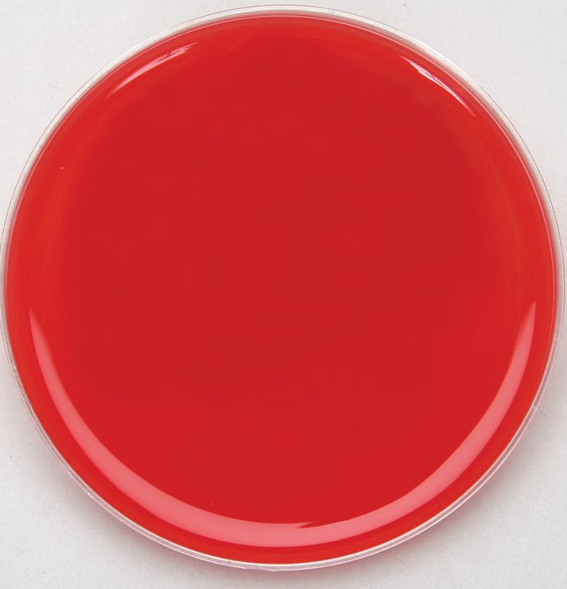
Throat Culture
Throat cultures performed on blood agar plate only
Medium supplemented with 5 – 10% sheep blood
Supports growth of some fastidious organisms
Limitations: 24 – 48 hrs required for accurate detection
What information do blood agar plates provide that would be helpful to this case?

Slide 8
Blood agar plate
Differential, non selective media
Differentiates bacteria based on hemolytic properties

Slide 9
Hemolysis
α-hemolysis | β-hemolysis | γ-hemolysis
Partially breaks down RBCs Leaves greenish color behind (presence of biliverdin) | β-hemolysin breaks down RBC and hemoglobin completely Leaves a clear zone around bacterial growth | No hemolysin production No RBC breakdown → no clearing
Examples? | Examples? | Examples?
Group A, B, C, F, G Strep Non Enterococcus Group D
Strep pneumoniae Strep viridans
S. aureus Staph epidermidis

Slide 10
Hemolysis
α-hemolysis | β-hemolysis | γ-hemolysis
Partially breaks down RBCs Leaves greenish color behind (presence of biliverdin) | β-hemolysin breaks down RBC and hemoglobin completely Leaves a clear zone around bacterial growth | No hemolysin production No RBC breakdown → no clearing
Strep pneumoniae Strep viridans | Group A, B, C, F, G Strep S. aureus | Non Enterococcus Group D (S. galloyticus, bovis) S. epidermidis

Slide 11
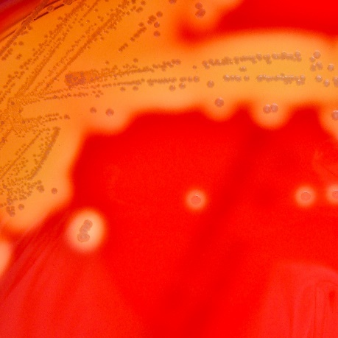
Throat culture…
Hemolysis?
Possible organisms?
How could you further identify?

Slide 12
Throat culture…
Hemolysis?
β-hemolysis
Possible organisms?
Group A, B, C, F, G Strep
Grey colonies
S. aureus
Less likely in this scenario
Yellow/white colonies
How could you further identify?
Catalase test
CAMP test
Streptex
PCR
Notes:
S. Aureus

Slide 13
Catalase test
Catalase Test
Tests for presence of catalase (enzyme that breaks down hydrogen peroxide into water and oxygen)
Positive
Negative
Notes:
separates staphylococci (positive) from streptococci and enterococci (negative)

Slide 14
Catalase test
Catalase Test
Tests for presence of catalase (enzyme that breaks down hydrogen peroxide into water and oxygen)
Positive
Negative
Staphylococci
Streptococci
Enterococci
Notes:
catalase-positive Micro
coccaceae and Staphylococcaceae from catalase-negative Streptococcaceae.
separates staphylococci (positive) from streptococci and enterococci (negative).
Staphylococcus aureus: Catalase positive.
Streptococcus pyogenes: Catalase-negative.

Slide 15
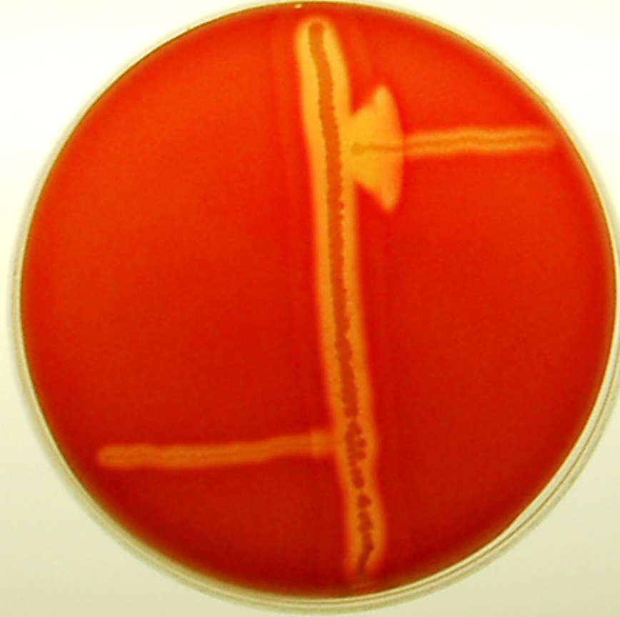
CAMP Test
Distinguishes S. agalactiae from other species of beta hemolytic Streptococcus based on formation of CAMP factor
1: streak of S. aureus
2: negative test (non S. agalactiae, beta hemolytic Strep)
3: positive test. S. agalactiae produces CAMP factor which synergistically interacts with beta-hemolysin produced by S. aureus resulting in arrowhead zone of enhanced lysis
*Listeria monocytogenes also produces a (+) CAMP reaction
1
3
2

Slide 16
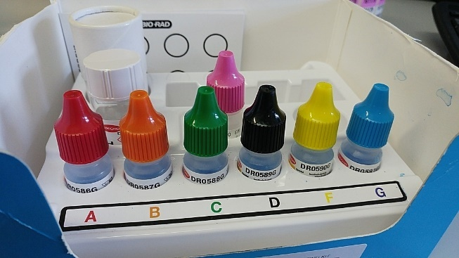
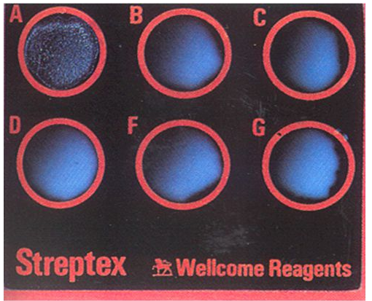
Streptex
Rapid latex test system
Identifies and differentiates Lancefield group of beta hemolytic Streptococci (A, B, C, D, F, and G)
Identify group specific antigens by precipitation reactions with group specific antibodies
Agglutinates: presence of homologous antigen
Smooth suspension: absence of homologous antigen

Slide 17
Throat culture…
Only Group A, C, G beta hemolytic Strep reported in throat culture
<page> culture result without susceptibilities. Need assistance.
How might you respond?
a) Email the micro lab to request susceptibilities
b) Susceptibilities will not be performed
c) Lab is probably working on susceptibilities already, wait 24 – 48 hrs
Notes:
Only Group A, C, and G streptococcus reported. Group A - antimicrobial treatment is only appropriate for these pathogens to decrease risk of sequelae
Role of Group C and G as causes of pharyngitis is controversial.

Slide 18
Throat culture…
Susceptibilities not routinely performed
Can be requested in those penicillin-allergic

Slide 19
Strep PCR
Has now replaced Streptococci throat cultures at our institution
Only identifies Group A Strep (C and G are of uncertain clinical significance and not associated with acute rheumatic fever and immune-mediated complications)
Does not require confirmatory testing
Notes:
Isolation of GCS or GGS in throat culture from a patient with pharyngitis of uncertain significance with the possible exception of a suspected outbreak

Slide 20
Other bacterial causes of pharyngitis
H. influenzae, S. aureus, N. meningitidis, and S. pneumoniae are not etiologic agents of acute pharyngitis and should not be identified or reported in throat cultures
Organisms that cause pharyngitis that may not routinely grow on BAP?

Slide 21
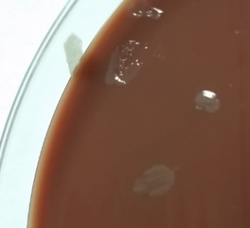
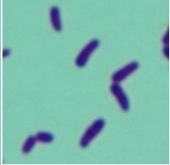
Other bacterial causes of pharyngitis
Arcanobacterium haemolyticum: facultative anaerobe (will grow on BAP but not all labs report it); a/w diffuse erythematous, sandpaper like blanching papules
Neisseria gonorrhea: NAAT, Thayer-Martin (chocolate agar with vancomycin, polymyxin, nystatin, trimethoprim)
C. diphtheriae: Loffler’s media, Tinsdale (tellurite) media
B. pertussis: PCR, Regan – Lowe media
Fusobacterium necrophorum
Notes:
Small opaque, grayish-white to colorless, raised, glistening and smooth colonie

Slide 22
Fusobacterium necrophorum
Describe gram stain

Slide 23
Fusobacterium necrophorum
Pleomorphic, long gram negative, bacilli
Vary from coccoid to long filaments
Filamentous forms: more common in broth cultures
Rod-like forms more frequently seen in older cultures or when grown on agar
Round or tapered ends
Most commonly associated with which syndrome?

Slide 24
Fusobacterium necrophorum
Associated with deep neck infections and Lemierre syndrome (septic thrombophlebitis internal jugular vein)
Pathogens that cause Lemierre’s syndrome
F. necrophorum (most commonly)
other Fusobacterium species
Streptococci (S. pyogenes, S. anginosus)
Bacteroides, Porphyromonas asaccharolytica, Eikenella corrodens
Rarely S. aureus

Slide 25
Fusobacterium necrophorum
Long filaments with round or tapered ends
Morphological differences from Fusobacterium necrophorum?

Slide 26
Fusobacterium necrophorum
Long filaments with round or tapered ends
Fusobacterium nucleatum
Fusiform rods or spindle shaped
Oral flora implicated in periodontal, head/neck, lower respiratory infections

Slide 27
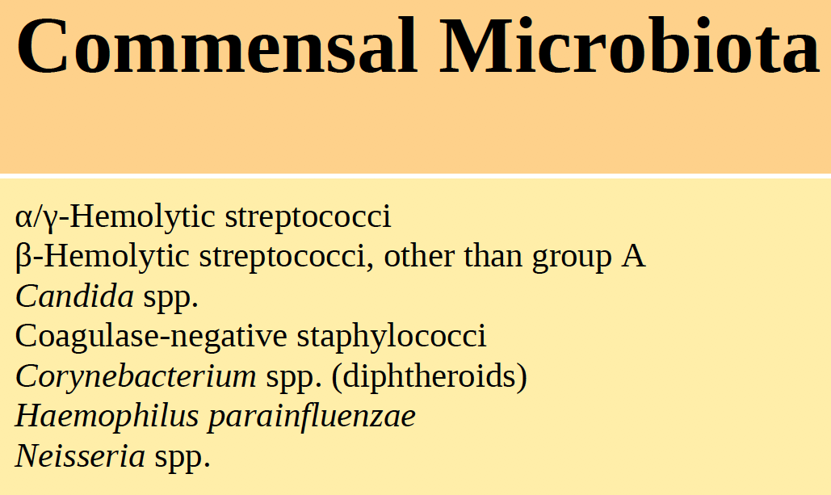
Lower Respiratory Cultures
Up to 40% of sputum samples may be incorrectly obtained
Gram stain performed to determine presence of
Squamous epithelial cells
Reject if ≥ 25 epithelial cells per low (10x objective power field)
WBC
BAL cultures: all organisms are identified
Identifying Enterococcus
Report only if > 90% pure culture present

Slide 28
Case
70 yo man presenting in August for 3 days of fevers, chills, fatigue and multiple episodes of diarrhea
Repairing his broken basement tub for the past week
Hospital roommate is his wife who is experiencing similar symptoms
T102.9, RR21, 94% on room air
WBC 12.7, Na 131
Respiratory culture:
Gram stain: no organisms, 2 + WBC
No growth on BAP, chocolate, or MacConkey
Next diagnostic testing?

Slide 29
Legionella Urinary Antigen
Detects Legionella pneumophila serogroup 1 antigen only
Serogroup 1 accounts for 71.5% of Legionella isolates in US adults per WHO
For serogroup 1, BinaxNow Legionella urinary antigen has sensitivity of 95% and specificity of 95% compared to culture
Can be detected as early as 1 day of symptoms
Can persist for > 42 – 61 days even despite resolution of symptoms and therapy (1 case report reported persistence for > 300 days)
Notes:
immunochromatographic membrane assay
Onset end duration of urinary antigen excretion in Legionnaires’ diseas

Slide 30
Case
Do you send a Legionella respiratory culture? If so, on what media?

Slide 31
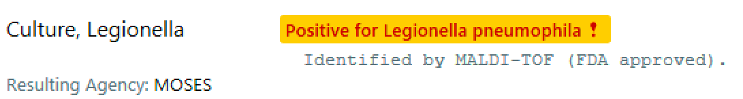
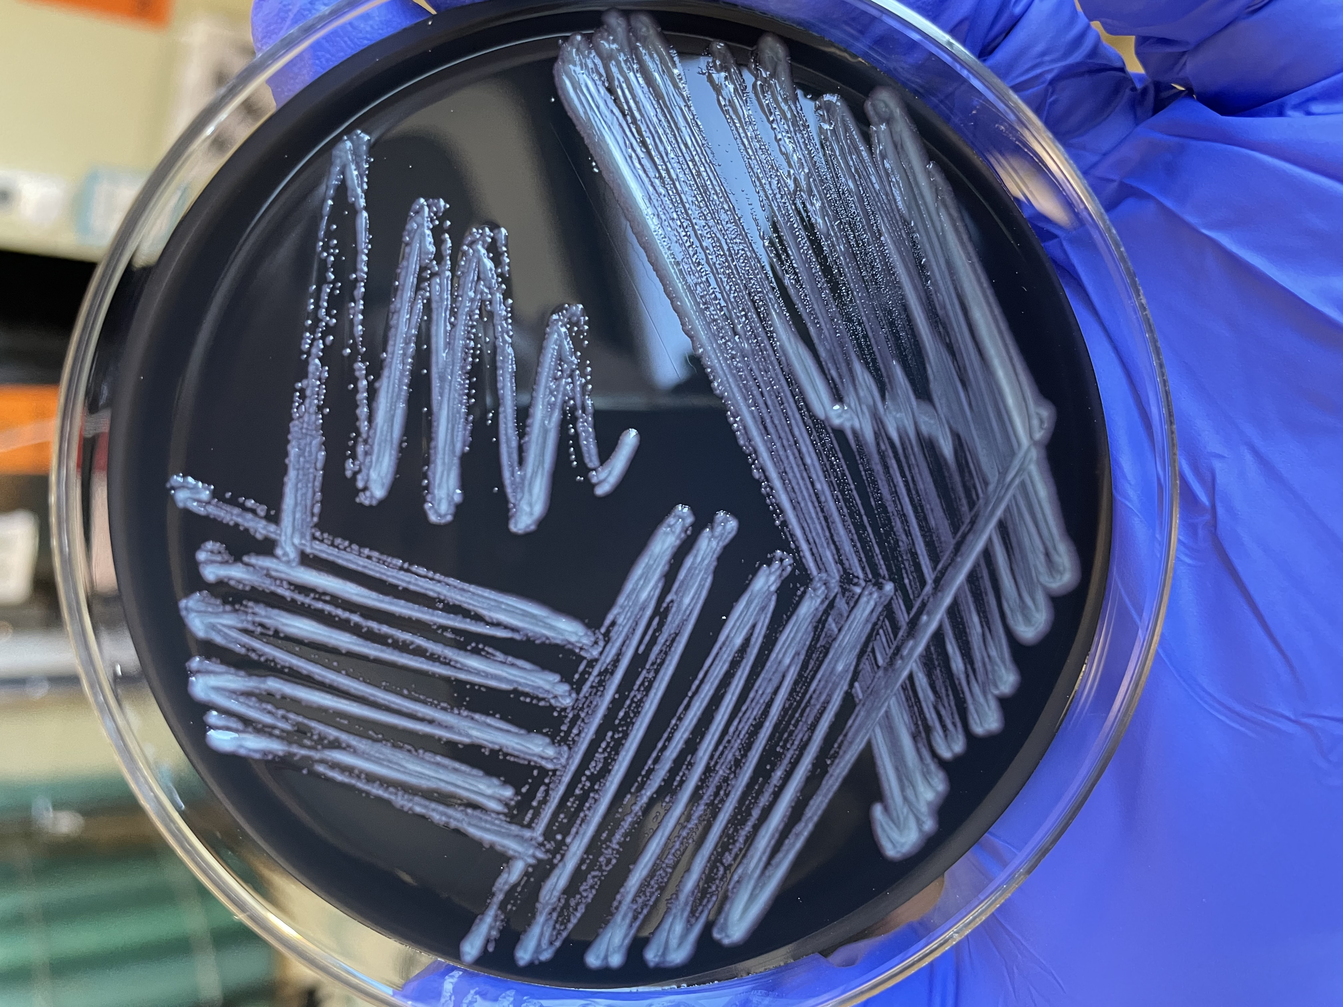
Legionella
Enrichment medium as Legionella requires L-cysteine and iron salts for growth
Contains:
L-cysteine
Ferric pyrophosphate
ACES buffer
Alpha-ketoglutaric acid
Activated charcoal
Agar may contain antibiotics (cephalothin, colistin, vancomycin, and cycloheximide)
Incubated 5-10% CO₂ at 35ºC x7 days
Buffered charcoal yeast extract agar (BCYE)
*Nocardia also grows on BCYE agar

Slide 32
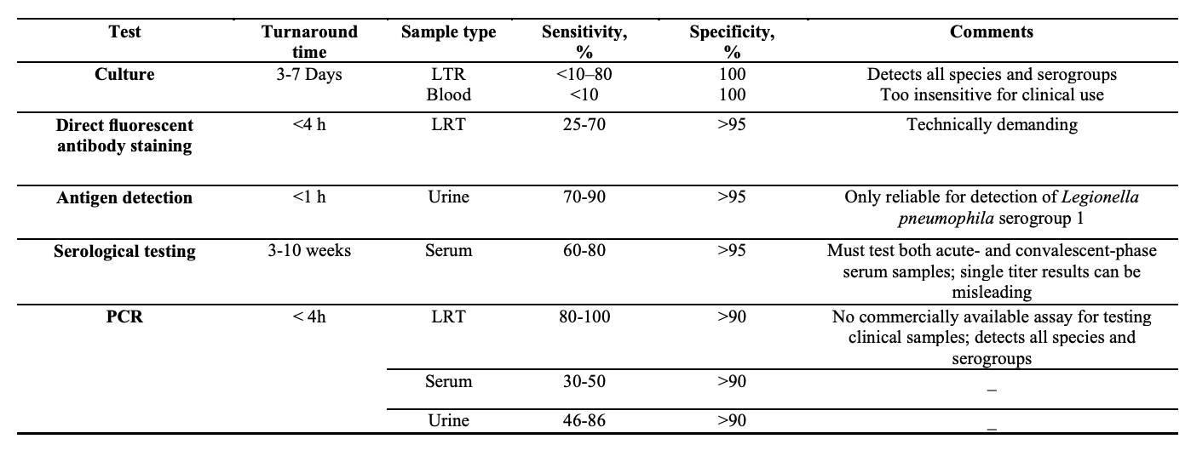
Comments on diagnostic methods
Frontiers in Science 2012 Aug; 1(4):72-85
Also, MALDI-TOF gives sensitivity >99% and specificity ~90%. (J Med Microbiol. 2010 Mar;59(Pt 3):273-284.)
Notes:
LRT: Lower respiratory tract
Also, MALDI-TOF gives sensitivity >99% and specificity ~90%. (J Med Microbiol. 2010 Mar;59(Pt 3):273-284.)
Available methods have great specificity in general, but sensitivity significantly varies. Urinary antigen is only reliable for legionella pneumophila serogroup 1 only, but gives sensitivity 70-90% with specificity >95%. Also very rapid turnaround. Culture is 100% specific, however low sensitivity, especially for blood.

Slide 33
Legionella culture
Request cultures even for patients with (+) urinary antigen
Establish potential causative association between cases and contaminated water sources
Molecular comparison of patient isolate and environmental isolates
Identify linked clusters of infection and potential environmental sources of infection
Susceptibilities are not performed in clinical settings
Broth or agar susceptibility results have no clinical correlates
Notes:
Visible Legionella colonies usually do not appear before day 3 of incubation

Slide 34
Gram (-)s that do not grow on MacConkey agar…
MacConkey optimal for recovery of Enterobacterales
Not all gram negatives grow on MacConkey (fastidious, specific nutritional requirements)
Examples…
Legionella

Slide 35
Gram (-)s that do not grow on MacConkey agar…
MacConkey optimal for recovery of Enterobacterales
Not all gram negatives grow on MacConkey (fastidious, specific nutritional requirements)
Examples…
Legionella
Chyrseobacterium spp
B. pertussis
Brucella
Pastuerella
Haemophilus
Francisella
Kingella
Campylobacter
Helicobacter
Actinobacillus

Slide 36
Case
18 yo male w/ cystic fibrosis transferred from OSH for acute hypoxic respiratory failure
RCx: 4+ WBC, Pseudomonas and normal flora
Febrile despite Cefepime for Pseudomonas coverage
What specialized testing could you request?
Notes:
Test as sputum culture, ensuring to identify Burkholderia cepacia when present. Burkholderia(Pseudomonas)cepacia agar contains bile salts and crystal violet, which inhibits Gram- positive bacteria and polymyxin B and ticarcillin to inhibit most Gram-negative organisms that comprise the normal flora. B. cepacia utilizes the pyruvate and produces alkaline products
that turns the media bright pink to red

Slide 37
Burkholderia cepacia
Often grow slowly and poorly on conventional media
Can be overgrown by faster growing mucoid bacteria ubiquitous in the respiratory tract of CF pts
Burkholderia cepacia selective agar
Bile salts, crystal violet → inhibits gram (+)s
Polymyxin B, gentamicin, ticarcillin → inhibit gram (-) of normal flora
Burkholderia cepacia appears
Translucent, rough
Greenish-brown w/ yellow halo OR
White with yellowish-pink halo (phenol red color indicator)
Notes:
. B. cepacia is a slow grower and usually outgrown by the faster growing Escherichia coli , Staphylococcus aureus , and Pseudomonas aeruginosa
On BCSA medium Burkholderia cepacia colonies typically appear translucent and rough as greenishbrown with a yellowish halo or white with a yellowish-pink halo (phenol red color indicator).

Slide 38
Summary
Several diagnostic tests for streptococcal pharyngitis: rapid antigen detection test, culture, PCR
Streptococcal species are catalase negative. Staphyloccoccal species are catalase positive
Blood agar plates differentiate bacteria based on hemolytic properties
CAMP test differentiates S. agalactiae from other beta hemolytic Streptococci
Fusobacterium necrophorum and nucleatum are clinically important anaerobes implicated in head/neck infections but have distinct morphological differences
Legionella cultures are useful to identify linked infections and environmental sources of infection
Specialized media is required for identification and growth of Legionella (BCYE agar). Specialized media can assist in recovery of Burkholderia cepacia (BC agar)

