Slide 1
Micro Plate Rounds
Mycology
Session 13

Slide 2
QuantiFERON
≥ 0.35 IU/Ml cut-off established by manufacturer to give “best” combination of sensitivity and specificity based on ROC curve analysis (population derived cut-off)
Small changes in level of response may be expected on individual level (inherent variability of test, lab artifact, variability of individual immune response over time)
If serial testing is discordant, dx/tx dependent on clinical & historical information
Depending on prevalence & risk of MTB screening situation, different cut – offs may be used to optimize sensitivity or specificity
Harada, 2008

Slide 3
Comprehensive Review of Infectious Diseases, 2020

Slide 4
Poll #1
Although actual tissue, aspirates, and fluids are specimens of choice over swabs, which specimen containers/devices can be used for each of the following cultures?
 | Eswabs | Sterile Cup
Aerobic culture
Anaerobic culture
AFB culture
Fungal culture

Slide 5
Poll #1
Although actual tissue, aspirates, and fluids are specimens of choice over swabs, which specimen containers/devices can be used for each of the following cultures?
 | Eswabs | Sterile Cup
Aerobic culture | Yes
Anaerobic culture
AFB culture
Fungal culture

Slide 6
Poll #1
Although actual tissue, aspirates, and fluids are specimens of choice over swabs, which specimen containers/devices can be used for each of the following cultures?
 | Eswabs | Sterile Cup
Aerobic culture | Yes | Yes
Anaerobic culture
AFB culture
Fungal culture

Slide 7
Poll #1
Although actual tissue, aspirates, and fluids are specimens of choice over swabs, which specimen containers/devices can be used for each of the following cultures?
 | Eswabs | Sterile Cup
Aerobic culture | Yes | Yes
Anaerobic culture | Yes
AFB culture
Fungal culture

Slide 8
Poll #1
Although actual tissue, aspirates, and fluids are specimens of choice over swabs, which specimen containers/devices can be used for each of the following cultures?
 | Eswabs | Sterile Cup
Aerobic culture | Yes | Yes
Anaerobic culture | Yes | No
AFB culture
Fungal culture

Slide 9
Poll #1
Although actual tissue, aspirates, and fluids are specimens of choice over swabs, which specimen containers/devices can be used for each of the following cultures?
 | Eswabs | Sterile Cup
Aerobic culture | Yes | Yes
Anaerobic culture | Yes | No
AFB culture | No
Fungal culture

Slide 10
Poll #1
Although actual tissue, aspirates, and fluids are specimens of choice over swabs, which specimen containers/devices can be used for each of the following cultures?
 | Eswabs | Sterile Cup
Aerobic culture | Yes | Yes
Anaerobic culture | Yes | No
AFB culture | No | Yes
Fungal culture

Slide 11
Poll #1
Although actual tissue, aspirates, and fluids are specimens of choice over swabs, which specimen containers/devices can be used for each of the following cultures?
 | Eswabs | Sterile Cup
Aerobic culture | Yes | Yes
Anaerobic culture | Yes | No
AFB culture | No | Yes
Fungal culture | No

Slide 12
Poll #1
Although actual tissue, aspirates, and fluids are specimens of choice over swabs, which specimen containers/devices can be used for each of the following cultures?
 | Eswabs | Sterile Cup
Aerobic culture | Yes | Yes
Anaerobic culture | Yes | No
AFB culture | No | Yes
Fungal culture | No* | Yes
Can share sterile cup if needed
≥ 10 mL of fluid preferred for fungal/AFB culture (2 mL for CSF)
Notes:
One piece of tissue/swab in one Eswab container can be submitted for both aerobic and anaerobic cultures

Slide 13
Specimen Collection
Biopsy, aspirate, currettings from advancing border of lesion are essential to demonstrate invasive fungal disease
Use swabs only for superficial skin or mucous membranes infections

Slide 14
Specimen Processing
1. Process promptly – within 2 hours of collection
If unable to process promptly, refrigerate
Exceptions:
Bone marrow → room temp
Blood cultures → room temp
Mucorales or Dermatophytes suspected → room temp
Fungal tissue cultures are minced, rather than grinded
Zygomycetes have few septations → grinding between septations can kill pieces of hyphae

Slide 15
Specimen Processing
1. Process promptly – within 2 hours of collection
2. Direct Smear
Visualization of fungal elements to give early evidence of fungal infection [e.g. size of yeast, type of budding, hyphae (pseudo, true, septations, pigment)]
Can guide selection of appropriate media or growth conditions
Limitations:
Does not rule out fungal infections (culture must be done)
Many fungi have similar appearances on direct mounts
Blood or bone marrow → no direct mount done. Collected in yellow top tube with SPS, transferred to Myco-F bottles, incubated in BacTec

Slide 16
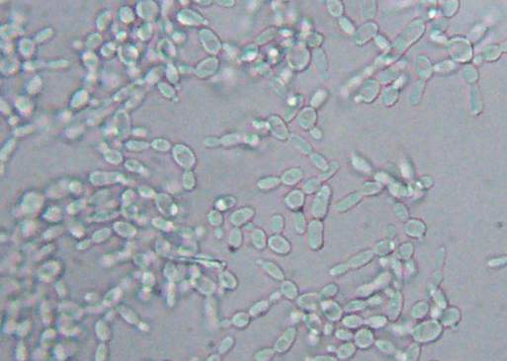
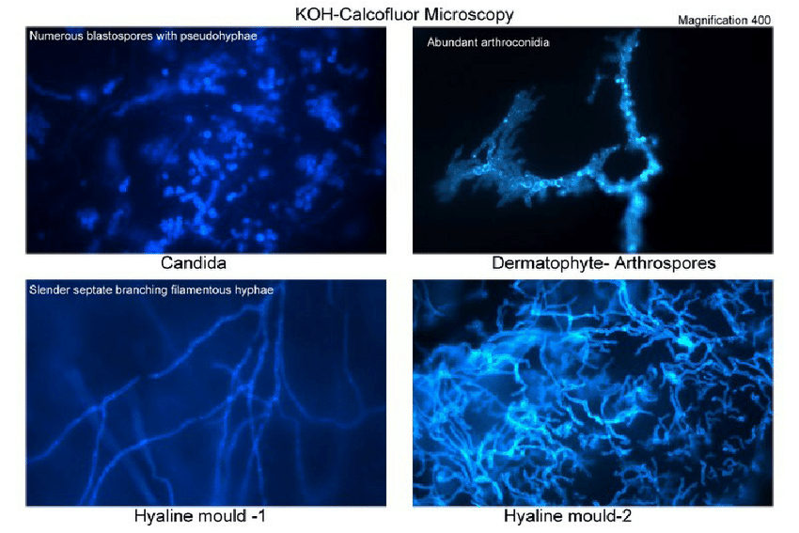
Direct Smear
Wet Mount, KOH-Calcofluor
KOH:
Softens, digests, and clears surrounding tissue to make fungal elements more visible
Calcofluor White:
Binds to cellulose and chitin → fluoresces when exposed to UV light
Bacteria may fluoresce to a lesser degree; presence of fungi should be determined based on morphology

Slide 17
Poll #2
*Note - At MMC, no KOH-calcofluor performed on skin, hair, nail cultures
Specimens directly inoculated into Mycosel culture bottles by providers
A KOH direct examination of skin scrapings from torso lesions reveals short curved hyphal elements along with round yeast cells in compacted clusters. After visualization of these fungal elements, the Micro Lab will…
A. Add an overlay of olive oil to agar
B. Perform a germ tube test
Use Sabouraud Heart Infusion Agar with blood
as culture media

Slide 18
Poll #2
A KOH direct examination of skin scrapings from torso lesions reveals short curved hyphal elements along with round yeast cells in compacted clusters. After visualization of these fungal elements, the Micro Lab will…
A. Add an overlay of olive oil to agar
B. Perform a germ tube test
Use Sabouraud Heart Infusion Agar with blood
as culture media
Notes:
Blood cultures usually negative in absence of lipid-enriched media – communicate clinical suspicion with the micro lab

Slide 19
Malassezia furfur
“Spaghetti and meatball appearance”
Lipophilic dimorphic fungi
Cannot synthesize medium-long chain fatty acids, requires exogenous supply for growth
Tend to colonize oily areas of skin
Contaminates parenteral lipids
Communicate with lab if suspected. Isolation requires media enriched with fatty acids (olive oil or tween to Sabouraud dextrose agar or Dixon’s media)
Clinical:
Pityriasis versicolor, folliculitis
Systemic disease. RF: preterm neonates, CVC, parenteral lipids, immunocompromised

Slide 20
Specimen Processing
1. Process promptly – within 2 hours of collection
2. Direct Smear
3. Media Inoculation and Incubation

Slide 21
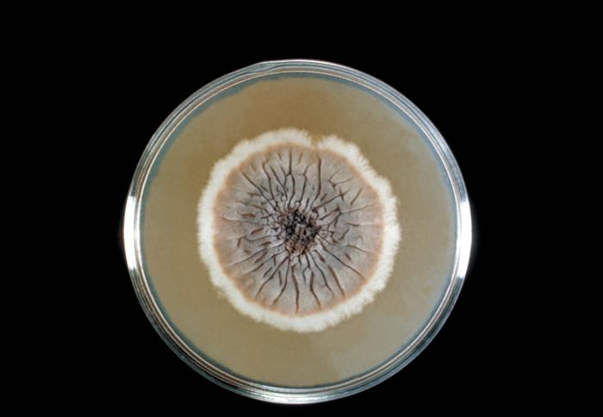
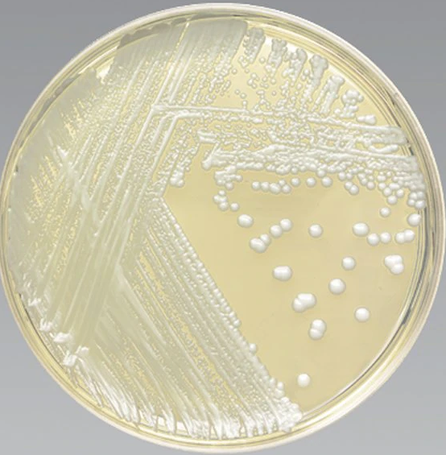
Culture Media
Sabouraud dextrose agar (SAB), Inhibitory Mold Agar (IMA), Sabouraud Heart Infusion Agar (SABHI), Mycosel/Mycobiotic agar (MYCO), among others…
Each culture media has advantages and disadvantages
Media selection for inoculation is based on specimen type, identifying characteristics on direct mount, and clinically suspected fungi/mold
Sporothrix schenckii on SAB
Mycosel/Mycobiotic agar

Slide 22
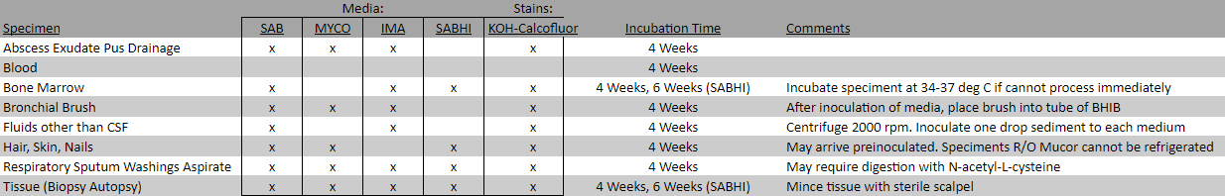
Incubation
Incubated at 28 – 30ºC for 4 weeks
Examined twice weekly for new growth
To ensure selection of optimal media and incubation conditions, notify lab if particular agent is suspected
Mucormycosis: Processed stat. Temperature sensitive and does not survive refrigeration
Dimorphic fungi: SABHI media used. If Histoplasma suspected, BM and liver biopsies are held for 6 rather than 4 weeks

Slide 23
Specimen Processing
1. Process promptly – within 2 hours of collection
2. Direct Smear
3. Media Inoculation and Incubation
If growth, additional identification methods can be used based on appearance on lactophenol blue, gross colony morphology and growth rate
Yeast → MALDI-ToF, BD-Phoenix
Mold → manual morphologic ID
4. Identification

Slide 24
Lactophenol Cotton Blue (LPCB)
Used once fungal colonies are growing in culture
Helps identify morphologic structures and characteristics
No role in tissue staining
Cotton blue: Stains chitin on fungal wall
Lactic acid: preserves fungal structures
Phenol: kills any organisms suspended in the stain
Microscopical appearance of Histoplasma capsulatum microconidia and macroconidia on LPCB stain

Slide 25
Poll #3
The Micro Lab will not routinely identify non-albicans Candida in culture to the species level if the specimen type is a…
BAL specimen
B. Urine specimen
C. Tissue specimen
D. Blood culture

Slide 26
Poll #3
The Micro Lab will not routinely identify non-albicans Candida in culture to the species level if the specimen type is a…
BAL specimen
Urine specimen
C. Tissue specimen
D. Blood culture
For non sterile sites (urine, sputum/tracheal, wound, genital),
ID of C. albicans
ID of other non C. albicans only performed upon request
*Urine SOP applies (e.g. CFU/mL of organisms, # of organisms, urine specimen type)

Slide 27
Poll #4
In addition to MALDI-ToF and BD-Phoenix, all of the following methods can help distinguish among Candida species except:
A. Urea hydrolysis test
B. Germ tube test
C. Rice tween agar
D. CHROMagar Candida
E. Candida albicans screen test

Slide 28
Poll #4
In addition to MALDI-ToF and BD-Phoenix, all of the following methods can help distinguish among Candida species except:
A. Urea hydrolysis test
B. Germ tube test
C. Rice tween agar
D. CHROMagar Candida
E. Candida albicans screen test
Rapid screening test for Cryptococcus in respiratory specimens
Performed when Cryptococcus, Rhodotorula, Trichosporon species are suspected
Cryptococcus and Rhodotorula are urease positive
Trichosporon has both positive and negative species

Slide 29
Germ Tube Test
Screening test for presumptive identification of C. albicans
Colony + reagent/serum for germ tube testing → incubated → wet mount
(+) Germ Tube Test | (-) Germ Tube Test
Short, slender, tube like structures arising laterally from yeast cell with NO constriction at point of origin | No hyphal extension arising from a yeast cell or a short hyphal extension with constriction at the point of origin
C. albicans [up to 5% clinical isolates germ tube (-)] C. dubliniensis | All other Candida spp C. tropicalis can produce pseudohyphae that closely resemble germ tubes
Notes:
Minimum of 4 germ tubes should be observed before calling an organism positive
Growth at 45oC separates C. albicans from C. dubliniensis

Slide 30
Rice Tween Agar
Morphology of yeast on Rice-Tween 80 Agar is a key characteristic used in yeast identification
Media enhances formation of hyphae and helps differentiation of yeasts, especially C. albicans, on the basis of chlamydospore formation
C. albicans produces chlamydospores (terminal, round, thick walled) on corn meal/rice agar at 25ºC
C. dubliniensis also produces chlamydospores, but often multiple
Notes:
If pseudohyphae and blastoconidia are present, a presumptive identification of Candida species can be made. The different patterns of growth in the cornmeal agar preparations are often sufficiently distinctive to establish presumptive species identification.
Chlamydospores are large terminal vesicles at the end of pseudohyphae

Slide 31
CHROMagar
Selective and differential medium for the following Candida spp and C. auris
Other yeast species may develop either cream, or appear rose or light – dark mauve. For these, additional identification methods are needed
C. albicans Green - blue | C. krusei Pink with whitish border, fuzzy | C. tropicalis Metallic blue with pink halo | C. glabrata Mauve colonies*
Notes:
Colonies of C. albicans, C. tropicalis, and C. krusei produce different colors, allowing for direct detection on agar plate

Slide 32
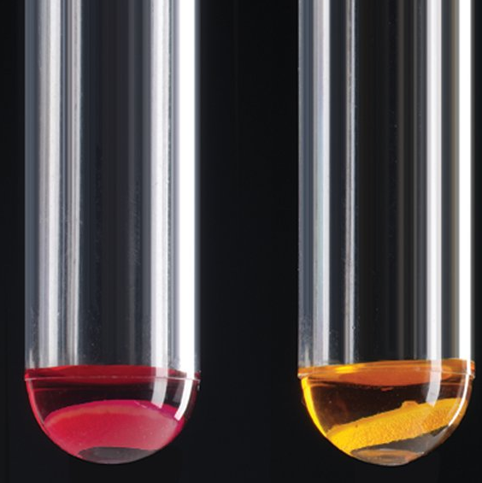
C. albicans screen test
Identifies C. albicans by detection of enzymes L-proline aminopeptidase and B-galactosaminidase
C. albicans is positive for both enzymes, unlike other yeast species (except C. dubliniensis)
Presence of
L-proline aminopeptidase → pink-red
Presence of
B-galactosaminidase → yellow
Notes:
Substrate for enzyme B-galactosaminidase on disc:
Positive: Yellow color
Negative: No yellow color
Substrate for enzyme L-proline aminopeptidase on disc:
Positive: pink – red color
Negative: no color change or slight yellow color

Slide 33
Poll #5
24 year old man with HIV (CD4 55%/497, VL 28), Crohn’s disease complicated by perianal abscesses/fistulas on adalimumab. He was admitted for gastro-colonic fistula, inflammatory stricture of transverse colon causing obstruction and transverse colon intramural abscess and underwent ex-lap with right hemi-colectomy and gastric-colonic fistula take-down.
One week later he develops new fevers and leukocytosis. CT scan shows pneumoperitoneum concerning for leak, but repeat ex-lap notable for no perforation. He has a RUE PICC line that was placed 10 days ago. and is receiving enteral feeds through a G-J tube.
Bacterial blood cultures are positive by instrument after 20 hours of incubation

Slide 34
Poll #5
Growth on Sabouraud agar
White, creamy, shiny Wrinkled or smooth colonies
Gram Stain (bacterial blood cultures)
Yeast forms with pseudohyphae
Pseudohyphae
Yeast form

Slide 35
Poll #5
The organism identified in blood culture was most likely
A. Cryptococcus spp
B. Rhodotorula spp
C. Candida spp
D. Trichosporon spp
E. Malassezia furfur

Slide 36
Poll #5
The organism identified in blood culture was most likely
A. Cryptococcus spp
B. Rhodotorula spp
C. Candida spp
D. Trichosporon spp
E. Malassezia furfur

Slide 37
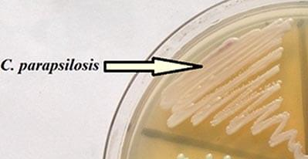
Poll #6
Additional studies:
Germ tube test: (-) | C. albicans screen test: (-)
Rice Tween agar: Short pseudohyphae (usually) with yeast in small groups or singularly at intervals along their length. No chlamydoconidia | CHROMagar: cream colored colonies

Slide 38
Poll #6
The Candida spp identified in this patient’s blood culture was:
A. C. tropicalis
B. C. parapsilosis
C. C. albicans
D. C. glabrata
Germ tube test: (-) C. albicans screen test: (-) Rice Tween agar: Short pseudohyphae, no chlamydoconidia CHROMagar: cream colored colonies

Slide 39
Poll #6
The Candida spp identified in this patient’s blood culture was:
A. C. tropicalis
B. C. parapsilosis
C. C. albicans
D. C. glabrata
Notes:
C. tropicalis: negative germ tube test, negative CAS, no chlamydocondia, but blue/greenish – metallic blue on CHROMagar
C. albicans: (+) germ tube test, (+) CAS, chlamydocondia, green colonies on CHROMagar
C. glabrata:

Slide 40
Poll #6
The Candida spp identified in this patient’s blood culture was:
A. C. tropicalis
B. C. parapsilosis
C. C. albicans
D. C. glabrata
Long pseudohyphae bearing yeast singly or in groups, occasional true hyphae
Pseudohyphae with large chlamydospores singly, occasionally multiple
Usually appears as tiny budding yeast cells without pseudohyphae

Slide 41
Poll #7
Which susceptibility pattern is most consistent with that of C. parapsilosis?
**general patterns**
 | Amphotericin B Formulations | Fluconazole | Voriconazole | Echinocandins
1. | S | R | S | S
2. | R | S | S | S
3. *no established breakpoints | +/- | R | +/- | +/-
4. | S | S | S | +/-
5. | S | R (usually) | S | S

Slide 42
Poll #7
Which susceptibility pattern is most consistent with that of C. parapsilosis?
 | Amphotericin B Formulations | Fluconazole | Voriconazole | Echinocandins
1. | S | R | S | S
2. | R | S | S | S
3. *no established breakpoints | +/- | R | +/- | +/-
4. C. parapsilosis | S | S | S | +/-
5. | S | R (usually) | S | S
May have increased MIC to echinocandins

Slide 43
Poll #8
 | Amphotericin B Formulations | Fluconazole | Voriconazole | Echinocandins
1. | S | R | S | S
This Candida spp is most likely:
C. krusei
B. C. lusitaniae
C. C. auris
D. C. tropicalis

Slide 44
Poll #8
 | Amphotericin B Formulations | Fluconazole | Voriconazole | Echinocandins
1. C. krusei | S | R | S | S
Intrinsically resistant to fluconazole

Slide 45
Poll #9
 | Amphotericin B Formulations | Fluconazole | Voriconazole | Echinocandins
1. C. krusei | S | R | S | S
2. ? | R | S | S | S
This Candida spp is most likely:
B. C. lusitaniae
C. C. auris
C. glabrata
C. tropicalis

Slide 46
Poll #9
 | Amphotericin B Formulations | Fluconazole | Voriconazole | Echinocandins
1. C. krusei | S | R | S | S
2. C. lusitaniae | R | S | S | S
Resistant to amphotericin
Other fungi resistant to amphotericin:
C. auris (some)
Aspergillus terreus
Scedosporium apiospermum (some)
Lometospora (Scedosporium) prolificans
Fusarium spp (some)
Sporothrix schenckii
Pseudallescheria boydii

Slide 47
Summary
Eswabs for fungal cultures, expect for superficial skin/mucous membranes specimens, are unacceptable. Sterile cup is specimen of choice.
KOH-calcofluor preparation can help identify fungal elements to guide appropriate media and growth conditions. Lactophenol blue stain performed after fungal colony growth and helps identify morphological structures
Communicate with the lab if a particular fungi is suspected to optimize media used and incubation conditions (e.g. Malassezia furfur requires fatty acids for growth; Mucormycosis; dimorphic fungi)
C. albicans can be differentiated from other Candida spp using germ tube test (+), rice tween agar (chlamydocondia), CHROMagar, and Candida albicans screen
C. krusei → intrinsically resistant to fluconazole
C. lusitaniae → resistant to amphotericin
C. glabrata → usually fluconazole resistant (or SDD)
C. parapsilosis → occasional echinocandin resistance
C. auris → multi class resistance

