Slide 1
Micro Plate Rounds
Mycobacteriology and Mycology
Session 12

Slide 2
Poll #1
65 year old woman with well controlled HIV and (+) Quantiferon (no hx of LTBI treatment) and presenting for two months of cough with occasional hemoptysis and subjective fevers. CT scan is shown numerous large cavitary lesions with nodular and patchy opacities in right lower and middle lobes
LJ slant grew the following colonies within 1 week
What is an important characteristic of this organism when taken from culture, spread on a slide, and stained with acid-fast?
Forming rosettes
Sticking together to form cords
Grouping in irregular shapes
Clumping around edges of preparation
Non-pigmented, buff
Rough, dry colonies

Slide 3
Poll #1
65 year old woman with well controlled HIV and (+) Quantiferon (no hx of LTBI treatment) and presenting for two months of cough with occasional hemoptysis and subjective fevers. CT scan is shown numerous large cavitary lesions with nodular and patchy opacities in right lower and middle lobes
LJ slant grew the following colonies within 1 week
What is an important characteristic of this organism when taken from culture, spread on a slide, and stained with acid-fast?
Forming rosettes
Sticking together to form cords
Grouping in irregular shapes
Clumping around edges of preparation
Non-pigmented, buff
Rough, dry colonies

Slide 4
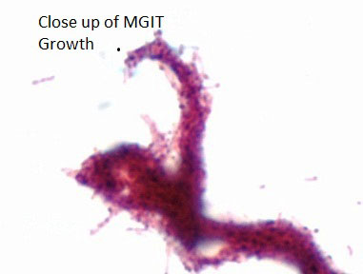
M. tuberculosis
May appear as gram positive “beaded” bacilli or “ghost cells”
Slow doubling time (15 – 20 hrs), but growth rate in primary culture dependent on infectious burden
Niacin (+), nitrite (+)
Cording due to cord factor
  Stick end-end and side-side forming serpentine structures/tight bundles
  Can be seen with other Mycobacteria
Non-pigmented, buff
Rough, dry colonies
  Glycolipid that has various immunologic effects: e.g. blocking macrophage activation by IFN-y and inducing TNFα secretion
Notes:
(if not from subculture, varies depending on the burden of organism)

Slide 5
NTM: Runyon Classification
Growth rate based on subculture
Further classified based on pigment production
Slow Growers (> 7 days) | I - Photochromogens | Pigment produced after exposure to light | M. kansasii M. marinum
 | II - Scotochromogens | Pigment present without exposure to light | M. scrofulaceum M. xenopi M. gordonae
 | III – Nonchromogenic | No pigment even after exposure to light | MAC M. haemophilum
Rapid Growers ( ≤ 7 days) | IV – Rapid growers |  | M. fortuitum M. chelonae M. abscessus
Notes:
Classification scheme of mycobacteria based on rate of growth and pigment production
However, the classification of RGM vs. SGM is determined by the growth rate after subculture, not the growth rate in primary culture.

Slide 6
Poll #2
  51 M avid seaman presented to the ED for non healing swelling of left fourth finger after sustaining an injury due to a wood splinter on the same finger while working on his boat 15 months ago. For concern of possible gout of that area, he had received a local steroid injection in that finger. MRI showed tenosynvoitis of 4th extensor tendons.
  An I&D was performed and an AFB culture is performed. There is presence of yellow pigmented colonies after exposure to light in 10 days
  The most likely organism is:
Mycobacterium haemophilum
B. Mycobacterium avium complex
C. Mycobacterium marinum
D. Mycobacterium abscessus
  Sin et al, 2019

Slide 7
Poll #2
  51 M avid seaman presented to the ED for non healing swelling of left fourth finger after sustaining an injury due to a wood splinter on the same finger while working on his boat 15 months ago. For concern of possible gout of that area, he had received a local steroid injection in that finger. MRI showed tenosynvoitis of 4th extensor tendons.
  An I&D was performed and an AFB culture is performed. There is presence of yellow pigmented colonies after exposure to light in 10 days
  The most likely organism is:
Mycobacterium haemophilum
B. Mycobacterium avium complex
C. Mycobacterium marinum
D. Mycobacterium abscessus
  Sin et al, 2019
Growth in 10 days: slow grower
Pigment under light: Group I, photochromogen

Slide 8
Poll #3
  Most Mycobacteria grow at 35 – 37ºC, however, this AFB culture was also incubated at what temperature for isolation of M. marinum?
30 – 32ºC
B. 40 – 42ºC

Slide 9
Poll #3
  Most Mycobacteria grow at 35 – 37ºC, however, this AFB culture was also incubated at what temperature for isolation of M. marinum?
30 – 32ºC
B. 40 – 42ºC
M. marinum, M. haemophilum, and M. ulcerans require lower incubation temperatures of 30 – 32ºC for growth
M. haemophilum also requires supplementation of iron containing compounds

Slide 10
Poll #3
  Most mycobacteria grow at 35 – 37ºC, however, this AFB culture was also be incubated at what temperature for isolation of M. marinum?
30 – 32ºC
B. 40 – 42ºC
M. xenopi is a thermophile with optimal growth at 42ºC
Frequently recovered from health care associated hot water systems
Notes:
Mycobacterium xenopi : uncommon in US but 2nd most common MAC to cause NTM disease in Canada, UK, certain parts of Europe

Slide 11
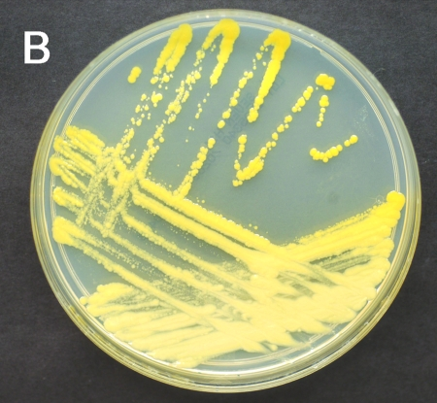
Mycobacterium marinum
Grows optimally at 28 – 32ºC
  Other NTM that require lower temp for growth: M. haemophilum, M. ulcerans
  Typically cause skin/soft tissue/bone/joint infections, therefore, AFB wound cultures are incubated at 5 – 10% CO₂ at 35 – 37ºC and 30 – 32ºC
Runyon Group I: photochromogenic, grows in 8 – 12 days
Clinical features:
  Single, painless papule on extremity 2 – 3 weeks after inoculation (may also cause OM, tenosynovitis, septic arthritis)
  Causative agent of “swimming pool” or “fish tank” granulomas due to injury in fresh water, salt water, fish-tanks
Yellow pigmented colonies under light
Staropoli 2008
Presence of ”rice bodies” within mass lesion seen on MRI wrist (Jiang et al 2015)
Notes:
Infections after swimming pool exposure now rare due to routine chlorination

Slide 12
Poll #4
78 yo F with history of gastric ulcer perforation s/p ex-lap and repair (2017) complicated by an incisional hernia causing bowel obstruction requiring hernia repair with mesh 2 months ago presenting for abdominal pain and swelling.
CT showed 15 x 7 x 4.3 cm bi-lobed collection in adjacent anterior abdominal wall. She underwent IR drainage followed by OR I&D and washout x 2 notable for 200 cc of pus and fascial dehiscence. Mesh was incorporated into fascia and therefore not removed.
Bacterial aerobic and anaerobic abscess cultures were sent (no AFB cultures). Culture growth on agar was noted in 5 days.
*
*

Slide 13
Poll #4
The organism identified was most likely…
A. M. fortuitum
B. M. gordonae
C. M. chimaera
D. M. kansasii

Slide 14
Poll #4
The organism identified was most likely…
A. M. fortuitum
B. M. gordonae
C. M. chimaera
D. M. kansasii
(*last session)
Identification via rpoB sequencing distinguishes among species
16s rRNA only to genus level of Mycobacteria spp
*
*

Slide 15
Poll #4
The organism identified was most likely…
A. M. fortuitum
B. M. gordonae
C. M. chimaera
D. M. kansasii
Slow grower
Rarely a pathogen, most cases represent contamination
Distinctive yellow/orange colonies
Coute et al, 2013

Slide 16
Poll #4
The organism identified was most likely…
A. M. fortuitum
B. M. gordonae
C. M. chimaera
D. M. kansasii
Slow grower, member of M. avium complex
Linked cardiac surgery pts due to contaminated heater-cooler devices used in cardiac bypass (heart valve surgery >>> CABG, LVAD, heart-lung transplant, vascular grafts)
Endocarditis, severe disseminated infection, chronic sternal wound infection

Slide 17
Poll #4
The organism identified was most likely…
A. M. fortuitum
B. M. gordonae
C. M. chimaera
D. M. kansasii
Slow grower
2nd most common cause of NTM lung disease in the US
Extra-pulmonary infections uncommon

Slide 18
RGM
M. fortuitum
  Particular associations: whirlpool pedicure footbaths outbreaks, chronic aspiration and acid reflux (for pulmonary disease)
M. chelonae
  Particular associations: keratitis (contact lenses, ocular surgeries), tattoo ink outbreaks
M. abscessus (subsp. abscessus, massiliense, bolletii)
Clinical manifestations: skin, bone, soft tissue infections; less commonly pulmonary infections
Notes:
Treatment:
Source control – drainage of all abscesses and removal of infected foreign bodies
Abx – combination therapy, guided by RGM identified and susceptibilities
Duration varies based on clinical presentation

Slide 19
RGM
 | Inducible resistance to macrolides? (separate from constitutive resistance)
M. fortuitum | Yes, erm gene
M. chelonae | No
M. abscessus | subsp. abscessus | Yes, erm gene
 | subsp. massiliense | No, erm gene is non-functional due to large deletion
 | subsp. bolletii | Yes, erm gene
Identify inducible resistance by prolonged incubation (14 days)
Molecular testing can detect if erm gene is present, but only phenotypic susceptibility testing can determine if it is functional
Notes:
Precise subspeciation of M. abscessus as identification of subsp. massiliense is associated with a nonfunctional erm(41) gene and in vitro susceptibility (MIC below 4 μg/ mL) [42], and thus the macrolides are active if constitutive resistance is not present.

Slide 20
Poll #5
A 56-year-old man presented with cough and dyspnea for 3 weeks. He had a history of GERD and a 40 pack-year smoking history. Investigations:
  - CXR: right upper lobe infiltrates
  - Incidentally performed Quantiferon was positive
  - Sputum AFB: smear negative, mycobacterial culture positive at 3 weeks with yellow colonies after exposure to light
What is the most likely causative organism?
  A. Mycobacterium abscessus
  B. Mycobacterium avium complex
  C. Mycobacterium chelonae
  D. Mycobacterium kansasii

Slide 21
Poll #5
A 56-year-old man presented with cough and dyspnea for 3 weeks. He had a history of GERD and a 40 pack-year smoking history. Investigations:
  - CXR: right upper lobe infiltrates
  - Incidentally performed Quantiferon was positive
  - Sputum AFB: smear negative, mycobacterial culture positive at 3 weeks with yellow colonies after exposure to light
What is the most likely causative organism?
  A. Mycobacterium abscessus
  B. Mycobacterium avium complex
  C. Mycobacterium chelonae
  D. Mycobacterium kansasii
Notes:
Rapid growers are expected to grow faster, usually within 7 days – eliminates M chelonae and M fortuitum
MAC is non chromogenic

Slide 22
IGRA
2 commercially available: QuantiFERON, T-spot.TB
Evaluates immune response to MTB antigens
Antigens are located in specific genomic area in MTB, known as region of difference RD1
  RD1
    Present in M. tuberculosis complex
    Not present in M. bovis-BCG strains (but present in wild-type M. bovis)
    Not present in most NTM except for: M. kansasii, M. marinum, M. szulgai
Notes:
The RD1 antigens used in the 2 IGRAs are not encoded in the genomes of M bovis-BCG strains, although they are present on wild- type M bovis

Slide 23
IGRA
No role of IGRAs for active TB diagnosis
  IGRA intended for detection of LTBI, not active disease
  Cannot distinguish between latent infection and active disease
Metcalfe et al 2011 meta-analysis of IGRA in low – middle income countries for persons with active tuberculosis:
  Sensitivity 69 – 83%
    HIV infected individuals: sensitivity 60 – 70%
  Specificity of 52 – 61% for IGRAs
  No evidence that IGRA was more sensitive than TST
Notes:
suggesting ~1 – 3 HIV infected patients with active tuberculosis with have negative IGRA results

Slide 24
QuantiFERON-TB
has been replaced by
QFT-GIT (QuantiFERON-TB Gold in Tube) | QFT-Plus (QuantiFERON-TB Gold Plus)
3 tubes Mitogen Nil TB1 (CD4 response) | 4 tubes Mitogen Nil TB1 (CD4 response) TB2 (CD4 and CD8 response)
Notes:
Nil: background IFNy response
Mitogen: measures antigen independent T cell response
TB1: ESAT6 and CFP-10 antigens to detect CD4 T cell response
TB2: contains additional shorter peptides from ESAT6 and CFP10 to detect both CD4 and CD8 T cell responses

Slide 25
QuantiFERON-TB
QFT-Plus (QuantiFERON-TB Gold Plus)
CD8 T cell response included to help improve sensitivity of MTB infection detection especially for: Recent contacts Immunocompromised hosts Young children Actual improved sensitivity compared to QFT-GIT in these high risk populations? So far, no statistical significance observed in 1 meta-analysis (Oh, 2021)

Slide 26
Poll #6
Match each test to the respective test mechanism:
A. QuantiFERON | 1. Enumerates individual memory T cells that produce IFNγ in response to MTB antigens
B. T-spot.TB | 2. Quantify production of IFNγ released by T cells in response to MTB antigens

Slide 27
IGRAs
QuantiFERON | T-spot
Quantify production of IFNγ released by T cells in response to MTB antigens ESAT-6, CFP-10, (TB7.7) Results: Positive, Negative, Indeterminate | Enumerates individual memory T cells that produce IFNγ in response to MTB antigens ESAT-6 and CFP-10 Results: Positive, Negative, Borderline, Invalid
Similar performance between QFT-Plus and T-spot.TB for LTBI, although evidence is limited (Oh, 2021)

Slide 28
QuantiFERON: Limitations
Children:
  IDSA: TST preferred over IGRA for < 5 years of age, although use in those > 3 years of age may be appropriate
  AAP (12/2021):
    For < 2 years of age: TST recommended, IGRA acceptable
    Consider risk and BCG vaccination history
Notes:
Ie. high specificity (low risk BCG vaccinated children), IGRAs are superior

Slide 29
QuantiFERON: Limitations
Indeterminate:
  Causes
    Technical factors (delay in incubation, handling of blood specimen)
    Immune status of individual
  2 possibilities:
    Failure of (+) control
    insufficient release of IFNγ in response to positive control antigen
    Failure of (-) control
    Elevated IFNγ in nil sample
Notes:
Ie. high specificity (low risk BCG vaccinated children), IGRAs are superior

Slide 30
Summary
Cording is an important virulence factor for M. tuberculosis
NTM are classified based on growth rate and pigment production
M. marinum, M. haemophilum, and M. ulcerans require lower incubation temperatures for growth (30 – 32ºC). M. xenopi requires higher incubation temperatures for growth (40 – 42ºC)
    RGM are M. fortuitum, M. chelonae, M. abscessus and a functional erm gene confers inducible macrolide resistance
    M. kansasii, M. marinum, M. szulgai may cross-react with Quantiferon test

Slide 31
Mycology

Slide 32
Comprehensive Review of Infectious Diseases, 2020
Notes:
Dermatophytes: fungus with ability to obtain nutrients from keratin, infects skin, hair, or nails
Hyaline molds: Hyaline molds that do not produce pigment and are see through

Slide 33
Poll #7
Although actual tissue, aspirates, and fluids are specimens of choice over swabs, which specimen containers/devices can be used for each of the following cultures?
 | Eswabs | Sterile Cup
Aerobic culture
Anaerobic culture
AFB culture
Fungal culture

Slide 34
Poll #7b
Although actual tissue, aspirates, and fluids are specimens of choice over swabs, which specimen containers/devices can be used for each of the following cultures?
 | Eswabs | Sterile Cup
Aerobic culture | Yes
Anaerobic culture
AFB culture
Fungal culture

Slide 35
Poll #7c
Although actual tissue, aspirates, and fluids are specimens of choice over swabs, which specimen containers/devices can be used for each of the following cultures?
 | Eswabs | Sterile Cup
Aerobic culture | Yes | Yes
Anaerobic culture
AFB culture
Fungal culture

Slide 36
Poll #7d
Although actual tissue, aspirates, and fluids are specimens of choice over swabs, which specimen containers/devices can be used for each of the following cultures?
 | Eswabs | Sterile Cup
Aerobic culture | Yes | Yes
Anaerobic culture | Yes
AFB culture
Fungal culture

Slide 37
Poll #7e
Although actual tissue, aspirates, and fluids are specimens of choice over swabs, which specimen containers/devices can be used for each of the following cultures?
 | Eswabs | Sterile Cup
Aerobic culture | Yes | Yes
Anaerobic culture | Yes | No
AFB culture
Fungal culture

Slide 38
Poll #7f
Although actual tissue, aspirates, and fluids are specimens of choice over swabs, which specimen containers/devices can be used for each of the following cultures?
 | Eswabs | Sterile Cup
Aerobic culture | Yes | Yes
Anaerobic culture | Yes | No
AFB culture | No
Fungal culture

Slide 39
Poll #7g
Although actual tissue, aspirates, and fluids are specimens of choice over swabs, which specimen containers/devices can be used for each of the following cultures?
 | Eswabs | Sterile Cup
Aerobic culture | Yes | Yes
Anaerobic culture | Yes | No
AFB culture | No | Yes
Fungal culture

Slide 40
Poll #7h
Although actual tissue, aspirates, and fluids are specimens of choice over swabs, which specimen containers/devices can be used for each of the following cultures?
 | Eswabs | Sterile Cup
Aerobic culture | Yes | Yes
Anaerobic culture | Yes | No
AFB culture | No | Yes
Fungal culture | No

Slide 41
Poll #7i
Although actual tissue, aspirates, and fluids are specimens of choice over swabs, which specimen containers/devices can be used for each of the following cultures?
 | Eswabs | Sterile Cup
Aerobic culture | Yes | Yes
Anaerobic culture | Yes | No
AFB culture | No | Yes
Fungal culture | No* | Yes
Can share sterile cup if needed
≥ 10 mL of fluid preferred for fungal/AFB culture (2 mL for CSF)
Notes:
One piece of tissue/swab in one Eswab container can be submitted for both aerobic and anaerobic cultures

Slide 42
Specimen Collection
Biopsy, aspirate, currettings from advancing border of lesion are essential to demonstrate invasive fungal disease
Use swabs only for superficial skin or mucous membranes infections

Slide 43
Specimen Processing
1. Process promptly – within 2 hours of collection
If unable to process promptly, refrigerate
  Exceptions:
    Bone marrow → room temp
    Blood cultures → room temp
    Mucorales or Dermatophytes suspected → room temp
Fungal tissue cultures are minced, rather than grinded
  Zygomycetes have few septations, grinding between septation can kill piece of hyphae

Slide 44
Specimen Processing
1. Process promptly – within 2 hours of collection
If unable to process promptly, refrigerate
Exceptions:
  Bone marrow → 34-37ºC
  Blood cultures → room temperature
  Mucorales or Dermatophytes suspected → room temperature
2. Direct Smear

Slide 45
Specimen Processing
1. Process promptly – within 2 hours of collection
2. Direct Smear
Visualization of fungal elements to give early evidence of fungal infection [e.g. size of yeast, type of budding, hyphae (pseudo, true, septations, pigment)]
Can guide selection of appropriate media or growth conditions
Limitations:
  Does not rule out fungal infections; culture must be done
  Many fungi have similar appearances on direct mounts
Blood or bone marrow – no direct mount done. Collected in yellow top tube with SPS, transferred to Myco-F bottles, incubated in BacTec

Slide 46
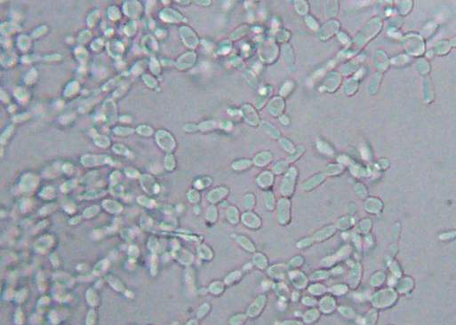
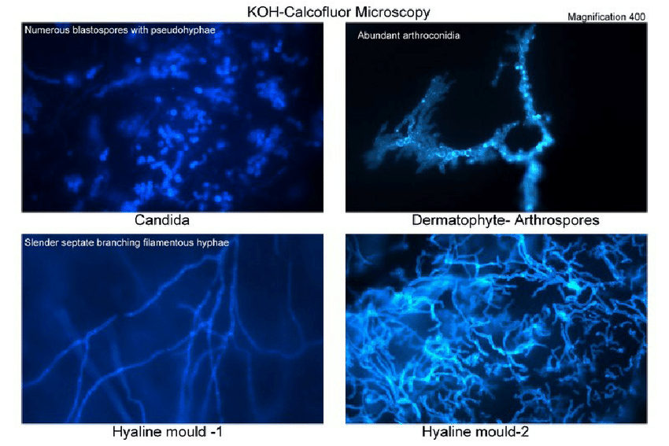
Direct Smear
Wet Mount, KOH-Calcofluor
  KOH:
    Softens, digests, and clears surrounding tissue to make fungal elements more visible
  Calcofluor White:
    Binds to cellulose and chitin → fluoresces when exposed to UV light
    Bacteria may fluoresce to a lesser degree; presence of fungi should be determined based on morphology

Slide 47
Poll #6
*Note - At MMC, no KOH-calcofluor performed on skin, hair, nail cultures
Specimens directly inoculated into Mycosel culture bottles by providers
A KOH direct examination of skin scrapings from torso lesions reveals short curved hyphal elements along with round yeast cells in compacted clusters. After visualization of these fungal elements, the Micro Lab will…
A. Add an overlay of olive oil to agar
B. Perform a germ tube test
Use Sabouraud Heart Infusion Agar with blood
as culture media

Slide 48
Poll #6
A KOH direct examination of skin scrapings from torso lesions reveals short curved hyphal elements along with round yeast cells in compacted clusters. After visualization of these fungal elements, the Micro Lab will…
A. Add an overlay of olive oil to agar
B. Perform a germ tube test
Use Sabouraud Heart Infusion Agar with blood
as culture media
Malassezia furfur
“Spaghetti and meatball appearance”
Cannot synthesize medium-long chain fatty acids, requires exogenous supply for growth
  Tend to colonize oily areas of skin
  Contaminates parenteral lipids
Communicate with lab if suspected. Requires media enriched with fatty acids (olive oil or tween to Sabouraud dextrose agar or Dixon’s media)
Notes:
Blood cultures usually negative in absence of lipid-enriched media – communicate clinical suspicion with the micro lab

Slide 49
Specimen Processing
1. Process promptly – within 2 hours of collection
2. Direct Smear
3. Media Inoculation and Incubation

Slide 50
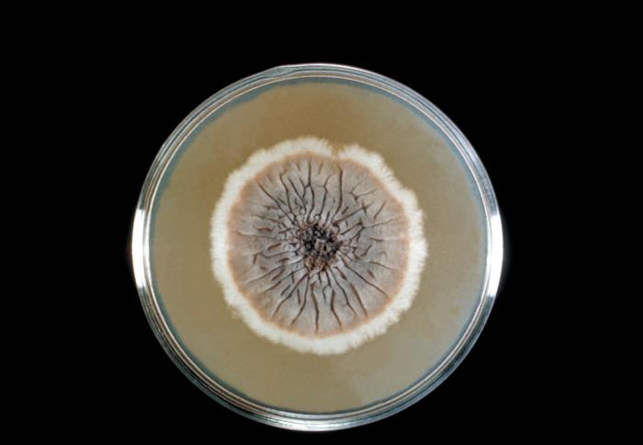
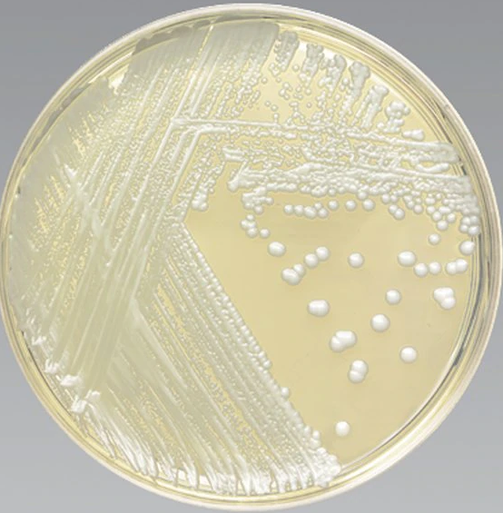
Culture Media
Sabouraud dextrose agar (SAB), Inhibitory Mold Agar (IMA), Sabouraud Heart Infusion Agar (SABHI), Mycosel/Mycobiotic agar (MYCO), among others…
Each culture media has advantages and disadvantages
Media selection for inoculation is based on specimen type, identifying characteristics on direct mount, and clinically suspected fungi/mold
Sporothrix schenckii on SAB
Mycosel/Mycobiotic agar

Slide 51
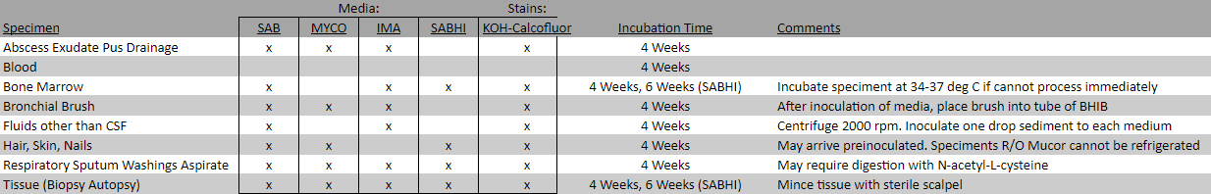
Incubation
Incubated at 28 – 30ºC for 4 weeks
Examined twice weekly for new growth
To ensure selection of optimal media and incubation conditions, notify lab if particular agent is suspected
    Mucormycosis: Processed stat. Temperature sensitive and does not survive refrigeration
    Dimorphic fungi: SABHI media used. If Histoplasma suspected, BM and liver biopsies are held for 6 rather than 4 weeks

Slide 52
Specimen Processing
1. Process promptly – within 2 hours of collection
2. Direct Smear
3. Media Inoculation and Incubation
If growth, additional identification methods can be used based on gross colony morphology and growth rate
Yeast → MALDI-ToF, BD-Phoenix
Mold → manual morphologic ID
4. Identification

Slide 53
Lactophenol Cotton Blue (LPCB)
Used once fungal colonies are growing in culture
Helps identify morphologic structures and characteristics
No role in tissue staining
Cotton blue: Stains chitin on fungal wall
Lactic acid: preserves fungal structures
Phenol: kills any organisms suspended in the stain
Microscopical appearance of Histoplasma capsulatum microconidia and macroconidia on LPCB stain

Slide 54
Summary
    Eswabs for fungal cultures, expect for superficial skin/mucuous membranes specimens are unacceptable. Sterile cup is preferred
    KOH-calcofluor preperation can help identify fungal elements to guide appropriate media and growth conditions
    Communicate with the lab if a particular fungi is suspected to optimize media used and incubation conditions (e.g. Malassezia furfur requires fatty acids for growth)

