Slide 1
Micro Plate Rounds
Mycobacteriology
Session 11

Slide 2
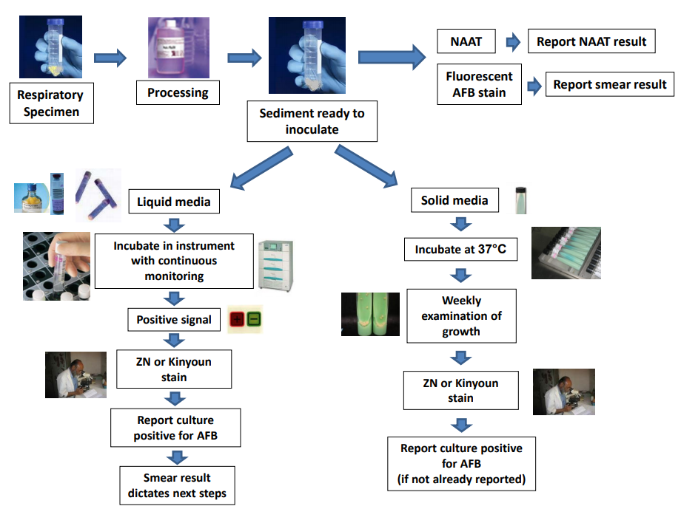
Mycobacteriology: Processing
Sterile specimens
Specimens received in lab
BLS-3 practices required
(containment, PPE, BSC)
Non sterile specimens

Slide 3
Decontamination and Concentration
Used for non-sterile sites specimens or sites that can harbor bacteria
  Examples: stool, urine, sputum, BAL, or gastric lavage
  Breaks down mucus
  Removes other bacteria that may overgrow mycobacteria
Notes:
Eliminate or reduce other bacteria in the specimen that can grow faster than or overgrow the mycobacteria
Mycobacteria are more resistant to this process but this process needs to be carefully followed to avoid harm to mycobacteria from extended exposure times, etc..
Don’t need to decontaminate if urine collected from suprapubic catheter
Similarly, no need for blood, CSF, joint aspiration, pericardial fluid, etc.
TB base solution contains sodium hydroxide and sodium citrate. Add NAC -> Digestion of mucus.
Centrifuge 1:1 specimen to TB base/NAC and vortex mix to liquefy. Let it sit for 15 mins

Slide 4
Mycobacteriology Processing
Staining/Smear
Sterile specimens
concentrated
Specimens received in lab
BLS-3 practices required
(containment, PPE, BSC)
Non sterile specimens
decontaminated and concentrated
sputum only
NAAT testing
  Only performed on sputum specimens in-house
    If sputum smear (+), routinely performed
    If sputum smear (-), requires specific ID request
  NAAT testing on specimens from other sites is a send-out

Slide 5
NAAT testing
Xpert MTB/RIF test
  Detects MTB and rifampin resistance (mutations in rpoB core region)
    >95% of all rifampin resistant strains contain mutations within this region
    Utilizes molecular beacon technology – oligonucleotide sequences with probe sequence between 2 arm sequences
2
1
1. Fluorophore
2. Nonfluoresecent quencher
If in close proximity, fluorescence is suppressed
In the presence of complementary DNA target
Conformational change
Separation of arms and fluorophore and quencher molecules → fluorescence
Lawn et al 2012
Notes:
rpoB core region flanked by MTB specific DNA sequences (simultaneous detection of MTB and rifampin resistance)
Any mutation within sequences in this region -> interferes with hybridization -> interferes with conformational change -> either delayed onset (partial inhibition) or complete suppression of fluorescence

Slide 6
NAAT testing
Xpert MTB/RIF test
  If rifampin resistance → needs confirmation w/ reference lab
  Not validated to determine cure or response to therapy
  Use on sputum (smear + or -), not specifically approved for other specimen types (blood, CSF, stool, tissue, urine) although can be performed as send-out
  Use if high suspicion for TB and…
      (1) not on tx or
      (2) ≤ 3d on tx
  Must perform concomitant culture (possible false (-)s and further susceptibility testing)
Notes:
MTB NAAT testing highly specific, but sensitivity varies depending on specimen

Slide 7
NAAT testing
Xpert MTB/RIF test compared to culture
 | Sensitivity |  |  | Specificity | PPV | NPV
 | Overall | Smear (-) | Smear (+)
High prevalence (Brazil & S. Africa) | 78.7% | 52.6% | 100% | 97.2% | 94.3% | 88.6%
Low prevalence (USA) | 85.2% | 59.3% | 96.7% | 99.2% | 94.9% | 97.6%
91.1% if 2nd Xpert assay performed
1 Xpert assay identifies >50% smear-/culture + cases that would be missed by initial AFB smear
100% if 2 Xpert assays performed (in separate analysis)
Luetkemeyer et al 2016
Notes:
MTB NAAT testing highly specific, but sensitivity varies depending on specimen

Slide 8
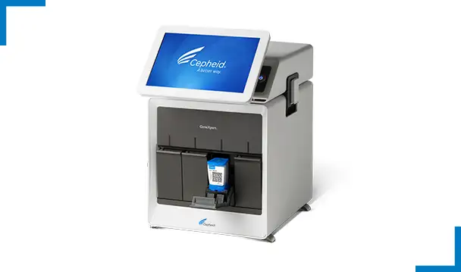
Poll #1
What is the AFB burden in sputum required for reliable detection of M. tuberculosis by current NAAT testing?
1 – 10 CFU/mL
B. 100 CFU/mL
C. 10,000 CFU/mL
https://www.cepheid.com/

Slide 9
Poll #1
What is the AFB burden in sputum required for reliable detection of M. tuberculosis by current NAAT testing?
1 – 10 CFU/mL
B. 100 CFU/mL
C. 10,000 CFU/mL
https://www.cepheid.com/

Slide 10
Mycobacteriology Processing
Staining/Smear
Sterile specimens
concentrated
Specimens received in lab
BLS-3 practices required
(containment, PPE, BSC)
Non sterile specimens
decontaminated and concentrated
sputum only
NAAT testing

Slide 11
Poll #2
In addition to Kinyoun acid-fast staining, which of the following stains are performed on mycobacteriology specimens?
Gram stain
B. Mucicarmine stain
C. KOH-Calcofluor preparation
D. Auramine-rhodamine fluorescent stain

Slide 12
Poll #2
In addition to Kinyoun acid-fast staining, which of the following stains are performed on mycobacteriology specimens?
Gram stain
B. Mucicarmine stain
C. KOH-Calcofluor preparation
D. Auramine-rhodamine fluorescent stain

Slide 13
Poll #2
In addition to Kinyoun acid-fast staining, which of the following stains are performed on mycobacteriology specimens?
Gram stain
B. Mucicarmine stain
C. KOH-Calcofluor preparation
D. Auramine-rhodamine fluorescent stain
Mycobacteria contain mycolic acids in cell walls that do not stain well on gram stain (but may appear as gram (+), beaded, bacilli)
Staining for Cryptococcus
Polysaccharide capsule appears pink
Staining for fungal elements

Slide 14
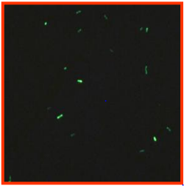
Smear Microscopy
Fluorochrome method (Auramine O/Rhodamine B)
Performed on smears of decontaminated and concentrated patient specimens
Fluorescent dyes bind to mycolic acids → fluorescence
If (+), confirm with Kinyoun stain
False results:
  (-): some Runyoun group IV rapid growers do not fluoresce
  (+): Nocardia may fluoresce weakly → perform gram stain to r/o bacteria + modified Kinyoun acid-fast stain

Slide 15
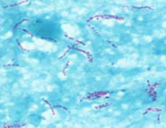
Smear Microscopy
Kinyoun acid-fast stain
Used to confirm (+) fluorochrome stains and used to stain culture (+) growth
Mycobacteria
  Not readily decolorized by acids → acid fast
  Retain carbol fuchsin and look red
Fluorochrome method is more sensitive
than Kinyoun method
Different from modified acid-fast stain used for aerobic Actinomycetes (e.g. Nocardia, Gordonia, Rhodococcus)
Modified acid fast stain
Use of weaker acid (H2SO4 rather than HCl
In our lab, use of HCl for shorter time period
Notes:
Because the fluorochrome method is more sensitive than the Kinyoun method not all fluorochrome positive smears will be positive by the Kinyoun method. Would be reported as: “Rare AFB seen by fluorochrome stain only”

Slide 16
Poll #3
What is the AFB burden in sputum required for reliable detection of M. tuberculosis by smear microscopy?
1 – 10 CFU/mL
B. 100 CFU/mL
C. 10,000 CFU/mL
Notes:
In order to detect mycobacteria in acid fast smear of a sputum sample, more than >10,000 organisms per mL of sputum are needed to visualize the bacilli with a 100x oil immersion objective

Slide 17
Poll #3
What is the AFB burden in sputum required for reliable detection of M. tuberculosis by smear microscopy?
1 – 10 CFU/mL
B. 100 CFU/mL
C. 10,000 CFU/mL

Slide 18
Mycobacteriology Processing
Staining/Smear
Fluorochrome, if (+) confirmed with
Kinyoun acid-fast stain
Inoculated on culture media (liquid & solid)
Sterile specimens
concentrated
Specimens received in lab
BLS-3 practices required
(containment, PPE, BSC)
Non sterile specimens
decontaminated and concentrated
sputum only
NAAT testing
Notes:
Cultures are incoluated to liquid and solid media
Some species grow better in liquid media; some grow better on solid media

Slide 19
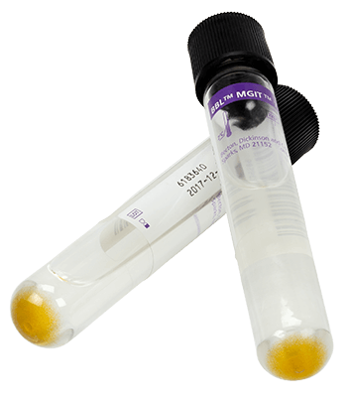
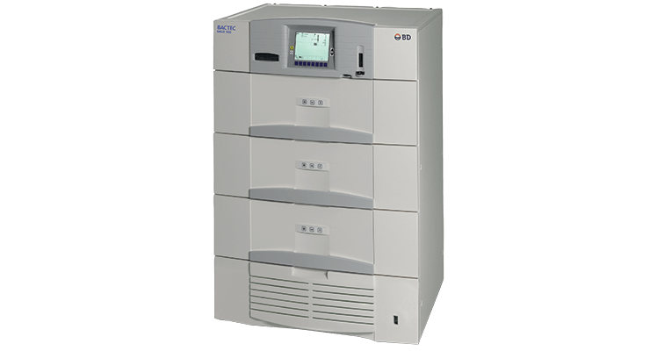
Liquid Culture Media
MGIT (Mycobacteria Growth Indicator Tube)
Modified Middlebrook 7H9 broth base
Growth → oxygen consumption → fluorescence of compound at the bottom tube tube
Incubated in the BacTec System
Evaluated weekly for a total of 6 weeks (MGIT)
Liquid broth media can allow for more rapid growth than solid media

Slide 20
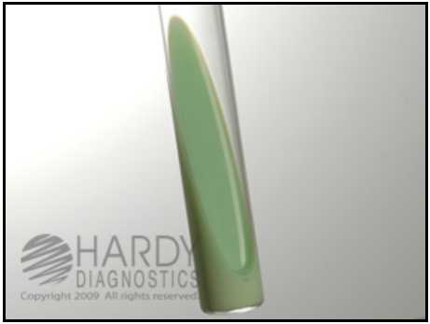
Solid Culture Media
Lowenstein Jensen Medium (L-J slant)
Glycerated egg-based medium with malachite green (dye that inhibits growth of most bacteria)
  Prevents growth of contaminants that survived decontamination treatment
  Encourages growth of Mycobacteria
Incubated in a 5-10% CO2 incubator at 35 - 37°C
  (more on incubation temperature for certain NTM species next session)
Evaluated weekly for a total 8 weeks
Notes:
LJ Slant
Contains malachite green, glycerol, asparagine, potato starch, coagulated eggs, mineral salt solution
Low levels of nalidixic acid and penicillin also present. Inhibits GP and GN.
Loosen cap, horizontal, x1 week, then upright tight sealing. Up to 6 weeks.

Slide 21
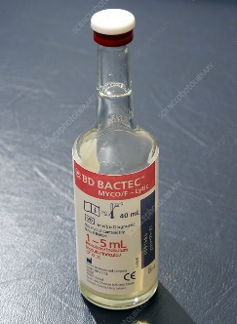
Culture Media
Myco-F lytic media
  Middlebrook 7H9 and Brain Heart Infusion broth formulation
  Used for blood and bone marrow specimens (which are also inoculated on L-J media)
  Incubated in BacTec instrument in main Bacteriology lab
Notes:
Middlebrook 7H9 and brain heart infusion broth formulation
For sterile specimens: blood and bone marrow
Inject specimen directly to the bottle
Incubate in BacTec 9240 instrument in Bacteriology Lab

Slide 22
Poll #4
What is the AFB burden in sputum required for reliable detection of M. tuberculosis by culture?
1 – 10 CFU/mL
B. 100 CFU/mL
C. 10,000 CFU/mL

Slide 23
Poll #4
What is the AFB burden in sputum required for reliable detection of M. tuberculosis by culture?
1 – 10 CFU/mL
B. 100 CFU/mL
C. 10,000 CFU/mL
NAAT testing
Smear microscopy

Slide 24
Mycobacteriology Processing
Inoculated on culture media
Solid media (LJ slant)
Liquid media MGIT
Myco-F lytic media (if blood/BM)
Staining/Smear
Fluorochrome, if (+) confirmed with
Kinyoun acid-fast stain
Sterile specimens
concentrated
Specimens received in lab
BLS-3 practices required
(containment, PPE, BSC)
If culture (+)
Non sterile specimens
decontaminated and concentrated
sputum only
Kinyoun stain
NAAT testing
(+)
(-)
DNA probes performed
Rule out Nocardia
Notes:
If culture flags positive, Kinyoun stain is performed to determine if AFB are present since MGIT can flag positive due to bacterial or fungal contamination

Slide 25
Poll #5
37 F living with HIV (VL undetectable, CD4 11%/117) with hx of disseminated MAC but treatment stopped due to concerns of medication toxicities presenting for back pain. A destructive T11 - T12 lesion a/w paraspinal abscess is seen on MRI and an IR biopsy is performed and AFB culture is sent.
In addition to requesting MTB Complex PCR/Rifampin resistance (Quest send-out), there is also concern that the lesion may be due to MAC. Smear is positive for AFB but there is no culture growth yet
Wait for culture growth. If there is culture growth, MAC DNA probe will be performed by the lab
Request MAC DNA probe be performed on the AFB specimen
Notes:
MAC found on liver and LN biopsies performed for diffuse intra-abdominal lymphadenopathy 1.5 years ago

Slide 26
Poll #5
37 F living with HIV (VL undetectable, CD4 11%/117) with hx of disseminated MAC but treatment stopped due to concerns of medication toxicities presenting for back pain. A destructive T11 - T12 lesion a/w paraspinal abscess is seen on MRI and an IR biopsy is performed and AFB culture is sent.
In addition to requesting MTB Complex PCR/Rifampin resistance (Quest send-out), there is also concern that the lesion may be due to MAC. Smear is positive for AFB but there is no culture growth yet
Wait for culture growth. If there is culture growth, DNA probe for MAC will be performed by the lab
Request MAC DNA probe be performed on the AFB specimen
Notes:
MAC found on liver and LN biopsies performed for diffuse intra-abdominal lymphadenopathy 1.5 years ago

Slide 27
Culture Growth and Identification
Culture growth is most sensitive but not 100%
Growth rate of a subculture can assist in identifying Mycobacteria species – slow growers versus rapid growers (more on this next session)
Culture identification methods
  DNA probes
  MALDI-TOF: requires inactivation of potential MTB first
  Sequencing
    16s rRNA: Only get genus level of Mycobacteria spp
    Hsp65 or rpoB: can help to distinguish among species
  High Performance Liquid Chromatography (HPLC): less commonly used than above

Slide 28
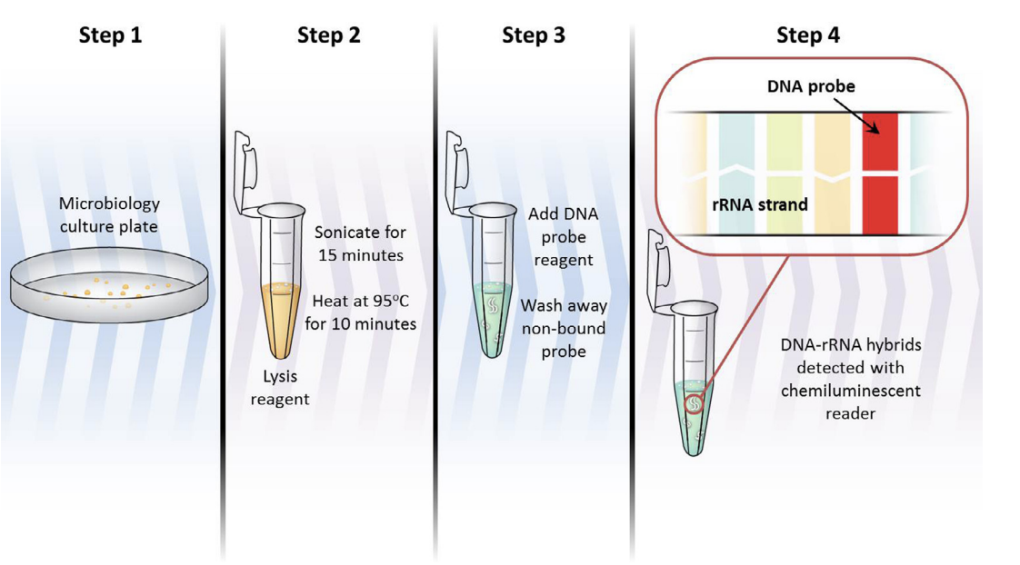
DNA probes (AccuProbe system)
Nucleic acid hybridization
Has been evaluated using fresh growth on solid or broth media
  Requires culture growth as it does not amplify nucleic acid sequences (unlike PCR)
Can be used to identify
  M. tuberculosis complex (cannot differentiate among TB complex)
  M. avium complex
  M. gordonae
  M. kansasii
J Clin Tuberc Other Mycobact Dis. 2016 May 25;4:33-43.
Notes:
Direct clinical specimen (urine, stool, respiratory specimens)
MTB complex: M. tuberculosis, M. bovis, M. bovis BCG, M. africanum and M. microti, M. caprae, M. pinnipedii, M. canettii

Slide 29
Note differences between Xpert MTB/RIF and DNA probe
Xpert MTB/RIF test
Can be performed on smear negative direct clinical specimens and prior to culture growth
DNA probe
Performed by the Micro Lab after culture growth in media

Slide 30
Mycobacteriology Processing
Inoculated on culture media
Solid media (LJ slant)
Liquid media MGIT
Myco-F lytic media (if blood/BM)
Staining/Smear
Fluorochrome, if (+) confirmed with
Kinyoun acid-fast stain
Sterile specimens
concentrated
Specimens received in lab
BLS-3 practices required
(containment, PPE, BSC)
If culture (+)
Non sterile specimens
decontaminated and concentrated
sputum only
Kinyoun stain
NAAT testing
(+)
(-)
DNA probes performed
Rule out Nocardia
(+)
(-)
If (+) MTB, sent to DOH & susceptibility testing
If (-) probes negative, send to DOH

Slide 31
Poll #6
65 year old woman with well controlled HIV and (+) Quantiferon (no hx of LTBI treatment) and presenting for two months of cough with occasional hemoptysis and subjective fevers. CT scan is shown numerous large cavitary lesions with nodular and patchy opacities in right lower and middle lobes. LJ slant grew colonies within 1 week. The most likely organism involved is:
A. A rapidly growing mycobacteria
B. A slowly growing mycobacteria
C. Not enough information

Slide 32
Poll #6
65 year old woman with well controlled HIV and (+) Quantiferon (no hx of LTBI treatment) and presenting for two months of cough with occasional hemoptysis and subjective fevers. CT scan is shown numerous large cavitary lesions with nodular and patchy opacities in right lower and middle lobes. LJ slant grew colonies within 1 week
A. A rapidly growing mycobacteria
B. A slowly growing mycobacteria
C. Not enough information
Clinical scenario suspicious for pulmonary MTB
Growth rate is dependent on burden of organisms
Once culture growth is present, a subculture determines if organism is rapid grower or slow grower (more on this next session)

Slide 33
Poll #7
65 year old woman with well controlled HIV and (+) Quantiferon (no hx of LTBI treatment) and presenting for two months of cough with occasional hemoptysis and subjective fevers. CT scan is shown numerous large cavitary lesions with nodular and patchy opacities in right lower and middle lobes
LJ slant grew the following colonies within 1 week
What is an important characteristic of this organism when taken from culture, spread on a slide, and stained with acid-fast?
Forming rosettes
Sticking together to form cords
Grouping in irregular shapes
Clumping around edges of preparation
Non-pigmented, buff
Rough, dry colonies

Slide 34
Poll #7
65 year old woman with well controlled HIV and (+) Quantiferon (no hx of LTBI treatment) and presenting for two months of cough with occasional hemoptysis and subjective fevers. CT scan is shown numerous large cavitary lesions with nodular and patchy opacities in right lower and middle lobes
LJ slant grew the following colonies within 1 week
What is an important characteristic of this organism when taken from culture, spread on a slide, and stained with acid-fast?
Forming rosettes
Sticking together to form cords
Grouping in irregular shapes
Clumping around edges of preparation
Non-pigmented, buff
Rough, dry colonies

Slide 35
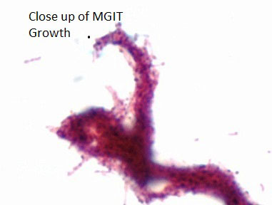
M. tuberculosis
May appear as gram positive “beaded” bacilli or “ghost cells”
Slow doubling time (15 – 20 hrs), takes 2-3 weeks to grow
Niacin (+), nitrite (+)
Cording
  Stick end-end and side-side forming serpentine structures/tight bundles
    Can be seen with other Mycobacteria
Non-pigmented, buff
Rough, dry colonies
  Due to cord factor
    Glycolipid that has various immunologic effects: e.g. blocking macrophage activation by IFN-y and inducing TNFα secretion
Notes:
(if not from subculture, varies depending on the burden of organism)

Slide 36
Take Home Points
Auramine-rhodamine fluorescent stain and a confirmatory Kinyoun acid fast stain are used on mycobacteriology specimens
Xpert MTB/RIF detects MTB and rifampin resistance a/w rpoB gene. Xpert MTB/RIF is performed on smear +/- sputum samples in-house.
Mycobacteriology culture media are: MGIT (Middlebrook broth), Lowenstein Jensen Medium (LJ slant) and Myco-F lytic media
Culture (1–10 CFU/mL) > NAAT (100 CFU/mL) > AFB smear (10,000 CFU/mL)

