Slide 1
Plate Rounds
Session 10
CSF specimens

Slide 2
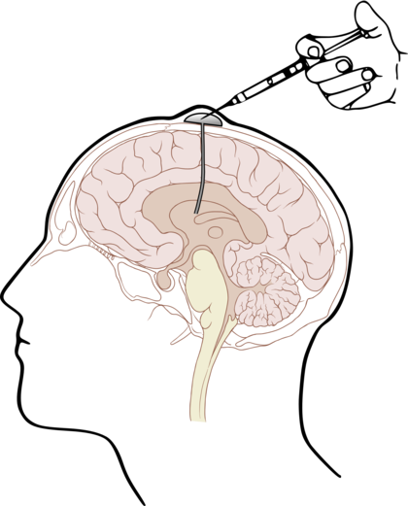
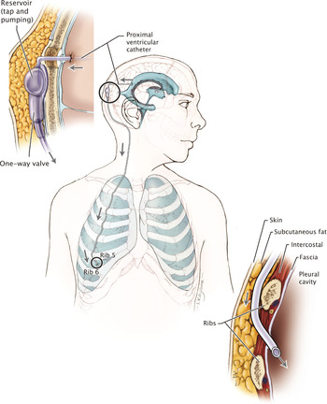
CSF collection
Sterile body fluid → all organisms recovered in culture are potential pathogens
Initial CSF sample ideally collected prior to antimicrobial therapy for highest diagnostic sensitivity
Clearly label 4 CSF tubes
Specimen types: lumbar puncture, ommaya reservoir, ventricular shunts
Important to label source of CSF since different organisms may be clinically significant
ME panel not FDA approved for shunt specimens
Most tests require 0.5 – 1 mL volume, fungal and AFB cultures require ≥ 2 mL

Slide 3
Poll #1
Specimen from which CSF tube should never be used for culture?
A. Tube #1
B. Tube #2
C. Tube #3
D. Tube #4

Slide 4
Poll #1
Specimen from which CSF tube should never be used for culture?
A. Tube #1
B. Tube #2
C. Tube #3
D. Tube #4

Slide 5
CSF collection
Tube #1 | HEME | Cell count | Highest potential for contamination with skin flora → do not send to Micro Lab for smears, culture, or molecular studies
Tube #2 | CHEM | Glucose Protein LDH
Tube #3 | MICRO | Gram stain (at Moses) Biofire ME panel Cultures (bacterial, fungal, AFB) Cryptococcal Ag VDRL Serologies and send-out testing | If there is not enough CSF in Tube #3, some CSF may be taken from Tubes #2 – 4, but the appropriate volume for the tests from that tube must be maintained
Tube #4 | HEME | Cell count Gram stain (at other campuses) Cytology, flow, cytogenetics, FISH

Slide 6
CSF processing
CSF specimens should be immediately sent to lab for processing (ideally within 1 hr) and immediately processed once it reaches the Micro Lab
RBCs and WBC have limited stability in CSF
CSF is hypotonic and cells may rapidly lyse
Do not refrigerate CSF specimens
Fastidious organisms (H. influenzae, N. meningitidis) may not survive at refrigerated temperatures

Slide 7
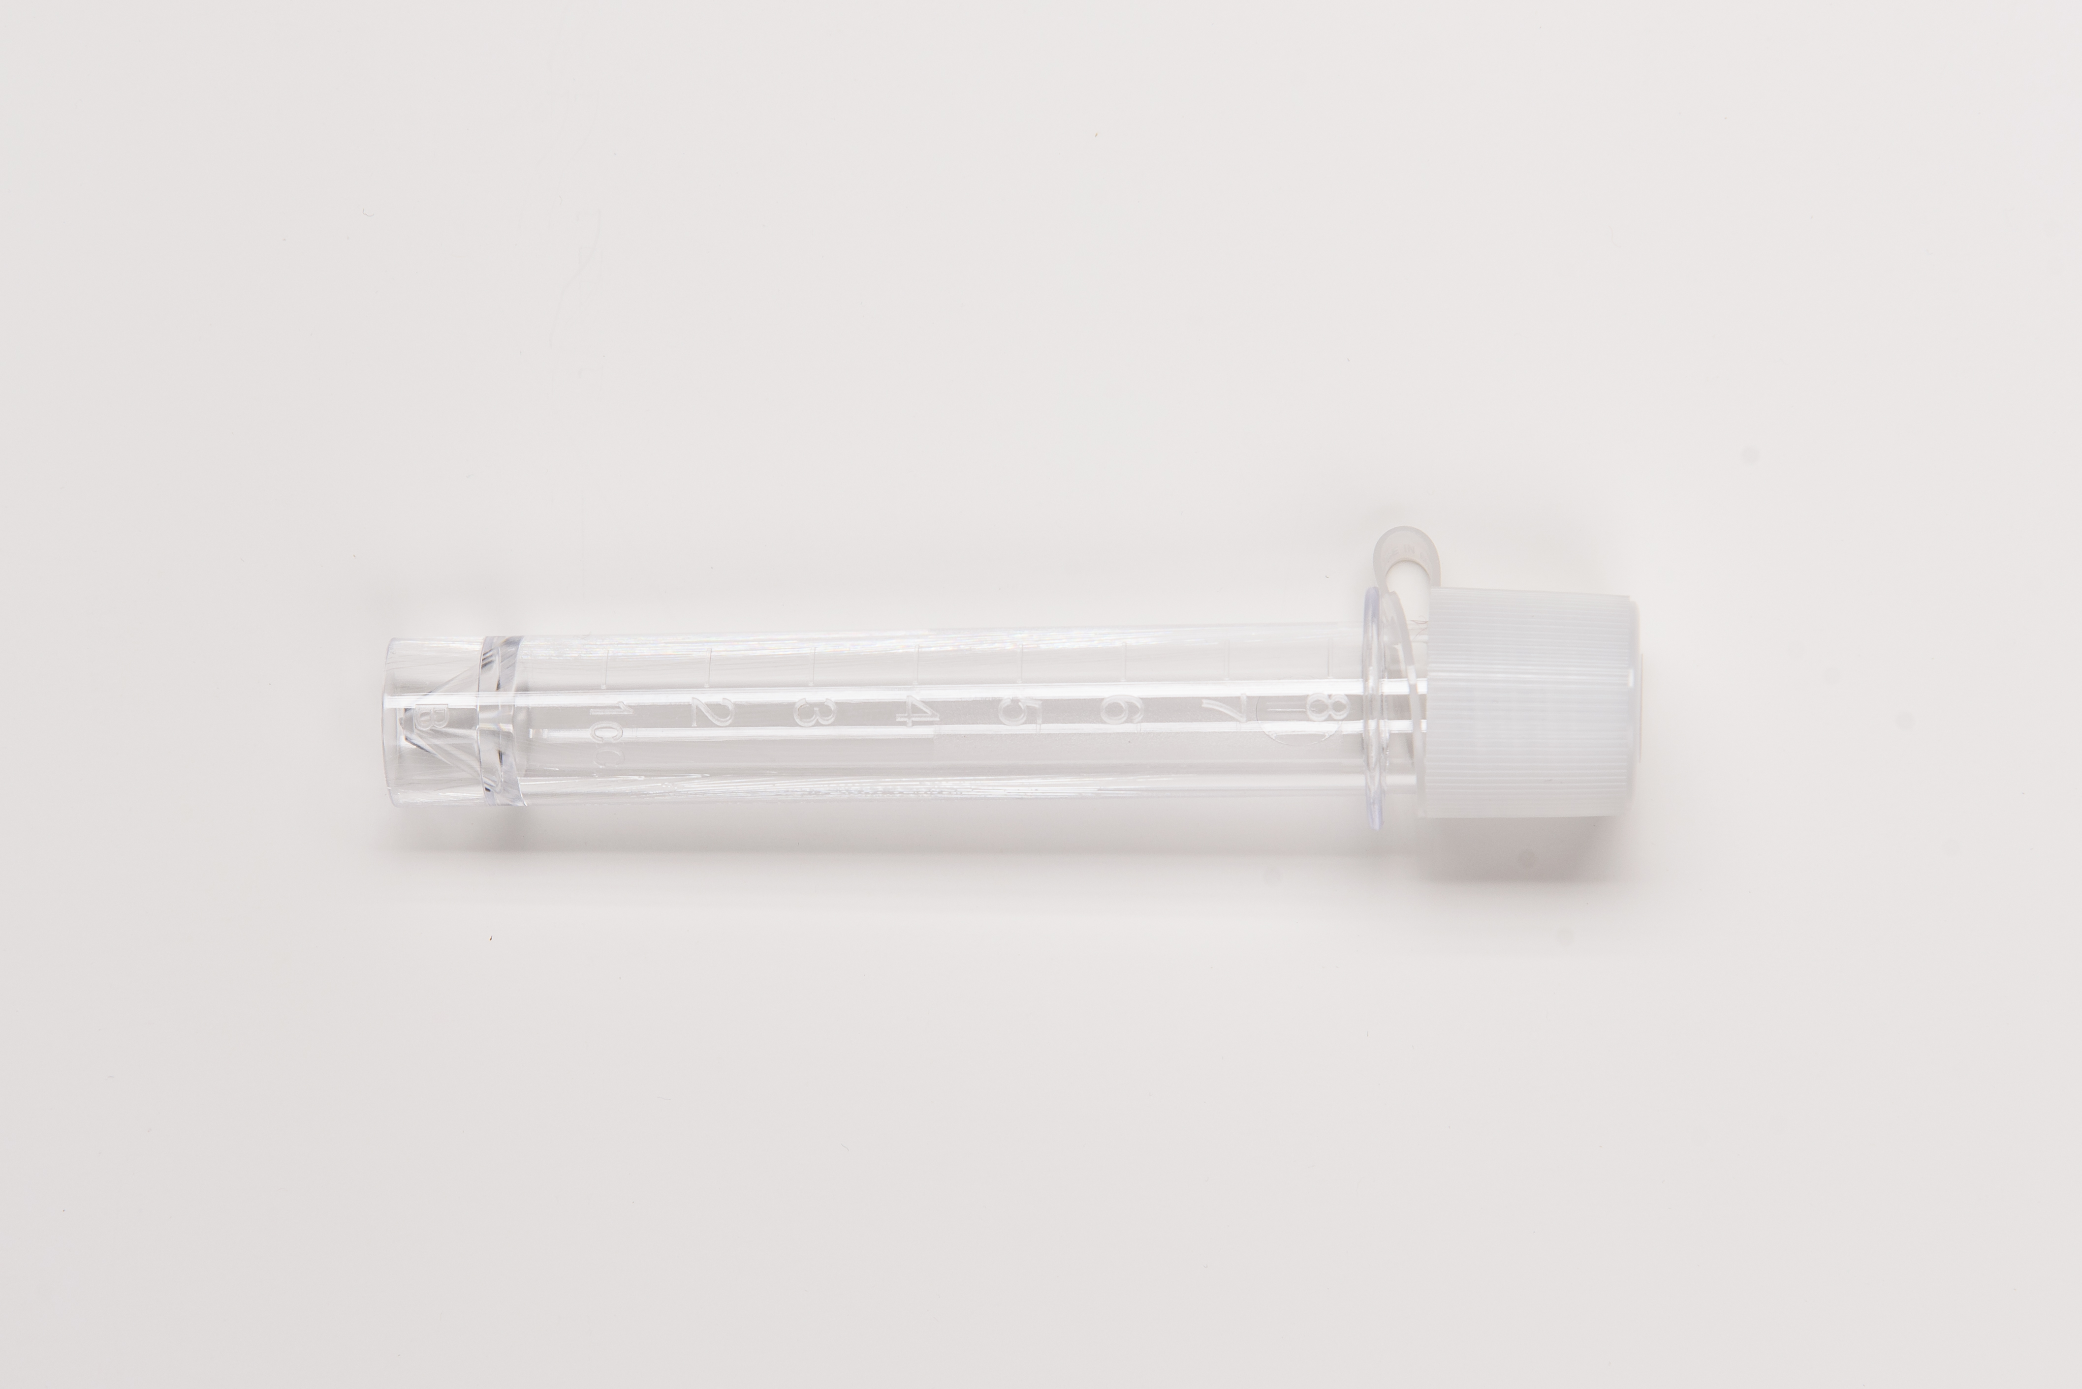
CSF processing: gram stain
Cytocentrifugation performed for concentration
(Cytospin concentration can ↑ sensitivity up to 100x compared with both uncentrifuged and conventional centrifuged fluid)
Gram stain prepared and read immediately
Tube #3: if at Moses
Tube #4: if at other campuses
Note cellular response
Tube #4
(+) organisms
(-) organisms
Reported to Micro supervisor or confirmed by 2nd technologist if Micro supervisor is unavailable. Provider is also notified
If (+) culture, re-smear original fluid and record gram stain

Slide 8
Poll #2
If gram negative, coffee bean shaped diplococci are noted on CSF gram stain, the next step is to:
A. Place culture plates in Infectious Organisms rack to perform all work under Biosafety Cabinet
B. Perform bacterial antigen testing
C. Perform and examine all cultures on the routine CSF bench

Slide 9
Poll #2
If gram negative, coffee bean shaped diplococci are noted on CSF gram stain, the next step is to:
A. Place culture plates in Infectious Organisms rack to perform all work under Biosafety Cabinet
B. Perform bacterial antigen testing
C. Perform and examine all cultures on the routine CSF bench
Neisseria meningitides: Biosafety Level 2 practices are required. Multiple lab acquired N. meningitides infections have been reported with a case fatality rate of 50% (CDC Lab Safety Manual Chapter 4)
Poor sensitivity for N. meningitides - not recommended

Slide 10
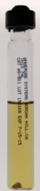
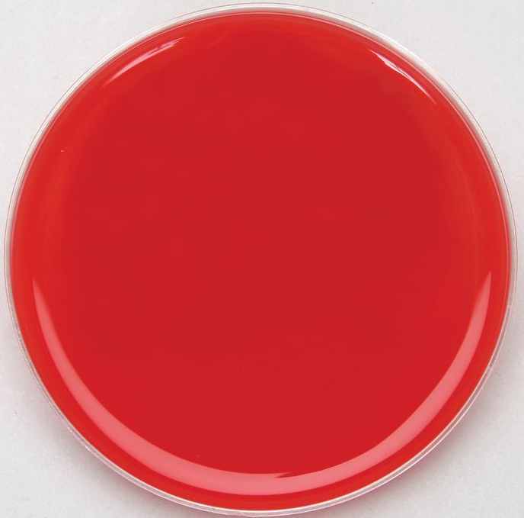
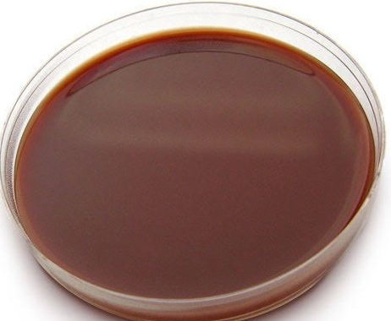
CSF processing: bacterial cultures
Inoculated onto:
1. Blood agar plate
2. Chocolate agar plate
3. Broth culture (thioglycolate)
Keep all negative broths and original culture tubes for four days before reporting as negative
Incubated in CO₂ at 35 – 37ºC and examine daily
If no growth:
BAP discarded after 48 hrs
CAP discarded after 72 hrs
Tube #3

Slide 11
Broth Culture (thioglycollate)
Enriched medium to support growth of anaerobes, aerobes, microaerophilic, and fastidious microorganisms
Used for only for sterile sites (e.g. CSF cultures)
Reporting of growth always noted as “isolated from broth only” to assist clinician in interpretation of relevance of these isolates
Advantages | Disadvantages
Routine aerobic cultures may be inadequate to detect low number or slowly growing organisms More useful for shunt associated CNS meningitis than community acquired bacterial meningitis (one study found 4/16 shunt associated CNS meningitis may be missed if broth culture is not used; Dunbar 1998) | Enhances growth of low number of contaminants (may not be clinically relevant) → growth may not be clinically relevant
Notes:
Interpret growth from broth only isolates in clinical context and with other CSF indices

Slide 12
CSF Meningitis-Encephalitis BioFire Panel
14 targets in 1 hour, requires 200 µL of CSF
CSF specimens should be tested with the BioFire ME panel as soon as possible (no processing such as centrifuge prior)
Test performance not validated for CSF specimens collected from shunts, collected from patients already on abx, or any other sites except for CSF
False (+): contamination of specimen with organisms shed by healthy individuals (e.g. S. pneumoniae, H. influenzae, HSV-1)
False (-): sequence variants, deletions, rearrangements in gene targets
Notes:
False (+): non specific amplification or cross-reactivity (e.g. enterovirus cross-reacts with rhinovirus; rhinovirus can be shed from resp tract of healthy individuals)
If 2 or more organisms are detected in a specimen, retesting is done to confirm the polymicrobial result

Slide 13
CSF ME BioFire Panel: Key Points
A positive detection on the BioFire ME panel does not imply the organism is infectious or the cause of clinical symptoms
E. coli K1:
K1 strains (K1 antigen is capsule that protects bacteria from immune system) account for nearly 80% of E. coli isolated from CSF
Non K1 E. coli serotypes may be present in specimen and will not be detected by the panel
Neisseria meningitides:
BioFire panel only detects encapsulated strains (six associated with epidemics, groups A, B,C,W, X and Y). Non-encapsulated or non-groupable strains rarely cause invasive human infection

Slide 14
CSF ME BioFire Panel: Key Points
HSV-1/2
Liesman et al, 2018
Notes:
discordant analysis was unable to be performed.
Percent positive agreement of 73.1% and 87.3%

Slide 15
CSF ME BioFire Panel: Key Points
HSV-1/2
False (-) on the BioFire Panel is a concern
Real-time PCR for HSV1/2 identified 14 CSF samples positive for either HSV-1/2 that negative for HSV-1/2 by FilmArray ME panel
Potential reason for discrepancy: Very small amount of target nucleic acid (limit of detection for FilmArray ME panel HSV-1/2 targets is 10x higher than for routine HSV-1/2 assay)
Liesman et al, 2018
Notes:
e performance characteristics of the FilmArray ME panel using clinical, residual CSF samples (n 291) that tested positive by a routine method(s) (e.g., bacterial culture, individual real-time PCR assay) for a pathogen represented on the ME panel.
Study conducted in 2018 that evaluated the performance characteristics of the ME panel using residual CSF samples positive by routine methods and compared that with associatd pathogen on the ME panel

Slide 16
CSF ME BioFire Panel: Key Points
HSV-1/2. At our institution,
Do not order separate CSF HSV-1/2 PCR
If HSV-1/2 target is negative on ME BioFire Panel, it is automatically reflexed to CSF HSV-1/2 PCR

Slide 17
CSF ME BioFire Panel: Key Points
Cryptococcus neoformans
BioFire ME panel correlation with:
CrAg assay: high proportion of CrAg (+) not detected by BioFire panel
Samples were collected after initial diagnosis while on anti-fungal therapy
CrAg can persist for months – years
CSF culture: BioFire ME panel sensitivity of 94%
Tests of choice remain CrAg and CSF fungal culture (gold standard)
Cryptococcus neoformans result from the ME panel is hidden at our institution

Slide 18
CSF ME BioFire Panel: Key Points
Other areas of concern:
Interpretation of positive CMV and HHV6 results: does not distinguish between latent/active infections (primary infection vs. secondary reactivation vs. presence of latent virus)
False positive rate of S. pneumoniae

Slide 19
Additional CSF testing
Since specimen volume is limited, indicate order of priority if multiple tests are requested

Slide 20
Case
70 yo woman with DM admitted after suffering a fall at home, found to be encephalopathic and febrile to Tmax 102.5ºF. There was initial suspicion was for acute pyelonephritis and obstructive uropathy but fevers and mental status did not improve after urgent ureteral stent placement.
Blood cultures from admission were positive by instrument in both aerobic and anaerobic bottles approximately 15 hours after collection
A lumbar puncture was performed once the organism was identified in blood culture.

Slide 21
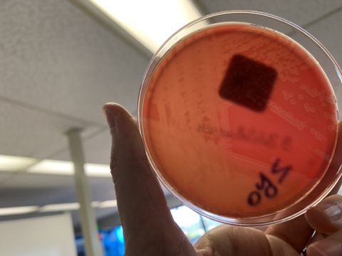
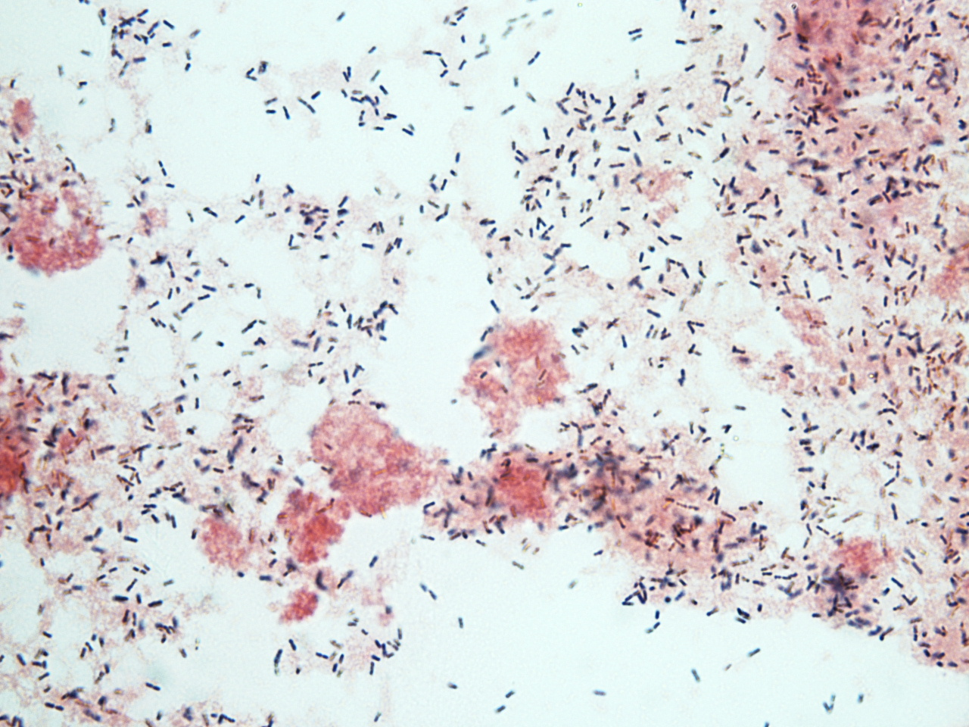
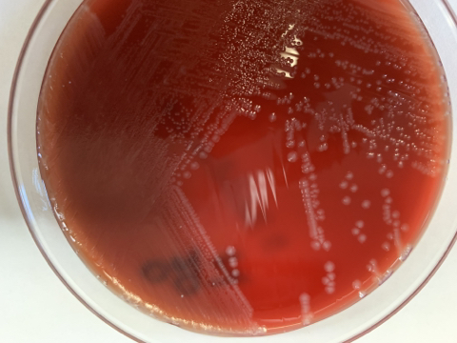
Case
Beta-hemolysis
Gram stain (blood culture):
Short gram positive rods
Can occur singly or in short chains
Can be easily confused with coccoid organisms

Slide 22
Poll #3
The most likely organism is:
A. Streptococcus agalactiae
B. Listeria monocytogenes
C. Haemophilus influenzae
D. Enterococcus faecalis

Slide 23
Poll #3
The most likely organism is:
A. Streptococcus agalactiae
B. Listeria monocytogenes
C. Haemophilus influenzae
D. Enterococcus faecalis

Slide 24
Poll #4
Which of the following tests can help distinguish Streptococcus spp from Listeria monocytogenes?
A. Catalase test
B. Motility test
C. Both A and B

Slide 25
Poll #4
Which of the following tests can help distinguish Streptococcus spp from Listeria monocytogenes?
A. Catalase test
B. Motility test
C. Both A and B

Slide 26
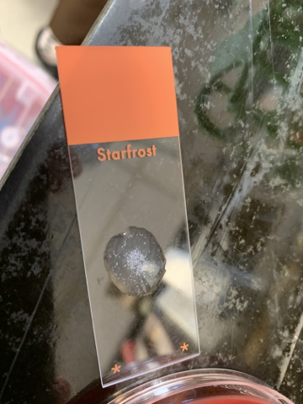
Poll #4
Which of the following tests can help distinguish Streptococcus spp from Listeria monocytogenes?
A. Catalase test
B. Motility
C. Both A and B
Catalase Test: tests for presence of catalase, which breaks down H₂O₂ into H₂O and O₂
Catalase Test
Positive
Negative
Listeria
Staphylococci
Streptococci
Enterococci

Slide 27
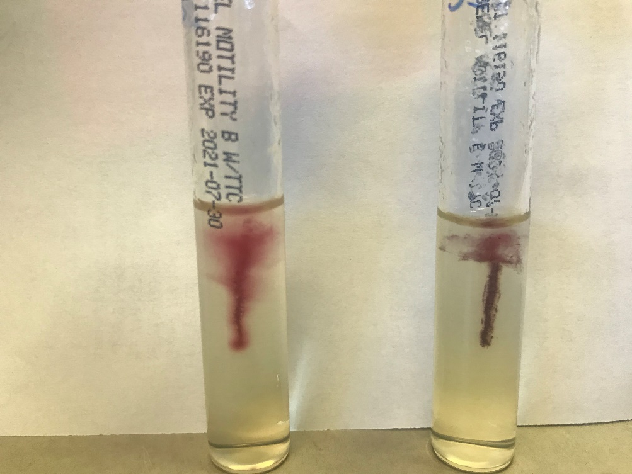
Poll #4
Which of the following tests can help distinguish Streptococcus spp from Listeria monocytogenes?
A. Catalase test
B. Motility
C. Both A and B
Listeria monocytogenes:
Umbrella-like motility in semi-solid media
A layer of ↑ growth 0.5 cm below surface because Listeria has better development in this zone of reduced O₂ tension
Tumbling motility (end over end) on hanging drop preparation
Optimally motile by means of flagella at 20 – 25ºC
Non motile at 37ºC - does not synthesize flagella at body temperature

Slide 28
Listeria monocytogenes
Microbiological characteristics
Growth in both aerobic and anaerobic conditions
Short, gram positive rod, occasionally intracellular
May be confused with beta-hemolytic Streptococcus species or diphtheroids on gram stain
Characterized by:
Beta hemolysis (does not usually extend beyond the border of the colony)
Catalase (+)
Tumbling motility at 20 – 25ºC, non-motile at 37ºC
CAMP (+)

Slide 29
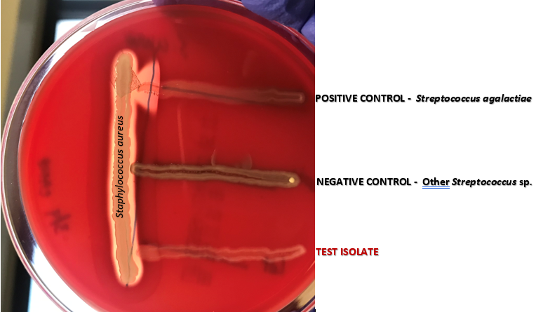
Listeria monocytogenes
CAMP test
S. agalactiae CAMP (+)
Produces CAMP factor which synergistically interacts with beta-hemolysin produced by S. aureus → zone of enhanced lysis
Other Streptococcus species (not Group B) → Negative test
L. monocytogenes
Like S. agalactiae, Listeria is CAMP (+)

Slide 30
Listeria monocytogenes
Able to grow at low temperatures (4ºC); killed by heat and pasteurization
Food associations: contaminated food (soft cheeses, unpasteurized milk/diary products, peanut butter, deli meat, fruit, salad)
Mild febrile illness, gastroenteritis, fatal invasive infection (especially in neonatal disease), meningoencephalitis (rhombo-encephalitis)
Treatment:
Ampicillin: drug of choice based on in-vitro data, but delayed in vitro bactericidal activity at concentrations in CSF (add gentamicin)
Alternatives: TMP-SMX
Cephalosporins do not have activity against Listeria

Slide 31
Case
68 yo F presented with 1 day of diplopia, dysmetria, and headache found to have newly diagnosed CLL. MRI brain showed left tympanomastoid effusion and numerous punctate hyperintensities within the frontal lobes and occipital horns of bilateral lateral ventricles either due to hemorrhage or meningitis. A lumbar puncture was performed
CSF First Tube | CSF Last Tube
WBC 315 RBC 50 Lymphocytes 90% PMNs 10% Glucose 65 Protein 103 | WBC 197 RBC 50 Lymphocytes 83% PMNs 16%
The BioFire ME panel detects one bacterial target while
CSF gram stain and culture is performed.

Slide 32
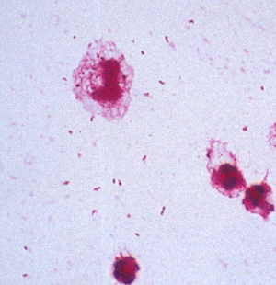
Poll #5
The most likely organism is:
A. Viridans streptococcus
B. Streptococcus pneumoniae
C. Haemophilus influenzae
D. Neisseria meningitides
CSF gram stain:
Small, pleomorphic gram negative bacilli or coccobacilli

Slide 33
Poll #5
The most likely organism is:
A. Viridans streptococcus
B. Streptococcus pneumoniae
C. Haemophilus influenzae
D. Neisseria meningitides
CSF gram stain:
Small, pleomorphic gram negative bacilli or coccobacilli

Slide 34
Poll #6
You expect which of the following growth pattern when H. influenzae plated on agar?
A. Growth on standard BAP only
B. Growth on CAP only
C. Growth on both standard BAP and CAP
D. No growth on BAP or CAP
CSF gram stain:
Small, pleomorphic gram negative bacilli or coccobacilli

Slide 35
Poll #6
You expect which of the following growth pattern when H. influenzae plated on agar?
A. Growth on standard BAP only
B. Growth on CAP only
C. Growth on both standard BAP and CAP
D. No growth on BAP or CAP
CSF gram stain:
Small, pleomorphic gram negative bacilli or coccobacilli

Slide 36
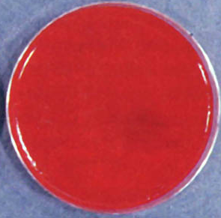
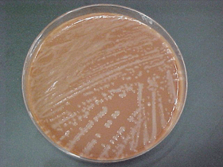
Case
CSF gram stain:
Small, pleomorphic gram negative bacilli or coccobacilli
BAP:
No growth
CAP:
Large, round, colorless – grey, opaque colonies

Slide 37
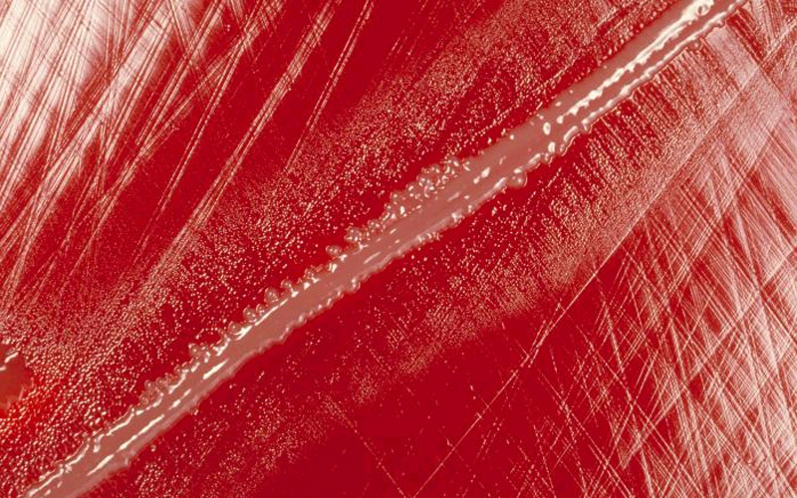
Haemophilus influenzae
Satelliting
Microbiological characteristics
Small, pleomorphic gram negative coccobacilli, often have a tendency to string out like long thread-like rods
Fastidious organism
Grows best at 35 – 37ºC with 5% CO₂
Requires hemin (factor X) and NAD (Factor V) for growth
Does not grow on BAP, which contains Factor X but not V
“Satelliting”: will grow on BAP when colonies are streaked close to S. aureus colonies (S. aureus produces NAD factor V as metabolic byproduct when grown in culture media containing blood)
Growth on CAP only, which contains available Factor X and Factor V
Colonies: large, colorless-gray, semiopaque, smooth, flat convex

Slide 38
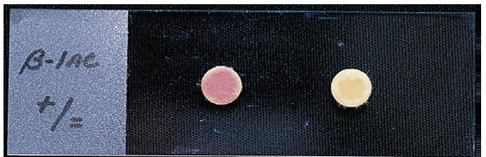
Haemophilus influenzae
Classified as serotypable or nontypable based on presence/absence of polysaccharide capsule
Encapsulated strains are further divided into six serotypes (a – f)
In areas with routine vaccination, majority of invasive H. influenzae disease are caused by non typeable strains
RF for meningitis (0.08 cases/100,000): otitis/pharyngitis, DM, immune deficiency, head trauma with or without CSF leakage
Susceptibilities: when isolated in culture, tested for beta-lactamase production and by KB method. For H. influenzae,
(+) beta lactamase
R: ampicillin
S: cephalosporins
(-) beta lactamase implies but do not
guarantee ampicillin susceptibility
Presence of β-lactamase
No β-lactamase

Slide 39
Poll #6
Gram negative diplococci, kidney shaped (adjacent sides flattened)
May occur intracellularly or extracellularly
Fastidious, grows best at 35 – 37ºC with 5% CO₂
Grows on BAP and CAP
BAP: grey, unpigmented, clearly defined edge
CAP: large, colorless-gray, opaque
6 serogroups associated with epidemics (A, B, C, W, X, Y)
The most likely organism is:
A. Viridans streptococcus
B. Streptococcus pneumoniae
C. Haemophilus influenzae
D. Neisseria meningitides

Slide 40
Take Home Points
CSF Tube #3 is used for microbiological testing. Tube #1 has highest potential for contamination
Interpret broth only isolates within clinical context; broth will enhance growth of contaminants
Meningoencephalitis BioFire panel has excellent sensitivity and specificity, but has notable limitations specifically for HSV-1/2 and Cryptococcus targets
Listeria monocytogenes is a short gram positive rod, that is catalase (+), CAMP (+), and has umbrella like motility in semi-solid media
H. influenzae are small, pleomorphic, fastidious gram negative coccobacilli that require Factors X and V to for growth → will only grow on chocolate agar (exception: satelliting around S. aureus on BAP)

