Slide 1
Plate Rounds
Session 1

Slide 2
Case
71 yo M
  MDS (azacitadine, last dose 3 days ago), cirrhosis, DMII, obstructive lung dx
  Productive cough x 1 week, ANC 100 - 400
RUL PNA
vanco/zosyn
RCx - normal flora
worsening respiratory status
massive hemoptysis
RUL necrotizing PNA
vanco, cefe, vori
BAL RCx: Acinetobacter
meropenem
BAL RCx...
what else grew?
persistent high
grade fevers
septic shock

Slide 3
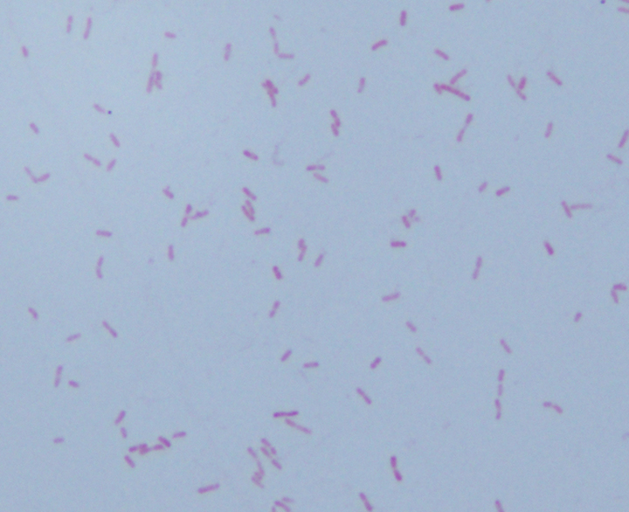
gram stain of BAL sputum
?
gram positive
gram negative

Slide 4
?
gram positive
gram negative
cocci rods/bacilli

Slide 5
gram positive
gram negative
cocci rods/bacilli
One way to differentiate gram negative rods?

Slide 6
gram positive
gram negative
cocci rods/bacilli
lactose fermenting
non lactose fermenting
One way to differentiate lactose fermentation…?

Slide 7
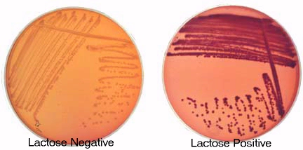
gram positive
gram negative
cocci rods/bacilli
lactose fermenting
non lactose fermenting
MacConkey Agar
Selective – bile salts and crystal violet inhibit gram (+) growth
Differentiates - enteric gram negatives based on ability to ferment lactose
Organisms that ferment lactose produce acidic environment – pink
Organisms that do not ferment lactose - normal or colorless

Slide 8
gram positive
gram negative
cocci rods/bacilli
lactose fermenting
non lactose fermenting
Examples…
1.
2.
3.
4.
Examples…
1.
2.
3.
4.
5.

Slide 9
gram positive
gram negative
cocci rods/bacilli
lactose fermenting
non lactose fermenting
Examples…
1. Klebsiella
2. E. coli
3. Enterobacter
4. Citrobacter (slow)
5. Serratia (slow, rarely)
Examples…
1.
2.
3.
4.
5.

Slide 10
gram positive
gram negative
cocci rods/bacilli
lactose fermenting
non lactose fermenting
Examples…
1. Klebsiella
2. E. coli
3. Enterobacter
4. Citrobacter (slow)
5. Serratia (slow, rarely)
Examples…
Pseudomonas
Proteus
3. Shigella, Salmonella, Campylobacter
4. Stenotrophomonas
5. Acinetobacter

Slide 11
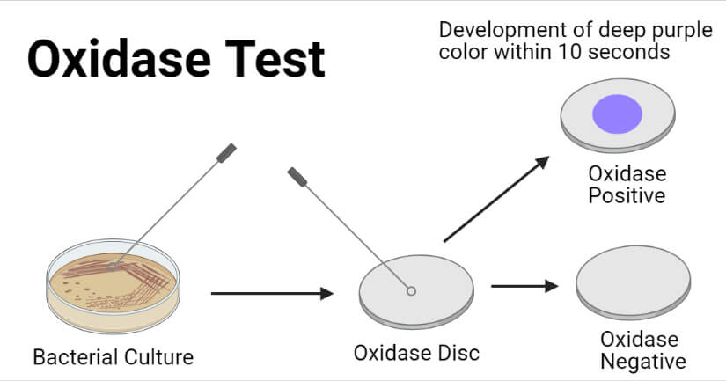
gram (+)
gram (-)
cocci rods/bacilli
Non lactose fermenting
oxidase (+) oxidase (-)
Examples…
1.
2.
3.
Examples…
1.
2.
3.
4.
5.
6.
Test to evaluate presence of cytochrome oxidase enzyme

Slide 12
gram (+)
gram (-)
cocci rods/bacilli
Non lactose fermenting
oxidase (+) oxidase (-)
Examples…
Pseudomonas
Examples…
1. Proteus
2. Shigella
3. Salmonella
4. Stenotrophomonas
5. Acinetobacter
6. Burkholderia
Test to evaluate presence of cytochrome oxidase enzyme

Slide 13
Gram negative bacilli
Non lactose fermenting
Oxidase positive
Characteristics on agar?
  1.
  2.

Slide 14
Chryseobacterium indologenes
Gram negative bacilli
Non lactose fermenting
Oxidase positive
Characteristics on agar?
  1. Distinctive yellow - orange pigment on blood agar
  2. No growth on MacConkey

Slide 15
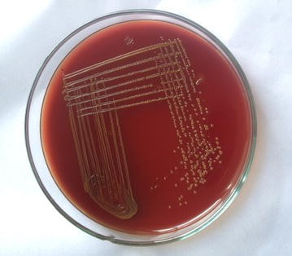
Chryseobacterium indologenes
Ubiquitous in nature – soil, plants, water (resists chlorination ∴ in municipal water supplies)
Forms biofilms (indwelling devices)
Hospital settings:
  water systems, wet surfaces (faucets, wash basins)
  contaminated medical devices (respirators, endotracheal tubes, syringes, humidifers)
RF: immunocompromised, prolonged abx use, hospitalization
Infections: bacteremia, pneumonia, meningitis, pyomyositis, keratitis, indwelling device associated infections

Slide 16
Chryseobacterium indologenes
Susceptibility patterns (84 isolates)
Drug | MIC₅₀ | MIC₉₀ | % susceptible
Ceftriaxone | >32 | >32 | 0
Meropenem | >8 | >8 | 0
Gentamicin | >8 | >8 | 0
Tetracycline | >8 | >8 | 0
Pip/tazo | 128/4 | >128/4 | 13%
Cefepime | >32 | >32 | 16%
Levofloxacin | >8 | >8 | 19%
Tigecycline | 4 | >8 | 25%
TMP-SMX | 4/76 | >4/76 | 42.9%
Minocycline | 4 | 8 | 67.9
Lin et al, 2019

Slide 17
Chryseobacterium indologenes
Susceptibility patterns (84 isolates)
1. Intrinsically resistant to cephalosporins and carbapenems (produces molecular class A β-lactamase and class B carbapenem-hydrolyzing β-lactamase)
2. Higher rates of resistance to pip/tazo and fluoroquinolones in East Asia (from ‘97 – ’01 in N. America 100% and 93% isolates susceptible respectively)
3. Highest susceptibility rates to TMP-SMX and minocycline
Drug | MIC₅₀ | MIC₉₀ | % susceptible
Ceftriaxone | >32 | >32 | 0
Meropenem | >8 | >8 | 0
Gentamicin | >8 | >8 | 0
Tetracycline | >8 | >8 | 0
Pip/tazo | 128/4 | >128/4 | 13%
Cefepime | >32 | >32 | 16%
Levofloxacin | >8 | >8 | 19%
Tigecycline | 4 | >8 | 25%
TMP-SMX | 4/76 | >4/76 | 42.9%
Minocycline | 4 | 8 | 67.9
Lin et al, 2019

Slide 18
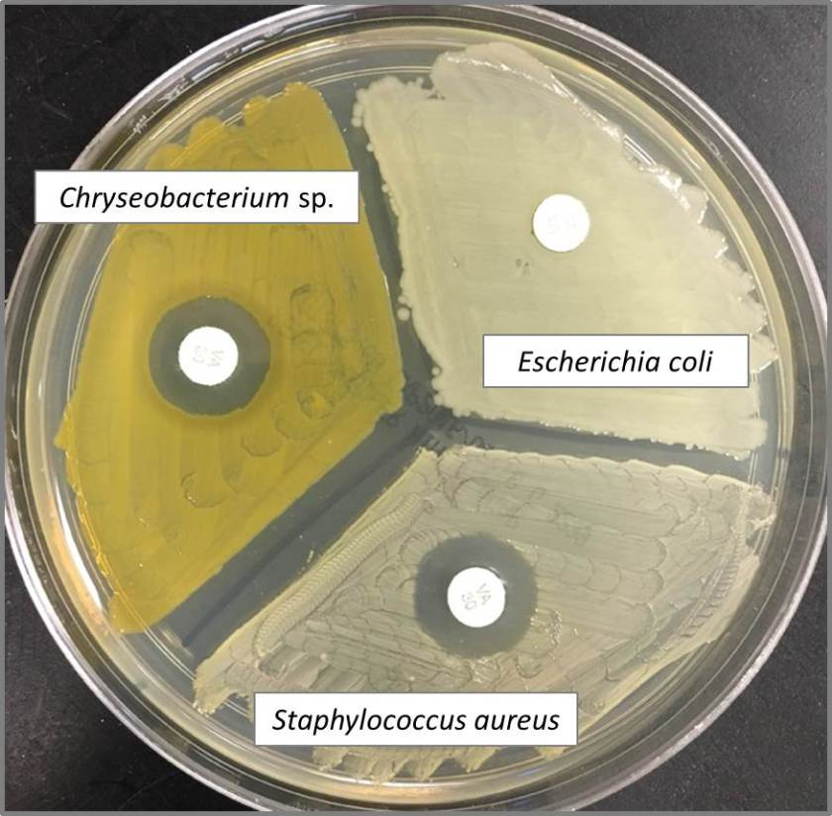
Chryseobacterium indologenes
vancomycin
Susceptibility patterns
4. Disk diffusion testing does not accurately predict susceptibilities as determined by agar dilution testing
28 Chryseobacterium isolates (Aber, 1978)
Disk diffusion testing: 100% isolates vancomycin susceptible (zones ≥ 12 mm)
Agar dilution testing: all isolates with vancomycin MIC 8 – 16 ug/mL

Slide 19
Tmax 102, 94% SpO2
Diffuse rales, wheezing
WBC 13.8
54 year old woman w/ HFrEF and asthma presenting to ED in July 2021
symptomatic with dyspnea, cough x 3 days
recently visited <1 year old granddaughter and son with similar symptoms
not vaccinated against COVID19

Slide 20
Tmax 102, 94% SpO2
Diffuse rales, wheezing
WBC 13.8
ED asks which tests to send
for SARS-CoV-2?
what other testing?

Slide 21
ED inquires about the differences among…
expedited SARS-CoV-2 NP
expedited Flu/RSV/SARS-CoV-2 NP
standard SARS-CoV-2 NP
 | Expedited SARS-CoV-2 NP | Expedited Flu/RSV/SARS-CoV-2 NP | Standard SARS-CoV-2 NP
Indications
Performed
Platform

Slide 22
ED inquires about the differences among…
              expedited SARS-CoV-2 NP
              expedited Flu/RSV/SARS-CoV-2 NP
              standard SARS-CoV-2 NP
 | Expedited SARS-CoV-2 NP | Expedited Flu/RSV/SARS-CoV-2 NP | Standard SARS-CoV-2 NP
Indications | ED or direct admit Urgent pre-procedural testing | ED or direct admit w/ symptoms | Occupational Health Inpatient -> discharge
Performed | Micro | Micro | Virology
Platform | Cepheid Xpert | Cepheid Xpert

Slide 23
Respiratory Viruses
Respiratory Pathogen Panel
(performed in Virology)
Nasopharyngeal swab
Multiplex NAAT
16 respiratory viral pathogens and 2 bacterial targets
Cannot differentiate rhinovirus and enterovirus due to genetic similarity

Slide 24
Parainfluenza
Serotypes | Seasonality
PIV-1 | Sept – Dec year Biennial pattern (peaks in odd numbered years) | Most common cause of croup
PIV-2 | Fall of each year but can have every other year periodicity | Croup and URI/LRI illnesses
PIV-3 | April – June Even number years when PIV1 not circulating, longer season | Bronchiolitis, pneumonia
PIV- 4 (a/b) | No established seasonality | Milder disease
Enveloped RNA virus, single stranded, negative sense
Ab serotype specific with little cross protection afforded by Abs between serotypes
Highest morbidity/mortality by PIV-3 especially in BMT pts

Slide 25

SARS-CoV-2 Diagnostics
1
2
3
Nucleic Acid
Amplification
Test (NAAT)
Antigen
detection
Serology
(ELISA)

Slide 26
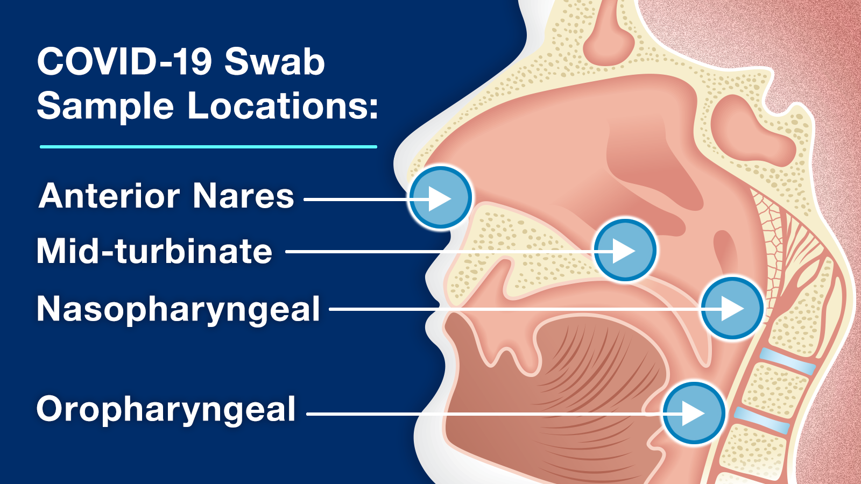
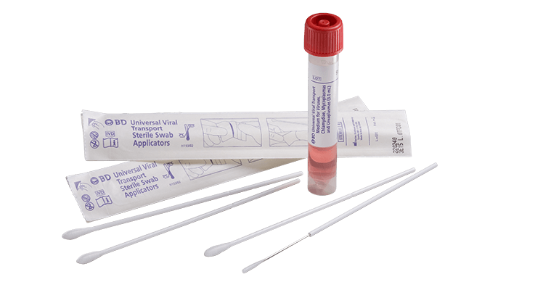
1
Nucleic Acid
Amplification
Test (NAAT)
Specimen types:
  Upper respiratory - Nasopharyngeal, mid-turbinate, anterior nasal, saliva
  Lower respiratory - Sputum, endotracheal aspirate, BAL
Specimen collection:
  Viral transport media (preferred)

Slide 27
1
Cycle Threshold
<page> Pt COVID+, asymptomatic but high CT value. Please call.
What might you reply about the cycle threshold value?
Nucleic Acid
Amplification
Test (NAAT)

Slide 28
1
Nucleic Acid
Amplification
Test (NAAT)
Cycle Threshold
PCR commonly uses 40 cycles of amplification. Each cycle doubles the target DNA
The cycle of amplification that fluorescence crosses the threshold to positive
Relative measure of the concentration of target in a reaction (inversely proportional)
Fluorescence intensity
Threshold
Cycle Threshold = 25
0 5 10 15 20 25 30 35 40
Cycle Number

Slide 29
1
Nucleic Acid
Amplification
Test (NAAT)
Cycle Threshold
At CT value > 24,
  Strong correlation with reduced recovery of virus in cell culture
  Culture positivity declined with increasing CT values.
At CT value 33, 12.5% viral cultures positive
At CT value > 34, SARS-CoV-2 could not be isolated in culture
Scola et al, 2020
Fluorescence intensity
Threshold
Sample 2: Negative
Does not cross the threshold line after 40 cycles
0 5 10 15 20 25 30 35 40
Cycle Number

Slide 30
1
Cycle Threshold
<page> Pt COVID (+), first CT value 15. Accidentally ordered another COVID swab again today, CT value 20. Any change in mgmt?
How do you explain the difference in CT values?
Nucleic Acid
Amplification
Test (NAAT)

Slide 31
1
Nucleic Acid
Amplification
Test (NAAT)
Factors that impact CT value
Test Factors
Volume of sample subjected to testing
Gene target
PCR primer and probe design
Nucleic acid extraction efficiency
Gene target amplification efficiency
PCR instrument parameters and settings
Specimen Factors: age of specimen, specimen quality, dilution of sample in transport medium or other liquid, transport and storage condition
Two primers
  E: Envelope protein sensitive to all coronaviruses
  N2: Specific gene in nucleoprotein gene region and highly specific for the virus
Notes:
Qualitative PCRs not designed to provide quantitative measurements (not normalized to standardized controls of known concentration)

Slide 32
1
Nucleic Acid
Amplification
Test (NAAT)
CT values can vary significantly between platforms and gene targets
ACP surveyed > 700 laboratories using proficiency testing material produced from the same batch
Using identical control material:
  Median CT values reported by different instruments varied by as many as 14 cycles
  Reproducibility on same instrument differed by median of 3 cycles

Slide 33
1
Nucleic Acid
Amplification
Test (NAAT)
Exposure to virus
Symptom onset
NAAT (NP swab)
Viral RNA detectable as early as day 1 of symptoms
Peaks 4 – 6 days after symptoms
Declines by week 3
Remains detectable for a median duration 15 – 18 days
NAAT NP vs LRT specimens
Probability of detection
NAAT (NP swab)
-2 -1 0 1 2 3 4 5 6
Time from symptom onset (weeks)

Slide 34
2
Antigen
detection
Exposure to virus
Symptom onset
Probability of detection
How does the probability timeline of SARS-CoV-2 detection differ for antigen testing compared to NAAT testing?
NAAT (NP swab)
-2 -1 0 1 2 3 4 5 6
Time from symptom onset (weeks)

Slide 35
2
Antigen
detection
Exposure to virus
Symptom onset
Antigen testing
Detects viral protein
Sensitivity
  Dependent on presence/absence of symptoms and timing of testing relative to symptoms
  ~40% for those without symptoms
  First 7d illness x symptomatic: 84%
  >7d symptoms 62%
Specificity
  ≥ 98% compared to NAAT
  (+) Ag does not warrant confirmatory NAAT
Probability of detection
NAAT (NP swab)
Ag
-2 -1 0 1 2 3 4 5 6
Time from symptom onset (weeks)

Slide 36
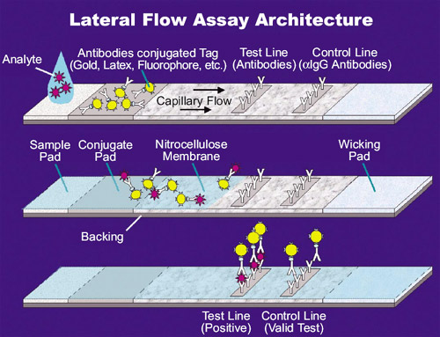
2
Antigen
detection
Lateral Flow Immunoassay
Sample applied to absorbent pad
Migrates through conjugate pad - detector Abs (conjugated to coloured or fluorescent particles)
Sample flows into test line which has Abs that bind to SARS-CoV-2 protein

Slide 37
Summary Points
MacConkey agar is a selective and differential medium. Selects for gram (-) and differentiates lactose vs non lactose fermenters
Chryseobacterium indologenes GNR, yellow pigmented colonies, no growth on MacConkey. Intrinsically resistant to cephalosporins and meropenem, more likely susceptible to minocycline, TMP-SMX, fluoroquinolones
Parainfluenza serotype 3 most associated with severe disease especially in ICT pts
SARS-CoV-2 NAAT CT value represents # of PCR cycles required to amplify the targeted viral nucleic acid to a detectable level but use with caution as CT values can vary
SARS-CoV-2 Ag testing most useful in symptomatic pts within 5 - 7 days of symptoms. High false negative rate in asymptomatic or >7 d of symptoms

