Slide 1
Antimicrobial Review 1
Hongkai (Jack) Bao, PharmD
ID Pharmacist @ Wakefield

Slide 2
Outline
Antibiotics
Vancomycin
Aminoglycosides
Linezolid
Fluoroquinolones
Tetracyclines
Fosfomycin

Slide 3
Important Formulas
Ideal Body Weight (IBW)
Adjusted Body Weight (Adj BW)
Creatinine Clearance (CrCl)
Male: 50 + 2.3 x (inches above 60 inches)
Female: 45 + 2.3 x (inches above 60 inches)
IBW + (0.4 * (TBW - IBW))
[(140-Age)/(72*SCr)]*Dosing Weight
Multiply by 0.85 if female
IBW: Ideal body weight
TBW: Total body weight
Adj BW: Adjusted body weight

Slide 4
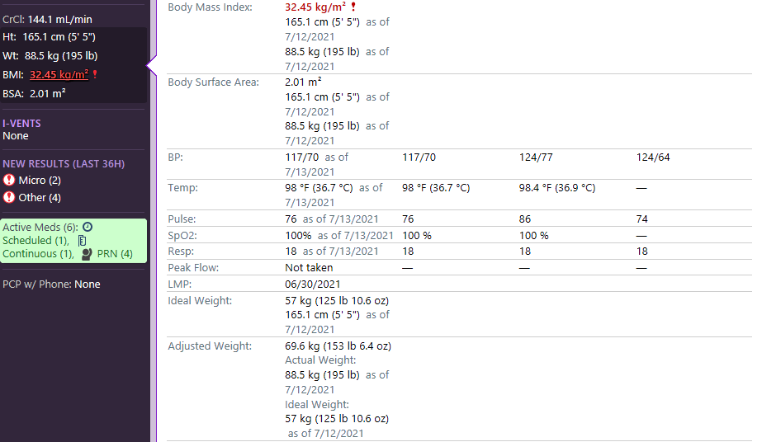

Slide 5
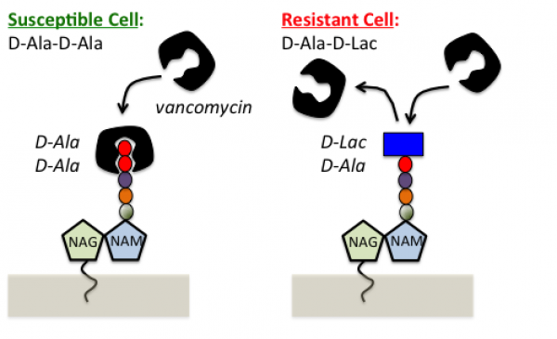
Vancomycin (Glycopeptide)
 | MRSA | MSSA | VRSA | Enter | VRE | Strep | Anab
VANC
+
+/-
+
+
CoNS
Corynebacterium
Notes:
Discovered in 1950’s
“Mississippi mud”
CoNS
Corynebacterium

Slide 6
Pharmacokinetics/ Pharmacodynamics
Bactericidal (slowly)
Poorly absorbed from the intestinal tract
  Should be administered parenterally unless treating for C. difficile
90% excreted via kidneys
Target AUC:MIC >400 to achieve clinical effectiveness
  Trough monitoring as a surrogate
  10-15 for SSTI, CoNS line infections
  15-20 anything else
Levine DP. Clin Infect Dis. 2006 Jan 1;42 Suppl 1:S5-12
Rybak MJ et al. Pharmacotherapy. 2009 Nov;29(11):1275-9..

Slide 7
Adverse Effects
Red man’s syndrome
  Idiopathic, not related to antibodies
  May occur with first administration
  Related to direct activation of mast cells & histamine release
  Tingling/flushing of face, neck, upper torso > lower body
  Erythema & pruritus
  Related to rate of infusion
Nephrotoxicity particularly with piperacillin-tazobactam
Ototoxicity
Rybak MJ et al. Pharmacotherapy. 2009 Nov;29(11):1275-9..

Slide 8
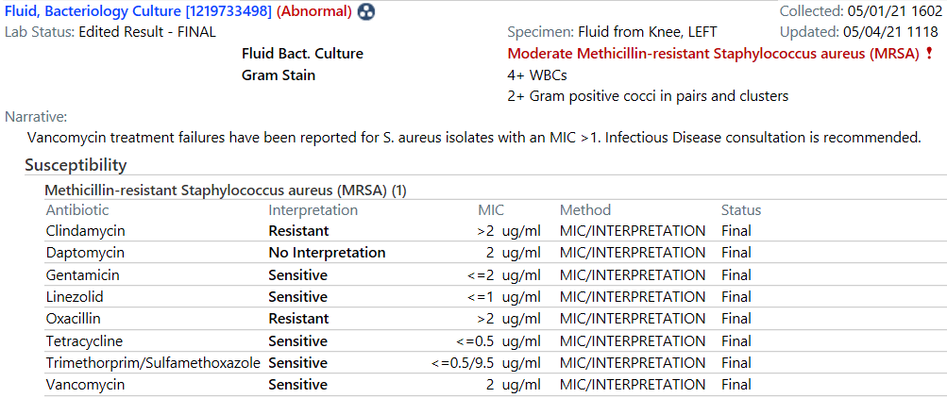
MIC Creep

Slide 9
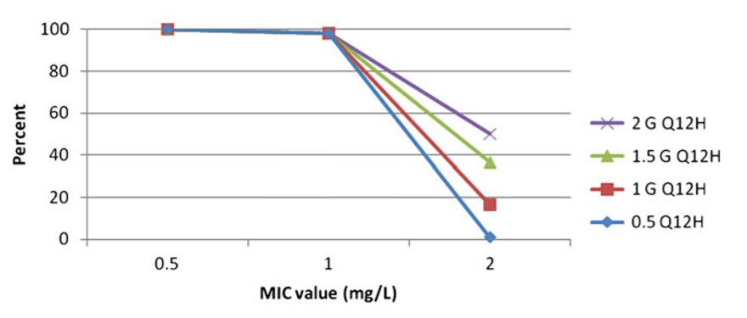
Probability of AUC:MIC >400 when MIC is 2
Decreased probability of achieving a therapeutic AUC:MIC of at least 400 when MIC is > 1
Patel N et al. Clin Infect Dis. 2011;52(8):969–974
Notes:
Caveats about using AUC:MIC – MIC of bug being treated cannot be > 1. As you see, the probability of achieving a therapeutic AUC:MIC of drastically decreased when MIC goes above 1 mg/L.

Slide 10
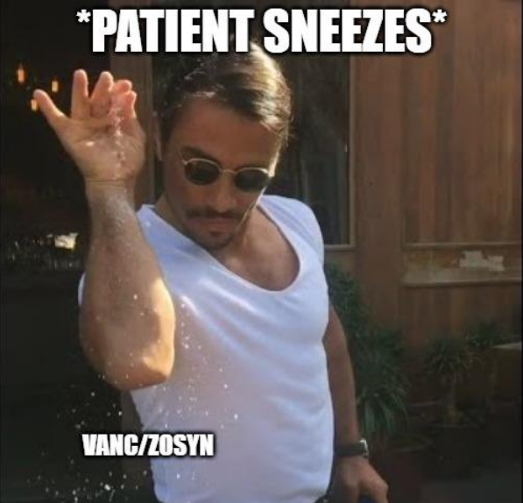


Slide 11
Dosing Vancomycin
60y M comes in with septic shock, unclear source
“Urgent page, need help with vancomycin dosing”
83 kg
CrCl 60 ml/min
How would you dose this patient?

Slide 12
Empiric Dosing
Based on ACTUAL body weight
This dosing scheme NOT recommended for:
  Acute kidney injury (AKI)
  Renal replacement therapy (i.e. hemodialysis)

Slide 13
Other methods?
15 mg/kg Total BW; round to nearest 250 mg
AKI = dose by level
< 30 ml/min = Q24H
> 30 ml/min = Q12H
If young or CrCl > 80 ml/min = Q8H
Exceptions?
  Don’t exceed 4000 mg/daily
  Don’t exceed 1500 mg/per dose
Notes:
Watch out for accumulation

Slide 14
Dosing Vancomycin
60y M comes in with septic shock, unclear source
“Urgent page, need help with vancomycin dosing”
83 kg
CrCl 60 ml/min
How would you dose this patient?
Nomogram
1g Q12H
Quick math
1.25g Q12H

Slide 15
Example #2
40yo M comes in with a horrible R leg cellulitis that wasn’t improving on PO Bactrim
2AM urgent page: “please help, vanco dosing”
180 kg
CrCl 140 ml/min
How would you dose the patient?
Nomogram
1g Q6H
Quick math
1.25g Q8H
Notes:
Obese patients ACCUMULATE
Both of these regimens will get the patient therapeutic, I prefer the higher dose less frequently
But over time, the patient will accumulate vanco
Monitor vanco troughs closely and likely will end up on high dose q12h

Slide 16
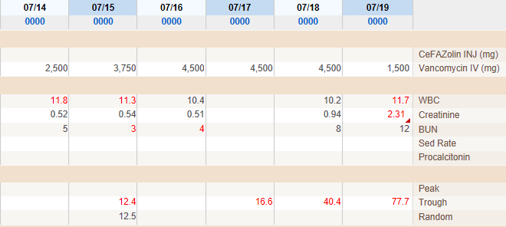
Caution with Obese patients accumulating
1250mg q8h

Slide 17
Therapeutic Drug Monitoring (TDM)
Indicated for:
  Unstable renal function
  Receiving prolonged courses of therapy (> 3 days)
  High risk for toxicity
    Receiving concurrent nephrotoxins
(-) AKI : obtain trough prior to the fourth dose
(+) AKI : dose by level
  Obtain “random” level
  Redose 15 mg/kg only when level < 20
Rybak MJ et al. Pharmacotherapy. 2009 Nov;29(11):1275-9..

Slide 18
Trough Monitoring
Trough | Dose Adjustment | Example
< 10 | Increase frequency Keep same dose | Q12H -> Q8H
10-15 | Increase dose by 25-50% Keep same dosing interval | 1 gm -> 1.25 gm
15-20 | Continue current dosing regimen | -
20-25 | Decrease dose by 25-50% Keep same dosing interval | 1 gm -> 750 mg
>25 | Hold dose and check random concentrations | -
Unfortunately … dosing vancomycin is often by feel
When in doubt, err on the side of caution
Unless your patient is actively dying of MRSA bacteremia in which case go wild

Slide 19
Example #3: Subtherapeutic trough?
You are treating a 50yo diabetic with MRSA osteomyelitis with vancomycin 1500mg q12h
100 kg
CrCl 80 ml/min
She has received 3 doses and a true trough returns as 13.1
What would you do?
STAY THE COURSE

Slide 20
Renal Replacement Therapy
Intermittent Hemodialysis (HD)
  Dosing
    Initial Dose 15 mg/kg (x2) or 25 mg/kg (x1)
  Monitoring
    Obtain pre-HD level with AM labs
      HD removes ~30% of vancomycin
      Can predict a post-dialysis “trough”
    Assess redosing based on pre-HD level

Slide 21
Renal Replacement Therapy
Intermittent Hemodialysis (HD)
  Monitoring
  Post-HD levels?
    Must be drawn at least 4 hours after completion of hemodialysis to account for drug distribution
    Redose if post-HD serum level is < 20
Pre-HD Level | Dose x 1 Administered After Dialysis
 | < 80 kg | ≥ 80kg
< 10 | 1000mg | 1250mg
10-25 | 500 - 750mg | 1000mg
>25 | Hold vancomycin

Slide 22
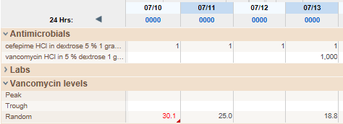
Example #4
HD
HD

Slide 23
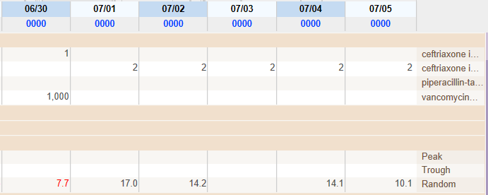
Example #5
1g = ~10
HD
HD

Slide 24
Continuous Renal Replacement Therapy (CRRT)
Continuous venovenous hemofiltration (CVVH) and continuous venovenous hemodialysis (CVVHD)
  Instrinic CrCl ~30-50 ml/min
  15mg/kg daily
  Consider every 12 hours for morbidly obese patients
Monitoring
  Obtain random level within 12-24 hours and redose <20

Slide 25
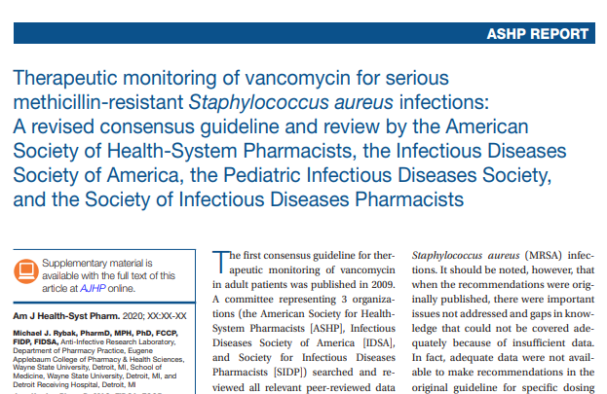
Hot off the Press

Slide 26
Highlights
Where does trough 15-20 come from?
Correlates to AUC:MIC ≥400 which is actually true parameter for effectiveness and minimizing toxicity
Reserved for serious MRSA infections
  Endocarditis, osteomyelitis, bacteremia, pneumonia
Exclusions
  MRSA MIC >1
  Mild infections (SSTI)
  AKI/renal replacement therapy

Slide 27
How to use AUC monitoring
Rule of ‘3’
  After 3rd dose (steady state)
  Obtain 1st level (3 hours after dose)
  Obtain 2nd level (3 hours after 1st level)
Call your friendly pharmacist to calculate AUC:MIC
Modify dose as needed
Troughs may be <15 but this is OK
Continue to monitor troughs every 3-4 days to ensure not >20

Slide 28
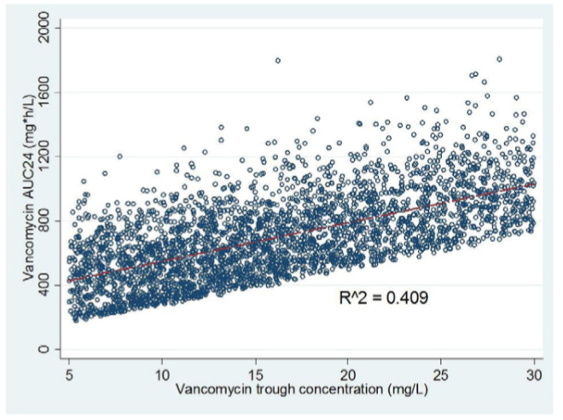
AUC:MIC vs Troughs
Pai MP et al. Adv Drug Deliv Rev. 2014 Nov 20;77:50-7.
Notes:
Relationship of trough to AUC could have wide variation and could result in extremetly high AUC:MIC values. Lower trough values can also result in appropriate AUC:MIC values, hence, AUC:MIC should be looked at directly since it is the PK/PD parameter of choice

Slide 29
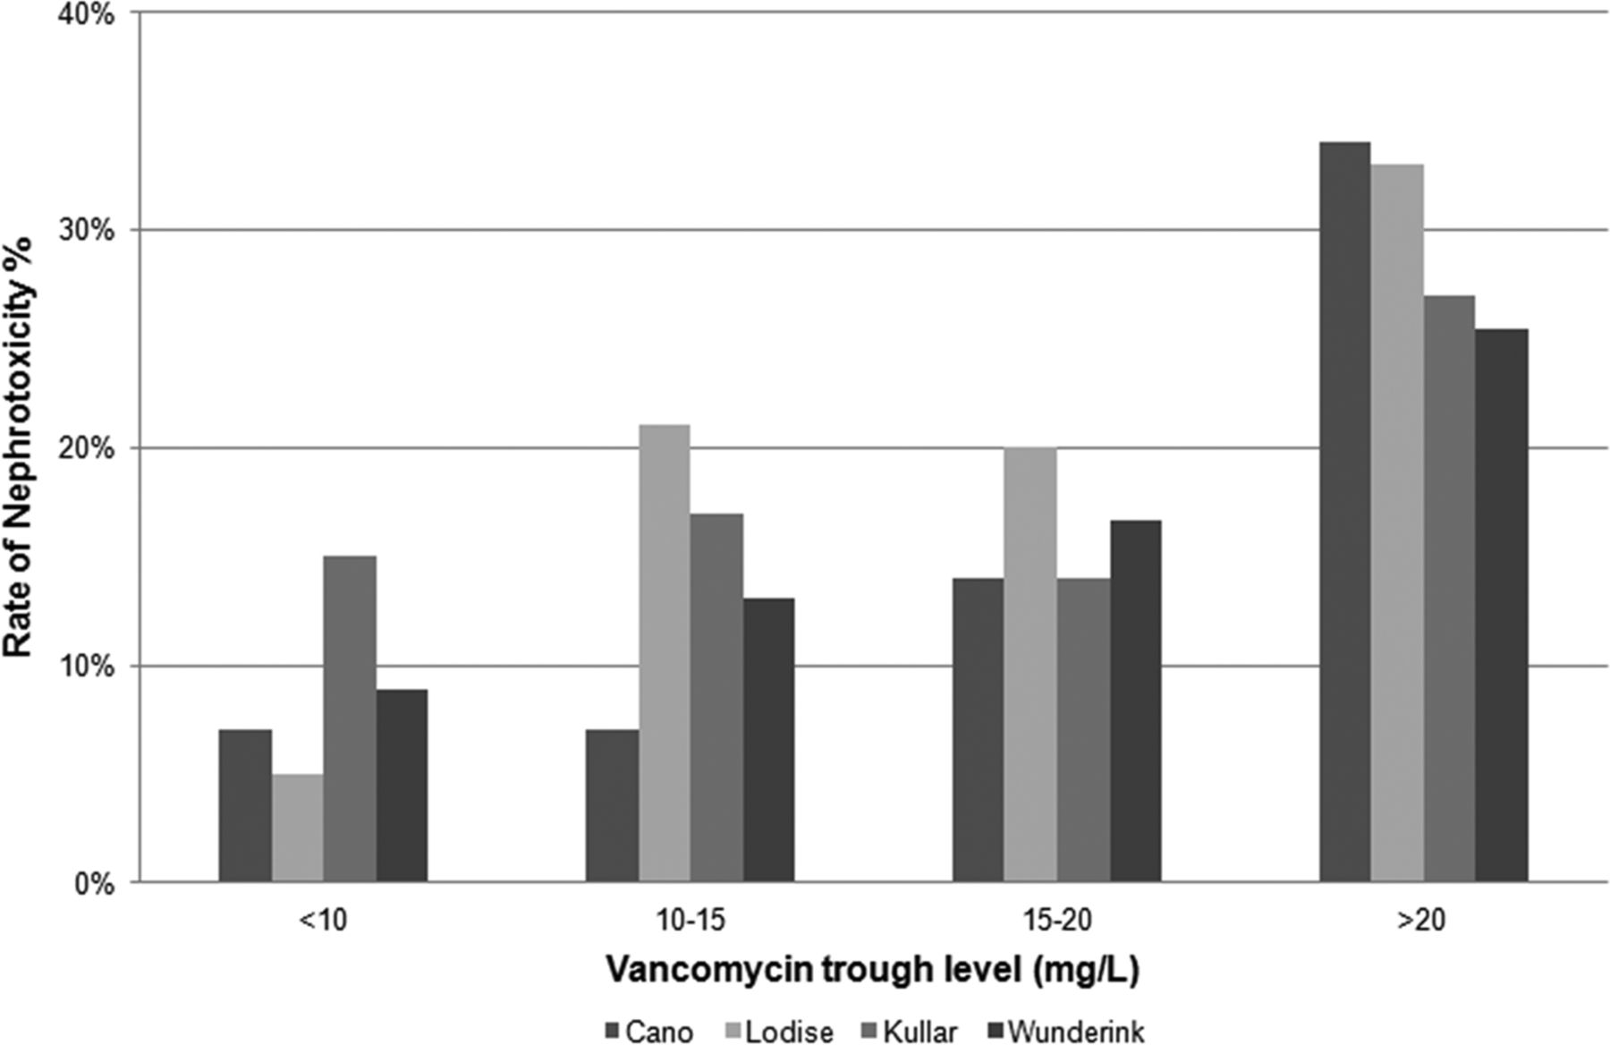
Even Troughs >15 Increase Nephrotoxicity
van Hal SJ, Paterson DL, Lodise TP. Antimicrob Agents Chemother. 2013;57(2):734-744.
Notes:
Over half of patients with a therapeutic AUC, expected to have trough < 15 mg/L

Slide 30
Major Risk Factors for Nephrotox
Doses ≥ 4 grams daily
Weight > 101 kg
CrCl < 87 mL/min
ICU residence
High initial trough levels (≥15)
Concomitant nephrotoxins (Zosyn)
Lodise TP, Patel N, Lomaestro BM, Rodvold KA, Drusano GL. Clin Infect Dis. 2009;49(4):507-514.
Lodise TP, Lomaestro B, Graves J, Drusano GL. Antimicrob Agents Chemother. 2008;52(4):1330-1336. ​
Notes:
very little nephrotoxicity was observed among patients undergoing vancomycin therapy for complicated skin and soft-tissue infection [27-29]. Such patients rarely resided in the ICU, generally had trough values of <10 mg/L, and typically received therapy for <10 days. Our results indicate that this population was at a <5% risk for nephrotoxicity

Slide 31
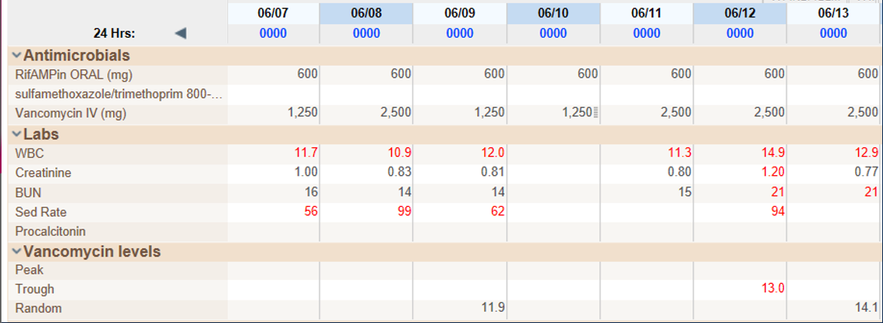
32F being treated for MRSA L knee prosthetic joint infection w/ rifampin & vancomycin IV 1250mg Q12H
Vanco troughs are repeatedly <15. Her calculated AUC is 480. SCr is stable. How would you modify therapy?

Slide 32
Aminoglycosides
Protein synthesis inhibitors
Bactericidal
Concentration-dependent
  Peak:MIC
Post-antibiotic effect
Synergistic bactericidal activity with cell-wall agents
Usually adjunctive agents
  Exceptions: UTIs
Vakulenko S et al. Clin Microbiol Rev. 2003 Jul;16(3):430-50
Vidal L et al. J Antimicrob Chemother. 2007 Aug;60(2):247-57

Slide 33
Aminoglycosides
 | MRSA | MSSA | Enter | Strep | GNR | PsA | Anab
GENT
TOB
AMIK
+
+
← ← SYNERGY → →
+
+
+
+
Mycobacterium
30S
Cell Wall Synthesis Inhibitor
Gentamicin

Slide 34
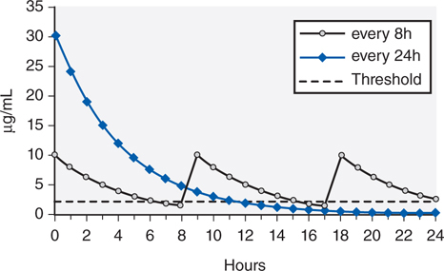
Extended Interval
Extended Interval is more efficacious, less nephrotoxic

Slide 35
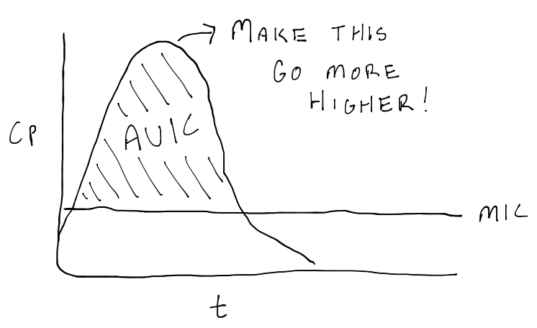
Post-antibiotic effect
Notes:
Takes advantage of two pharmacodynamic properties
Post-antibiotic effect (up to ~7 hours)
Concentration-dependent killing

Slide 36
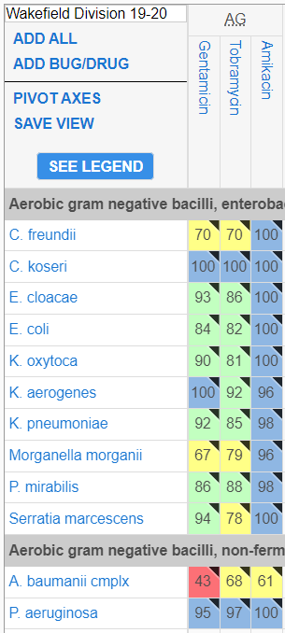
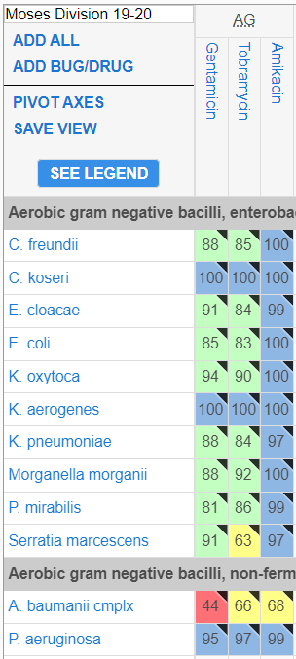
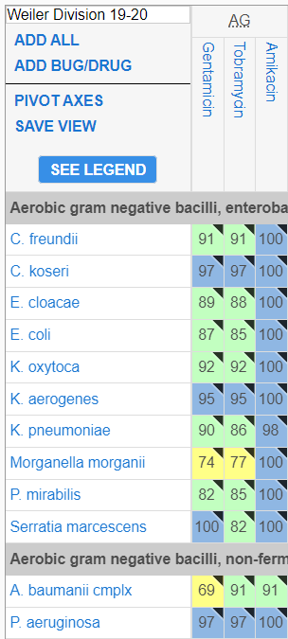
Susceptibilities are Great

Slide 37
Extended Interval Dosing
Indication | CrCl (ml/min) | Gentamicin/ Tobramycin | Amikacin
Staphylococcal infections (Synergy only) | >30 | 3 mg/kg q24h* | -
 | ≤ 30 | 1.5 mg/kg q24h* | -
Urinary Tract Infection | > 30 | 3 mg/kg q24h | 10 mg/kg q24h
 | ≤ 30 | 1.5 mg/kg q24h | 5 mg/kg q24h
All other infections | > 60 | 5-7 mg/kg q24h | 15-20 mg/kg q24h
 | > 30-59 | “ q48h | “ q48h
 | ≤ 30 | 1.5 mg/kg q24h | 5 mg/kg q24h
ALWAYS Ideal BW EXCEPT in the following:
  If TBW > 1.2 times IBW, use Adj BW
  If Total BW < Ideal BW, use Total BW
*Gentamicin only

Slide 38
Exclusions to Extended Interval
Neonates
Burn patients
Creatinine clearance < 20mL/min
Renal replacement therapy (i.e. intermittent hemodialysis, CRRT, etc.)
Gram positive synergy for Enterococcus

Slide 39
Monitoring
Extended Interval
  Obtain a trough level ~30 minutes prior to when next dose is due
  Redose when serum trough level is in the appropriate range
  Gentamicin and tobramycin levels are performed in-house
  Amikacin levels are a send-out
Indication | Gentamicin | Tobramycin | Amikacin
Other indications | < 1 μg/mL | < 1 μg/mL | < 8 μg/mL
Gram-positive synergy | < 1 μg/mL | - | -
AKA “Undetectable”

Slide 40
Dosing and Monitoring
Conventional Dosing
  Initial Dosing
  Initial Frequency
Indication | Gentamicin/ Tobramycin | Amikacin
Gram positive synergy | 1 mg/kg (Gentamicin ONLY) | n/a
All other infections | 1.5-2 mg/kg | 5-7.5 mg/kg
CrCl (ml/min) | Gentamicin/Tobramycin/Amikacin
> 60 | q8H
30-60 | q12H
20-30 | q24H
< 20 | Dose by level (Redose when level < 1 µg/ml for gentamicin/tobramycin and < 5 µg/ml for amikacin

Slide 41
Dosing and Monitoring
Conventional Dosing
  Peak levels correlate to efficacy
  Trough levels correlate to toxicity
  Obtain peak and trough with 3rd dose (at steady state)
    Peak: Draw ~1 hour after dose is given
    Trough: Draw about 30 minutes prior to dose
Notes:
Peak = efficacy
Trough = toxicity

Slide 42
Dosing and Monitoring
Conventional Dosing
  Target Serum Levels
Indication | Gentamicin/ Tobramycin | Amikacin
Sepsis, pneumonia, other serious infections | Peak: 6 to 8 µg/ml Trough: < 1µg/ml | Peak: 25 to 40 µg/ml Trough: < 5 µg/ml
Life-threatening infections | Peak: 8 to 10 µg/ml Trough: < 1 µg/ml | Peak: 20 to 25 µg/ml Trough: < 5 µg/ml
Urinary tract infections | Peak: 4 to 6 µg/ml Trough: < 1 µg/ml | Peak: 15 to 20 µg/ml Trough: < 5 µg/ml
Gram positive synergy | Peak: 3 to 4 µg/ml Trough: < 1 µg/ml | n/a
Notes:
Peak = efficacy
Trough = toxicity

Slide 43
Dosing Aminoglycosides for RRT
Consult your ID pharmacist

Slide 44
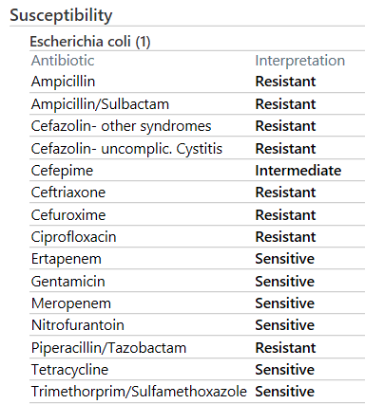
85 yo F admitted with AMS
Can’t verbalize symptoms
Possible cystitis
Wt 50 kg
CrCl 28 ml/min
How would you treat?

Slide 45
Why aminoglycosides for UTI?
Excreted 98% in urine
Concentrate in the urine up to 100-fold
With just 1 mg/kg gentamicin – peak urine concentrations may exceed 400 ug/ml
  Breakpoint for E coli is 4 ug/ml
Concentrations remain therapeutic in the urine for 72h or longer
Low risk of collateral damage

Slide 46
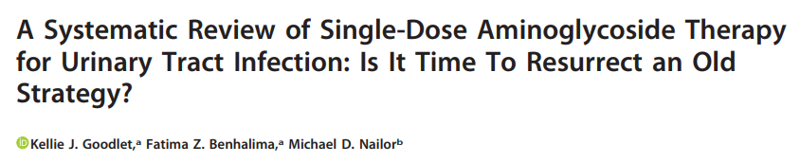
13 studies, representing 13,804 patients
E coli most common pathogen
Pooled microbiologic cure rate: 94.5%
30-day clinical cure (without recurrence): 73.4%
Nephrotoxicity, vestibular toxicity: <1%

Slide 47
85 yo F admitted with AMS
Can’t verbalize symptoms
Possible cystitis
Wt 50 kg
CrCl 28 ml/min
How would you treat?
Gentamicin IV 1.5 mg/kg (80mg) x1

Slide 48
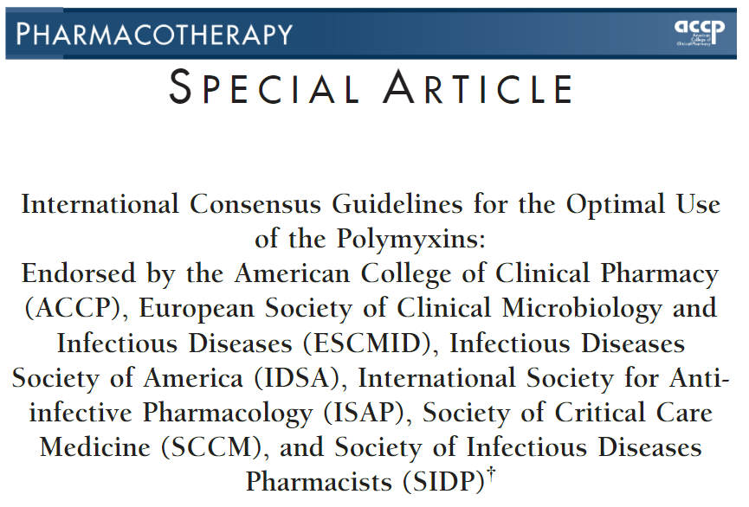
Polymyxins
You REALLY shouldn’t be using these anymore

Slide 49
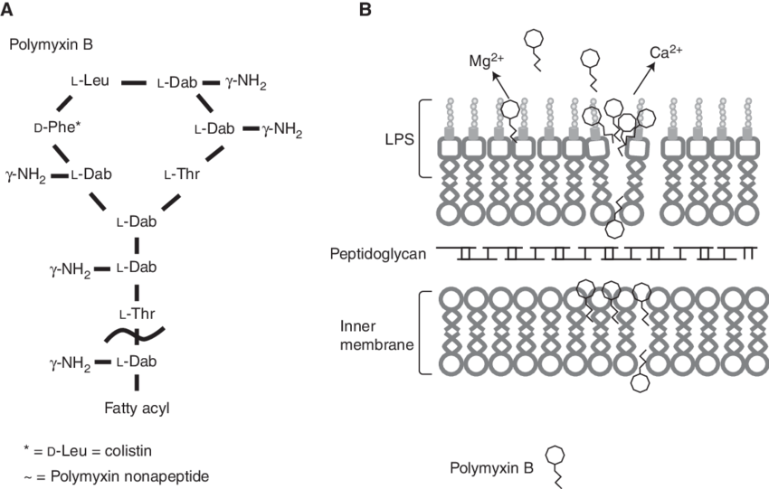
Polymyxins
Bactericidal
Concentration dependent killing
Efficacy: AUC:MIC
Bergen PJ, et al. Diagn Microbiol Infect Dis 2012;74(3):213-223.
Zavaski AP, et al. Clin Infect Dis 2008;47:1298-1304.

Slide 50
Spectrum of Activity
Actively Against:
Does Not Cover:
Anaerobes
Gram-positive organism
Burkholderia spp.
Morganella morganii
Neisseria spp.
Proteus spp.
Providencia spp.
Serratia spp
Most of gram-negative bacilli
Acinetobacter spp.
Enterobacter species
E. coli
K. pneumoniae
P. aeruginosa
S. maltophilia
Landman D, et al. Clinical Microbiology Reviews 2008;21(3):449-465

Slide 51
Toxicity
Nephrotoxicity (14%)
  Damage to the convoluted tubule epithelium
  Increase BUN, Cr
  Decrease urine output
Neurotoxicity (7%)
  Weakness
  Peripheral and facial paresthesia
  Ataxia
Kwa A, et al. Expert Rev. Anti Infect Ther 2007;5(5);811-821.
Zavaski AP, et al. Clin Infect Dis 2008;47:1298-1304.
Mendes CA, et al. Rev Assoc Med Bras 2010;56(6):752-758
Falagas ME, et al. Crit Care 2006;10:R27

Slide 52

Place in Therapy
Last resort treatment for multidrug-resistant gram-negative “superbugs”
  P. aeruginosa, A. baumannii, K. pneumoniae, E. coli, etc.
Caution is required with monotherapy due to suboptimal exposure and emergence of resistance
Zavaski AP, et al. Clin Infect Dis 2008;47:1298-1304.
Kassamali Z, et al. International Journal of Infectious Diseases 2015;30:125-132
Bass SN, et al. Antimcirob Agents Chemother 2015;59 (7):3748-3753
Notes:
Mention aminoglycoside caution or other nephrotoxic agents

Slide 53
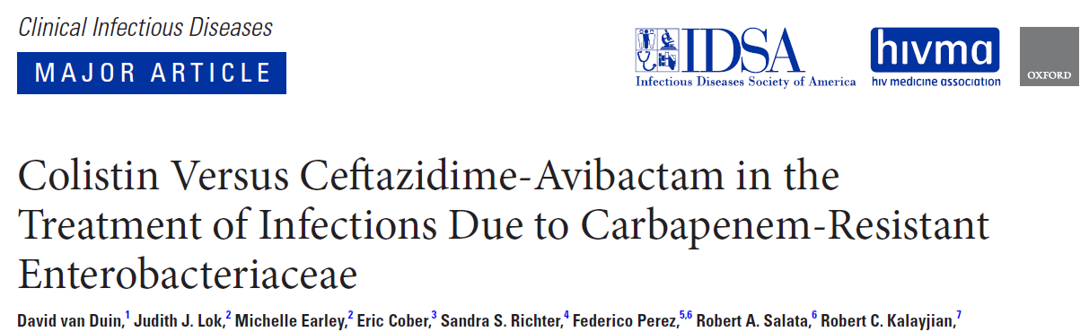
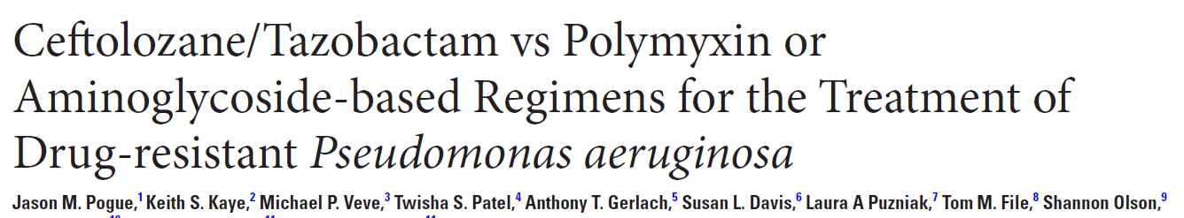
More double coverage with Polymyxins
Increased mortality with Polymyxins
Increased nephrotoxicity with Polymyxins

Slide 54
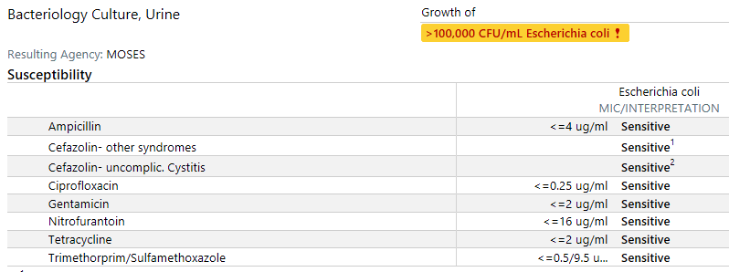
55yo F with cystitis; Penicillin allergy
What would you prescribe for her UTI?
Anything but Ciprofloxacin

Slide 55
Quinolones
Topoisomerase inhibitor
Concentration-dependent
Bactericidal
Prolonged post-antibiotic effect
Agents with PO and IV options
  Excellent bioavailability (~90%)
Spangler SK et al. Antimicrob Agents Chemother. 1998 May;42(5):1253-5.

Slide 56
Quinolones
 | MRSA | MSSA | Enter | Strep | GNR | PsA | Anab | Atyp
CIPR
LEVO
MOXI
+
+
+
+/-
+
+
+
+
+
+/-
+
+
+
+
+
ADE: Tendinitis and tendon rupture, aortic aneurysm, C. diff, QT prolongation (cipro is the least likely)
Only oral anti-Pseudomonal agents
Notes:
Moxifloxacin: Anaerobes (Bacteroides)
Does not get into urine
No Pseudomonas
Delafloxacin (Baxdela)
MRSA, Pseudomonas

Slide 57
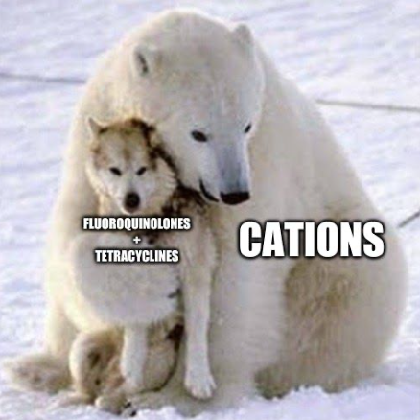

Slide 58
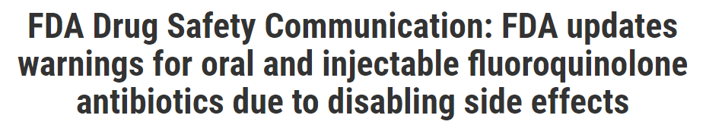
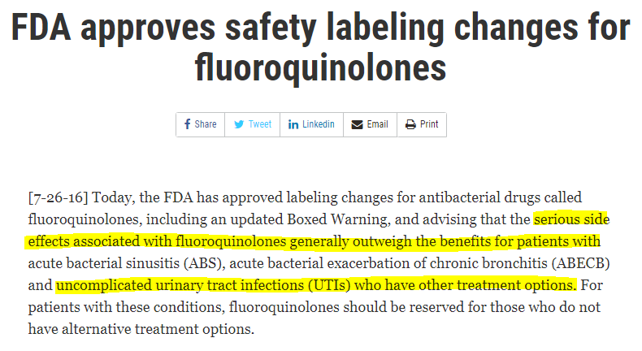
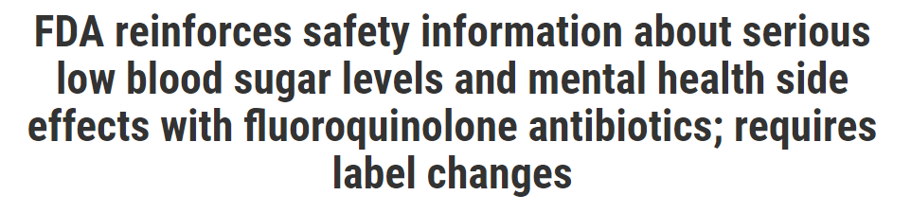
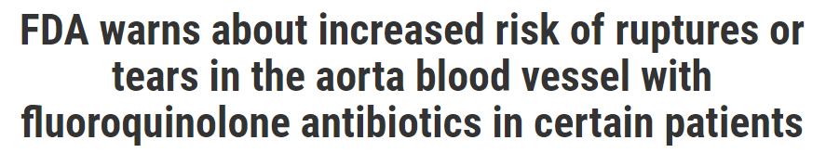
Quinolones are NOT benign

Slide 59
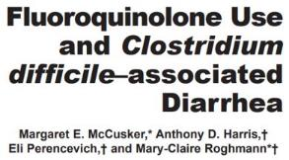
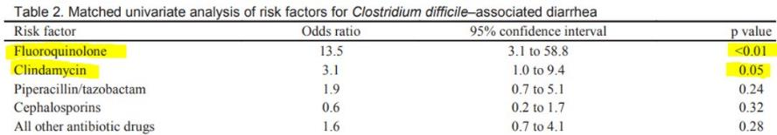
Quinolones and C Diff

Slide 60
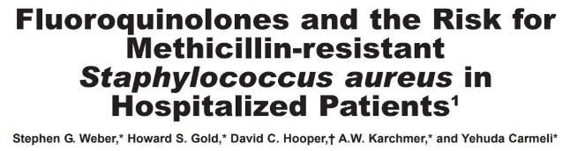
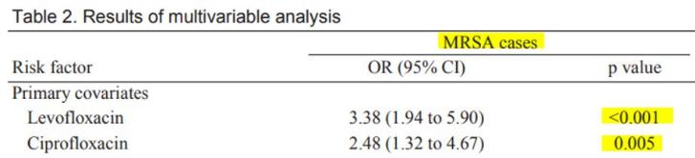
Quinolones and MRSA

Slide 61
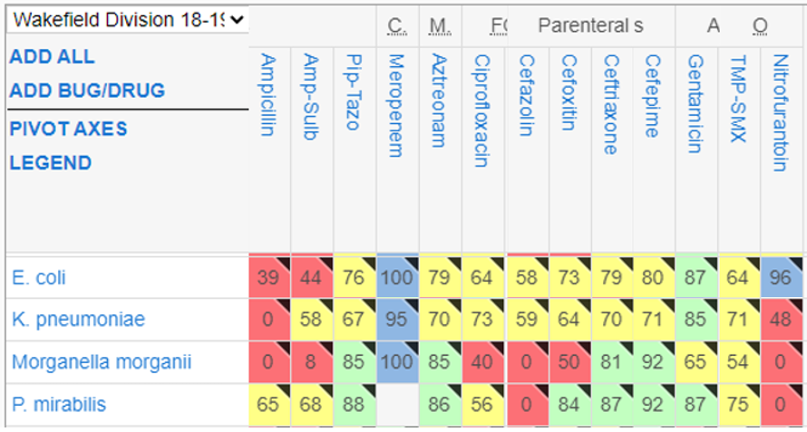
Quinolones have poor Gram-negative coverage

Slide 62
When are Quinolones Preferred?
ONLY oral anti-pseudomonal
ONE of two oral agents for ESBL gram-negative bacteremia
Bone & joint infections

Slide 63
Linezolid
MRSA​ | MSSA​ | VRSA​ | Enter​ | VRE​ | Strep​
​+ | ​+ | ​+ | ​​+ | ​​+ | ​​+
50S ribosomal subunit inhibitor
  Toxin suppressant
Drug of choice for VRE, SSTI, NTM
Great tissue penetration: skin, lungs, bone, CNS
  Urine only 30% excretion
100% bioavailability
600mg BID

Slide 64
Which side effects are associated with linezolid?
Due to weak monoamine oxidase inhibition, unpredictable onset
Serotonin syndrome
Optic neuritis
Peripheral neuropathy
Thrombocytopenia
Lactic acidosis
Direct mitochrondrial toxicity, duration dependent
Risk of SS dependent on #, dose, type of serotonergic agent(s)
Although linezolid does not require renal adjustment, risk of mitochondrial toxicity increases in CKD/ESRD (~30% renally cleared)

Slide 65
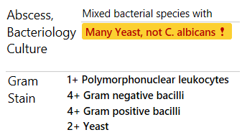
57F with secondary peritonitis due to colon perforation, also C. diff (+), found to have multiple intra-abdominal abscess on imaging, in septic shock
Abscesses drained
How would you treat her?

Slide 66

DRUG
TREAT

Slide 67
Eravacycline
Cousin of tigecycline
  ESBL, AmpC, CRE, XDR-Acinetobacter
  No Pseudomonas, Proteus, Providencia
1 mg/kg q12h
  Dose reduce for hepatic impairment (q24h)
  Dose increase for strong 3A4 inducer (1.5 mg/kg)
Gastrointestinal side effects still present, but less than tigecycline
High volume of distribution, poor urinary penetration
  Avoid in bacteremia & UTI
Niche is for intra-abdominal infections
  Some activity against C. difficile
Notes:
Failed UTI study

Slide 68
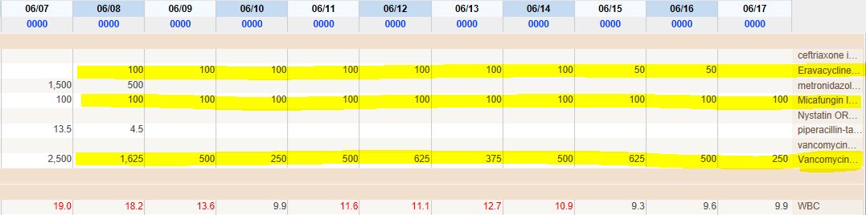
Pt did very well
Sepsis resolved and eravacycline was continued for 14 days from drainage
Conflict of interest disclosure: Jack Bao also receives royalties from drug manufacturer

Slide 69
Tetracyclines
 | MRSA | MSSA | Enter | VRE | Strep | GNR | PsA | Anab | Atyp
DOXY
MINO
ERAV
+
+
+
+
+
+
+
+/-
+
+
+
+
+
+
+
+
+
Doxycycline
  Tick-borne diseases
Minocycline
  Stenotrophomonas
IV to PO 1:1
Static
Poor urinary penetration & high tissue distribution

Slide 70
Fosfomycin – Non-formulary
First described in 1969
Phosphonic acid derivative
Interfering with bacterial peptidoglycan synthesis
  Inhibits the enzyme pyruvyl transferase, which catalyzes the first step of peptidoglycan biosynthesis
FDA approved indication:
  Uncomplicated UTI (acute cystitis) in women due to susceptible strains of E. coli and E. faecalis
  NOT indicated for pyelonephritis or perinephric abscess
Falagas ME. Clin Infect Dis 2008;46:1069-1077.
Shrestha N, et al. Infectious Diseases in Clinical Practice 2001;10:255-260.

Slide 71
Fosfomycin
Spectrum
  E. faecium, E. faecalis (VRE)
  E. coli (ESBL)
  Citrobacter
  Klebsiella (CRE)
  Enterobacter
  Serratia
  Proteus
  P. aeruginosa
  Does NOT cover A. baumannii
Microbiology
  Breakpoint only for E. coli & E. faecalis (CLSI)
    MIC < 64 – Susceptible
    MIC 128 – Intermediate
    MIC > 256 – Resistant
  Europe
    MIC < 32 – Susceptible
Garcia-Rodriquez JA, et al. J Chemother 1997;9:394-402.
Falagas ME. Clinical Infect Dis 2008;46:1069-1077.

Slide 72
Fosfomycin
Resistance
  Little cross-resistance between fosfomycin and the other classes of antibiotics
Dosage
  3g sachet, mix 3-4 ounces of water
    3g PO x 1 dose
    3g PO every 2 to 3 days (off-label)
Place in Therapy
  UTI associated with multidrug-resistant gram-negative pathogen or enterococcus
  IV to PO switch upon discharge
  REQUEST ADD-ON TESTING FROM MICRO LAB
Popovic M, et al. Er J Clin Micobial Infect Dis 2010;29:127-142.
Shrestha N, et al. Infectious Diseases in Clinical Practice 2001;10:255-260.

Slide 73
Fosfomycin for Prostatitis?
Reference | Dosing | Duration
Karaiskos et al. | 3g PO daily x 7 days then 3g PO q48h OR 3g q72h with diarrhea | 6-12 weeks (longer duration if calcifications in prostate)
Grayson et al. | 3g PO once daily | 12-16 weeks
Los-Arcos et al. | 3g PO q48-72h | 6 weeks
Standard urinary breakpoint of < 64 may not apply
Insurance issues
Gastrointestinal side effects with daily dosing

Slide 74
Questions?

