Slide 1
Beyond Antibiotics:
A Review of Antifungals & Antivirals
Terrence McSweeney, PharmD, BCIDP
Clinical Pharmacy Manager, Infectious Diseases
Montefiore Medical Center, Moses Campus
Mei H. Chang, PharmD, BCPS, BCIDP, BCCCP
Clinical Pharmacy Manager, Infectious Diseases
Montefiore Medical Center, Einstein Division
July 26, 2022

Slide 2
Objectives
Review antifungal and antiviral mechanisms of action
Examine the spectrum of activity of antifungals and antivirals
Describe antifungal and antiviral dosing strategies and when to dose adjust for renal or hepatic impairments
Discuss the clinical pearls of various antifungals and antivirals

Slide 3
Antifungals

Slide 4
History of Antifungal Therapy
Amphotericin B deoxycholate
(1958)
Flucytosine (1973)
1st gen azoles, lipid-based amphotericin B
(1990s)
2nd gen azoles, echinocandin, triterpenoid
(2000s +)
Notes:
Looking through the history of antifungals, you’ll fnd that little progress has been made in the development of new antifungal agents, especially when compared to antibacterials. This is likely due to lower occurrence of fungal infections compare to bacterial. Another reason for the slow development of antifungal agents is the fact that fungi are eukaryotic, with a close evolutionary relationship with human hosts, which complicates the research for antifungal targets. Typically prospective antifungal agents undergo a long period of 8-10 years of bench research and manipulation before it is approved for clinical use.
The first antifungal, amphotericin B deoxycholate, was introduced in 1958. It offers potent broad-spectrum antifungal activity but is associated w/ significant renal toxicity and infusion reactions
Flucytosine, a pyrimidine analogue introduced in 1973, is active against candida and cryptococcus. Its use is limited by the emergence of drug resistance and toxicity.
First generation azoles, including fluconazole and itraconazole, became available in the 1990s. These offer advantages of oral administration with activity against yeasts, but are limited due CYP450 interactions.
Lipid-based amphotericin B formulations were introduced in 1990s and maintain the potent board-spectrum activity of the deoxycholate formulation with less toxicity.
Echinocandins became available in the 2000s, offering excellent activity against Candida with few drug-drug interactions, however, they are available in IV form.
Second-generation azoles, including voriconazole, posaconazole, and isavuconazole, were brought to market in the early 2000s. The major advantage of these agents is the extended spectrum of activity against filamentous fungi.
Most recently, ibrexafungerp was FDA approved as the first triterpenoid antifungal agent with a MOA similar to that of echinocandins. Luckily, it does not share the same binding site target, limiting cross resistance potential. It is fungicidal against many Candida species, including echinocandin resistant C. glabrata and C. auris.

Slide 5
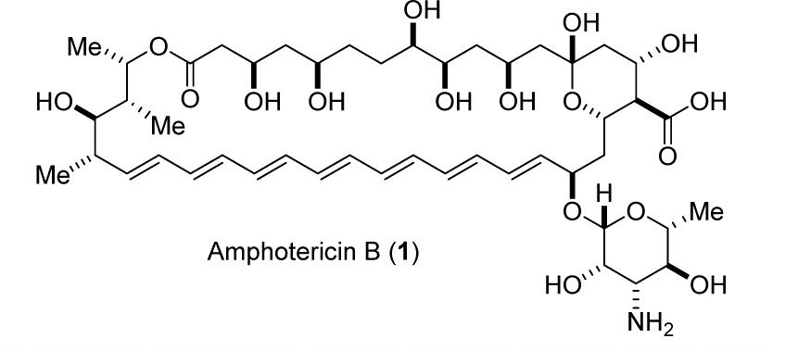
Amphotericin
Polyene antifungal
Lipophilic rod like molecule produced by Streptomyces nodosus

Slide 6
Amphotericin MOA
Inserts itself into fungal cytoplasmic membrane
Binds to sterols such as ergosterol which increases membrane permeability -> electrolyte leakage -> cell death

Slide 7
Amphotericin Spectrum of Activity
Widest spectrum of activity of all antifungals
Resistance is rare; due to the presence of altered membrane sterols

Slide 8
Amphotericin Spectrum of Activity
Candida species
  Candida albicans
  Candida glabrata
  Candida parapsilosis
  Candida tropicalis
  Candida krusei
    Candida lusitaniae – variable activity

Slide 9
Amphotericin Spectrum of Activity
Aspergillus spp.
  Aspergillus fumigatus
  Aspergillus niger
  Aspergillus flavus
    Aspergillus terreus is amphotericin resistant!

Slide 10
Amphotericin Spectrum of Activity
Cryptococcus neoformans
Zygomycetes (Mucor, Rhizopus spp.)
Histoplasma capsulatum
Coccidioides immitis
  Scedosporium prolificans can be resistant

Slide 11
Amphotericin
Formulations available:
  “Conventional” Amphotericin B deoxycholate (ABD, Fungizone®)
  Liposomal Amphotericin B (Ambisome®)
  Amphotericin B lipid complex (ABLC, Abelcet®)
  Amphotericin B cholesteryl sulfate complex (ABCD, Amphotec®) – not available in US
Notes:
“Conventional” amphotericin B deoxycholate (ABD, Fungizone®)
Amphotericin B colloidal dispersion or cholesteryl sulfate complex (ABCD, Amphotec®)
Amphotericin B lipid complex (ABLC, Abelcet®)
Liposomal Amphotericin B (LAMB, Ambisome®)

Slide 12
Formulation Comparisons
(Wingard et al. CID 2000;31:1155-63)

Slide 13
Formulation Comparisons

Slide 14
Formulation Comparisons
(Groll et al. JID 2000;182:274-282)

Slide 15
Amphotericin Dosage Range
“Conventional” deoxycholate (Fungizone®)
  0.3 mg/kg for C. glabrata UTI
  0.6 mg/kg for invasive Candida spp. infection
  0.7 mg/kg for Cryptococcal meningitis
  1-1.5 mg/kg for Aspergillus spp. infection
Liposomal ampho (Ambisome®)
  3 mg/kg for Cryptococcal meningitis
  5-10 mg/kg for mucormycosis

Slide 16
Amphotericin Toxicity
Nephrotoxicity
  Azotemia due to dose-dependent decrease in the GFR
    Vasoconstrictive effect on afferent arteriole
    Expect creatinine to rise to 2-3 mg/dl at therapeutic doses
    Permanent loss of renal function is rare; GFR returns to baseline following cessation of therapy

Slide 17
Amphotericin Nephrotoxicity
Exacerbated by concomitant nephrotoxic agents (cyclosporine, tacrolimus, AGs), pre-existing renal insufficiency, intravascular volume depletion
Causes renal tubular acidosis with significant wasting of K+, Mg++, and HCO3-
  Need to monitor K+, Mg++ and replete aggressively

Slide 18
Amphotericin Toxicity
Infusion related
  Fever/ rigors (“shake and bake”)
    Decreased incidence following multiple doses
    Can premedicate with acetaminophen/ diphenhydramine
    Treat rigors with low dose meperidine
Anemia (consequence of long term use)

Slide 19
Flucytosine
Antimetabolite antifungal
Not recommended as monotherapy given high risk of drug resistance
Place in therapy is in combination with amphotericin for cryptococcal meningitis, Candida spp. endocarditis
  Excellent CNS penetration

Slide 20
Flucytosine MOA
Flucytosine (5-FC) taken up by fungal transmembrane cytosine permease -> once in cytoplasm 5-FC gets converted to its active form 5-fluorouracil (5-FU) by cytosine deaminase
5-FU competes with uracil and disrupts fungal RNA synthesis
  5-FU further converted to fluoro-deoxyuridylic acid which inhibits DNA synthesis
Notes:
Cytosine deaminase is only present in fungal cells, not mammalian cells explaining why there is no effect on human cells or bacteria

Slide 21
Flucytosine
Dosing: 25 mg/kg/dose q6h (comes in 250 mg and 500 mg oral capsules)
Requires renal dose adjustment
Adverse events: thrombocytopenia, altered mental status, hepatotoxicity
Monitor trough levels once to twice weekly in the setting of changing renal function or concern for toxicity
  Goal 25-50 mcg/mL, toxicity can be seen if >100 mcg/mL

Slide 22
Triazoles
Ketoconazole
  No longer used for systemic fungal infections given hepatotoxicity and adrenal insufficiency
Fluconazole
Itraconazole
Voriconazole
Posaconazole
Isavuconazole

Slide 23
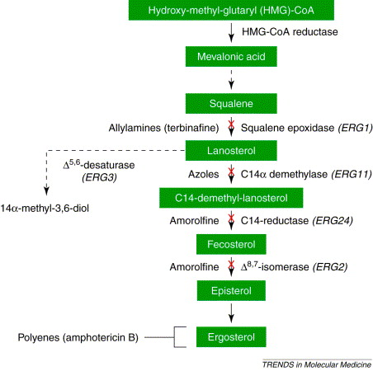
Triazoles MOA
Inhibit C-14 alpha demethylase, an enzyme necessary in ergosterol biosynthesis
Ergosterol = component of fungal cell membrane
Ergosterol depletion leads to fungal cell lysis

Slide 24
Triazoles
With the exception of itraconazole and posaconazole, excellent oral bioavailability
  IV -> PO switch
Mechanism: inhibits cytochrome P-450-dependent 14 alpha demethylase. Various CYP-mediated drug-drug interactions
  Itraconazole > voriconazole > fluconazole, posaconazole, isavuconazole
Hepatotoxicity
  Monitor hepatic function
Notes:
Flu: inhibits CYP2C19 strongly, also CYP2C9 and CYP3A4
Itra: inhibits CYP3A4 strongly, also a CYP3A4 substrate
Vori: inhibits CYP3A4 strongly, also CYP2C9 and CYP2C19 plus substrate of all 3
Posa: inhibits CYP3A4 strongly
Isavu: inhibits CYP3A4, also a CYP3A4 substrate, weakly inhibits and induces many other CYP isoenzymes

Slide 25
Fluconazole Spectrum of Activity
Candida spp.
  Candida albicans
  Candida parapsilosis
  Candida tropicalis
  Candida lusitaniae
Candida glabrata – hit or miss
Candida krusei – innately resistant to fluc
Notes:
Flu C glabrata 8% resistant, 92% SDD
Isolates with low level resistance to fluc and/or itra exhibit 15% cross-resistance to voriconazole. However, high level resistance to fluc results in 50% of cross resistant to voriconazole.

Slide 26
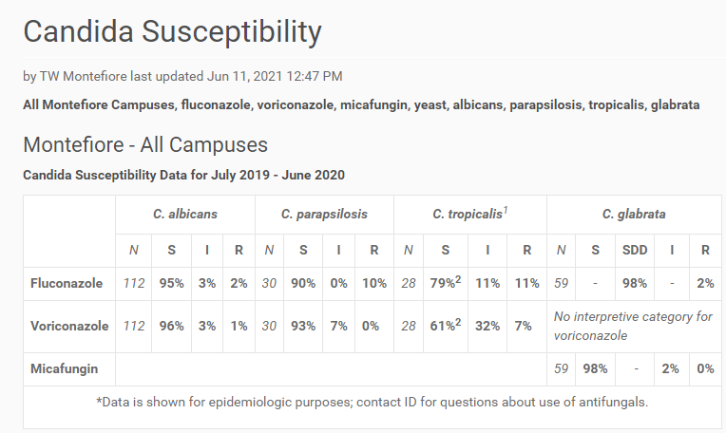

Slide 27
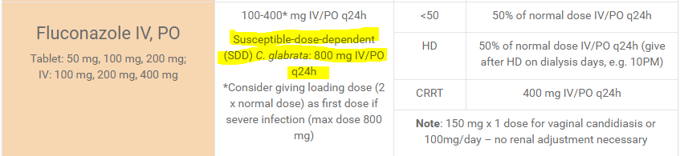

Slide 28
Fluconazole Spectrum of Activity
Cryptococcus neoformans
  Useful in maintenance therapy of cryptococcus meningitis
Histoplasma
  Not drug of choice
Coccidioides immitis
No activity against Aspergillus spp.

Slide 29
Fluconazole
Half life: 30 hours, linear pharmacokinetics
Oral bioavailability is 90%
  IV = PO
Usual dose:
  Need to load with 2X maintenance dose
  100 mg PO/IV q24h for oral thrush
  200 mg PO/IV q24h for esophageal candidiasis
  400 mg PO/IV for candidemia, cryptococcal meningitis
Metabolism – minimally by CYP3A4
Excretion – renal

Slide 30
Fluconazole Side Effects
Increase in LFTs (10%)
Extremely high doses (>800 mg) can cause N/V
Chronic therapy can cause alopecia
QTc prolongation

Slide 31
Fluconazole Drug-Drug Interactions
Inhibitor of CYP3A4
  Phenytoin; increases phenytoin levels by up to 75%
  Rifampin; decreases fluc levels by 23%
  Tacrolimus; increases levels significantly
  Cyclosporine; increases levels significantly
  Midazolam; increases serum levels by 30%
  Warfarin; increases INR by 39%

Slide 32
Voriconazole Spectrum of Activity
Candida spp.
  C. albicans
  C. tropicalis
  C. parapsilosis
  C. krusei
C. glabrata
  Improved activity, however cross resistance can be seen with fluconazole resistant strains

Slide 33
Voriconazole Spectrum of Activity
Aspergillus species
  Excellent anti-aspergillus activity
  More effective in treatment of invasive aspergillosis than amphotericin B
    Vori response rate: 52.8%
    Ampho B response rate: 31.6%
      (Herbrecht et al. NEJM 2002;347:408-15)
Fusarium spp.
Not active against Zygomyctes (Mucor, Rhizopus spp.)

Slide 34
Voriconazole
Half life: 6 hours
Excellent bioavailability – 97% IV = PO
Usual dose:
  Load with 6 mg/kg IV/PO q12h x 2 doses
  Maintenance dose: 4 mg/kg IV/PO q12h
Requires therapeutic drug monitoring
  Wait 5-7 days to get trough level (steady state)
  Goal trough level 2-5 mcg/mL

Slide 35
Voriconazole
Pharmacokinetic variation with CYP2C19 polymorphisms
Non-linear pharmacokinetics
  Dose increases not associated with linear increases in serum concentrations, can overshoot
?concerns with IV formulation given cyclodextrin solvent vehicle accumulation when CrCl < 50

Slide 36
Voriconazole
Metabolism
  Hepatic via CYP2C19, CYP2C9, CYP3A4
Extensive drug-drug interactions due to affected isoenzymes above

Slide 37
Voriconazole Side Effects
Elevated LFTs (10-20%)
Transient ocular changes
  Blurred vision, changes in color vision (difficulty distinguishing blue and green colors)
Audio and visual hallucinations (associated with supratherapeutic levels)
QTc prolongation
Rare: periostitis due to fluoride toxicity

Slide 38
Itraconazole
Active against most Candida spp. and Aspergillus spp. minus:
  C. glabrata, C. krusei, A. niger
Use superseded by voriconazole for invasive aspergillus infections
  Voriconazole is more active, better bioavailable
No benefit over fluconazole for Candida infections

Slide 39
Itraconazole
Niche = treatment of histoplasmosis
Use the oral suspension, not capsules
  Better bioavailability
Capsules require acidic environment (take with Coca cola, avoid PPIs, H2RAs); suspension can be taken on empty stomach
Trough of 0.5 mg/L considered lower threshold for ppx; target trough of >1-2 mg/L for treatment

Slide 40
Posaconazole
Candida spp. and Aspergillus spp.
  Similar to voriconazole
  No RCT against ampho or vori for treatment of Aspergillosis
+ Zygomycetes (Mucor, Rhizopus spp.)

Slide 41
Posaconazole
Commonly used for:
  Mucor and aspergillosis treatment
  Prophylaxis in high risk immunocompromised patients
    AML, myelodysplastic syndrome
      ANC <500, discontinue when ANC >500
    High risk allogeneic stem cell transplant
      Acute or chronic extensive GVHD, history of IFI, alemtuzumab recipient, or high dose steroids
  Resistant fungal infections

Slide 42
Posaconazole
Extended release 300mg tablet is better absorbed than oral suspension
  Oral suspension: PEG/NG only, avoid PPI
Troughs can be monitored: >2 mcg/ml
  Wait for 5- 7 for first trough from initial dose

Slide 43
Isavuconazole (non-formulary)
Isavuconazonium sulfate
  Prodrug, hydrolyzed in blood to isavuconazole
Active against Candida spp. and Aspergillus spp. similar to vori
Zygomycetes
  FDA approval for treatment of Mucorales infections based on response in case series of 37 patients (success rate was 31.4%)

Slide 44
Isavuconazole
Dose
  Load 372 mg PO/IV q8h x 6 doses
  Maintenance dose 372 mg PO daily
Metabolized by CYP3A4
Bioavailability 98%
Can open capsules and administer via NGT

Slide 45
Isavuconazole
No TDM per manufacturer (??)
Only azole that shortens the QTc

Slide 46
Echinocandins
Caspofungin
Micafungin (formulary)
Anidulafungin

Slide 47
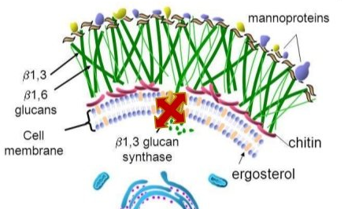
Echinocandins MOA
Inhibits B(1,3)-D-glucan synthase
Weakens fungal cell wall
“Beta lactams for fungi”

Slide 48
Echinocandins Spectrum
Candida spp.
  C. albicans
  C. glabrata
  C. tropicalis
  C. krusei
  C. lusitaniae
Asperigillus spp.
  A. fumigatus
  A. flavus
  A. niger

Slide 49
Echinocandins Spectrum
Intrinsic resistance seen with:
  Candida parapsilosis
  Candida guilliermondii
Due to alterations in FKS 1 and 2 which affects binding of echinocandin
Not active against Cryptococcus, Zygomycetes, or Fusarium spp.

Slide 50
Echinocandins
All available IV only
Caspofungin has more DDIs: cyclosporine, tacrolimus, CYP450 inducers
Well-tolerated as a class, besides histamine-release related reactions
Poor penetration into CNS, urinary tract, and eye
Micafungin does not routinely use a loading dose
  Usual dosing: 100-150 mg IV daily
  HSCT prophylaxis: 50 mg IV daily
Less hepatotoxic compare to azoles

Slide 51
Triterpenoid
Ibrexafungerp
  First in class, oral triterpenoid; inhibits 1,3-β-D-glucan synthase at a different binding site from echinocandins
  FDA approved June 1, 2021 for vulvovaginal candidiasis (low dose, 1 day)
Concomitant strong CYP3A inhibitors: dose reduce ibrexafungerp
Activity against echinocandin resistant Candida sp. and Aspergillus sp.
High bioavailability, extensive tissue penetration, but not into CNS
Studies for invasive fungal infections required loading dose followed by higher daily doses (e.g. 1250mg to 1500mg load, followed by 750mg daily)
No activity against Mucorales and Fusarium sp., however, is active against Paecilomyces variotii and panresistant Scedosporium prolificans

Slide 52
Beyond Antibiotics:
A Review of Antivirals
Mei H. Chang, PharmD, BCPS, BCIDP, BCCCP
Clinical Pharmacy Manager, Infectious Diseases
Montefiore Medical Center, Einstein Division
July 2022

Slide 53
Objectives
Review antiviral mechanisms of action
Examine the spectrum of activity of antivirals
Describe antiviral dosing strategies and when to dose adjust for renal or hepatic impairments
Discuss the clinical pearls of various antiviral agents

Slide 54




Slide 55




























HIV
TIME!
Hepatitis
CLASSICS
Mechanisms of Actions
VIRAL AFFAIRS
CUT IT BACK
Bust the MYTHS
YOU FINISHED THIS GAME
TIME TO COUNT THE MONEY!

Slide 56
Preferred initial regimen for most people with HIV
Click here for the answer

Slide 57
Answers:
What are...
BIC/TAF/FTC
DTG/ABC/3TC (-HLA B5701 & -HBV)
DTG/FTC or 3TC/TDF or TAF
DTG/3TC (VL<500K, -HBV, -resistance profile)
$ 200

Slide 58
Requires CCR5 tropism before initiation
Click here for the answer

Slide 59
Answer:
What is maraviroc (MVC)?
Entry inhibitor
Twice daily dosing
$ 400

Slide 60
Must be HLA-B*5701 negative before starting this medication
Click here for the answer

Slide 61
Answer:
What is abacavir (ABC)?
HSR within first 6 weeks
White pts 5-8% vs Black pts 2-3%
$ 600

Slide 62
ARV most sensitive to pH changes
Click here for the answer

Slide 63
Answer:
What is rilpivirine (RPV)?
gastric pH = absorption
Contraindicated with PPIs
Avoid crushing or G-tube administration
Very low barrier to resistance
$ 800

Slide 64
Decreases methadone AUC by >50% and known to cause false positive urine tests for cannabis
Click here for the answer

Slide 65
Answer:
What is efavirenz (EFV)?
May precipitate opioid withdrawal
Avoid in pyschiatric illess (suicidality, ADEs)
Risk for QTc prolongation
$ 1000

Slide 66
Preferred regimen for chronic HBV
Click here for the answer

Slide 67
Answers:
What are entecavir, TDF or TAF?
Avoid entecavir in 3TC refractory pts
BBW: HBV flare upon discontinuation
$ 200

Slide 68
First FDA approved DAA treatment for children 12 and older
Click here for the answer

Slide 69
Answer:
What is ledipasvir/sofosbuvir?
$ 400

Slide 70
DAA regimen that contains a drug active against HIV
Click here for the answer

Slide 71
Answers:
What are Viekira XR or Viekira?
(dasabuvir, ombitasvir, paritaprevir/ritonavir)
$ 600

Slide 72
DAAs recommended for Simplified Treatment
Non-cirrhotic
Treatment naive
Click here for the answer

Slide 73
Solutions:
What are glecaprevir-pibrentasvir (8 wks) or sofosbuvir-velpatasvir (12 wks)?
Pangenotypic
Not for coinfected, pregnant, HCC or post-transplant
National Academics of Sciences: goal of reducing chronic HCV cases by 90% by 2030
$ 800

Slide 74
When to obtain labs for “test of cure”(sustained virologic response [SVR]), for HCV
Click here for the answer

Slide 75
Answer:
What is ≥ 12 weeks after treatment completion?
Allows for complete washout of DAA
May repeat at ≥ 24 weeks of unexpected transaminitis noted
$ 1000

Slide 76
Nucleoside analog, inhibits replication of HSV1, HSV2, VZV, and EBV
Click here for the answer

Slide 77
Answer:
Whats is acyclovir or valacyclovir?
Valacylovir PO 1g 3x/day ~ Acyclovir IV 5mg/kg q8h >>> Acyclovir PO 800mg 5x/day
IV Acyclovir achieves higher peaks faster (increase potency and renal toxicity)
$ 200

Slide 78
Antiviral agent active against HSV, VZV, and CMV, and has a propensity for nephrotoxicity, electrolyte imbalance, seizures, and genital lesions
Click here for the answer

Slide 79
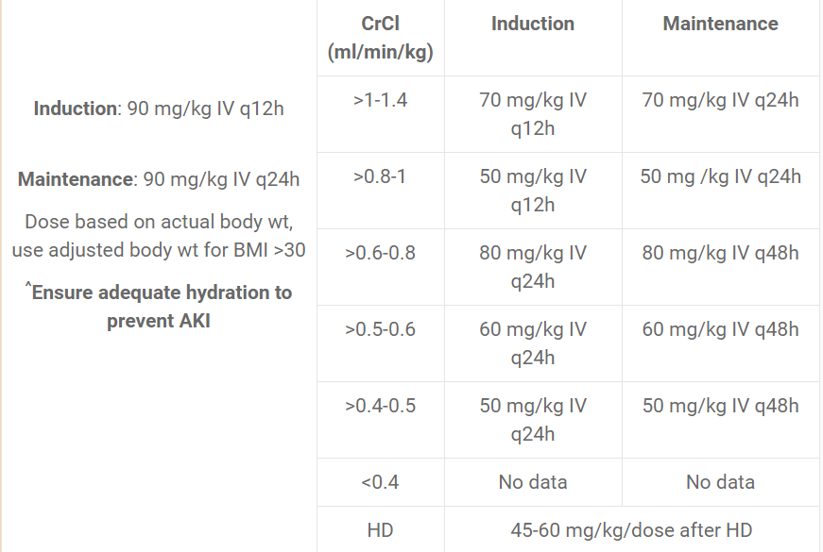
Answer:
Whats is foscarnet?
$ 400

Slide 80
DAA class that ends with -previr
Click here for the answer

Slide 81
Answer:
What are NS3/4A protease inhibitors?
E.g. Grazoprevir, voxilaprevir
Less durable, low barrier to resistance
$ 600

Slide 82
DAA class that ends with -asvir
Click here for the answer

Slide 83
Answer:
What are NS5A polymerase inhibitors?
E.g. Ledipasvir, elbasvir, velpatasvir, pibrentasvir
Least durable, lowest barrier to resistance
$ 800

Slide 84
DAA class that ends with -buvir
Click here for the answer

Slide 85
Answer:
What are NS5B polymerase inhibitors?
E.g. Sofosbuvir, dasabuvir
Most durable, highest barrier to resistance
$ 1000

Slide 86
Preferred regimen for Post-Exposure Prophylaxis
Click here for the answer

Slide 87
Answer:
What is DTG plus FTC/TDF?
$ 200

Slide 88
ARV that is dosed differently for HIV vs HBV
Click here for the answer

Slide 89
Answer:
What is lamivudine (3TC)?
HBV = 100mg daily
HIV = 300mg daily
$ 400

Slide 90
Names of currently available long-acting IM injectable ARVs for HIV
Click here for the answer

Slide 91
Answer:
What are cabotegravir and rilpivirine?
Oral lead-in therapy required
FLAIR extension study: direct to inject, similar adverse event profile and virologic suppression
$ 600

Slide 92
Name the chemist:
Main research focused on hepatitis drug discovery, co-recipient of Lasker-DeBakey Clinical Medical Research Award, has a hepatitis C drug named after him
Click here for the answer

Slide 93
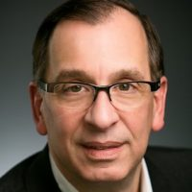
Answer:
Who is Michael J. Sofia?
Determined how to mask sofosbuvir molecule to allow entry into the liver
$ 800

Slide 94
Description for subset of HIV patients with VL below quantification for years and not on ART
Click here for the answer

Slide 95
Answer:
Who are the „elite controllers?“
START & TEMPRANO: ART beneficial regardless of CD4
ART remains controversial
May benefit those with: disease progresssion, declining CD4, HIV-related complications
$ 1000

Slide 96
Names of FDA approved antivirals for influenza
Click here for the answer

Slide 97
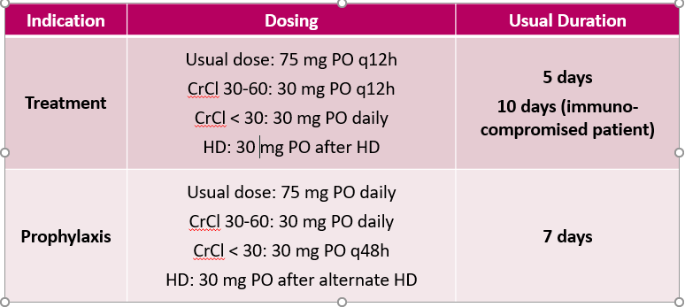
Answer:
What are oseltamivir, zanamivir, peramivir and baloxavir?
$ 200

Slide 98
Fill in the blank:
Primary prophylaxis against MAC is _____________ for adults and adolescents who start ART immediately
Click here for the answer

Slide 99
Answer:
What is “not recommended?“
Only indicated if CD4 <50 and not on ART or no options for fully suppressive ART regimen
$ 400

Slide 100
When to DC primary PCP ppx once ART started, with an adequate CD4 response
Click here for the answer

Slide 101
Answer:
What is >3 months?
CD4 >200 or ≥ 14%
CD4 100-200 with undetectable VL
$ 600

Slide 102
On-Demand PrEP dosing for cisgender males who participate in receptive or insertive anal sex with other cisgender males
Click here for the answer

Slide 103
Answer:
What is the “2-1-1“ schedule?
TDF/FTC 2 tablets 2-24 hours before encounter, then 1 tablet daily
$ 800

Slide 104
IV Acyclovir dosing for CNS infection in patients with CrCl <10 or on HD
Click here for the answer

Slide 105
Answer:
What is 5mg/kg q24h?
Give after HD on dialysis days, e.g. 10PM
IBW unless BMI >30 (then use adjusted BW)
Always ensure adequate hydration to prevent AKI
$ 1000

Slide 106
Dose of Biktarvy (BIC/FTC/TAF) for HIV patients undergoing chronic hemodialysis
Click here for the answer

Slide 107
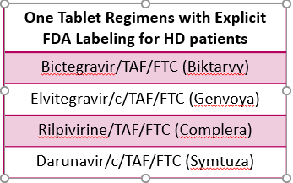
Answer:
What is full dose?
Not recommended if AKI or CrCl <30 & not on chronic hemodialysis
$ 200

Slide 108
Mutation associated with long term lamivudine (3TC) use
Click here for the answer

Slide 109
Answer:
What is the YMDD mutation?
Continue 3TC if benefits maintain
D/C and monitor for flares
Switch to alternative agent
$ 400

Slide 110
ARV that causes benign increases in serum creatinine
Click here for the answer

Slide 111
Answer:
What is dolutegravir (DTG) or cobicistat (c)?
Blocks renal tubular secretion
Increases Scr by 0.1 to 0.2 mg/dL
$ 600

Slide 112
Botswana Tsepamo study: neural tube defects (NTD) with this ARV use during conception is much lower than previously reported
Moved ARV up as a recommended option for people of childbearing potential
Click here for the answer

Slide 113
Answer:
What is dolutegravir (DTG)?
Prevalence lower than preliminary data
$ 800

Slide 114
CrCl cut-off at which dolutegravir-abacavir-lamivudine will require separation
Click here for the answer

Slide 115
Answer:
What is CrCl <30 mL/min?
Higher doses of 3TC generally well tolerated
Convenience of single-tablet-regimen
$ 1000

