Slide 1

Coronavirus Infections Including SARS-CoV-2
Eric A. Meyerowitz, MD
August 9, 2022, from 9-10AM
Montefiore Medical Center
Albert Einstein College of Medicine

Slide 2
Disclosures
I was a sub-investigator in the AstraZeneca chimp-adenovirus vector COVID-19 vaccine trial at Montefiore
I was a sub-investigator in the BACC-Bay trial of tocilizumab for COVID-19
No financial disclosures

Slide 3
Outline
The Common Human Coronaviruses
SARS and MERS
SARS-CoV-2 Etiology
SARS-CoV-2 Epidemiology
SARS-CoV-2 Transmission Dynamics
SARS-CoV-2 Testing
Therapeutics for COVID-19
COVID-19 Vaccines

Slide 4
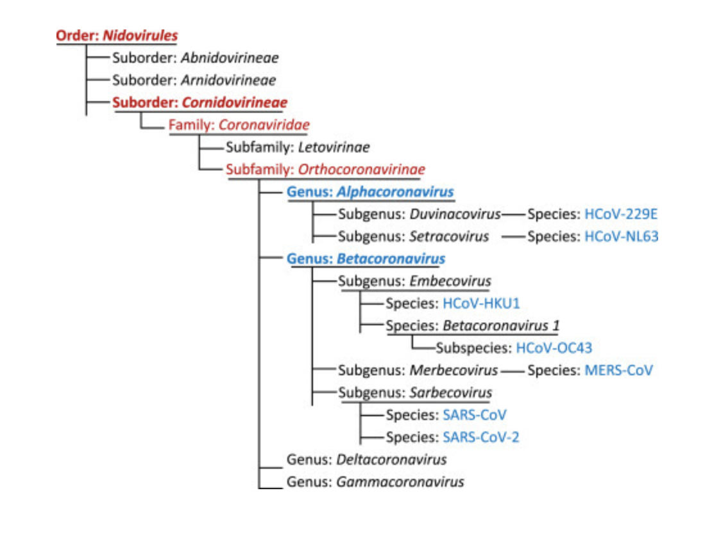
The common human coronavirus (pre-SARS-CoV-2)
The common human coronavirus cause mild upper respiratory tract symptoms and are estimated to cause 15-30% of the common cold:
HCoV-229E
HCoV-HKU1
HCoV-NL63
HCOV-OC43
Liu et al Encyclopedia of Virology 2021 doi 10.1016/B978-0-12-809633-8.21501-X

Slide 5
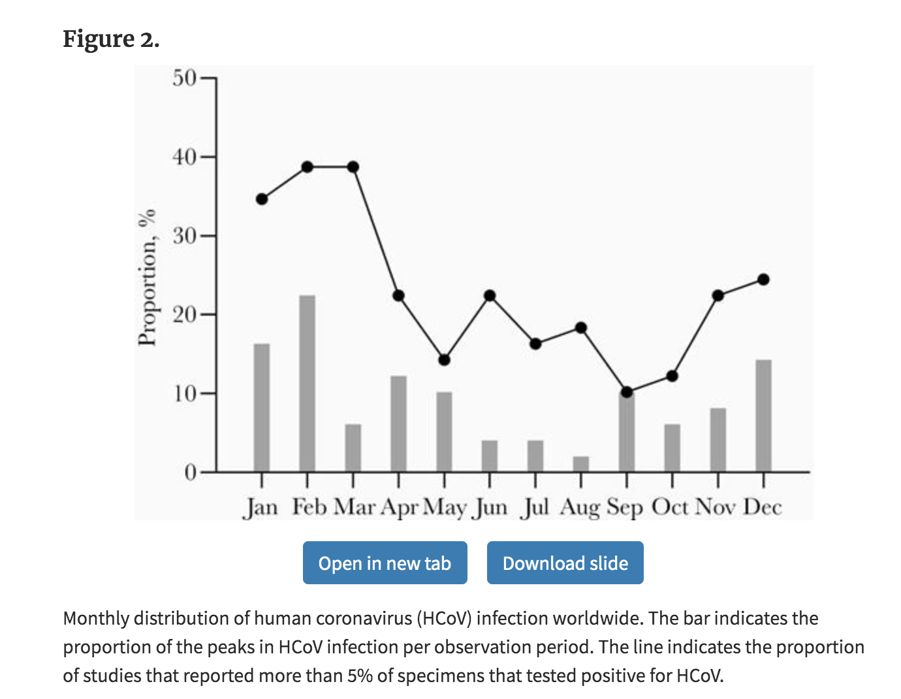
Seasonal variation in HCoV infection well described
Highest case numbers in January, February, March
No specific treatments for these infections
Reinfections were common starting around 6 months after prior infection
Edridge et al Nature Medicine 2020 doi: 10.1038/s41591-020-1083-1
Park et al OFID 2020 doi: 10.1093/ofid/ofaa443

Slide 6

SARS and MERS
(source: Wikipedia)
SARS-CoV
ACE2 entry receptor
Emerged in mainland China in 2002, no cases since 2004
~8000 total cases, 774 deaths (~10% mortality)
Bats (reservoir) -> palm civet (intermediate host)
MERS-CoV
DPP4 entry receptor
Emerged in Saudi Arabia in 2012
~2500 cases, 886 deaths (35% mortality rate)
Ongoing, sporadic cases in the middle east
Bats (reservoir) -> camels (intermediate host)
De Wit et al. Nat Rev Microbiol. 2021 doi 10.1038/nrmicro.2016.81
http://www.emro.who.int/health-topics/mers-cov/mers-outbreaks.html

Slide 7
Virology of SARS and MERS
Respiratory tract viral load peaks day 10-14 after symptom onset in SARS-CoV infection
Respiratory tract viral load peaks day 7-10 after symptom onset for MERS
Not believed to be asymptomatic cases (i.e., everyone develops symptoms)
No transmission from asymptomatic or pre-symptomatic cases
Cevik Lancet Microbe 2021 doi: 10.1016/S2666-5247(20)30172-5

Slide 8
SARS-CoV-2
The COVID-19 era

Slide 9
Clinical Epidemiology
Notes:
Let’s jump in with some of the clinical epidemiology

Slide 10
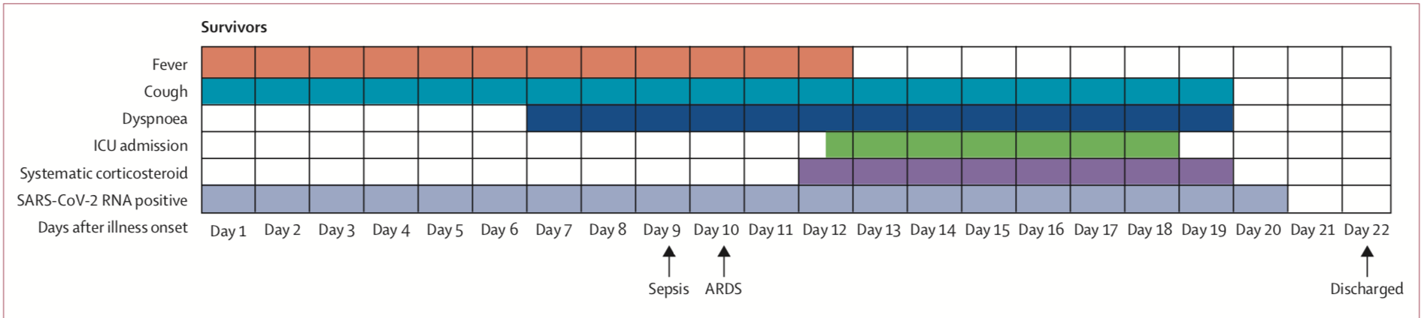
Two cases of COVID-19
35M without significant past medical history who works as a cashier at a grocery store develops myalgias, fever, cough and fatigue. Symptoms last for around 5 days and then improve.
65M with obesity (BMI = 33), diabetes, and coronary disease has the course outlined below:
Zhou Lancet 2020 doi 10.1016/S0140-6736(20)30566-3
Notes:
On this side you see two possible cases of COVID-19. The first a young man without comorbidities who has a self-resolving viral syndrome. The second, is a 65-year-old obese man with some common comorbidities who has a protracted and severe course involving need for ICU level care.

Slide 11
Illness severity spectrum
Persistently asymptomatic infection
20%
Self-resolving viral illness
64%
Severe disease with hypoxemia
12%
Critical Illness
4%
Wu JAMA 2020 doi 10.1001/jama.2020.2648
Buitrago-Garcia PLOS Med doi 10.1371/journal.pmed.1003346
Notes:
One of the defining features of COVID-19 has been the vast illness severity spectrum. Here I have represented a rough breakdown of the severity spectrum from the pre-vaccine era. Somewhere between 20 and 30% of individuals may have persistently asymptomatic infection. Around two thirds have mild disease, and 10-15% have more severe courses, including many who develop significant hypoxemia and some who require ICU level supports.

Slide 12
Among unvaccinated individuals which factor is associated the highest risk of severe COVID-19?
Diabetes, HbA1c 12.0%
Diabetes, HbA1c 8.5%
Morbid obesity, BMI 45
Age 85
Coronary artery disease

Slide 13
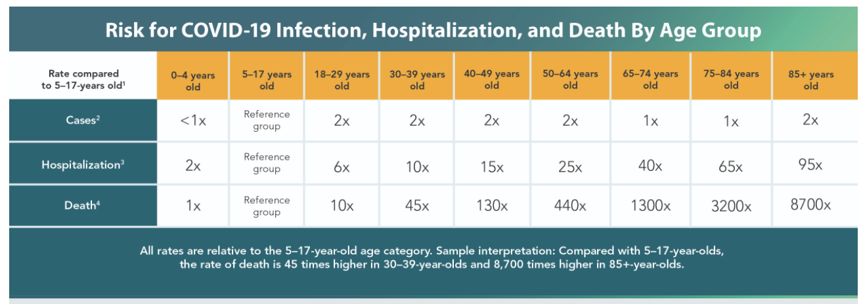
A key determinant of infection fatality rate is age distribution of a population
https://www.cdc.gov/coronavirus/2019-ncov/covid-data/investigations-discovery/hospitalization-death-by-age.html
Notes:
The age of the individual affected is the key determinant of infection severity and infection fatality rate. Therefore, the numbers that I had on the last slide would be different in regions with different demographics.
Analysis by the CDC shown on this slide shows that unvaccinated individuals 85 and older have 8700 times higher likelihood of death from COVID-19 compared with a reference group of individuals aged 5-17 years.

Slide 14
Table: Reported presenting symptoms
Symptom | Estimated Prevalence
Fever | 44-99%
Cough | 59-82%
Nausea, vomiting, diarrhea, anorexia | 3-50%
Myalgias | 11-44%
Fatigue | 20-35%
Anosmia or dysgeusia | Up to 65%
Sore throat | <20%
Headache | 15 - 35%
Rhinorrhea | <5%
*Fever is more common among those requiring hospitalization
*Anosmia/dysgeusia may be more common in mild cases
Guan NEJM 2020 doi 10.1056/NEJMoa2002032
Chen Lancet 2020 doi 10.1016/S0140-6736(20)30211-7
Wang JAMA 2020 doi 10.1001/jama.2020.1585
Pan Am J Gastroenterol 2020 doi 10.14309/ajg.0000000000000620
Menni Nature 2020 doi 10.1038/s41591-020-0916-2
Romero-Sanchez Neurology 2020 doi 10.1212/WNL.0000000000009937
Alvarado JAMA Netw Open 2020 doi 10.1001/jamanetworkopen.2020.20981
Notes:
Among those who develop symptoms, there are varied presentations. Fever is more common among those who are hospitalized. For the original SARS-CoV-2 virus, anosmia or dysgeusia were quite common, particularly among mild cases. Sore throat was more uncommon.

Slide 15
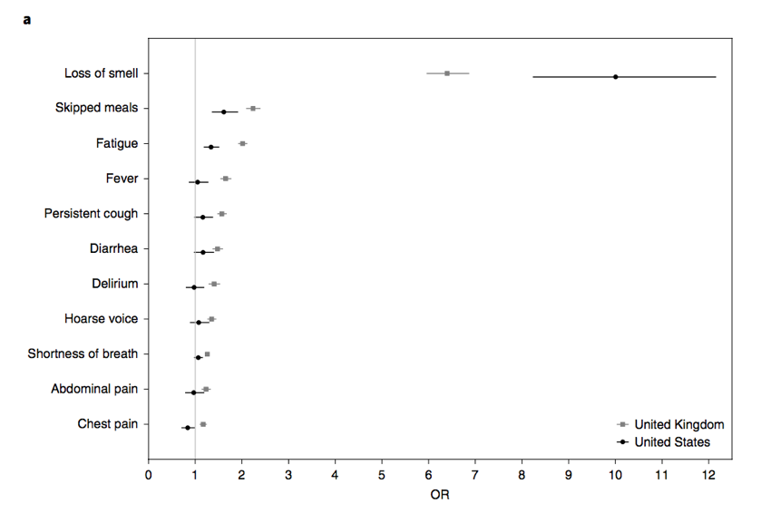
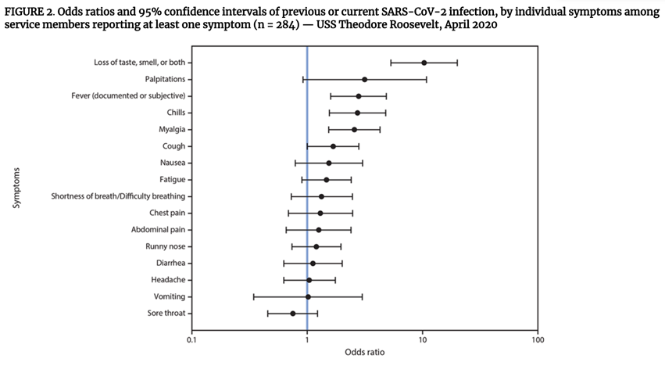
Among self-reported symptoms, anosmia has the highest odds ratio of being SARS-CoV-2+ for original virus
Menni Nature 2020 doi 10.1038/s41591-020-0916-2
Payne MMWR 2020 doi 10.15585/mmwr.mm6923e4external icon
Notes:
An important study from early in the pandemic found that among self-reported symptoms, anosmia had the highest odds ratio of being SARS-CoV-2 positive. You can see that represented graphically on the charts here, where reported loss of smell was associated with a far higher risk of COVID-19 compared to all of the other items tested.

Slide 16
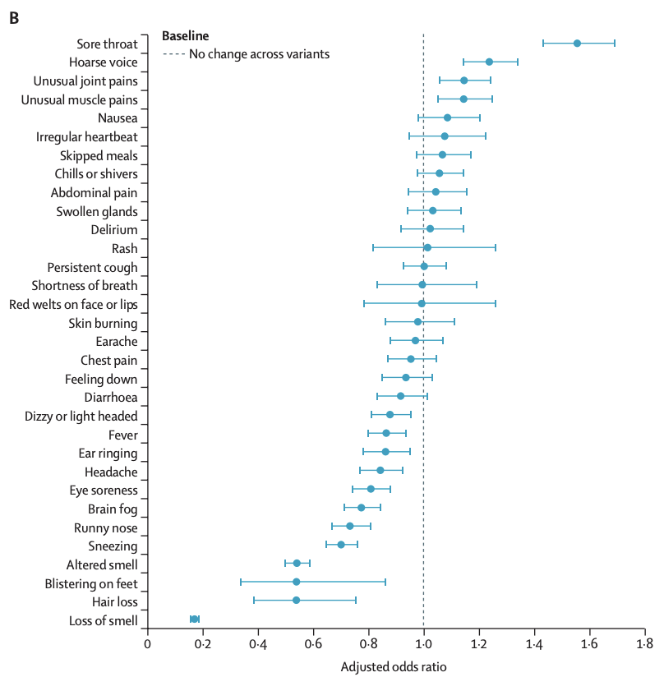
Specific symptom profile may change based on variant that is circulating
Prospective study from the UK found symptoms varied between Delta and omicron, with sore throat more common and altered smell less common for omicron
https://doi.org/10.1016/S0140-6736(22)00327-0
Notes:
Importantly the specific symptom profile has changed over time in the pandemic. The graph on the right of this slide is from a prospective study from the UK comparing symptoms between Delta and Omicron variants.
Report of sore throat was significantly more common for omicron versus Delta and loss of smell far more common for Delta than omicron.

Slide 17
Table: Epidemiologic Risk Factors for Severe COVID-19
Unvaccinated | Immunocompromised
Increasing age | Chronic kidney disease
Male sex | Hypertension
Obesity | Cancer
Cardiovascular disease | Advanced liver disease
Heart failure | Perioperative SARS-CoV-2 infection
Diabetes | Race
Chronic pulmonary disease | Poverty
Guan NEJM 2020 doi 10.1056/NEJMoa2002032
Docherty BMJ 2020 doi 10.1136/bmj.m1985
Wang JAMA 2020 doi 10.1001/jama.2020.1585
Wu JAMA Internal Med 2020 doi 10.1001/jamainternmed.2020.0994
Petrilli BMJ 2020 doi 10.1136/bmj.m1966
Zhou Lancet 2020 doi 10.1016/S0140-6736(20)30566-3
Patel medRxiv 2020 doi 10.1101/2020.04.27.20082107
Gross medRxiv 2020 doi 10.1101/2020.05.07.20094250
Nepogodiev Lancet 2020 doi 10.1016/S0140-6736(20)31182-X
Lei EClinicalMedicine 2020 doi 10.1016/j.eclinm.2020.100331
Notes:
I’ve compiled a list here of some of the risk factors for severe disease that are well described across multiple studies.

Slide 18
The Period of Infectiousness
Notes:
Next, I’m going to trace how the period of infectiousness has changes for the various SARS-CoV-2 viruses.

Slide 19
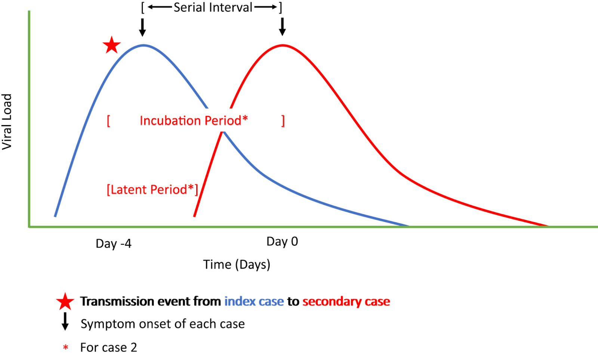
https://doi.org/10.1016/j.idc.2022.01.007
Notes:
Here you can see the viral load trajectories for 2 cases in the blue and red lines with a peak occurring about the time of symptom onset. The incubation period is the time from an exposure leading to a transmission event to the onset of symptoms in the secondary case.

Slide 20
Table: Incubation Period for SARS-CoV-2 Viruses
 | Prior SARS-CoV-2 Viruses | Delta | Omicron
Mean Incubation Period | 5.2 days (95% CI: 4.1-7.0) | 4.4 days (95% CI: 3.9 – 5.0) | ~3 days (uncertainty)
https://doi.org/10.1016/j.idc.2022.01.007
Notes:
The incubation period has gotten progressively shorter as the virus has changed from Wuhan-Hu-1 to Delta to omicron, with early estimates for omicron suggesting an incubation period of around 3 days, down from about 4.4 days with Delta and 5.2 days for the original virus.

Slide 21
Wuhan-Hu-1
Notes:
Next let’s review viral load trajectories and infectious period starting with Wuhan-Hu-1, the original SARS-CoV-2 virus.

Slide 22
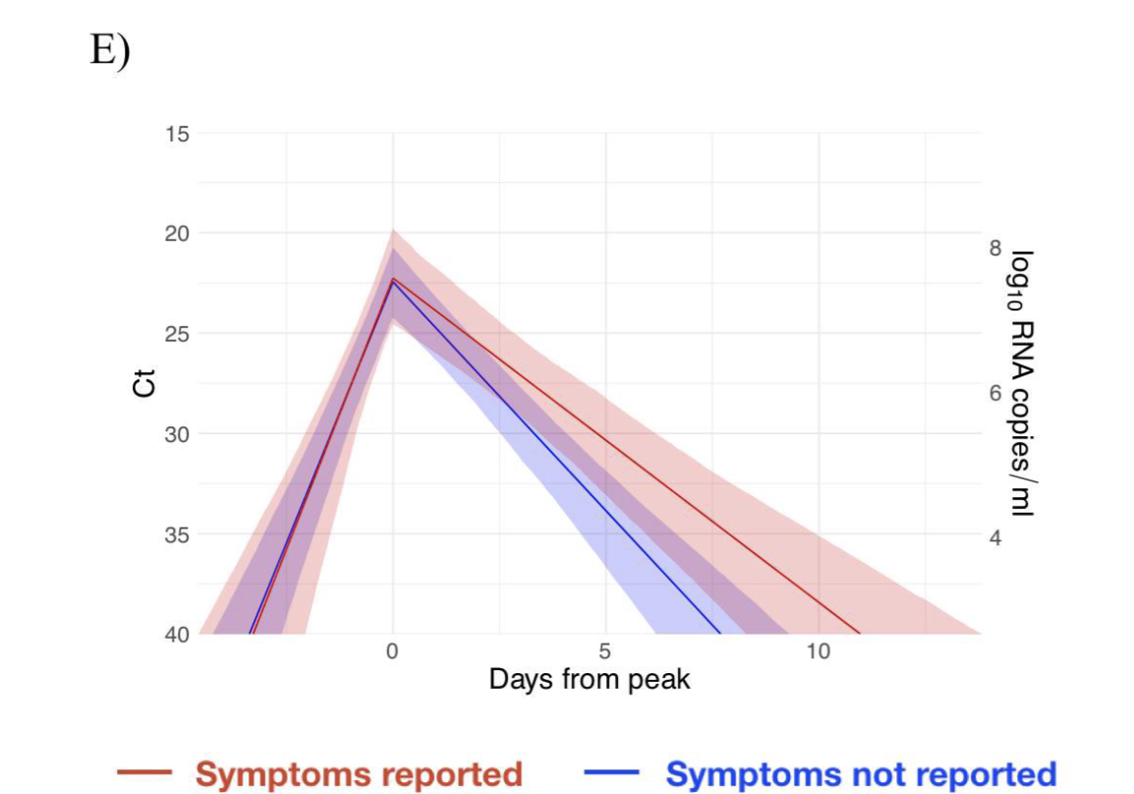
PLoS Biol 19(7): e3001333. https://doi.org/10.1371/journal.pbio.3001333
Notes:
This figure represents data from the 2020 NBA bubble study and shows typical viral load trajectories for the original SARS-CoV-2 virus. In this study the researchers analyzed data from 68 individuals who were tested at least 5 times during the study period. They found that viral load rises over a period of 1-3 days, peaks, and then declines rapidly over the course of about a week. Numerous studies suggest symptom onset occurs around the time of viral load peak.

Slide 23
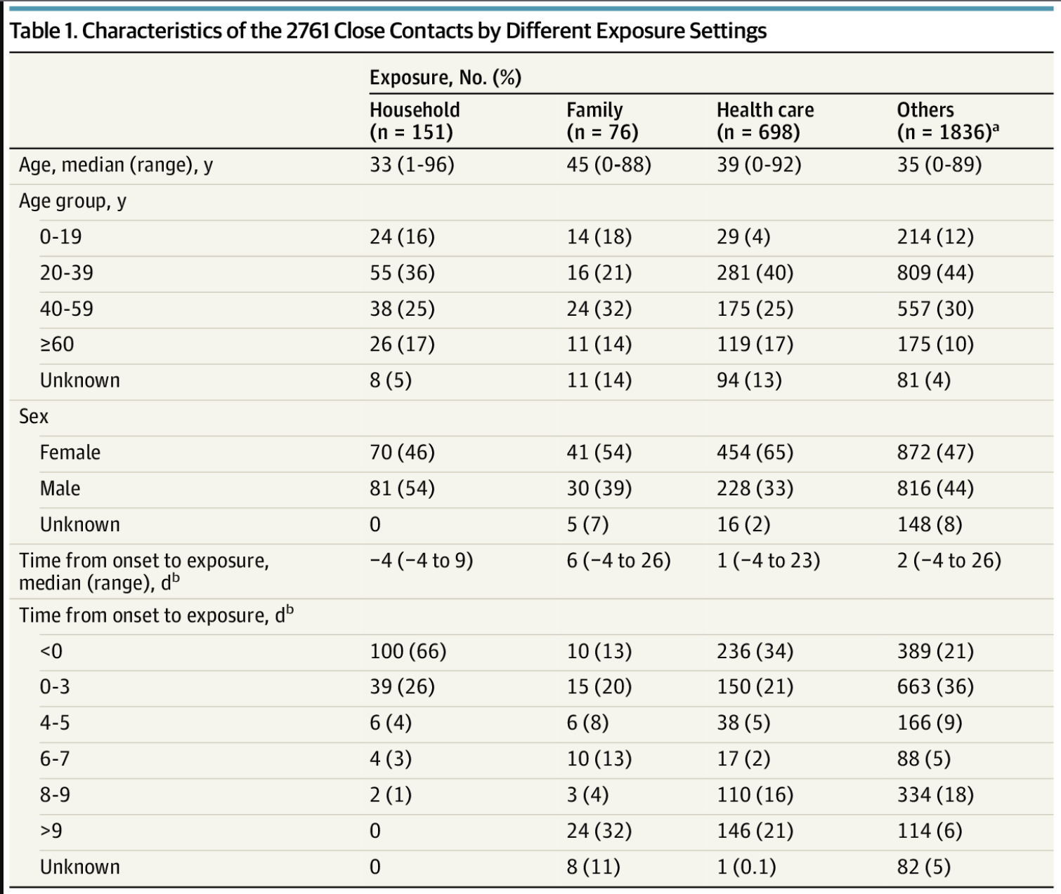
JAMA Intern Med. 2020;180(9):1156-1163. doi:10.1001/jamainternmed.2020.2020
Notes:
Transmissions happen before symptom onset and in the several days afterwards, as you would expect from the viral load trajectories.
The table shows the characteristics of the nearly 3000 contacts of the first 100 cases in Taiwan from an excellent case-contract study
The red box at the bottom shows the timing of the exposure in relation to symptom onset in the index case. You can see a nice distribution of exposures in various settings and distributions over time including from before symptom onset to greater than 9 days after onset of symptoms.

Slide 24
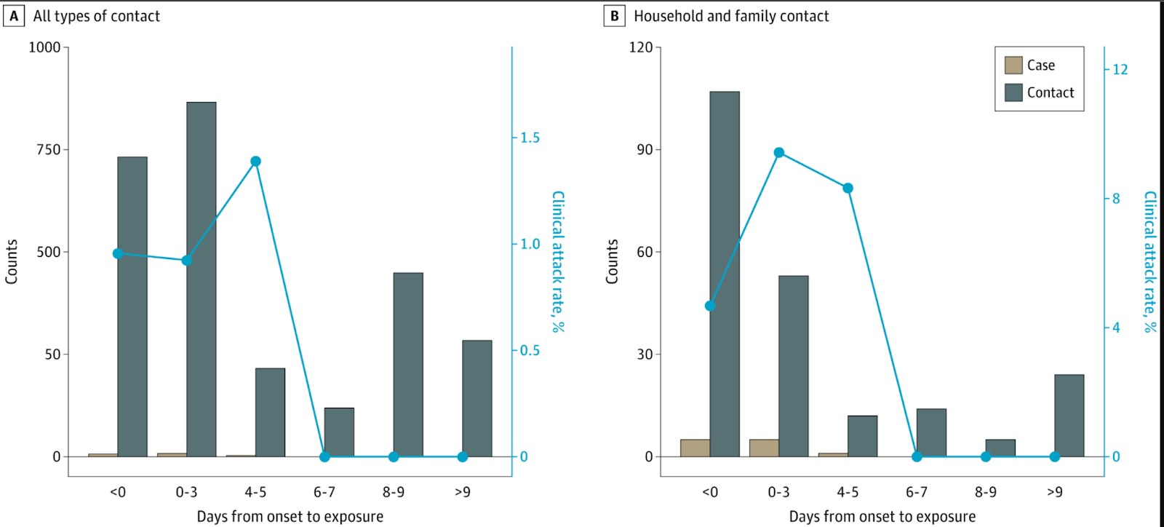
JAMA Intern Med. 2020;180(9):1156-1163. doi:10.1001/jamainternmed.2020.2020
Notes:
This is a figure from the same study shows that there were no transmissions when an exposure happened beyond 5 days after symptom onset for the index case.
You can see the timing of when the contacts happened in relation to symptom onset of the index case on the X axis and the blue line shows the attack rate for each day. On the left is the attack rate for all contacts and on the right is the attack rate for contacts restricted to household and family. By day 6 after symptom onset, the attack rate goes to 0 in both.

Slide 25
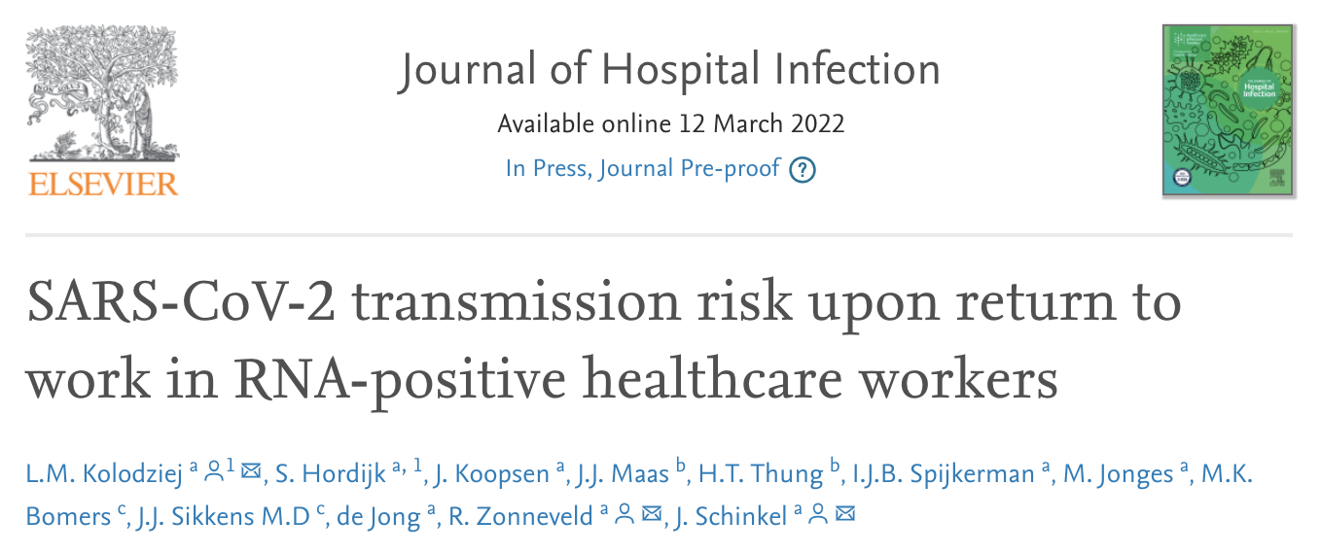
# HCW | Reported Symptoms at Day 21 | Median initial Ct | Median Follow-up Ct (30 positive of 61 tested)* | Ct < 30 | Contacts Tested Positive | Confirmed Linked Cases
72 | 43% | 21.1 (IQR 8.0) | 29.2 | 22/30 | 11 | 0
*13 days post symptom onset (range 6-42)
Notes:
We knew early on that some individuals have persistently positive PCR tests for weeks or even months after their initial positive test.
There are numerous data showing that these individuals do not transmit. The study referenced here is from the Netherlands healthcare workers who developed SARS-CoV-2 infection were prospectively enrolled between May and September 2020. They followed serial PCR tests and performed detailed contact tracing as well as phylogenetic analysis of any noted additional cases among contacts happening after return to work.
Of 72 participants, 43% had symptoms at day 21 with fatigue and change in taste and smell most common at that point, though 9 people or 13% still reported cough at that time. The median initial RT-PCR had a cycle threshold of 21.1 and was taken on average 1 day after symptom onset. 61 had repeat testing and 30 tested positive with a median Ct of 29.2. This testing occurred a median of 13 days after symptoms. 22 out of 30 had a Ct less than 30 which is a cutoff that has been associated with higher likelihood of viable virus. They identified 11 contacts who tested positive after having contact with an index case beyond the isolation period, but none were linked to the index cases.
Stated another way, to assess risk of transmission from an immunocompetent index case, it is important to consider not just the cycle threshold but also the time from onset of symptoms. Even with persistently positive PCR tests, transmissions did not occur after about a week from onset of symptoms for the original virus.

Slide 26
Delta
Notes:
Next let’s move on to Delta.

Slide 27
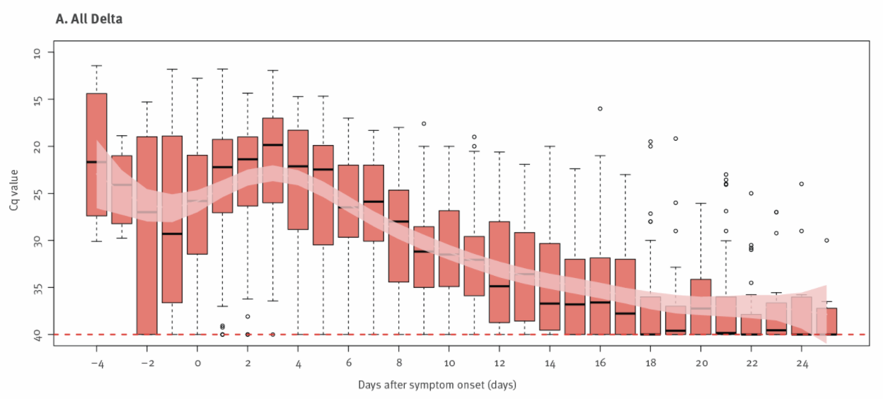
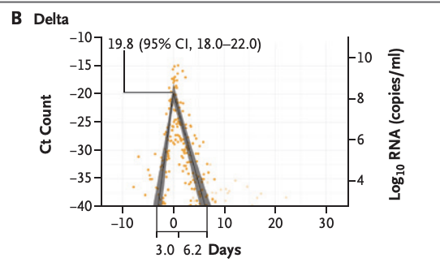
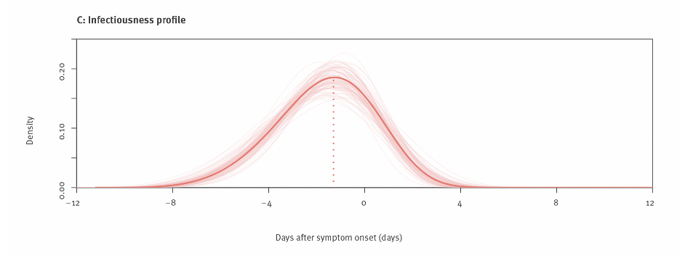
https://doi.org/10.2807/1560-7917.ES.2022.27.10.2100815
N Engl J Med 2021; 385:2489-2491. DOI: 10.1056/NEJMc2102507
Notes:
On the left of the slide, I have figures from a study of the contained Delta outbreak in Guangzhou, China. At the top of the slide, you can see that viral load is highest before symptom onset and up until around 1-2 days after onset of symptoms and then declines rapidly. In the figure below the same researchers modeled infectiousness of Delta showing that it is highest from up to about 4 days before onset of symptoms through about 4-5 days after onset of symptoms.
On the right of the slide is additional data from the NBA researchers that included 36 people with confirmed Delta infection. They plotted viral loads and find a similar trajectory, with a rapid rise over about 3 days and a fall over about 6 days.
Overall, the trajectories appear quite similar to those from the original strain.

Slide 28
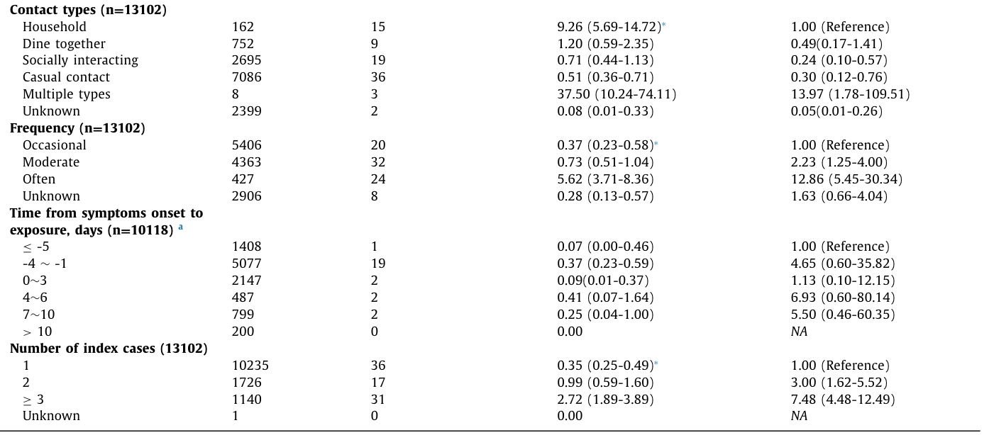
https://doi.org/10.1016/j.ijid.2022.01.034
Notes:
There are too few case-contact tracing studies from the Delta era, but this one was well done and was from the same contained outbreak in Guangzhou China. As you can see, these researchers documented a few later transmissions, between 7 and 10 days after symptom onset, which I’ve highlighted with a red box.
There were not clearly documented transmissions for Wuhan-Hu-1 after about 5 days from symptom onset, so this raises the possibility of a longer effective infectious period with Delta compared with the original virus.

Slide 29
Omicron
Notes:
Now let’s review some preliminary findings for omicron.

Slide 30
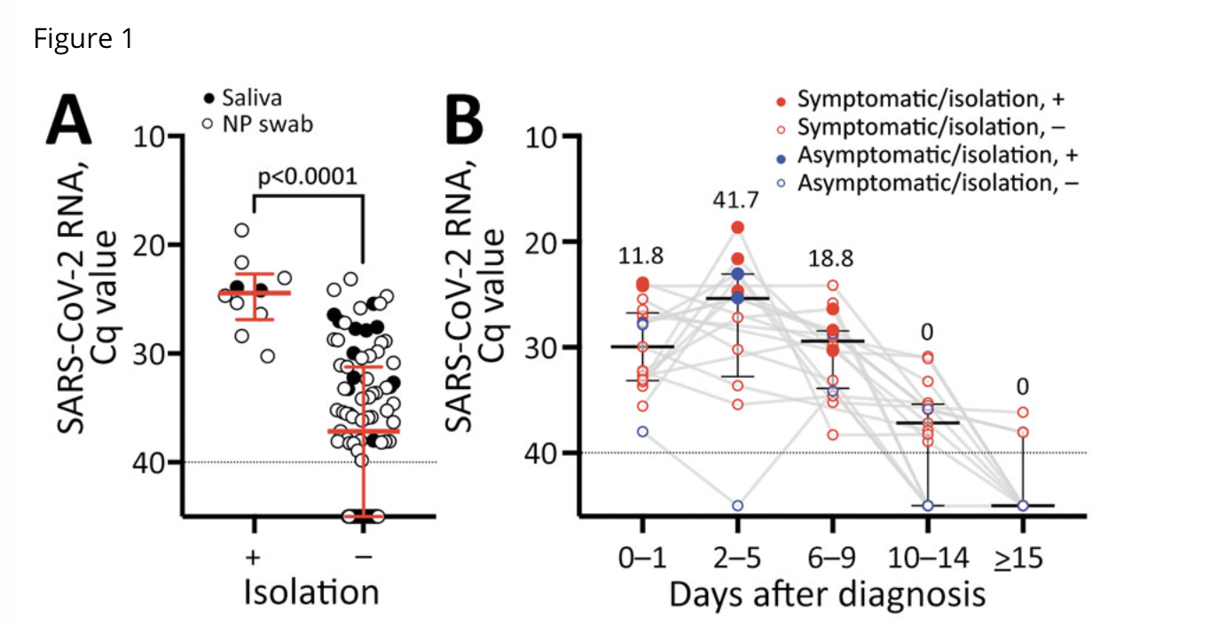
https://doi.org/10.3201/eid2805.220197
Notes:
Data from Japan suggest that viral load for omicron infections peaks 2-5 days after symptom onset as shown on the right of this slide.
In the figure on the left you can see that positive cultures were only found with Ct less than 30. On the right in part B, you can see the solid circles show viable virus isolated and none was isolated after day 9 from symptom onset.

Slide 31
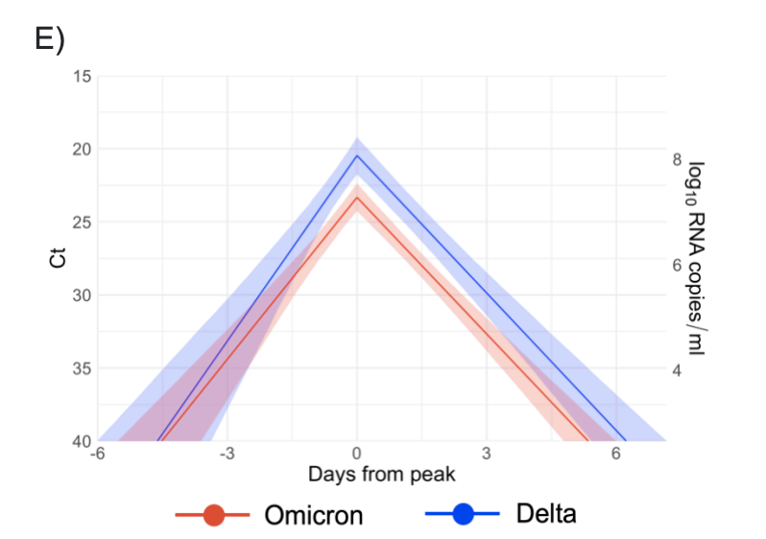
Preprint: https://nrs.harvard.edu/URN-3:HUL.INSTREPOS:37370587
Notes:
Some preliminary data from the amazing NBA researchers are also illuminating.
In this preprint they plot viral load trajectories for 97 omicron and 107 Delta variant infections. As you can see the curves are relatively similar trajectory and duration of positivity, with a rapid rise and fall over several days.
They did not have enough information to report on relationship to symptom onset, but one hypothesis that is supported by the data from Japan and other reports is that symptom onset is shifted earlier for omicron compared with Delta. I’ve added a red arrow representing possible symptom onset for omicron and a blue arrow for symptom onset for Delta as an example.
If this is indeed the case, we might expect fewer presymptomatic transmissions with omicron, and transmissions to occur somewhat longer after onset of symptoms.

Slide 32
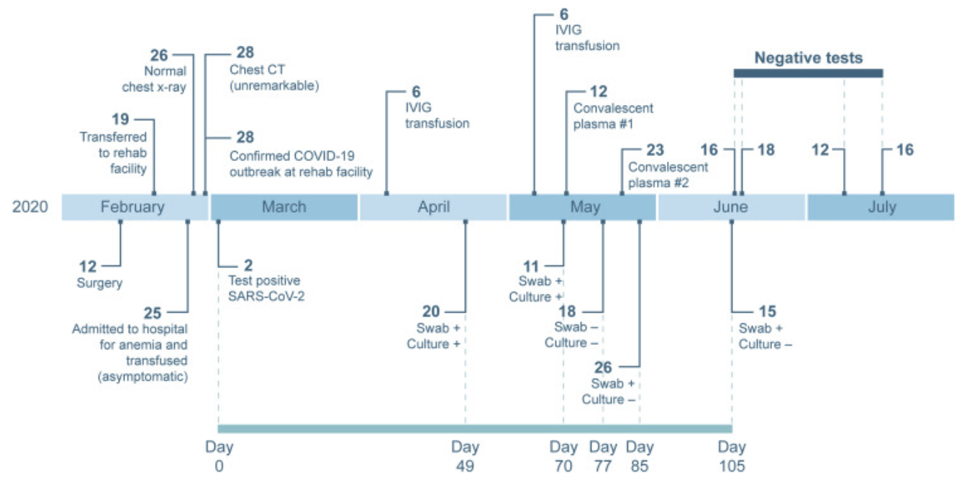
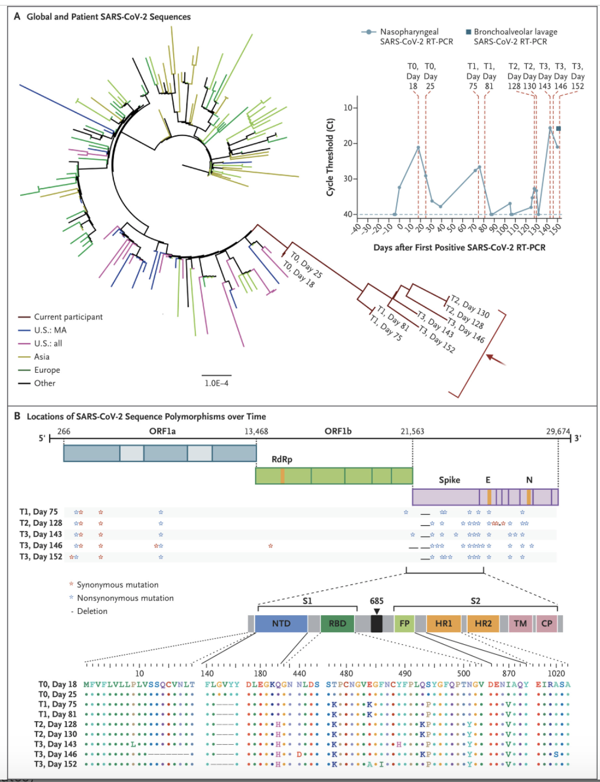
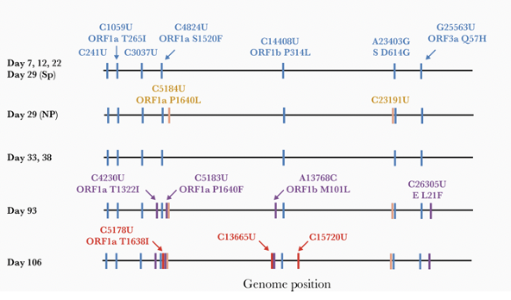
Prolonged infection described in severe B cell deficiency, advanced HIV/AIDS
Avanzato Cell 2020 doi: 10.1016/j.cell.2020.10.049
Choi NEJM 2020 doi: 10.1056/NEJMc2031364
Baang JID 2020 doi: 10.1093/infdis/jiaa666

Slide 33
Evolving Understanding of Transmission
Notes:
Next let’s review the evolving understanding of aerosol transmission

Slide 34
Transmission Events
Source with high viral load
Susceptible secondary contact
Potential for superspreading
Environment supportive of aerosol transmission
Notes:
The features that make transmission events likely include when a source has a high viral load in close proximity to a susceptible secondary contact and the environmental conditions favor aerosol transmission and superspreading.

Slide 35
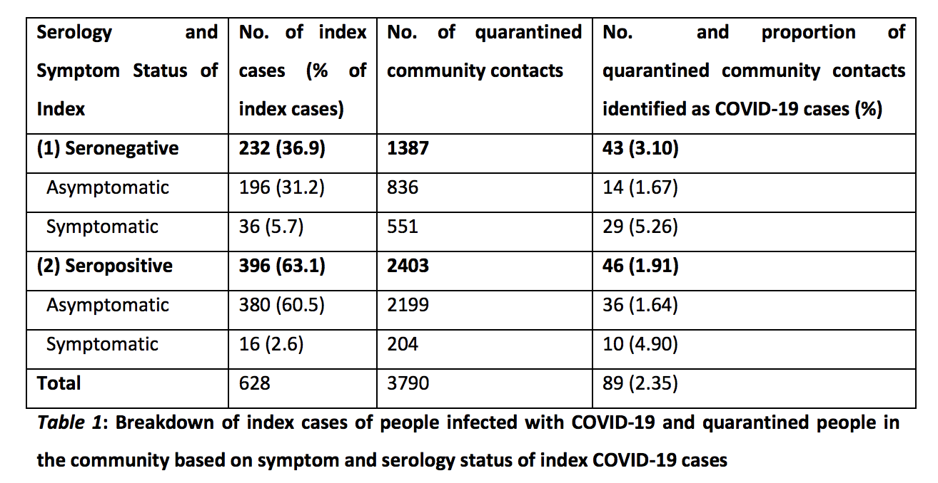
Persistently asymptomatic people are less likely to transmit
Sayampanathan Lancet 2020 doi 10.1016/S0140-6736(20)32651-9
Notes:
Persistently asymptomatic people are less likely to transmit than symptomatic individuals.
The table on this slide is from an important study from Singapore prior the emergence of variants. They included 628 people with COVID-19 and 3790 close contacts, of whom 89 developed COVID-19. After adjusting for age, gender and serology of the index case, the risk of COVID-19 among close contacts of symptomatic cases was 3.85 times higher than for close contact of asymptomatic cases.
In the far-right column of the table you can see the breakdown of percentage of contacts who developed COVID-19 for asymptomatic and symptomatic index cases and whether the index case was seronegative or seropositive at the time of identification.

Slide 36
Infectiousness is directly related to viral load
Marks Lancet ID 2021 doi 10.1016/S1473-3099(20)30985-3
Notes:
This is a representation of data from a study from Spain that looked at the secondary attack rate versus viral load for 753 contacts of 314 index cases with mild COVID-19. There was a clear relationship with higher viral load associated with higher secondary attack rate. A 23.9% secondary attack rate was found for index cases with a respiratory tract viral load >10 to the 10th copies/mL versus just 12.7% for those with a viral load of <10 to the 7th copes/mL.
Importantly they controlled for number of days from symptom onset, symptom status and other factors in this study.

Slide 37
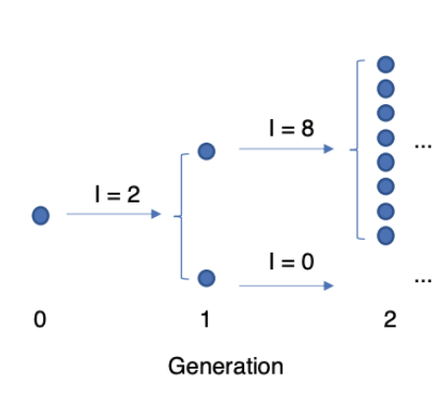


Heterogeneous Transmission Dynamics
R₀ = basic reproductive number
Adapted from: https://covid.idmod.org/data/Stochasticity_heterogeneity_transmission_dynamics_SARS-CoV-2.pdf
Notes:
All of the variants of SARS-CoV-2 to date have shown heterogeneous transmission dynamics.
The figures on this slide depict uniform and heterogeneous transmission dynamics.
On the left you can see an example of uniform transmission dynamics where an index case leads to 2 secondary cases which each lead to 2 tertiary cases.
On the right you can see heterogeneous transmission dynamics where an index case leads to 2 secondary cases. One of those secondary cases transmits to 8 tertiary cases while the other has no further transmissions.

Slide 38
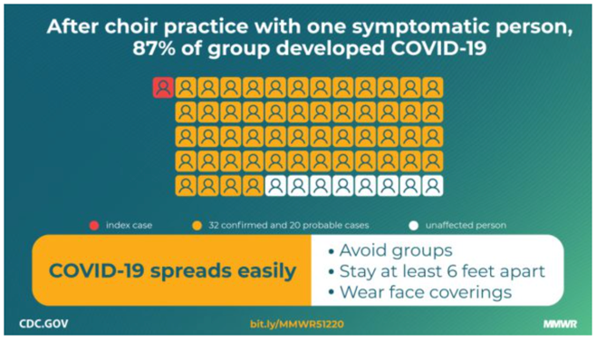
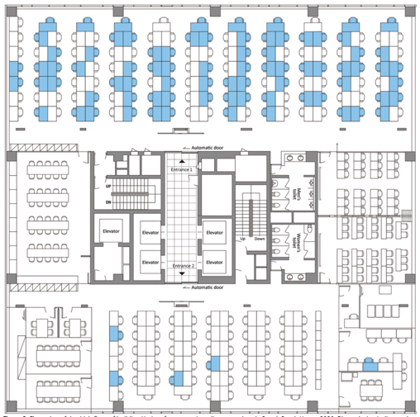
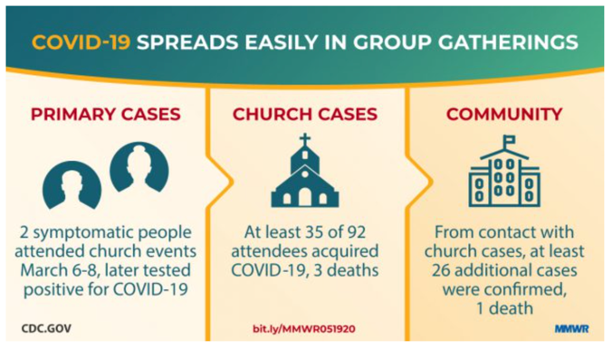
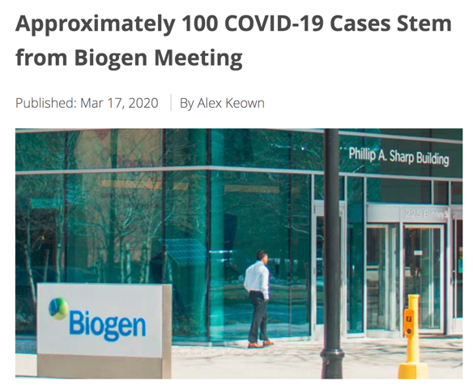
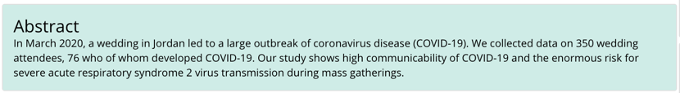
“Superspreading events”
Choir in Washington State
Korean call center
Church in Arkansas
Hamner MMWR 2020 doi 10.15585/mmwr.mm6919e6
Eagle MMWR 2020 doi 10.15585/mmwr.mm6920e2
Park EID 2020 doi 10.3201/eid2608.201274
Wedding in Jordan
Yusef EID 2020 doi 10.3201/eid2609.201469
https://www.biospace.com/article/approximately-100-covid-19-cases-stem-from-biogen-meeting/
Notes:
Heterogeneous transmission dynamics allow for superspreading events. These have been a major feature of transmission of SARS-CoV-2 throughout the pandemic, making news all around the globe. A few examples are on this slide including a call center in South Korea, a choir in Washington State and others.

Slide 39
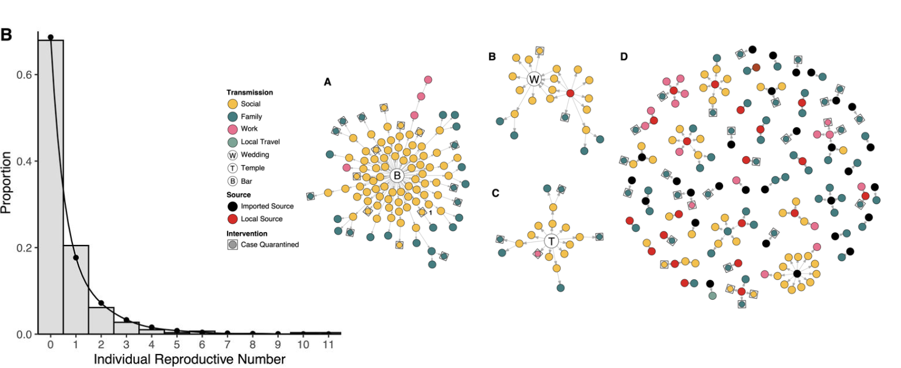
Contact tracing investigations in Hong Kong suggest transmission heterogeneity
Adam Nature 2020 doi 10.1038/s41591-020-1092-0
Notes:
Heterogeneity is evident in the contact tracing from Hong Kong shown here.
On the left you can see a plot of the individual reproductive number. You see that around 70% of cases had no subsequent transmissions with a long tail where some cases lead to many secondary cases.
On the right are plotted some of the clusters including a bar and band cluster and a wedding cluster where many cases are associated with a single event.

Slide 40
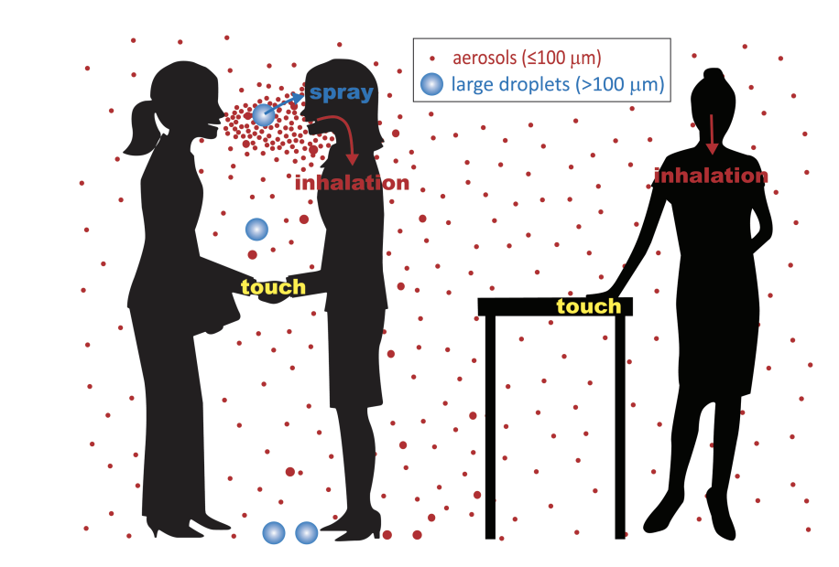
Old ID epidemiology definitions “aerosol” and “droplet” were developed and useful because of infection control considerations
https://doi.org/10.1093/cid/ciab722
Notes:
Let’s now discuss the updated understanding of aerosol transmission, which has been completely reshaped by knowledge gained from the pandemic.
Before the pandemic, infectious diseases epidemiology taught that the transmission of respiratory pathogens was dichotomous, with some spreading while suspended on larger droplets and others spreading on smaller aerosols.
In general, larger droplets fall to the ground quickly and within a short distance because of gravity whereas aerosols can remain suspended over more space and time. Surgical masking was felt to be sufficient in limiting droplet spread and enhanced ventilation with negative pressure isolation and N95 respirators were used in the setting of aerosol spread.
It’s clear that while this model had some use in infection control, it was deeply flawed and highly insufficient.
Whereas in the old model proximity was thought most important for droplet spread, it is clearly also very important for aerosol spread since, even though aerosols may remain suspended over further distances, they are diluted with distance, and so infection at a distance becomes less likely than at close range.

Slide 41
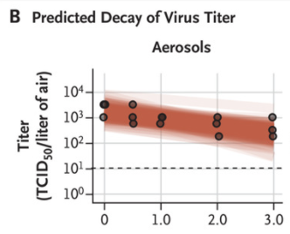
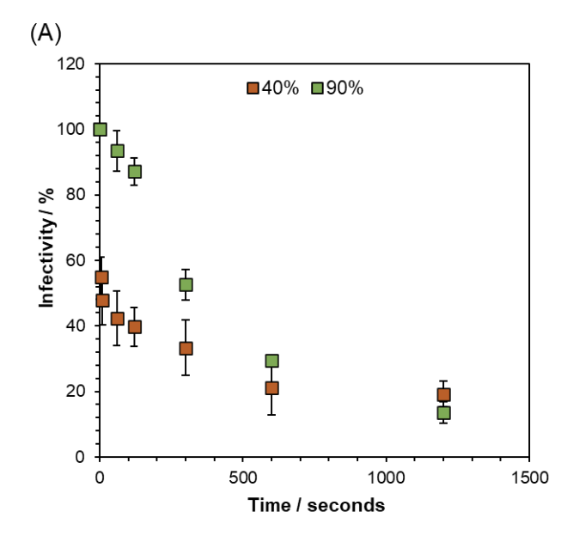
Environmental/aerosol viability is necessary but not sufficient for transmission
DOI: 10.1056/NEJMc2004973
https://doi.org/10.1101/2022.01.08.22268944
Notes:
A very early study of environmental viability led to frank panic at the time it was published and was responsible for such things as washing down groceries and other extreme practices. The figure on the left is from that paper and shows the decay curve for SARS-CoV-2 on aerosols with a predicted half-life of more than 1 hour.
A major concern was whether there could be transmissions spaced out over time, for instance if a person with infection produced aerosols in a room, might someone be vulnerable to infection an hour or more later, after the source was long gone from that space?
Our vast accumulated global experience tells us that those sorts of SARS-CoV-2 transmissions occur only very rarely if at all, with most or all transmissions happening when a source and contact share a physical space, at the same time.
More recent studies have looked at the infectivity of aerosols and found rapid declines over several minutes. The figure on the right comes from a preprint from chemists from the UK that tested infectivity of aerosols in tissue cultures after suspension and found rapid decline to about 10% within 20 minutes with much of the decline happening in the first 5 minutes after aerosolization. The green squares are for aerosols at a relative humidity of 90% and the orange squares for relative humidity of 40%. These researchers found aerosolization leads to changes in pH and other factors that likely contribute to the rapid decrease in infectivity.

Slide 42
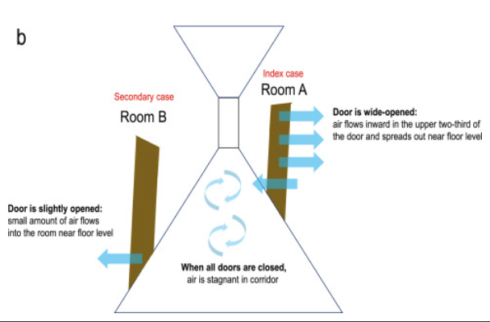
Long range aerosol transmissions in quarantine hotels
https://doi.org/10.1016/j.lanwpc.2021.100360
Notes:
While most transmissions occur between unmasked people in close proximity, there are numerous elegantly documented reports of longer-range transmissions due to specific air flow patterns and inadequate ventilation. These reports demonstrate the key role for improved ventilation to further impact transmission.
The figure on this slide is from an analysis following a transmission at a designated quarantine hotel in Hong Kong. There had been previous transmissions at this hotel and portable air purifiers with filtration systems were placed in the corridors and residents were asked to wear surgical masks when opening doors to their rooms.
The researchers used a smoke test to follow the air flow patterns and mapped a route of flow from Room A to Room B with both doors open simultaneously. They also noted the source patient did not wear a surgical mask when he opened the door. He sometimes wore a cloth mask and other times wore no mask. Through this analysis they hypothesized the route of transmission.

Slide 43
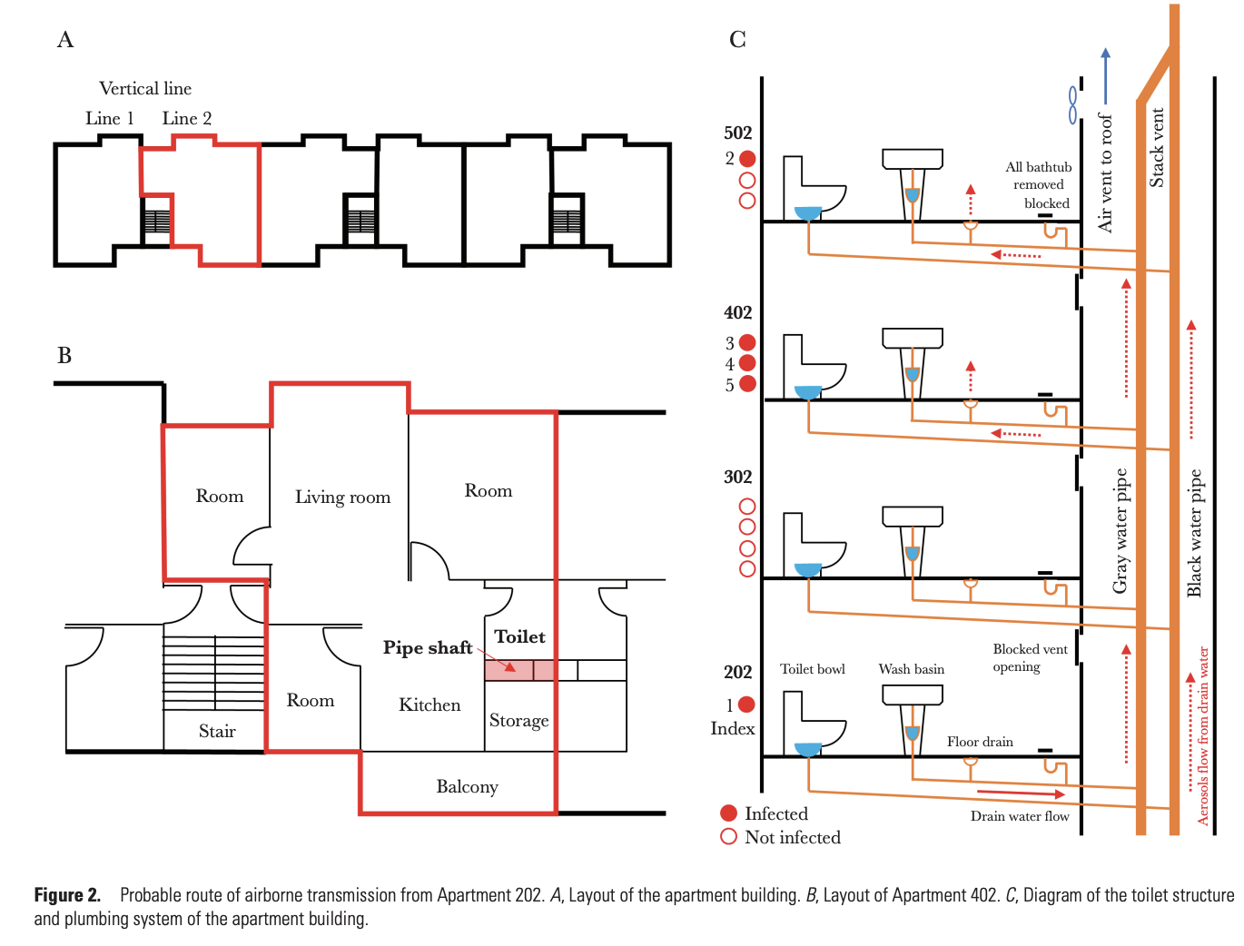
Probable between-floor transmission through drainage systems
https://doi.org/10.1093/infdis/jiab598
Notes:
In another striking report, a cluster of cases were linked to an apartment complex in South Korea. The outbreak included 19 cases, with 5 of the cases occurring in apartments in the same 6-story building labeled “line 2,” which is noted in red on at the top left of the figure. There were no cases the adjacent attached building labeled line 1. The additional 14 cases were all close contacts of one of the cases in the line 2 apartments.
The investigation revealed that the apartments in the building labeled line 2 had nonfunctional air vents in their bathrooms and further than when a kitchen hood in an apartment was activated, it pulled in air from the vent because of the negative pressure. I’ve labeled the kitchen in the floor plan at the bottom left of the slide with a blue arrow and you can see the close proximity to the bathroom.
On the right of the slide, you can see how the bathrooms in the line 2 building were vented to a common pipe system for all the apartments.
Contaminated air flowing from a source’s bathroom through the nonfunctional bathroom air vents of a secondary case, potentially enhanced by the negative pressure from the kitchen hoods, was hypothesized to be the mechanism of spread between the apartments.

Slide 44
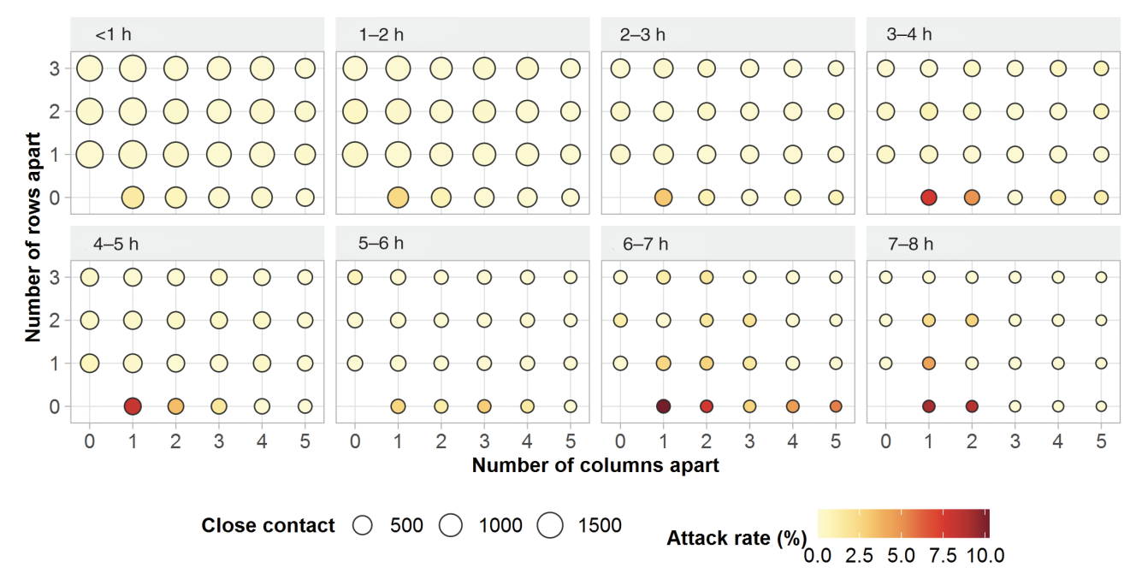
On a train, risk for SARS-CoV-2 infection is highest for people in close proximity (adjacent seat highest risk), as well as with increasing co-travel time
https://doi.org/10.1093/cid/ciaa1057
Notes:
This figure comes from an analysis of risk of SARS-CoV-2 infection during train travel from China from very early in the pandemic. The researchers analyzed 2334 index patients and 72 093 close contacts who had co-travel times of 0–8 hours from December 19 2019 through March 6 2020.
Each box represents a seat chart with increasing co-travel time as you move from left to right in the top and bottom rows. The position at 0 is the index case. You can see increasing risk attack rate risk as you have increasing co-travel time, with the highest risk in all cases being the person in the adjacent seat.

Slide 45
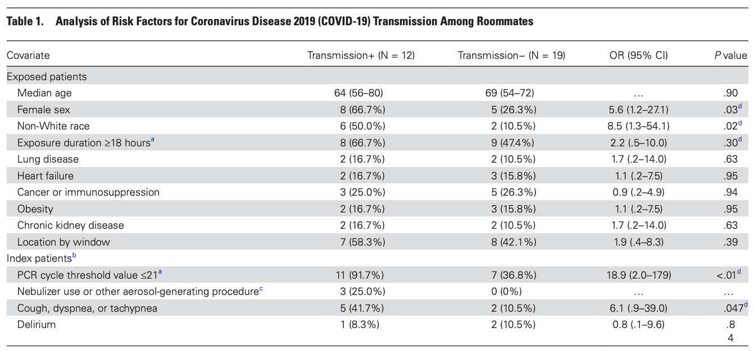
Shared patient rooms: high risk setting. 12/31 (39%) exposed in shared patient room tested positive within 14 days of exposure
https://doi.org/10.1093/cid/ciab564
Notes:
In healthcare settings, shared patient rooms represent a clear and present risk for transmission of SARS-CoV-2 infection.
The table on this slide is from a very nice study from the Brigham infection control group that found that among those patients who shared rooms with patients with undiagnosed SARS-CoV-2, nearly 40%, or 12 out of 31 total, tested positive within 14 days of the exposure.
In the red box you can see that a high viral load and respiratory symptoms in the index case increase the risk of transmission.

Slide 46
Long range transmissions more likely to occur when:
Source has high viral load
Source with cough at time of exposure
Poor ventilation / indoor settings
Airflow patterns that enhance flow between a source and susceptible contact
Longer shared time
Any unmasked time (e.g. during meals)
Notes:
To summarize some key points from this section, risks for aerosol transmission include a high viral load in the source, respiratory symptoms in the source, an indoor or poorly ventilated exposure settings or when airflow patterns enhance flow between a source and susceptible contact, and when there is longer shared time and especially any unmasked time, including during meals, between source and contacts.

Slide 47
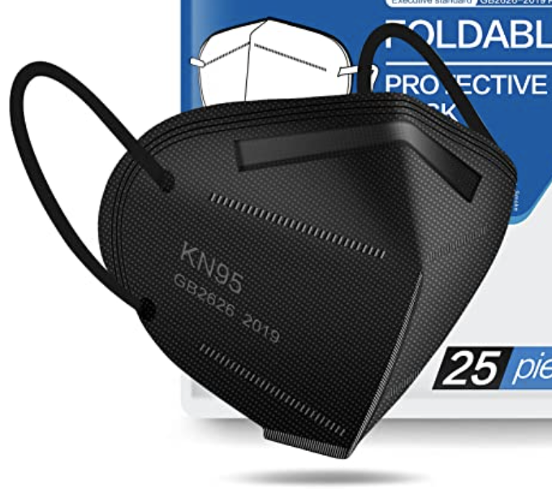
Tools for Preventing Aerosol Transmission
Dilution
Obstructing Flow
Ventilation
Distance
Time
Universal masking
Single patient rooms
Notes:
We have tools to prevent aerosol transmission, which fall into 2 categories including dilution and obstructing flow.
The dilutional tools include ventilation and increasing distance and time between a source and contact.
Obstructing flow happens with masking and with putting walls between sources and contacts, such as pushing for single patient rooms.

Slide 48
Diagnostics
Notes:
For my final section, we’ll cover testing briefly.

Slide 49
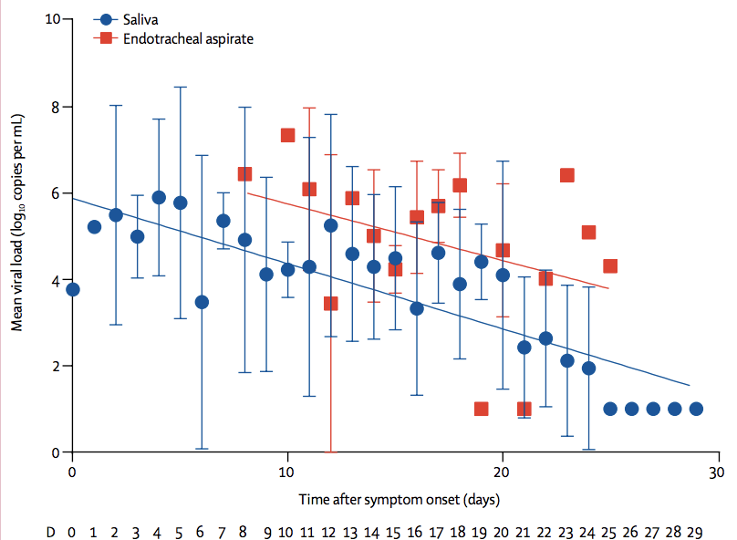
Diagnosis: PCR
PCR testing looks directly for viral genetic material (RNA)
The most common site tested is the nasopharynx
Viral RNA detected does not necessarily indicate presence of infectious virus
Pre-omicron viral load peaked just before or around time of symptom onset, likely later in omicron
To Lancet ID doi 10.1016/S1473-3099(20)30196-1
Notes:
PCR remains the gold standard for diagnosis of infection
The most common site used is the nasopharynx and this test is positive for an average of about 3 weeks.

Slide 50
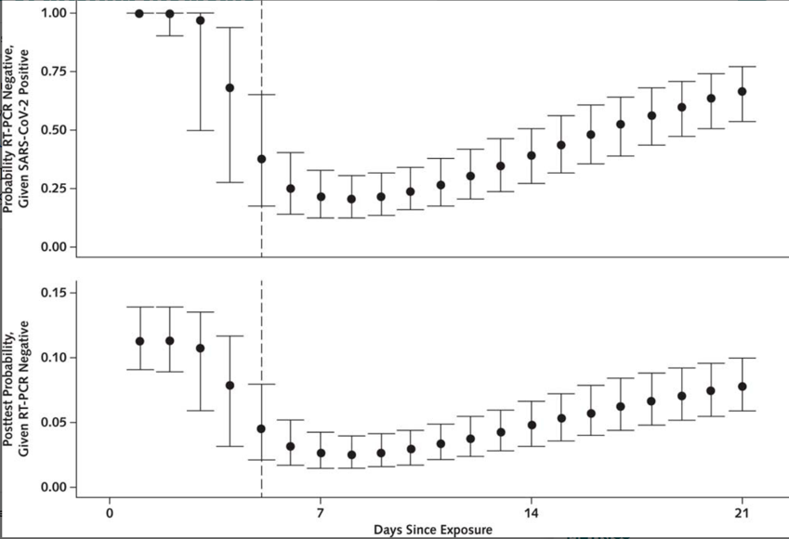
PCR testing is quite good, but timing of testing is critically important
Testing too early after exposure can yield a “false negative” result
Fewest “false negatives” are seen in the period from the time of symptom onset to about a week after onset of symptoms
Unless early onset of symptoms, should not test before day 4 after exposure (and if negative would need a repeat later for confirmation)
Kucirka Annals 2020 doi 10.7326/M20-1495
Notes:
PCR testing is quite good for diagnosis, but timing is critically important for interpretation.
Testing too early after exposure can yield a false negative result.
The fewest false negatives are seen from the time of symptom onset until about a week after onset of symptoms, as shown in this slide.
With the relatively shorter incubation period of newer variants, PCR testing should not be done before 3 days after exposure, unless someone has early onset of symptoms. If it is negative it needs to be repeated later.

Slide 51
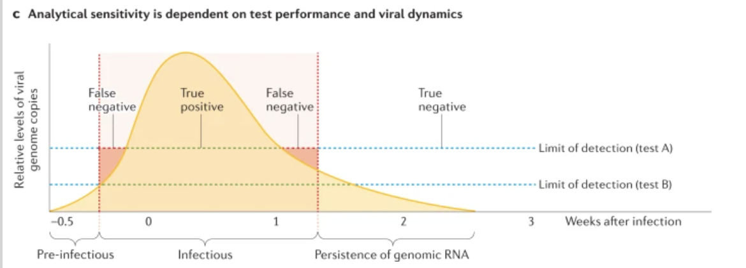
A positive test can indicate: - true active infection - not significant result (either from prolonged RNA shedding or a true false positive, ie from lab error)
Mercer Nature Reviews Genetics 2021 doi 10.1038/s41576-021-00360-w
Notes:
A positive PCR test requires interpretation since it can indicate a true active infection or a non-significant result either from prolonged RNA shedding or from a true false positive (which is unusual and would mostly be due to lab error)

Slide 52
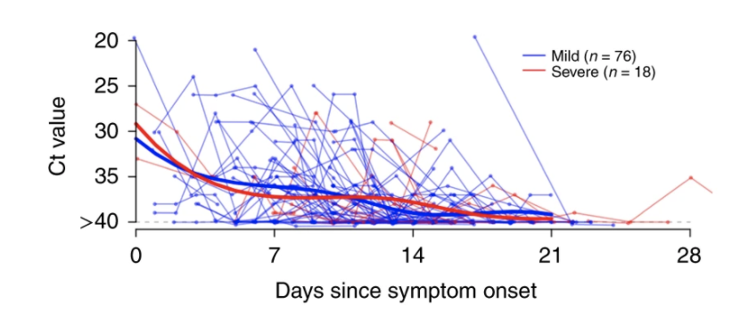
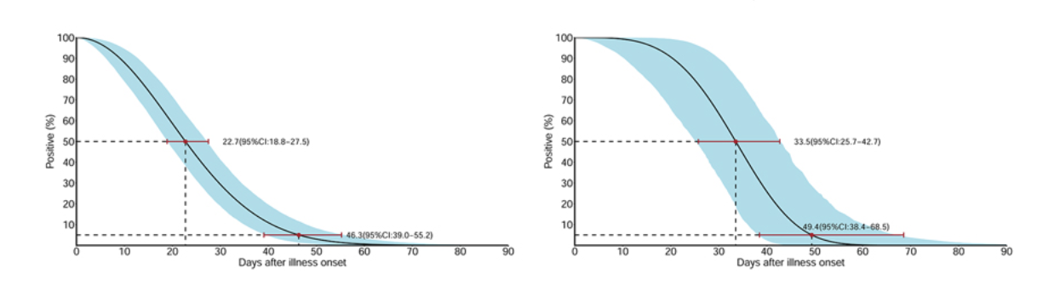
Prolonged PCR positivity common in mild and severe cases; longer shedding in severe cases
He Nature 2020 doi 10.1038/s41591-020-0869-5
Sun EID 2020 doi 10.3201/eid2608.201097
Notes:
I’ve mentioned PCR tests stay positive for some time. In a key modeling study with figures at the bottom of this slide, the median duration of PCR positivity from the nasopharynx of mild cases was 22 days and for severe cases was around 33 days.

Slide 53
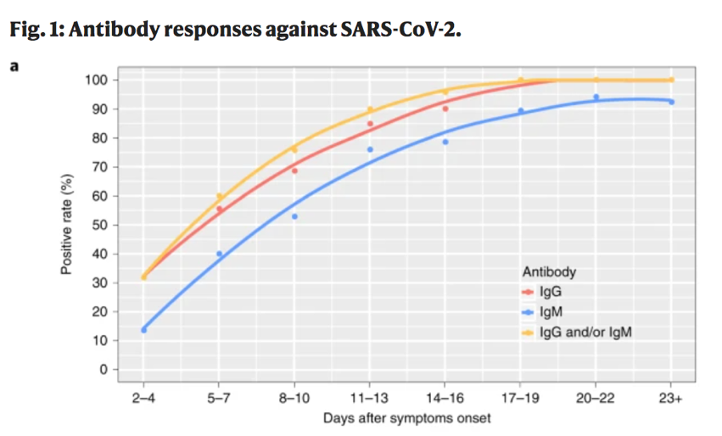
Diagnosis: antibodies
Antibodies are the host’s response to the virus
90% have antibodies by day 10 after symptom onset
People with severe illness have delayed antibody response
Long Nature Medicine 2020 doi 10.1038/s41591-020-0897-1
Sette Cell 2021 doi 10.1016/j.cell.2021.01.007
Notes:
Let’s move on to antibodies. Antibodies are the host’s response to the virus. Among unvaccinated individuals, 90% of individuals have antibodies by day 10 after symptom onset.
People with severe illness have a delayed antibody response.

Slide 54
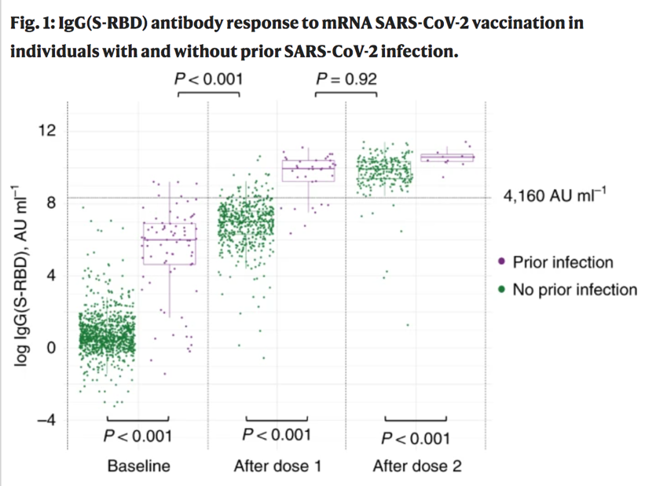
Antibodies after vaccination
Antibody assays are typically either to the nucleocapsid protein or the spike protein
If prior infection both are likely to be positive
If history of vaccination without prior infection, only anti-spike antibody will be positive
Ebinger Nature Medicine 2021 doi 10.1038/s41591-021-01325-6
Notes:
Checking antibody levels after vaccination or infection is not currently recommended.
If they are checked it is important to remember that many commercial antibody assays measure the antibody to the nucleocapsid protein which is found after natural infection but not after vaccination. Post vaccination antibody titers must look for anti-spike protein antibodies.
The figure on the right is from a study that found that anti-spike antibody titers were similar after one dose of the Pfizer-BioNTech mRNA vaccine for those with prior infection compared with 2 doses for those without prior infection.

Slide 55
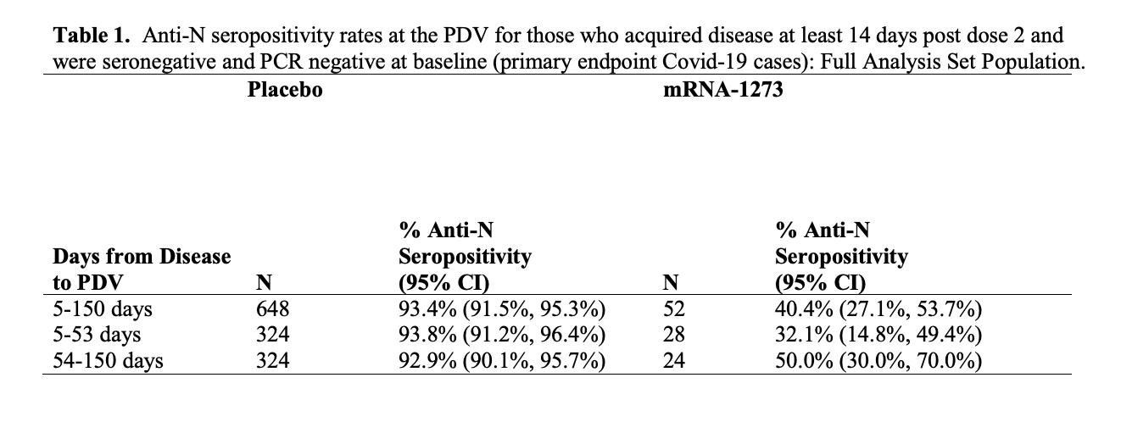
While >90% of unvaccinated individuals with PCR-confirmed infection developed anti-N antibodies, <50% of vaccinated individuals may develop N antibodies in follow up
Pre-print: https://doi.org/10.1101/2022.04.18.22271936
Notes:
Recently it’s become clear that serologic tests behave differently in vaccinated and unvaccinated individuals.
The table on this slide is from a preprint describing some analysis from individuals in the Moderna mRNA vaccine trial. On the left of the table, you can see that after PCR-confirmed infection, >90% of unvaccinated individuals had sustained anti-Nucleocapsid antibodies, compared with <50% of previously vaccinated individuals shown on the right.
One clear implication is that the N antibody test is not a good screening tool for vaccinated people who have a COVID-like illness and later want to know if they may have been infected.

Slide 56
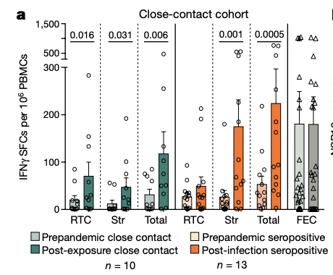
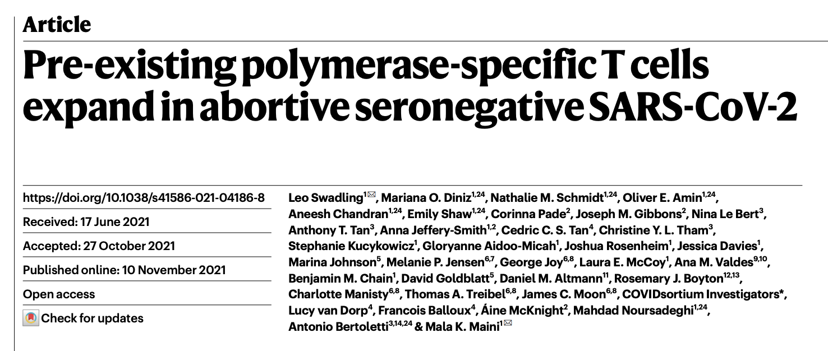
Pre-existing T-cell populations expand in “abortive” infections
Notes:
One possible explanation for what may be happening is that SARS-CoV-2 specific T cells may help rapidly clear SARS-CoV-2 leading to an aborted infection without seroconversion.
On the right you can see the T cell response in individuals who were seronegative in green versus the much greater response among seropositive individuals in orange. Response was measured for the replication transcription complex or RTC of SARS-CoV-2 which is transcribed early and to SARS-CoV-2 structural proteins labeled Str.

Slide 57
Rapid Tests
Notes:
I’m going to end with a couple slides on rapid tests.

Slide 58
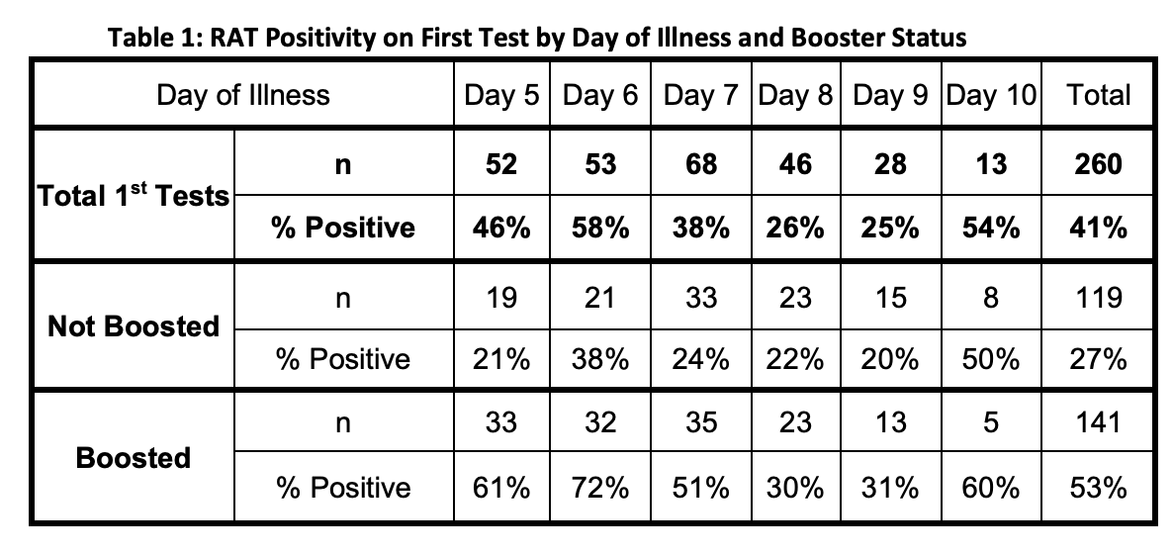
Reports of high rates of persistently positive rapid antigen tests beyond day 5 post symptom onset
https://doi.org/10.1101/2022.02.01.22269931
Notes:
Here you can see that among 260 healthcare workers with rapid testing 5-10 days after symptom onset, there were high rates of positive antigen tests out to day 10 after symptom onset.
The study is not a random sample and participation was voluntary, so it is at risk of selection bias. However, it led to a lot of concern about what this meant for infectious period of these individuals.

Slide 59
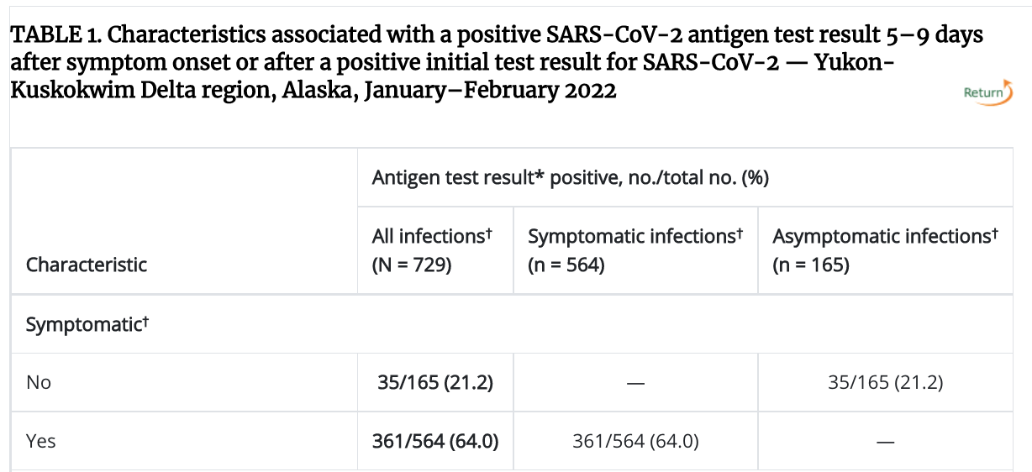
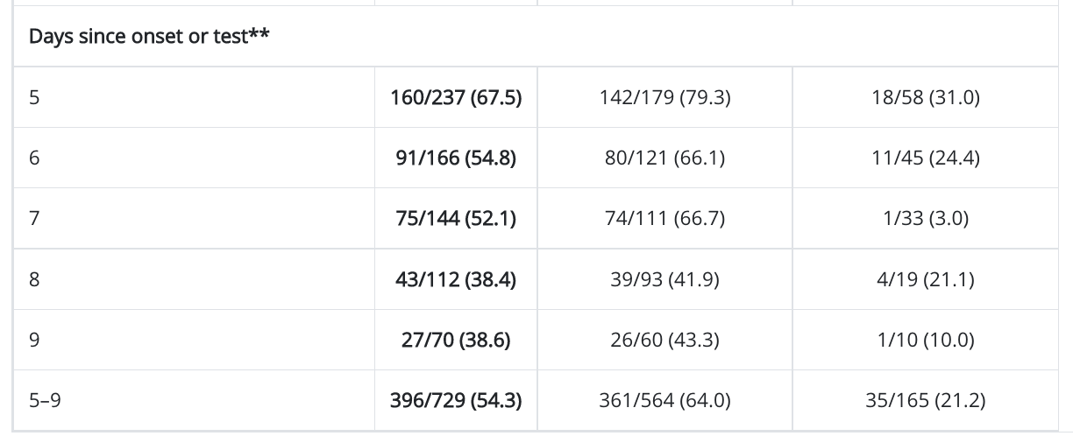
https://www.cdc.gov/mmwr/volumes/71/wr/mm7108a3.htm?s_cid=mm7108a3_w
Notes:
This table is from a similar study from Alaska in which 729 individuals with COVID-19 received rapid tests 5-9 after symptom onset. 54.3% had a positive antigen test during that time, with positivity declining throughout the period.
The study is not a random sample and the true positive rate may not be this high, but it is a striking finding.

Slide 60

Some rapid tests stayed positive even with prior SARS-CoV-2 viruses
https://journals.asm.org/doi/epub/10.1128/JCM.01742-21
Notes:
So how different is this from prior SARS-CoV-2 viruses?
This study included 299 individuals from Arizona with PCR positive SARS-CoV-2 infection from November 2020 and sought to understand sensitivity of rapid tests, which is highest early on. In the red box you can see that 50% of 12 positive cases were Antigen positive from days 8-10 and nearly 40% of 16 positive individuals were antigen positive from days 11-14.
Importantly, almost none are culture positive after day 10 from symptom onset, as you can see in the third column.
Therefore, even with prior variants some rapid tests persisted well beyond 5 days from symptom onset without documented late transmissions. Therefore, just like the earlier discussion about cycle threshold interpretation, rapid tests also need to be taken together with the whole clinical picture.
A final comment is that it seems to be clear that rebound that happens in some individuals after receiving the oral antiviral nirmaltrevir/ritonavir may be associated with transmissions, so in that particular setting, relapsed symptoms plus repeatedly positive rapid tests may be highly concerning for transmission risk.
Thank you!

Slide 61
COVID-19 Therapeutics

Slide 62

Strong evidence supports a viral phase followed by an immune dysregulation phase
Gandhi N Engl J Med 2020 doi: 10.1056/NEJMcp2009249

Slide 63


In mild disease, viral load declines sooner; in severe illness, viral load is higher for longer
Meyerowitz Clin Infect Dis 2020 doi: 10.1093/cid/ciaa1759

Slide 64
67F is admitted with 5 days of cough and shortness of breath, now with hypoxemia (SpO2 92% on 2L NC). What do you recommend?
IV methylprednisolone 125 mg daily for 5 days alone
Dexamethasone 6 mg daily for 10 days alone
IV remdesivir 200 mg x1, then 100 mg daily x4 days alone
Dexamethasone + remdesivir
IV remdesivir 200 mg x1, then 100 mg daily x2 days

Slide 65
Remdesivir (RDV)

Slide 66

ACTT-1: faster clinical recovery for RDV versus placebo (10 vs. 15 days), 28-day mortality 11.4% vs. 15.2% (p > 0.05)
Biggest benefit seen in subgroup on supplemental O2 by NC but not HFNC or MV
Benefit for those with ≤10 days of symptoms
Hospitalized patients early in infection on O2 get 5 days RDV

Slide 67

Remdesivir is safe in advanced CKD and ESRD
Thakare Kidney Int Rep 2021 doi: 10.1016/j.ekir.2020.10.005

Slide 68

PINETREE: 3 days of outpatient RDV had 87% lower risk of hospitalization or death than placebo
Hospitalized patients early in infection on room air get 3 days of RDV

Slide 69
Steroids

Slide 70

RECOVERY: open label RCT showed mortality benefit for dexamethasone; 22.9% vs. 25.7% mortality
Horby N Engl J Med 2020 doi: 10.1056/NEJMoa2021436

Slide 71

Effect strongest for those requiring mechanical ventilation, possible harm seen for those not requiring supplemental O2
Horby N Engl J Med 2020 doi: 10.1056/NEJMoa2021436

Slide 72

Among those with fewer than 7 days of symptoms (more likely to not require supplemental O2), no benefit seen
Horby N Engl J Med 2020 doi: 10.1056/NEJMoa2021436

Slide 73
Summary - dexamethasone
Unless a contraindication, all hospitalized patients requiring supplemental O2 should receive dexamethasone
Best data is for 6 mg daily for 10 days
Note another study for those with severe hypoxemia found no difference for 6 mg vs 12 mg dex, with trend towards better outcomes with 12. However, I favor adding a second agent where there is better data (see next slides).

Slide 74
68M with multiple medical issues is admitted with COVID-19 with 7 days of symptoms and has rapidly progressive hypoxemia, now transitioned to high flow nasal cannula. He was started on remdesivir and dexamethasone, what do you recommend next?
Increase dexamethasone to 12 mg daily
Add baricitinib 4 mg daily for 14 days
Add IV tocilizumab 10 mg/kg x1
Add both baricitinib and tocilizumab

Slide 75
Tocilizumab for COVID-19

Slide 76
RCTs of Toci for treatment of COVID-19 (before RECOVERY)
Reference (n) | Baseline Illness Severity of Cohort | Outcome | Tocilizumab | Control | Notes
COVACTA (452) | ~70% critically ill | Mortality at day 28 | 19.7% | 19.4% | Placebo
CORIMUNO-TOCI (130) | 100% with severe disease (floor patients on O2) | Mortality at day 28 | 10.9% | 11.9% | Open label
RCT-TCZ-COVID (126) | Face mask / HFNC | Clinical worsening w/i 14 days | 28.3% | 27.0% | Placebo
BACC Bay (243) | No critically ill patients | MV or death within 28 days | 10.6% | 12.5% | Placebo
REMAP-CAP (747) | All critically ill patients | Mortality at day 28 | 28.0%* | 35.8% | Open label
EMPACTA (389) | No MV, 25% HFNC/NIV | Mortality at day 28 | 10.4% | 8.6% | Placebo
Brazil trial (129) | 60% O2, 23% NIV/HFNC, 17% MV | Mortality at day 28 | 21% | 9% | Open label (stopped early)
*mortality benefit shown

Slide 77

RECOVERY Trial Group reported benefit of toci in some patients with COVID-19 in February, 2021
Another landmark trial for COVID-19 therapeutics
Horby et al Lancet 2021 doi: 10.1016/S0140-6736(21)00676-0

Slide 78
RECOVERY toci trial: baseline characteristics
Mean age: 63.6 years (SD 13.7)
At randomization: 14% MV, 41% HFNC or NIV, 45% supplemental O2 (not NIV/HFNC/MV)
Median CRP was 143 [IQR 107-204] mg/L
82% received steroids (97% of those enrolled since RECOVERY dexamethasone report)

Slide 79

Outcomes show benefit of toci in this group

Slide 80

Findings hold essentially across all subgroups

Slide 81
Why is mortality so high in both groups??
In ACTT 1 mortality at day 29 was 11.4% vs 15.2%
In ACTT-2 28-day mortality was 5.1% vs 7.8%
In RECOVERY dex, 28-day mortality was 22.9% vs 25.7%
In RECOVERY toci, 28-day mortality was 29% vs 33%
Answer: RECOVERY toci is not ALL hospitalized patients with COVID-19; CRP ≥75 (and median CRP was actually nearly double that in the study)
These may be among the sickest of patients.

Slide 82

Elevated CRP in COVID associated with mortality, among nearly 3000 patients admitted during first wave to a major hospital in NY, median CRP was 108 mg/L
Smilowitz European Heart Journal 2021 https://doi.org/10.1093/eurheartj/ehaa1103

Slide 83


Slide 84
Summary - tocilizumab
RECOVERY toci is another landmark treatment study for COVID-19
Tocilizumab has shown a clear mortality benefit for a subset of the sickest hospitalized patients with COVID-19 (it is NOT indicated for all hospitalized patients with COVID-19)
When used it should be used in a manner consistent with RECOVERY and REMAP-CAP:
It should be used with dexamethasone (not alone)
All who receive it should have marked elevation in CRP (>75-100 mg/L minimum)
Would plan to use it for progressive respiratory failure, and start within 24 hours of escalating organ support (starting on NIV, HFNC, or MV)

Slide 85

Baricitinib: multiple studies have now shown added benefit of baricitinib to dexamethasone and remdesivir for COVID-19 outcomes
https://www.thelancet.com/journals/lancet/article/PIIS0140-6736(22)01109-6/fulltext

Slide 86
Choosing tocilizumab or baricitinib?
Baricitinib: “the average mortality rate ratio from all nine trials, now involving 11888 randomized patients and 1485 deaths, was 0·80 (0·72–0·89; p<0·0001).”
Tocilizumab: “the mortality rate ratio from the nine trials was 0·86 (0·78–0·94), p=0·0017”
Use one or the other not both

Slide 87

Nirmatrelvir/ritonavir (aka Paxlovid) for outpatient COVID-19, within 5 days of symptom onset
https://www.nejm.org/doi/full/10.1056/NEJMoa2118542

Slide 88
Inclusion criteria
≥18 years old
Unvaccinated
Confirmed SARS-CoV-2 infection
Symptom onset no more than 5 days before randomization, with at least one sign or symptom on day of randomization (not asymptomatic)
Have at least one characteristic or coexisting condition associated with high risk of progression to severe COVID-19, including age >50, DM, heart disease, obesity, cancer, etc

Slide 89
Rebound after nirmaltrelvir/ritonavir (NMV/r)
Syndrome of rebound of symptoms (mild) and increased viral load and possible transmission risk after completing a 5-day course of NMV/r
A retrospective study from the Mayo Clinic found this happened about 1% of the time
Risk factors for rebound unknown
Whether longer courses of NMV/r (i.e. 10 days) would eliminate this issue also currently unknown
https://doi.org/10.1093/cid/ciac481

Slide 90
Monoclonal Antibody Therapy

Slide 91


Among high risk outpatients, mAb and mAb cocktails lead to less severe disease & faster viral clearance
Change in symptom scores
Chen N Engl J Med 2020 doi: 10.1056/NEJMoa2029849
Dougan et al NEM 2021 doi: 10.1056/NEJMoa2102685
Weinreich N Engl J Med doi: 10.1056/NEJMoa2035002

Slide 92

RECOVERY Trial shows benefit among certain hospitalized patients
Nearly 10,000 patients enrolled
Among 3153 seronegative patients, 24% who received REGEN-CoV died compared with 30% who received usual care, RR 0.80, 95%CI 0.70-0.91, p = 0.0010.
No benefit for seropositive patients

Slide 93
In the US: mAb available by EUA
Some post exposure prophylaxis cases
Outpatients (not hospitalized) within 10 days of illness (mild disease)
Inpatients hospitalized for another reason (not COVID-19)
Note mAb activity is dependent on variant circulating at that time (changing target)

Slide 94
Therapeutic Approach for COVID-19
Outpatients
Inpatients
NMV/r within 5 days of symptom onset
mAb (depending on activity of circulating variants)
No supplemental O2 & early in infection (within 7-10d of Sx onset, Ct ≤30): RDV 3 days
Supplemental O2 & early in infection: RDV 5d + dex 6 mg/d for 10d
HFNC/MV & late in infection: dex 6 mg/d + bari OR toci

Slide 95
Thank you!
Email anytime: emeyerowit@Montefiore.org

