Slide 1

Fill out the Automated Freezer Program (AFZP) Spreadsheet
Last Name | First Name | Phone # | E-mail | Department & Room # | PI Name | Admin Name | Admin phone # | Index # | Account # | Zip Code | Choose Vendor
This information is needed for billing and payment

Slide 2
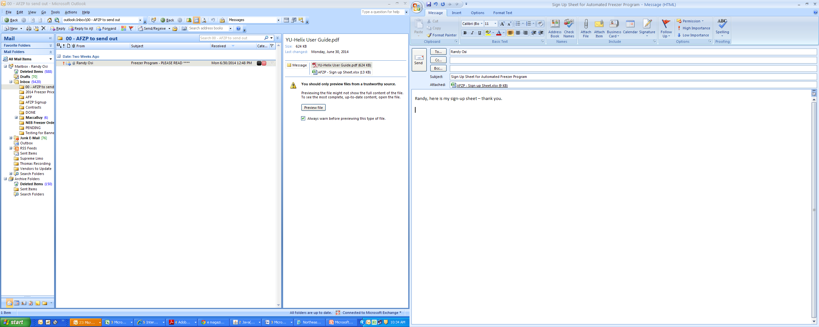
Send spreadsheet to Randy Osi (Purchasing Department)
Your information will be sent to the following vendors: Life Technologies, and New England Bio (NEB)

Slide 3

Welcome E-mail from Vendor
A welcome e-mail will be sent from the vendor(s) with your log-in information. It will contain your username and password
Life and Promega will also send you a card to access their machines
Registration for Bio-Rad and Promega must be completed on their websites

Slide 4
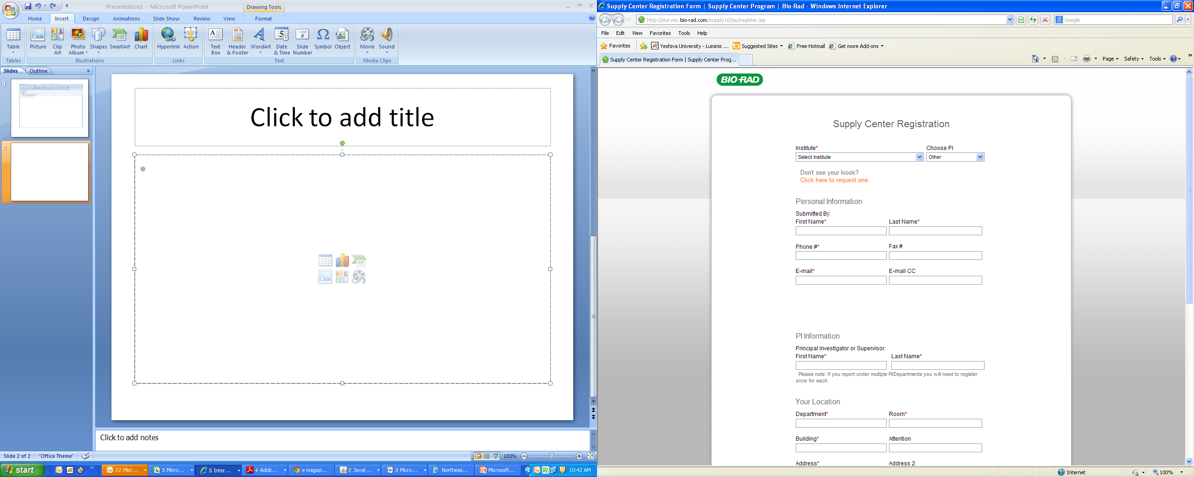
Register with Bio-Rad
Create your own Username and Password http://isurvey.bio-rad.com/isupply10/jsp/register.jsp

Slide 5
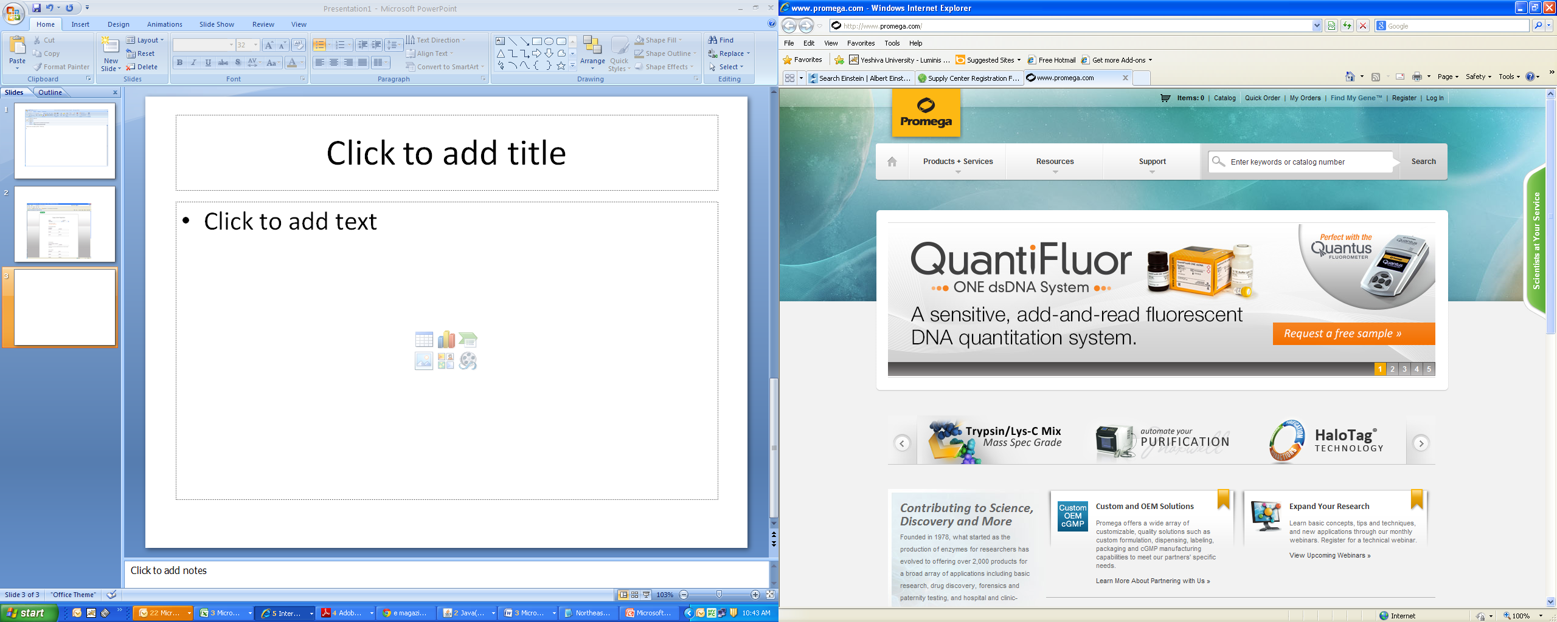
Register to receive your
Promega (Helix) Card - http://www.promega.com

Slide 6
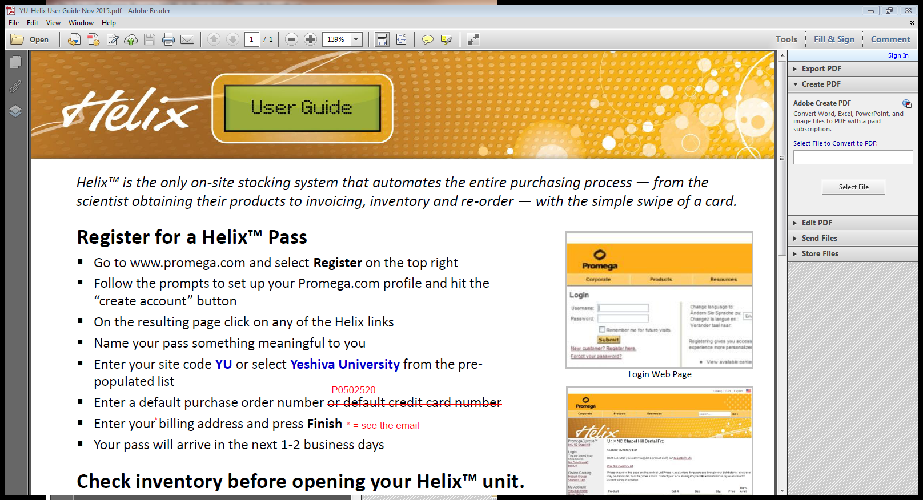
Promega Helix Card
Instructions

Slide 7
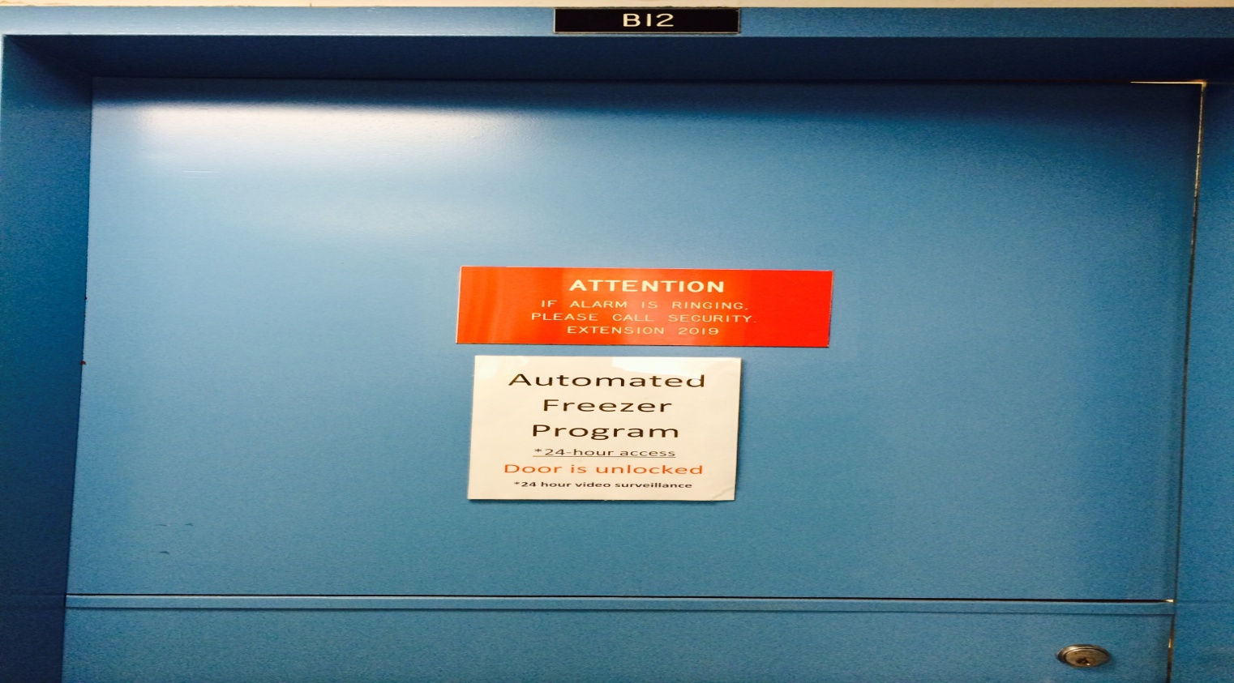
Automated Freezer Program
Belfer B12
24 Hour Access – 7 days a week
24 Hour Video Surveillance

Slide 8
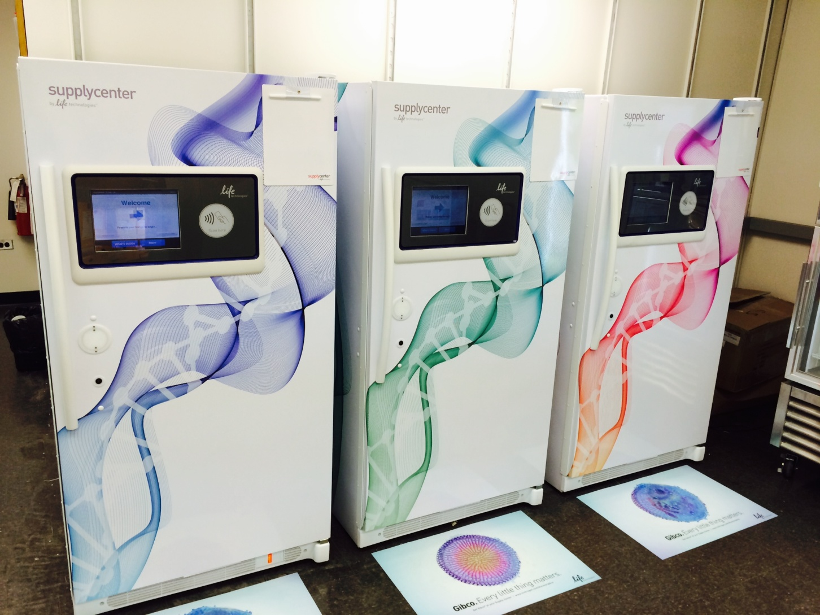
Life Technologies
Smiti Khanna - Consumables Sales Representative
Life Sciences Solutions - Thermo Fisher Scientific
Mobile: (516) 286-2558 - smiti.khanna@thermofisher.com
Stephanie Allen, MPH, RD – Life Sciences Solutions – Thermo Fisher Scientific
646.701.1498 - Stephanie.allen@thermofisher.com
1 – Scan your card or enter your Username
and Password
2 – Open Freezer and take out your product
3 – Close door & complete order
Real-time inventory when you log in from your desk

Slide 9
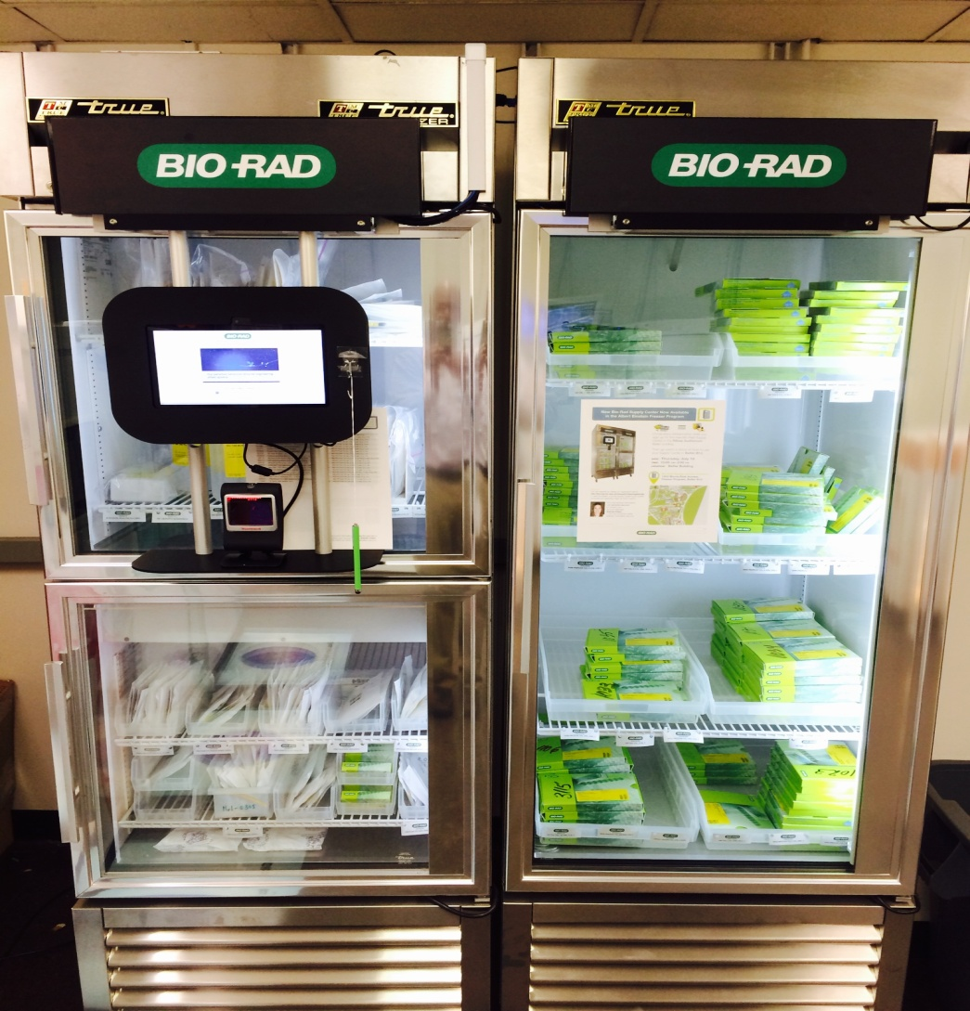
BIO-RAD
Brenda Chism - Account Manager - Bio-Rad Laboratories
brenda_chism@bio-rad.com - 646-262-3337
1 – Enter your Username and Password
2 – Open Freezer and take out your product(s)
3 – Scan item(s) – complete order

Slide 10
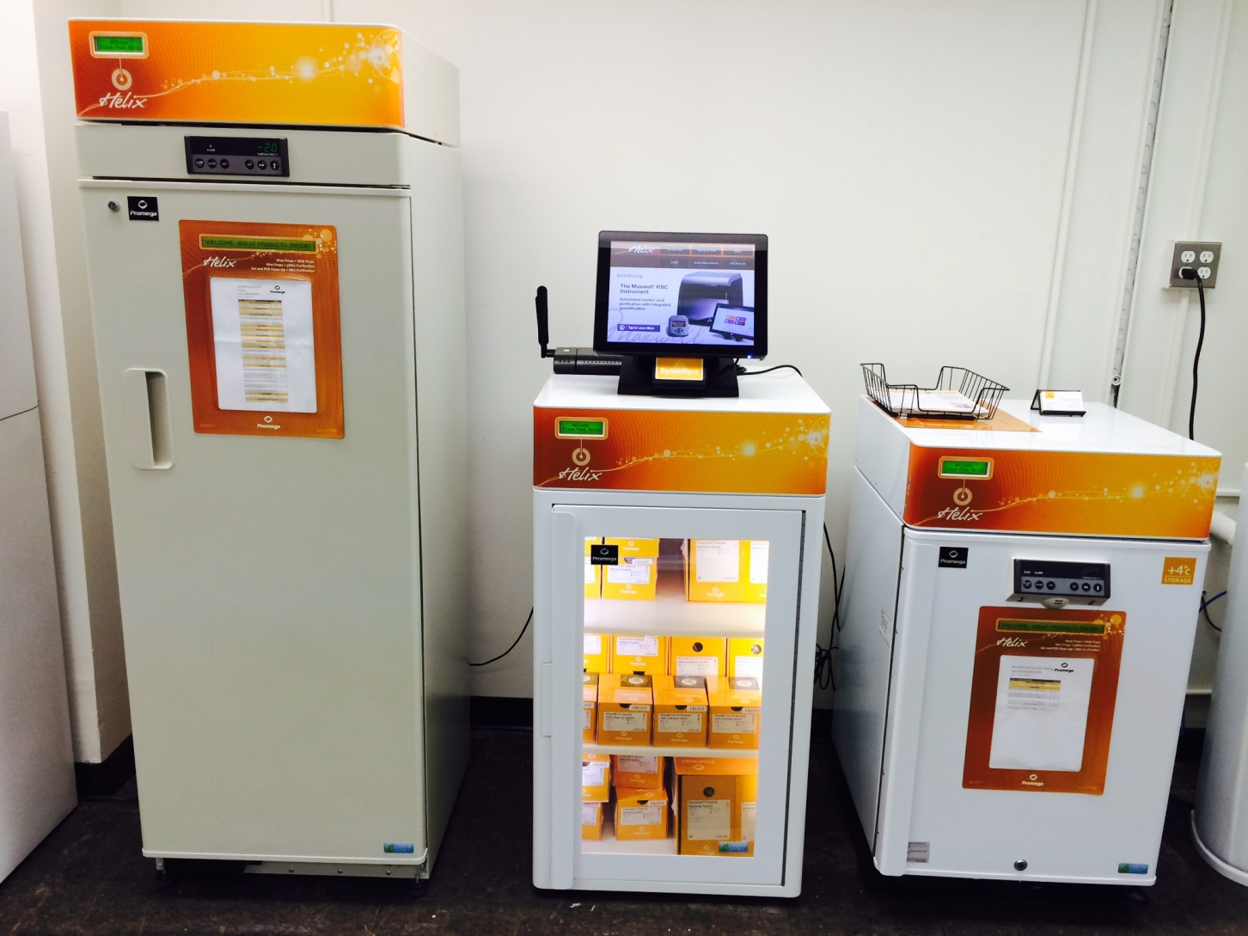
Promega
Poonam Jassal - Sr. Field Applications Specialist II - New York City & Long Island
mobile 516 509 8274 - office 203 292 6493 - poonam.jassal@promega.com
1 – Scan your card or enter your Username
and Password
2 – Open Freezer and take out your product
3 – Complete order by closing the door
Real-time inventory when you log in from your desk

Slide 11
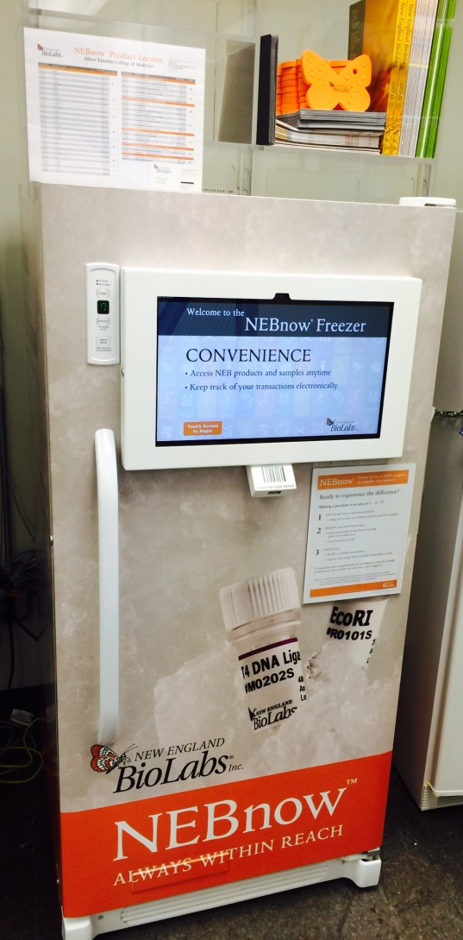
NEBNow
David Gdula, PhD - Field Account Manager, Tri-State Region - New England Biolabs
Cell: (978) 380-2970 - Email: gdula@neb.com
1 - Scan or enter your Username and Password
2 - Open Freezer and take out your product
3 - Scan item(s) – complete order

Slide 12





BILLING
1 – Weekly/Monthly billing reports sent to your department(s)
2 – Department/(Admins) review and indicate appropriate index(s) to bill for charges
3 – Report sent back to Purchasing from your department with the appropriate indexes indicated for each charge
5 – Inter-charge: money from indicated index(s) is transferred to Purchasing’s index
4 – Purchasing pays the invoices

Slide 13

Everybody’s Happy

