Slide 1
REIMBURSEMENTS
A Better Understanding

Slide 2
REIMBURSEMENT REQUEST FORM
The Reimbursement Request Form can be found in the SciQuest Homepage under Showcased Forms
This form should only be used for Einstein students/staff/faculty:
Reimbursement
Request Form

Slide 3
WORKFLOW STEPS
Submission
If requisition is under 5K
Buyer
Review
AP
Review
Travel
Manager
Approval
Banner
Budget
Authorization
Banner Budget Authorization 1
Department approval
If requisition is over 5K
PO
Creation
Department Finance

Slide 4
WORKFLOW DEFINITION
Submission – Department’s authorized requestor fills out a Reimbursement Request form in SciQuest.
Banner Budget Authorization 1 – The system automatically checks Banner for Budget approval.
Department Approval – Department’s designated approver must approve requisition in order for it to continue workflow.
  If the requisition is over 5K, it is routed to the Department Finance for review and approval. Once it is approved, it continues on to Buyer Review.
  If the requisition is under 5K, it is routed straight to Buyer Review.
Buyer Review – Purchasing Dept. reviews requisition.
AP Review – Accounts Payable Dept. reviews all supporting documents attached to the reimbursement. If incomplete in any way, Accounts Payable will return the requisition for changes and/or corrections or reject.
Travel Manager Approval – Travel Manager reviews and completes requisition accordingly.
Banner Budget Authorization 2 – Second Banner Budget action for PO creation.

Slide 5
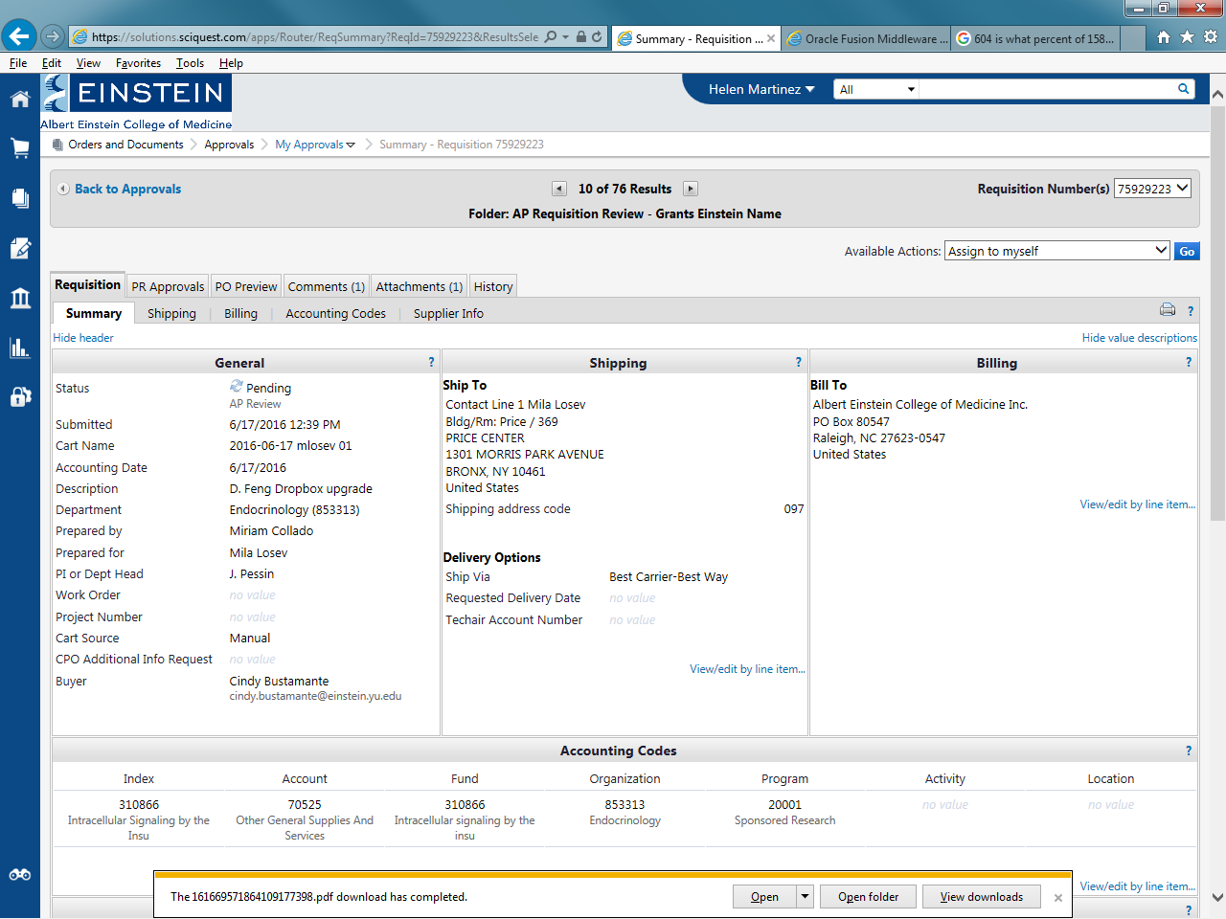
Requisition Tab Definitions
Requisition Tab – Details all the information that was submitted by the department.
PR Approvals Tab – Gives you workflow status from start to finish.
Comments Tab – Communication and information within departments.
Attachments Tab – Information included to support reimbursement.
History Tab – Provides you with detailed step by step information on workflow.

Slide 6
HOW TO CHECK ON THE STATUS OF YOUR REIMBURSEMENT
Enter Requisition # in the search box in SciQuest
  Open Requisition
    Scroll down to view PO # (P05xxxxx)
    Click on PO #
    Click on “Invoices” Tab
    View Payment Status
  If a PO hasn’t generated, please click on the PR Approvals Tab to view workflow status.

Slide 7
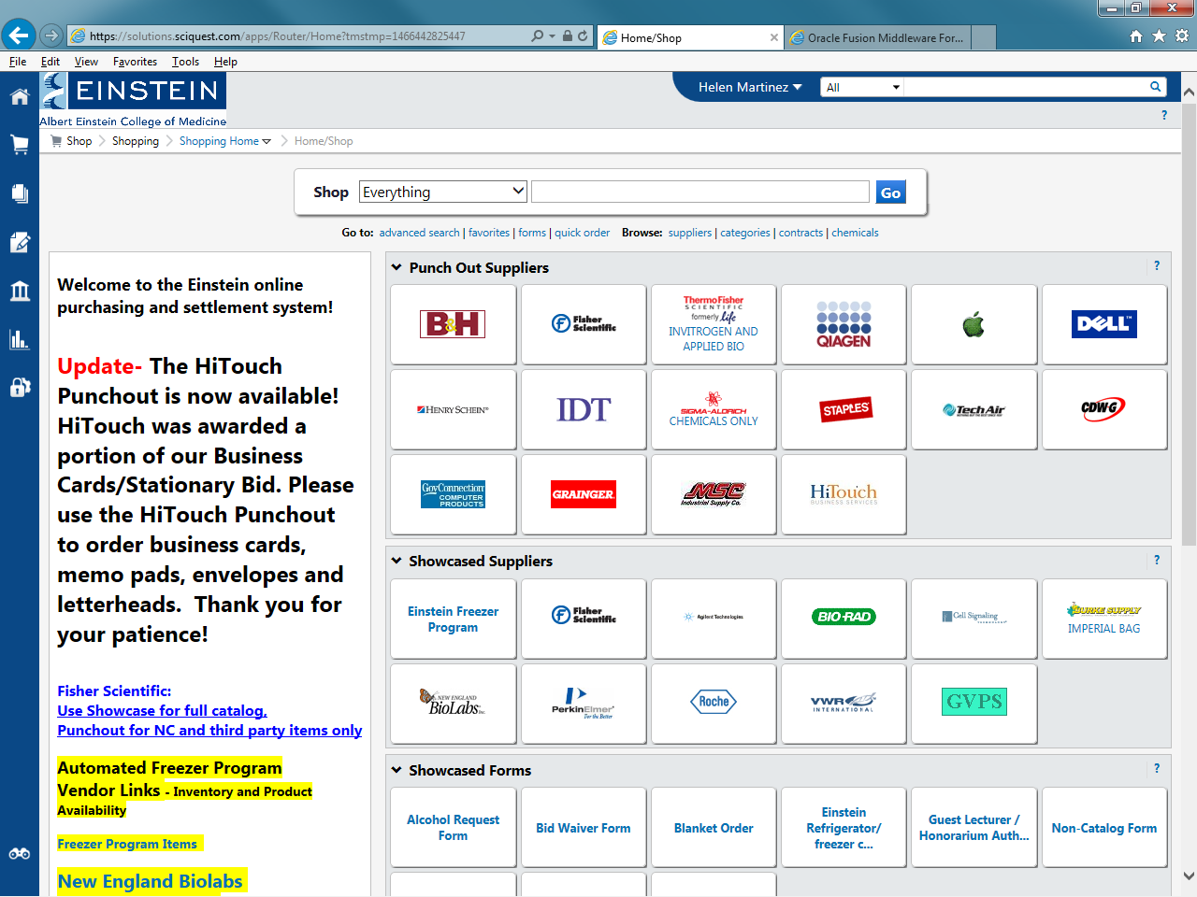
Enter Requisition #

Slide 8
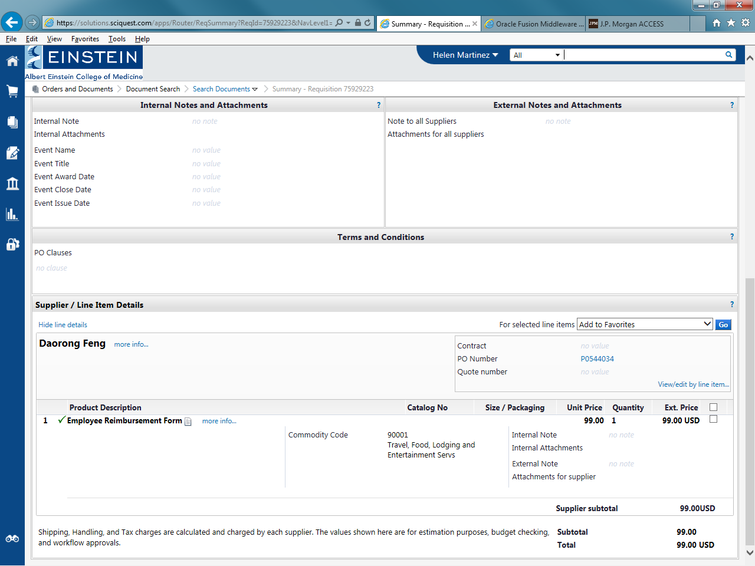
Click on PO #

Slide 9
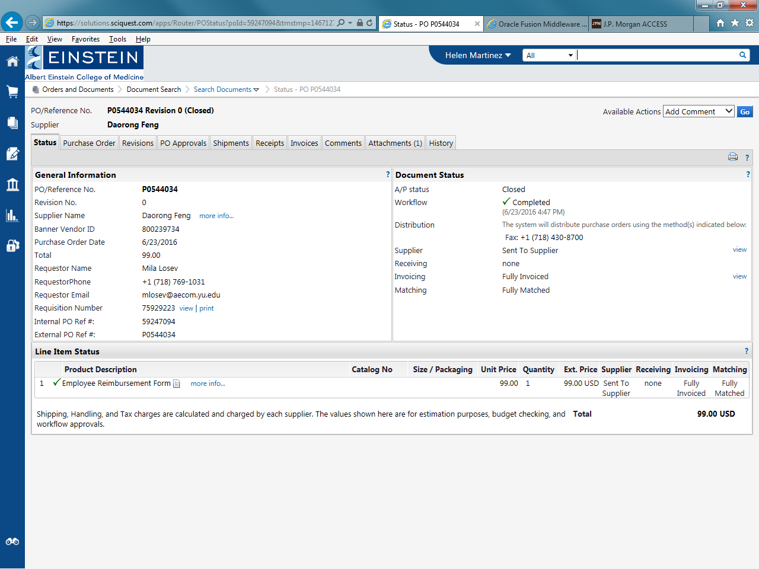
Click on “Invoices” tab to view Payment Status/Information

Slide 10
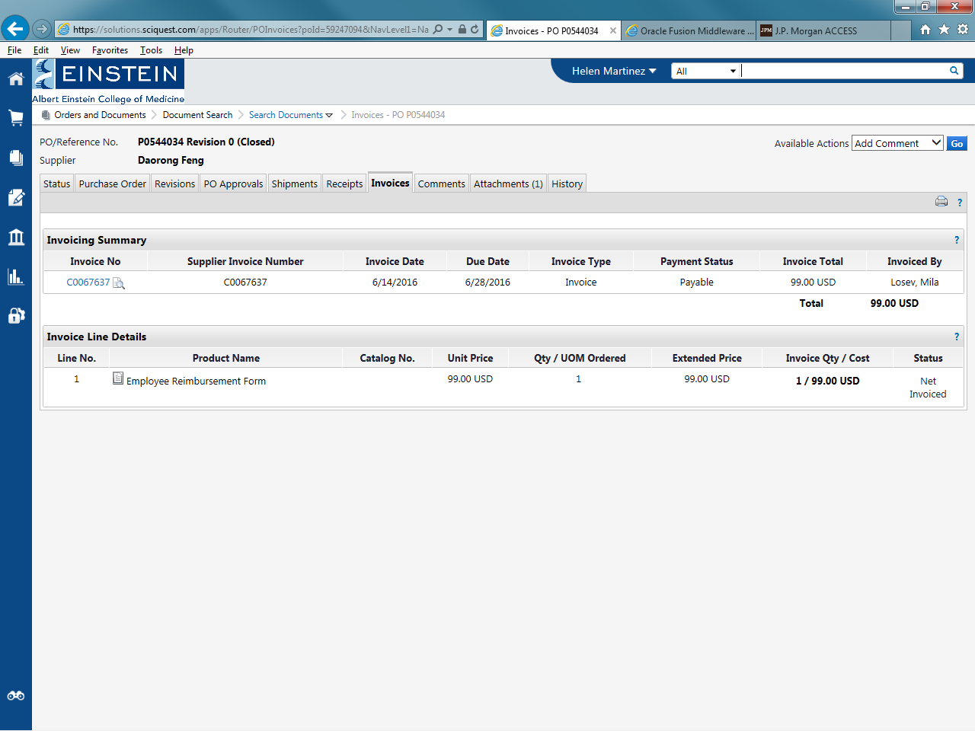
A PO # is generated
See slide 11 for Payment Status definition
An invoice # is generated.
Click on the C# for payment information

Slide 11
Payment Statuses and Definitions
In Process Status – Invoice may have an error.
Please contact our Travel & Expense Specialist in AP via e-mail.
Payable Status - Invoice is scheduled to be paid, see Due Date.
“History” tab should state “Successfully sent to ERP”.
Paid Status – Payment has been made.
Click on C# to view payment information – Check # & Check Date.

Slide 12
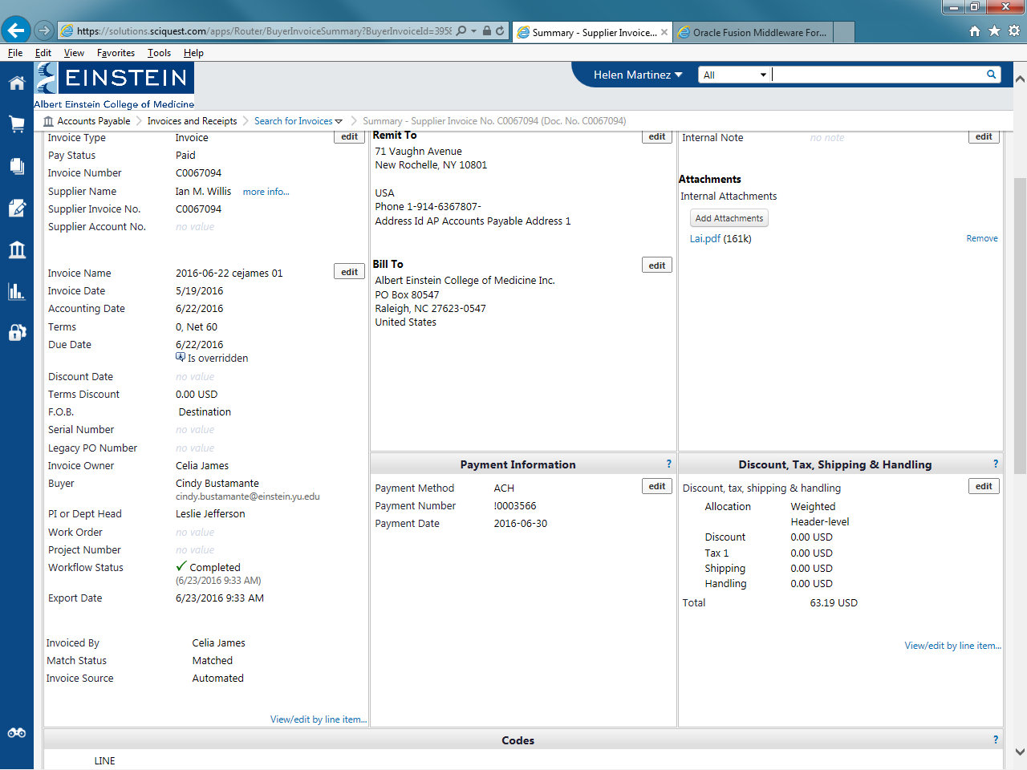
Payment information

